Slide 1
Student Counselling Service (SCS) Database: An approach to supporting student success
Dr Zahra Tayer Farahani, Dr Emma Howard, Mr Chuck Rashleigh, Prof Barbara Dooley

Slide 2
Introduction
The role SCSs in student success
SCS Database
Applications of SCS data for student success
Outcomes of the SCS Database project

Slide 3
The Role of SCSs in Student Success

Slide 4
SCSs in Higher Education Institutions (HEIs)
Embedded mental health services
Integral part of the student mental health on the campus
Providing psychological support to students
Contribution to students’ personal development
Contribution to students’ academic performance

Slide 5
Data Collection in SCSs
As part of their practice
Categories of data collection:
Student demographic
Presenting issues
Outcome measures
Counselling Impact on Academic Outcomes (CIAO)
Student feedback

Slide 6
The Importance of an Evidence-Based Approach
Identify different needs in various groups of students
Identify those who are more at risk
Identify effective interventions
Service evaluation
Service development based on identified needs

Slide 7
Key elements of an evidence-based approach
Robust and systematic data collection
Research based practice
Practice based research

Slide 8
SCS Database

Slide 9
SCS Database
Standardised data collection across SCSs
A sectorial approach
Support SCSs in their data collection
Provide evidence to inform decision making
Enhance collaboration between researchers and practitioners
Provide further evidence through a practice research network (PRN)

Slide 10
Our Approach
Site visits and interviews
Webinar
Presentation for stakeholders e.g., Psychological Counsellors in Higher Education in Ireland (PCHEI) members, GDPR officers, Registrars and Heads and Representative groups
One to one meetings with SCSs
Correspondence with DPOs and Research Ethics Committees

Slide 11
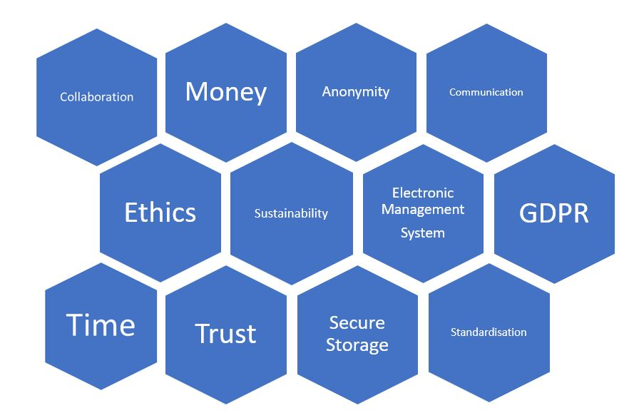
Important Factors

Slide 12
Applications of SCS data for student success

Slide 13
Use of the Data
Beneficial use of the data
Sectorial reports
Benchmarking
Research
Service development
Funding applications
Showcase SCSs’ contribution to student mental health
Misuse of the data
Out of context interpretation
Ranking of SCSs by authority and funding bodies

Slide 14
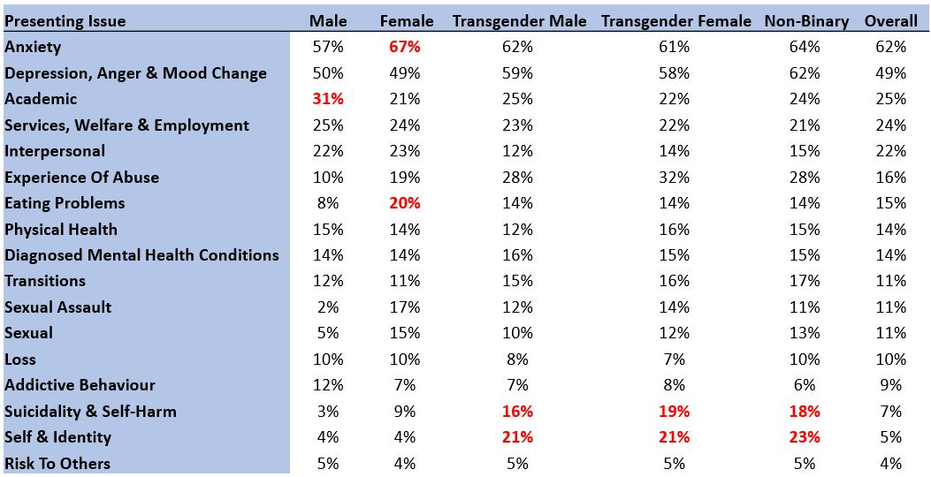
Presenting issues: An example of pseudo data

Slide 15
Outcomes of the SCS Database Project

Slide 16
Progress to Date
Conducted 28 interviews with staff in 22* HEIs
Organised a webinar on data standardisation across HEIs
Finalised a standardised dataset
Prepared documentations including data protection impact assessment and data sharing agreements
Agreed upon a governing structure
Built a secure and GDPR compliant database
Signed a memorandum of understanding (MoU) with PCHEI as our partner
11 number of HEIs have agreed to participate and 2 number started data collection

Slide 17
Going Forward
Data transfer round 1 - proof of concept
Data collection round 2 - with more HEIs
First annual sectoral report
Sustainability plan

Slide 18
Conclusion
Evidence-based approach requires robust data collection.
There are various benefits and challenges in a national approach to data collection.
Funding and resources, knowledge and expertise, communication, collaboration and trust are important elements for success.
This can apply to other student services such as maths support centre, academic writing centres, student advisors, career service etc.

Slide 19
Thank You!
Zahra.tayerfarahani@ucd.ie
Emma.Howard@ucd.ie
Chuck.Rashleigh@tcd.ie
Barbara.dooley@ucd.ie

