Slide 1
Study Abroad Information Session School of Social Sciences and Philosophy and Trinity Business School
Dr Yekaterina Chzhen
Director of Study Abroad
April 24, 2024

Slide 2
Coordinators and Executive officers
Business – Deirdre Crowe
Email: business.exchange@tcd.ie
Economics – Michael Wycherley
Email: Econ.Exchange@tcd.ie
Political Science – Tom Paskhalis
Email: PoliticalScienceExchange@tcd.ie
Philosophy – William Ratoff
Email: RATOFFW@tcd.ie
Sociology – Richard Layte
Email: LAYTER@tcd.ie
SSP Study Abroad
Email: sspsabr@tcd.ie

Slide 3
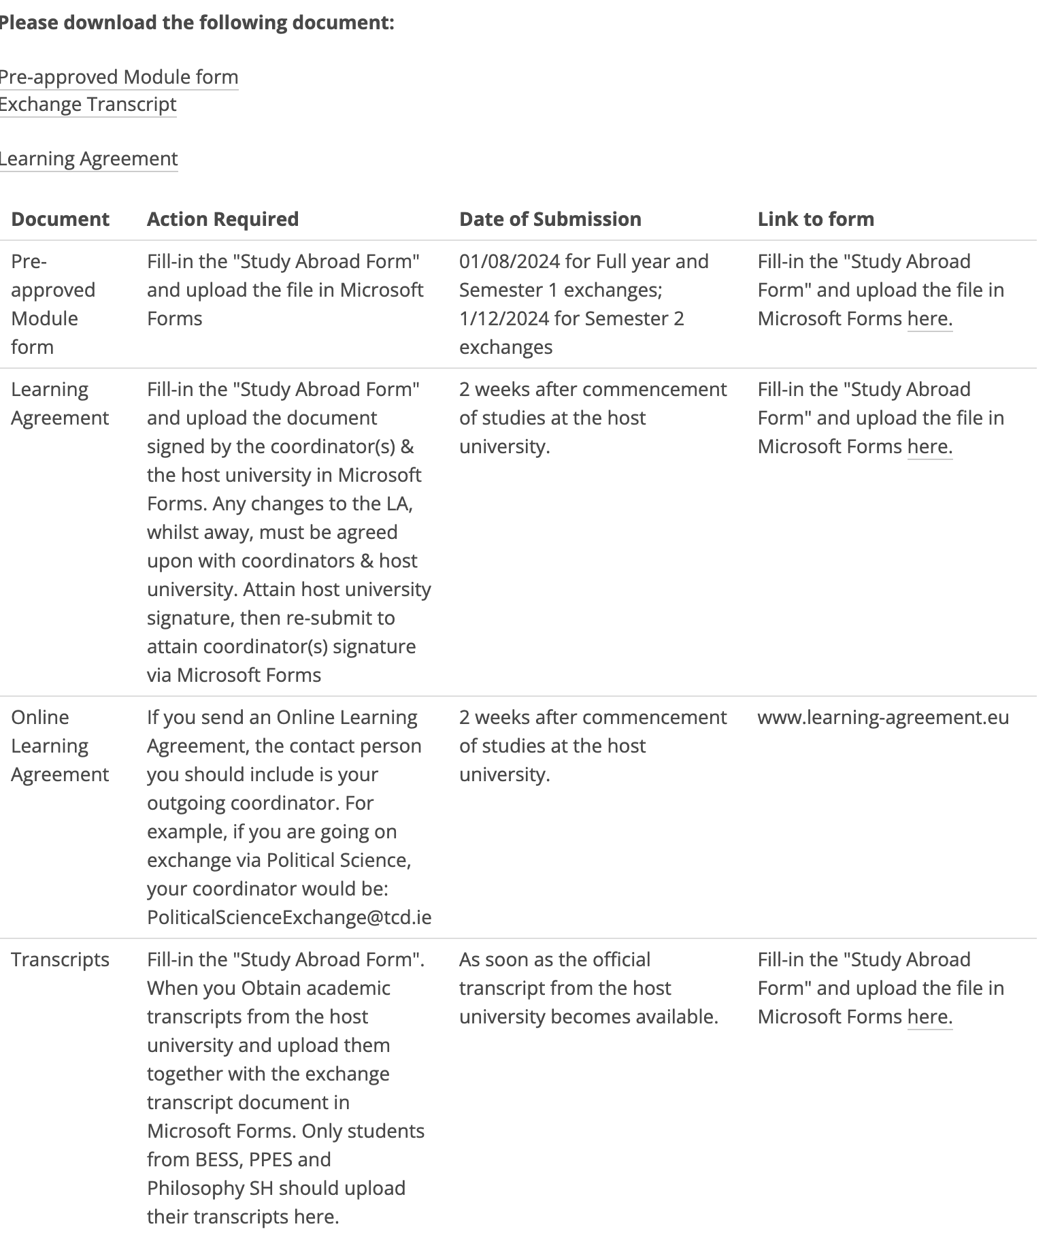
Checklist 24/25
https://www.tcd.ie/ssp/undergraduate/study-abroad/outgoing/

Slide 4
Applying for an Erasmus+ mobility grant
https://www.tcd.ie/study/study-abroad/outbound/apply/apply-erasmus.php
From €300 to €450 per month.
Not affecting SUSI grants and the NI Student Loan, but check with the Academic Registry Financial Aid Officer about other grants/loans.
Two instalments (80% and 20%).
To apply:
Send the following 3 things to erasmus.outgoing@tcd.ie
Grant agreement
Learning agreement
Confirmation of arrival/departure.

Slide 5
Preparing to go away
Do your research! Check the host university website to learn about your destination.
Get in touch with the contact person at your host university for information regarding modules and accommodation.
Register with Academic Registry.
Make sure you can meet your programme requirements
Check your programme handbook, if unsure talk to your coordinator
Make sure your Host University allows you to meet subject requirements for your Capstone Project, think about prerequisites for SS modules
Check your programme handbook, talk to your exchange coordinator.
Please remember that only students with a minimum of II.2 are allowed to go on exchange.

Slide 6
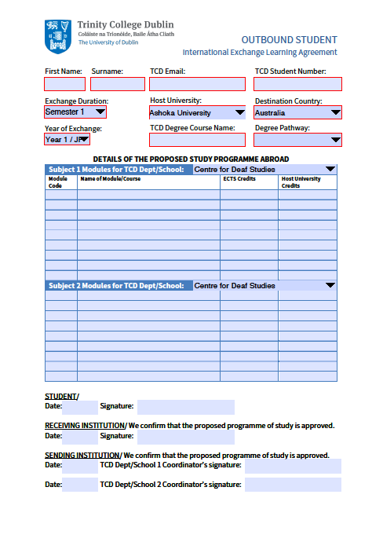
The Learning Agreement
This is a very important document
You must complete the Learning agreement
Have it signed by your TCD coordinator(s)
Have it signed and stamped by your host University
All changes to the learning agreement must be approved by your TCD coordinators

Slide 7
The Learning Agreement
If students deviate from the programme of study agreed upon in their learning agreement, coordinators are not obliged to accept non-approved modules, which could jeopardize the student’s ability to progress.

Slide 8
Requirements While Away
Full Year Exchanges
Students must enrol in modules equivalent to 60 ECTS
The results will be calculated on the best relevant 45 ECTS
------------------------------------------------------------------------------------------------
One Term Exchanges
Students must enrol in modules equivalent to 30 ECTS
The result will be calculated on the best relevant 20 ECTS
For the term spent in TCD students take 30 ECTS.

Slide 9
Requirements While Away
Please ensure your official transcript is sent to your main coordinator as soon as the official transcript from the host university becomes available.
Your grades will be translated using the School conversion tables.
If you fail to meet requirements, either by failing to get the requisite number of ECTS or by taking modules not deemed appropriate, your exchange will not be validated and your will have to repeat the year.

Slide 10
Support While Away
All documents needed for your exchange are provided by Erasmus/International exchange offices or available on the School website: https://www.tcd.ie/ssp/undergraduate/study-abroad/outgoing/
On Academic issues, stay in touch with your coordinator(s) via their exchange email address:
Especially important if you fail modules that jeapordize your ability to get requisite ECTS.
For pastoral issues, stay in touch with your college tutor
It is recommended that you contact your tutor before you leave for Erasmus to let them know that you will be going away.
For queries about the Erasmus grant contact Erasmus.Outgoing@tcd.ie
For other queries ask your Programme Administrator,

Slide 11
Thank You Remember, we are here to support you whilst on exchange – STAY IN TOUCH!

