Slide 1
Incoming Students in Economics

Slide 2
Economics Coordinator
Nicola Fontana
econ.visiting@tcd.ie
Office hours: 10-12 Wednesday, Room 3004
Book here: https://outlook.office365.com/owa/calendar/OfficehoursNicolaFontana@TCDUD.onmicrosoft.com/bookings/

Slide 3
What do you need to do?
Find what modules you would like to do …

Slide 4
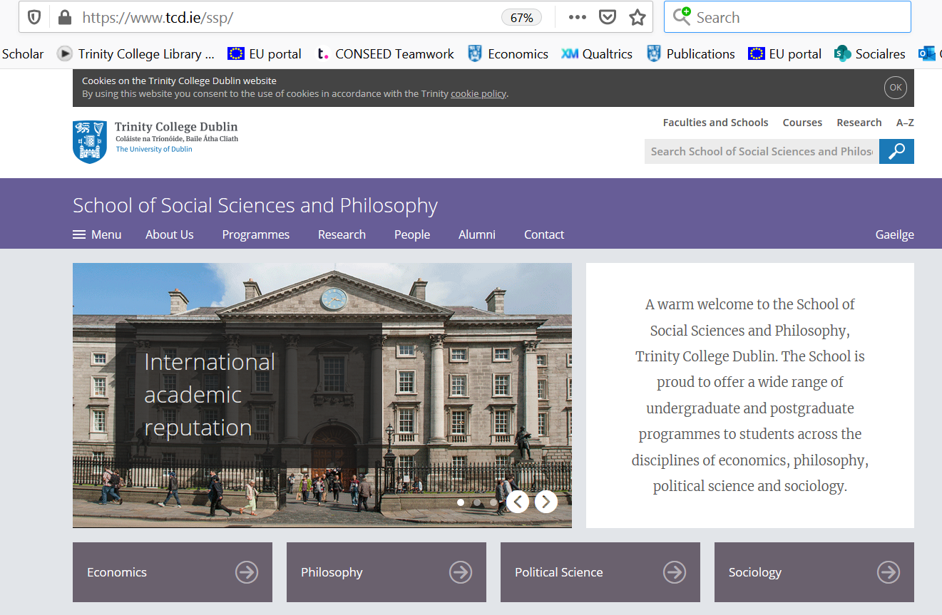
https://www.tcd.ie/ssp/
Menu

Slide 5
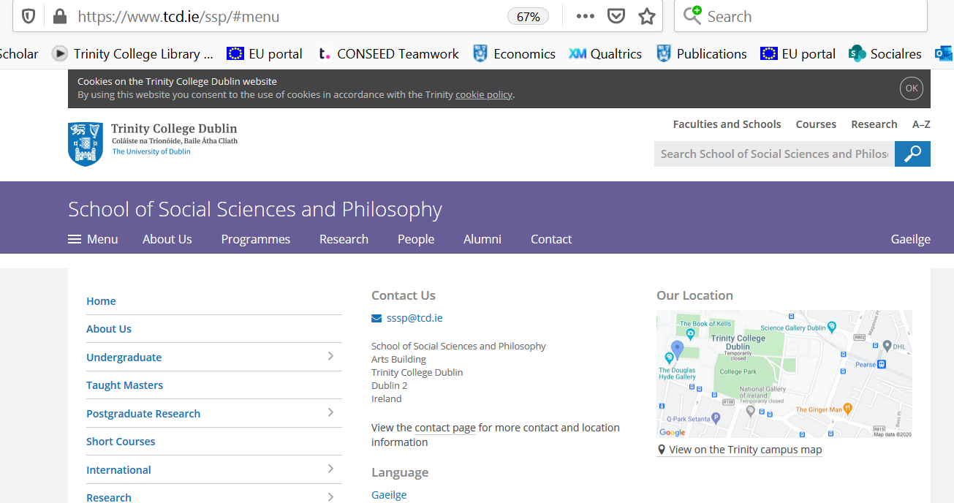
Pick undergraduate from the Menu
Undergrad

Slide 6
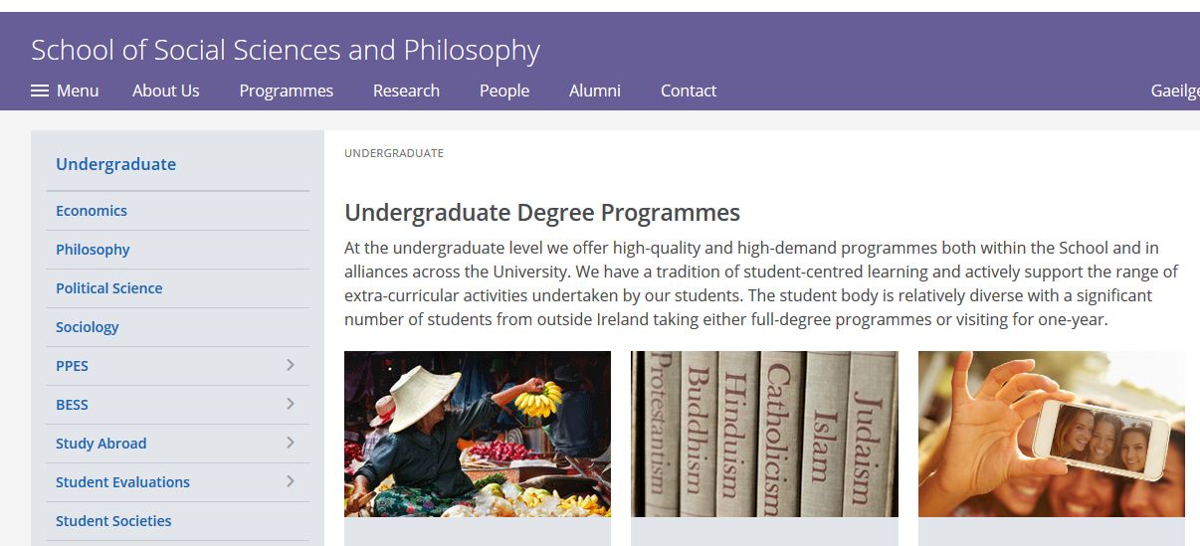
Then pick “Study Abroad”
Study Abroad

Slide 7
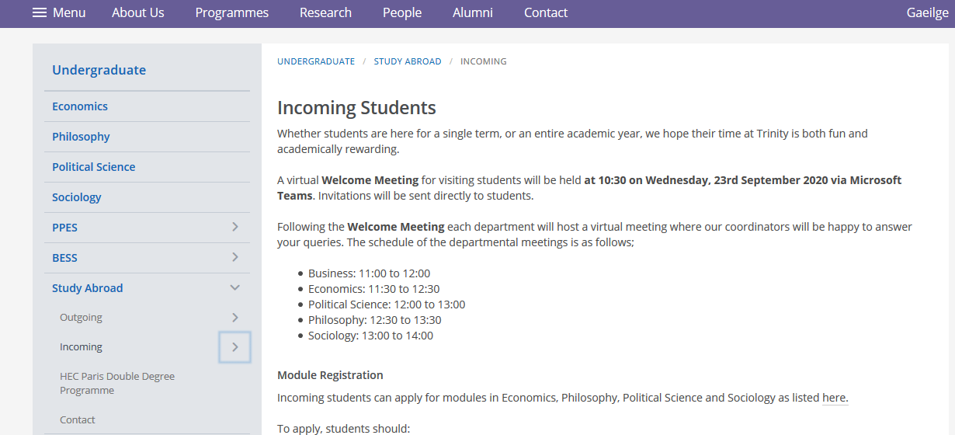
Click on “Incoming”

Slide 8
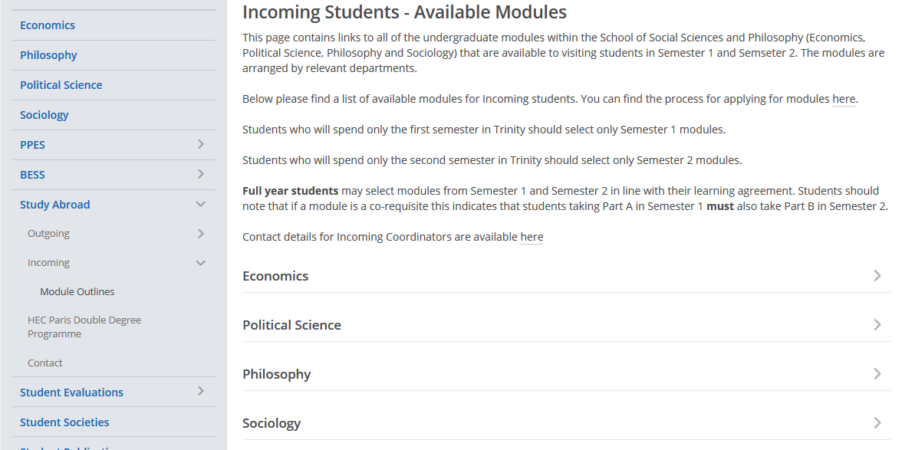
Click on ‘Module Outlines’ then ‘Economics’

Slide 9
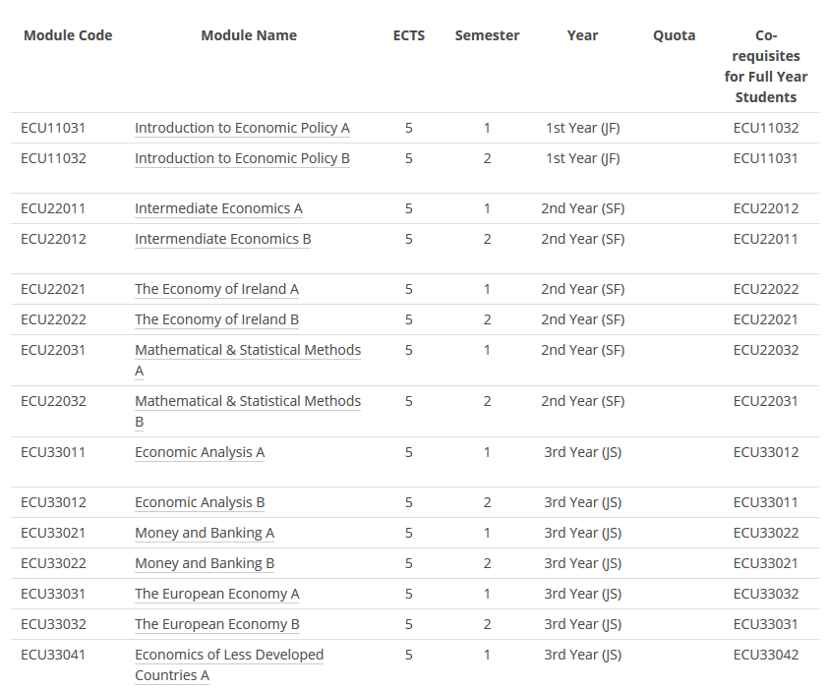
Now you can see the modules available for you

Slide 10
What do you need to do?
Find what modules you would like to do
Register for the modules you want to do …

Slide 11
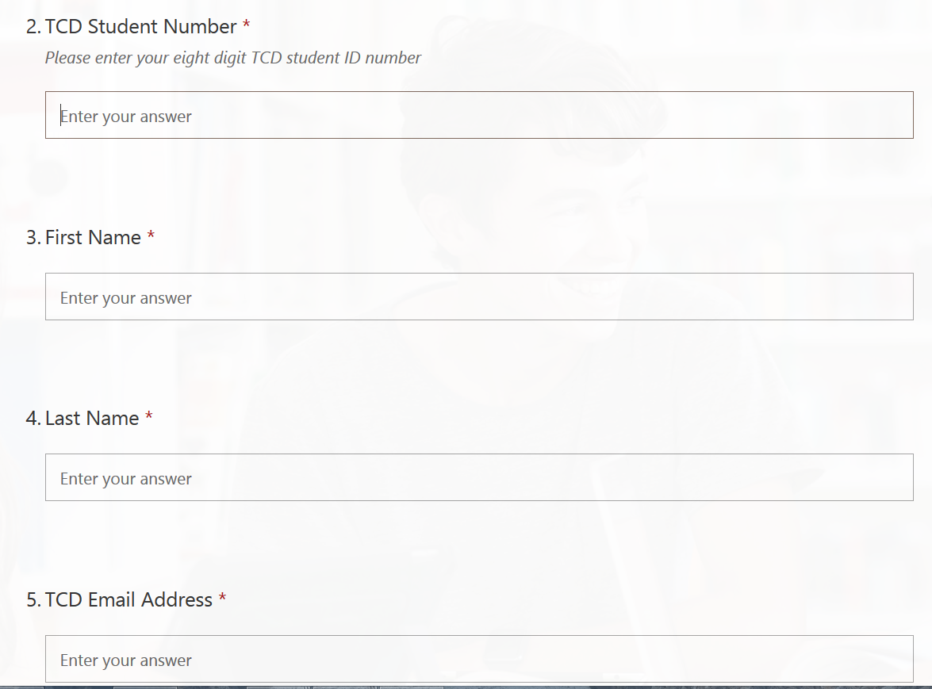
Registering for your modules Form from Academic Registry
Form available here: https://www.tcd.ie/students/orientation/visiting-exchange/module-enrolment.php

Slide 12
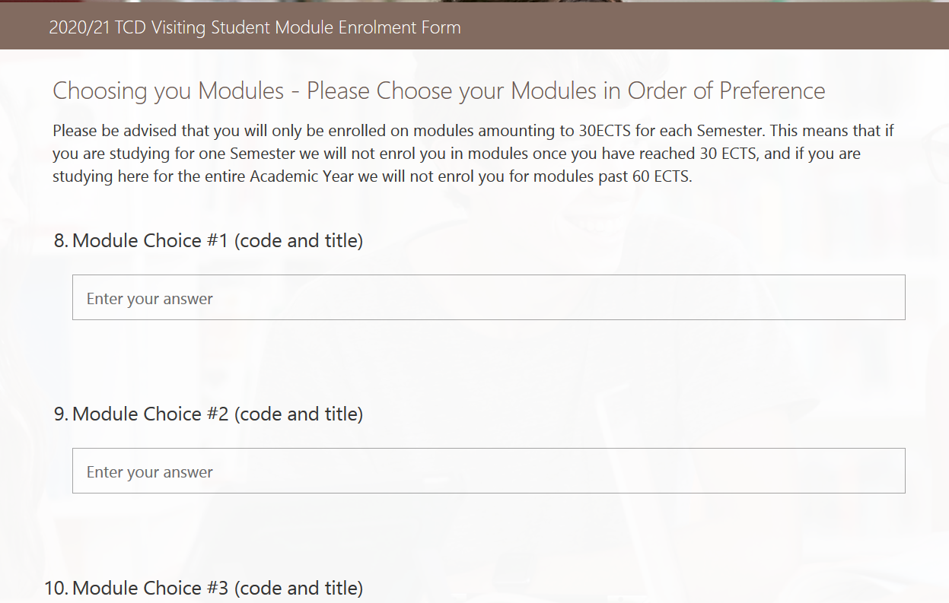
Registering for your modules

Slide 13
Before filling your registration form …
Check:
Have you got the right code and name?

Slide 14
Now you can see the modules available for you
Be careful!

Slide 15
Before filling your registration form …
Check:
Have you got the right code and name?
Is the module available to you (be careful to check the incoming student list not the full module list on the economics page)

Slide 16
Now you can see the modules available for you
Be careful!

Slide 17
Before filling your registration form …
Check:
Have you got the right code and name?
Is the module available to you (be careful to check the incoming student list not the full module list on the economics page)
Very important … do you have the required pre-requisites …

Slide 18
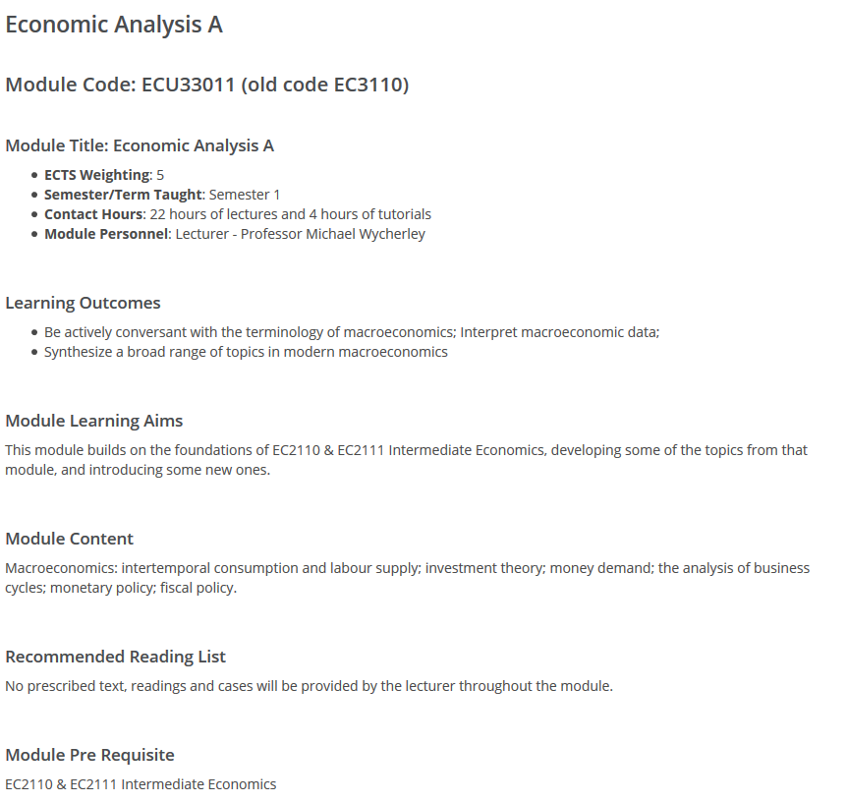
Pre-requisites (equivalent)
You will find these in the module outlines
You may be asked to provide proof you have done an equivalent module to the pre- requisites
It is your own responsibility to ensure that you fulfil any needed prerequisites.
Only put modules on your form if you have the pre-requisites

Slide 19
What happens next?
Academic registry will notify you if any of the modules you have selected have a timetable clash – you will not be allowed to do these
Would be a good idea to check ‘clashing’ lectures on the timetable before you submit your form
Timetables for all modules should be available online, can always check my.tcd.ie
Academic registry will contact me to confirm acceptance
We will check pre-requisites if necessary
We will check quotas (priority to econ dept exchange, then school exchange, then others) – only quota in Economics is for Econometrics

Slide 20
Timing
This process may take some time.
If lectures have started and you need access to certain materials, email the lecturer concerned and ask for access
Blackboard = mymodule.tcd.ie
Your own Timetable (once you’ve registered for modules) = my.tcd.ie

Slide 21
Lecture and tutorial format
Most modules have 2 hours of lectures and one tutorial per week
All compulsory

Slide 22
Any questions?

