Slide 1
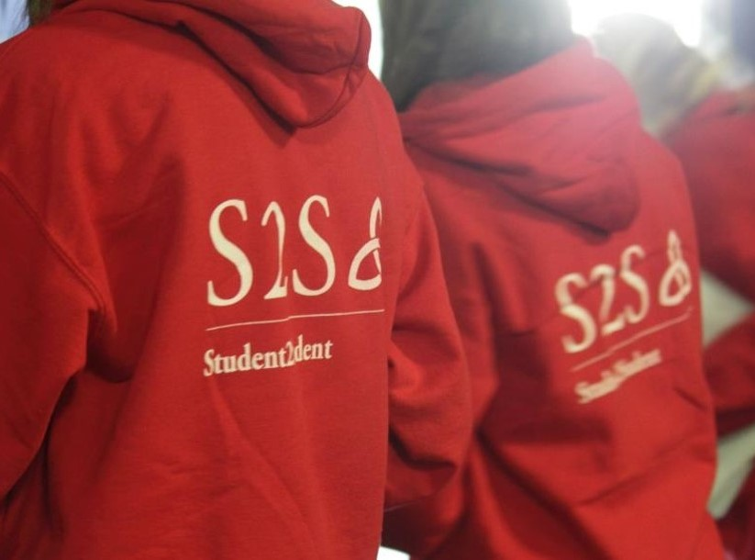






2026 Mentor Training
Welcome to S2S!
@tcds2s

Slide 2


Remember to sign in!
Sign in sheet beside the tea and coffee

Slide 3

Fire Safety & Toilets

Slide 4
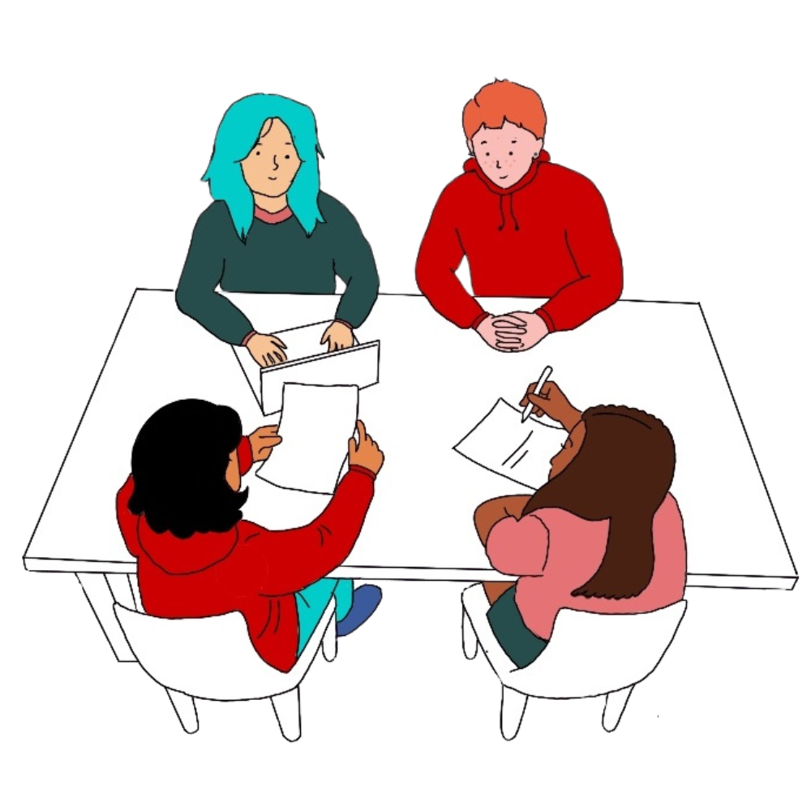
This is not a passive training session
We know 4hrs is a big chunk of your time.
We’re not going to spend huge amounts of time repeating what’s written on the slides or in the handbook – they’re all available online.
Today is about introducing concepts and giving you a chance to work through them, so your engagement is really important. You will get more out of it if you put more in.
If you need to stretch, open a window, eat food, get water – help yourself to stay in it as much as you can.

Slide 5

Content Indicator
Some topics may be heavier than others. We don’t want to catch you by surprise.
We will include the following symbol as an indication that some heavier topics are coming up!
These aren’t triggering conversations; we just want everyone to be mindful!

Slide 6
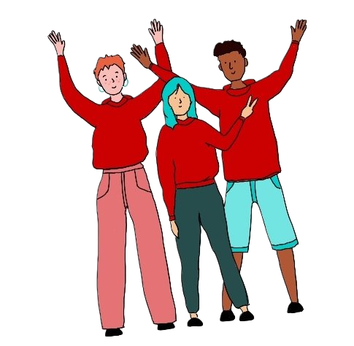

Agenda
Introducing S2S
Orientation
1
Mentor role throughout the year
2
Supports
Active listening
3

Slide 7
Introducing S2S:
Mentor Role
Odyssey
Accountable Space
Diversity
Section 1
Orientation:
Icebreaker
Q&A
Encouraging questions
Library tour
Campus tour
Agenda
Why you?

Slide 8


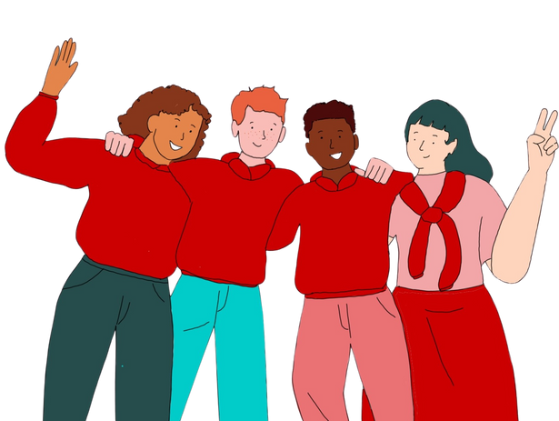
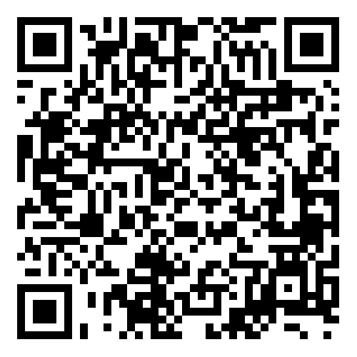
Mentor Role Description
Key Responsibilities
An S2S Mentor is a student who volunteers to provide guidance and support to a group of incoming undergraduate 1st year students. As a mentor, you will be one of the first students to welcome them to campus and help them feel included and like they belong.
As an S2S Mentor you play a crucial role at orientation, as well as offering guidance and support to mentees throughout the academic year.
During Orientation:
Run an Icebreaker session
Give a guided campus tour
Have a Q&A session
Requirements
Benefits
Attend a 4hr in-person training.
Complete a Blackboard module over the summer.
Be available for an orientation session in September during Freshers’ Week.
Contribute 1-3hrs per week during the academic year.
Apply for Garda vetting clearance (subject to group membership).
Attend meetings with Head Mentors.
Liaise with S2S staff.
Log all your activity on our volunteer portal.
Full training (one in-person 4hr training and one online module).
Mentor buddy to work with.
Excellent experience in leadership, teamwork and active listening.
References based on logged activity and involvement.
Support from Head Mentors, Committee, and Staff.
Strong social network and community.
The chance to make a difference in a student’s transition to Trinity.
During the year:
Send weekly emails to mentees
Organise 5 group meet-ups per term
Log activity on Odyssey portal
For more information visit our website:
www.tcd.ie/student2student/

Slide 9
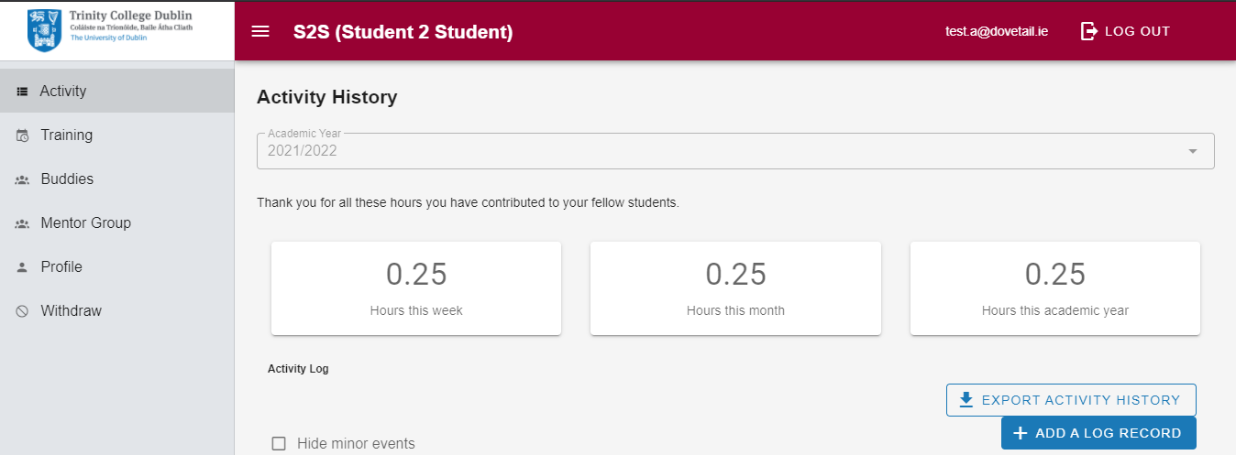
Odyssey
Log your activity
www.s2svolunteer.tcd.ie
Add a log and mention what you hope to learn from today’s training

Slide 10
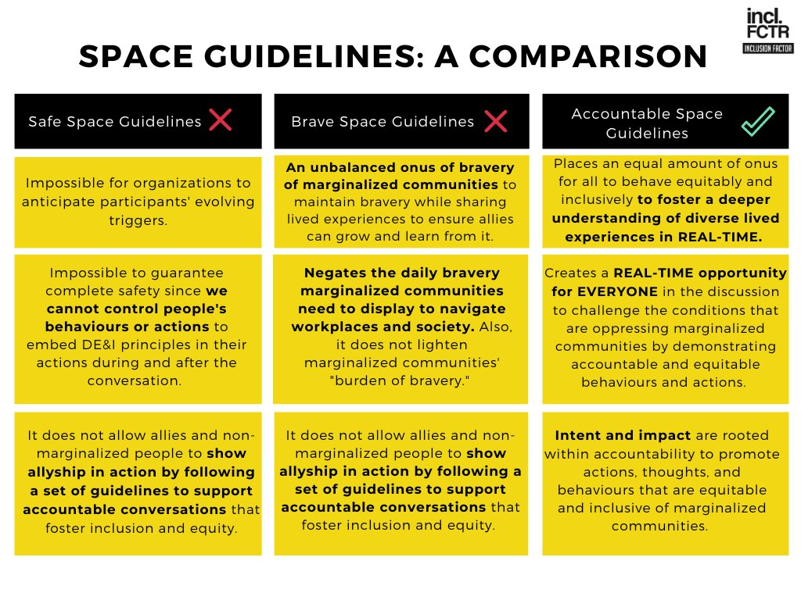
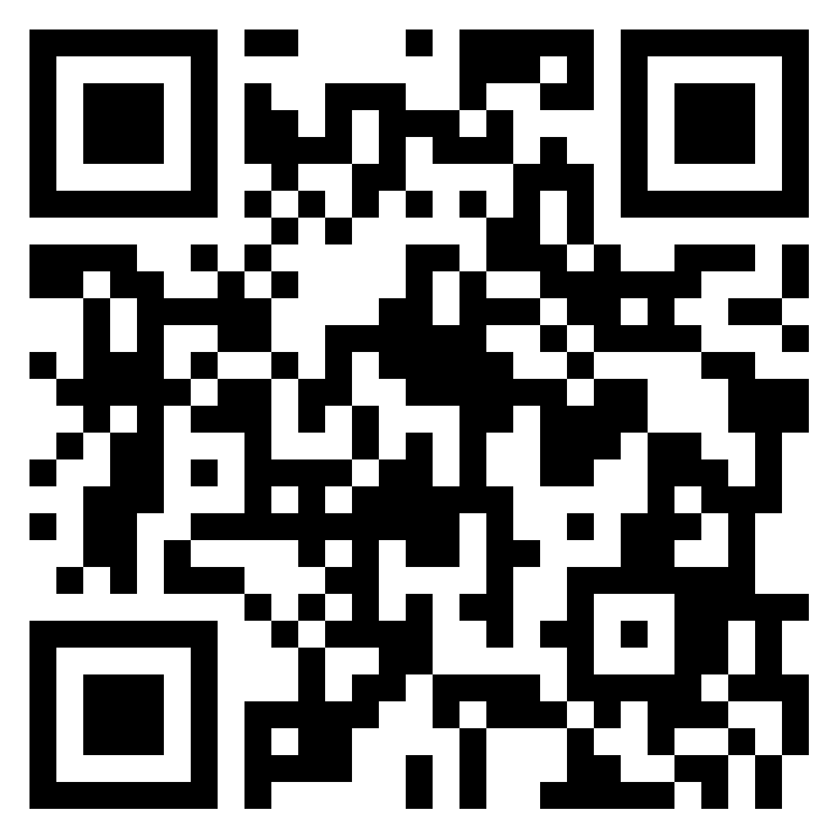
Accountable Space
What do you need for an accountable space?
Log in to padlet.com/TCDS2S/accountable
Anonymously post what you would need for this to be an accountable space

Slide 11
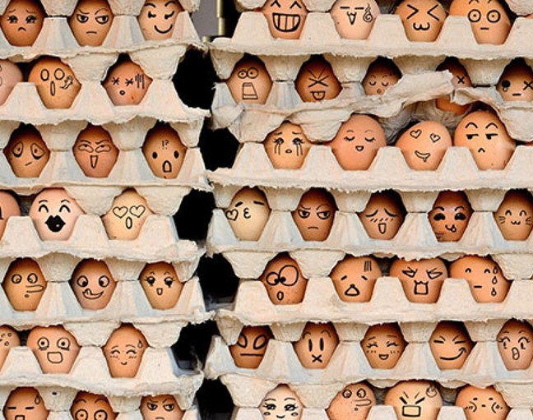
Diversity and Inclusion
Awareness:
Acknowledge your limitations but focus on your strength.
Acceptance:
You can’t see a person if you try to overlook their differences​.
Determination:
Bias takes time and practice to recognise and to address. You will make mistakes.
Focus:
Focus on what is being said in the moment. Listen actively.
Harmony:
When the 4 tips above come together you can approach anyone calmly with compassion, and they will feel it!
Notes:
Look at s2s accountable space would that fit better / cover details

Slide 12
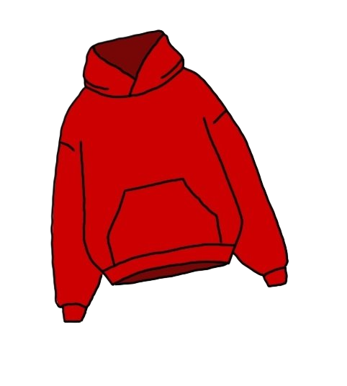
Orientation
Icebreakers
Q&A
Campus Tour
Library Tour

Slide 13


Icebreaker
Getting to know you
Name
Pronouns
Why you want to volunteer
Anything you’re happy to share that people might not know about you straight away
Last song/piece of music you remember listening to

Slide 14
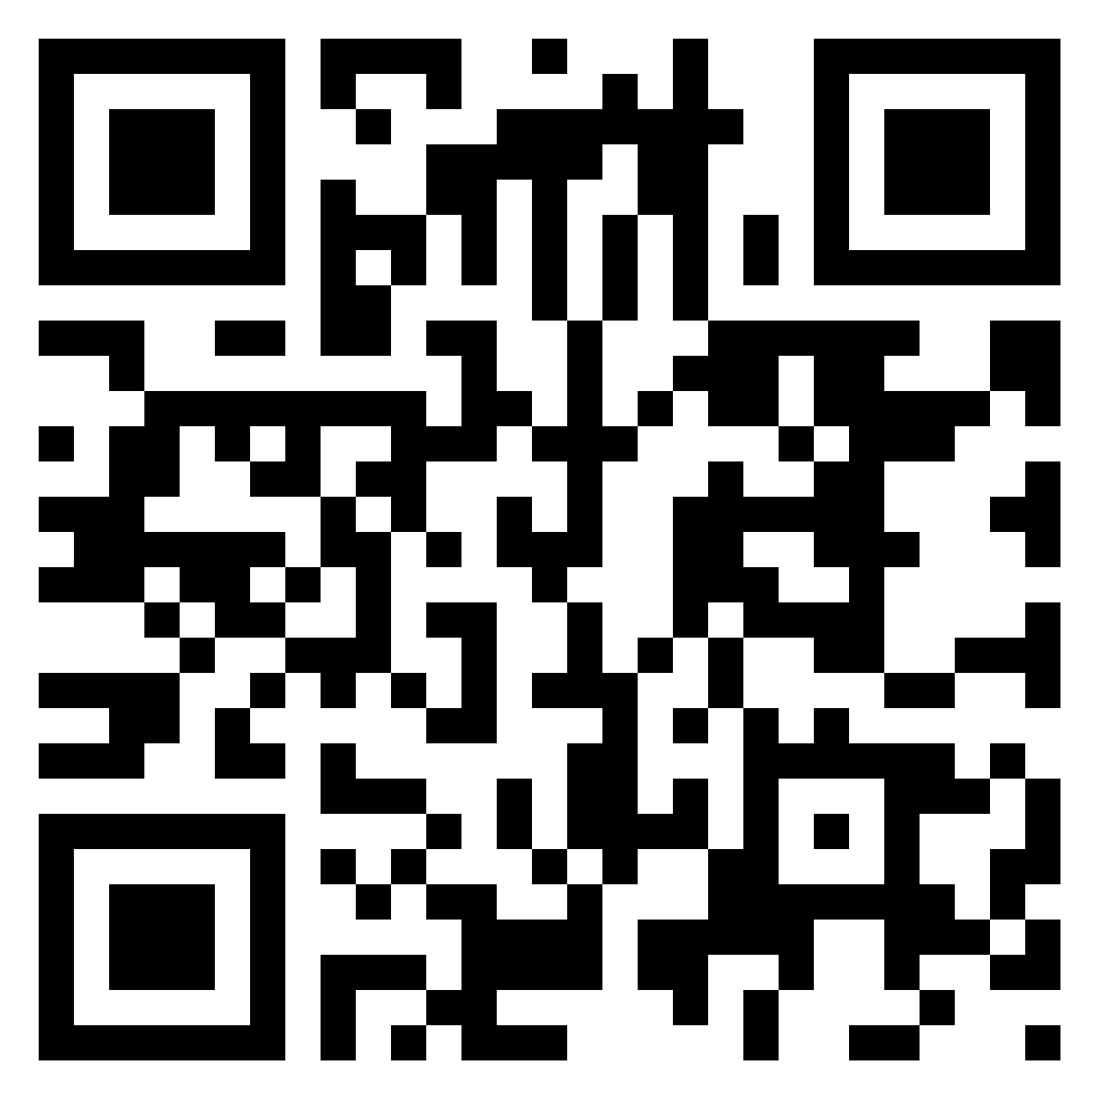
Q&A
Reflect on what your biggest problem/concern was when you started College
In your group, agree what your top question/concern was
One person from each group logs their question/concern on www.padlet.com/TCDS2S/new2TCD

Slide 15
Encouraging Questions
Don't ask if they have any questions, ask what questions they have.
Be appreciative of questions, and enthusiastic about answering them.
Use slips of paper/Post Its/a Padlet or another online tool.

Slide 16
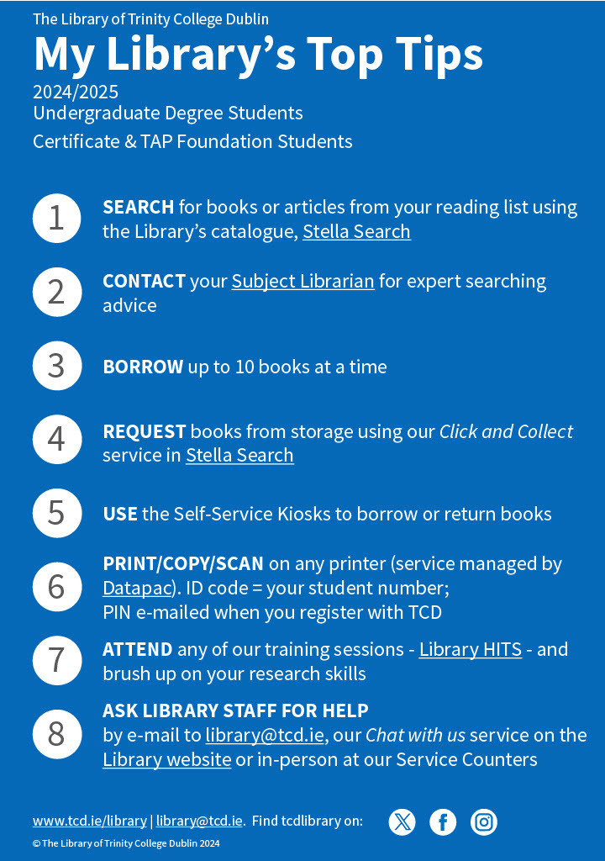
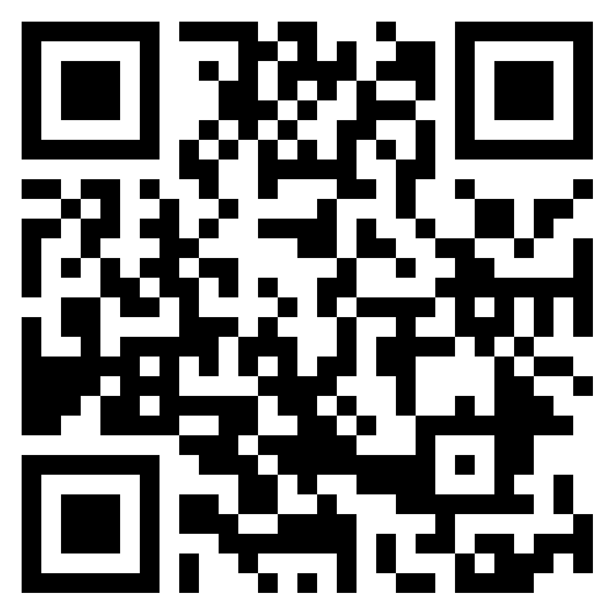
Library Tour
What do you need to know about your library to deliver a good tour?
Log your answers on: www.padlet.com/TCDS2S/Libraries

Slide 17
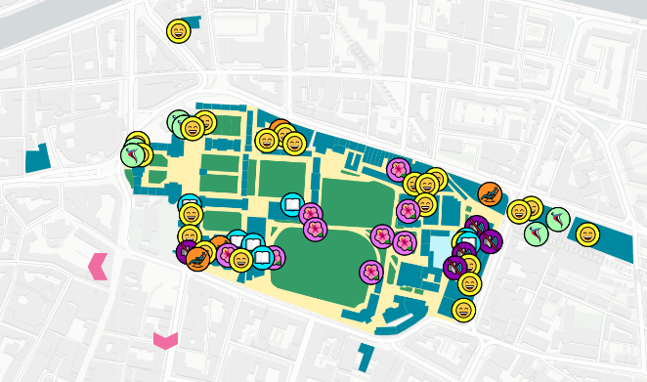
Campus Tour
Go to https://tcdsensemap.ie
Identify key places
Find 3 unique places
Know some info not there? Submit a tip to TCD Sense

Slide 18
Story Time!
Mentor Trainer Orientation Experience

Slide 19
Why You?
It’s not just me, and I am not alone in this
I know I don’t have to be right or perfect
The steps I have to take feel smaller
I can do this
Notes:
Double check third phrase ‘ everything feels more manageable’

Slide 20








Break
See you in 5 minutes!

Slide 21
Communication
Meet-ups
Inclusive events
Conflict resolution
Suicidality or risk of harm
Supports available
Section 2
Agenda

Slide 22

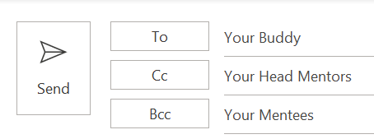
Communicating with Mentees
Email
Social Media
Weekly emails, Trinity in 12 weeks
Share helpful info, memes, recipes, workshops and deals
Give plenty of notice about events
Think abut what they need to know. E.g. what is reading week?
Remember:
Set up a private social media group (insta page)
In addition to your weekly emails
Social media should never replace email

Slide 23


Emails in Action
Will you get responses?

Slide 24
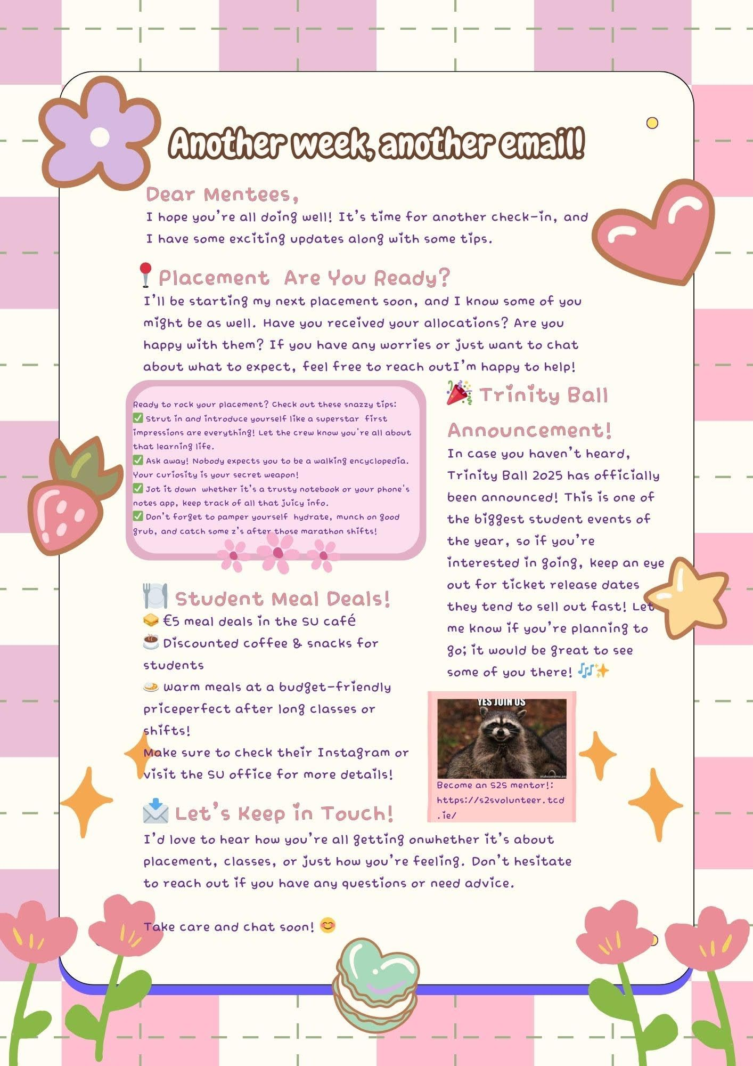
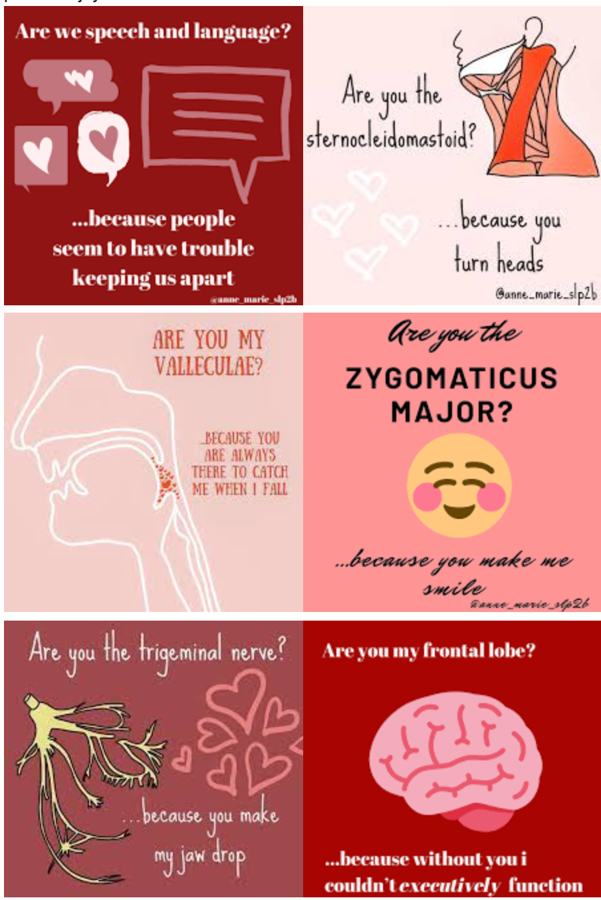
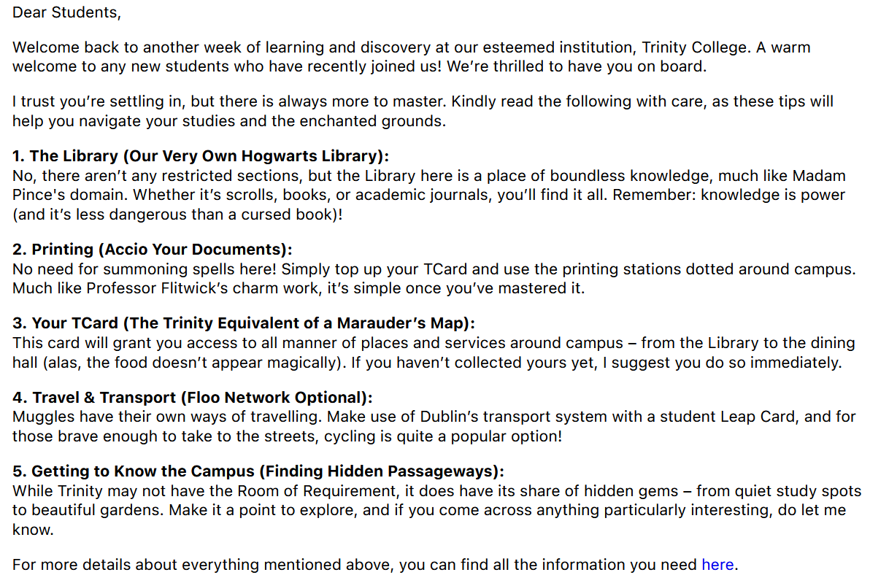
Take a look at some good examples of emails from Mentors this year

Slide 25
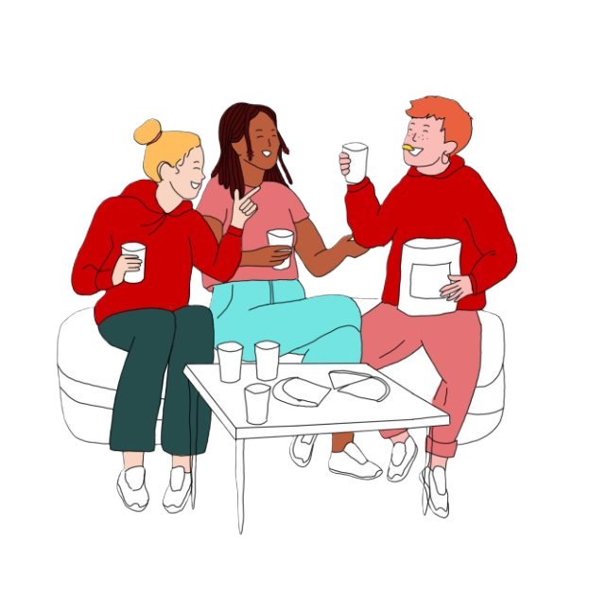
Meet-ups
In Groups
Let’s chat in groups
‘Talk around’ style
What events would you have liked as a mentee?
What event would you organise for mentees?
Pick your favourite and share with room

Slide 26
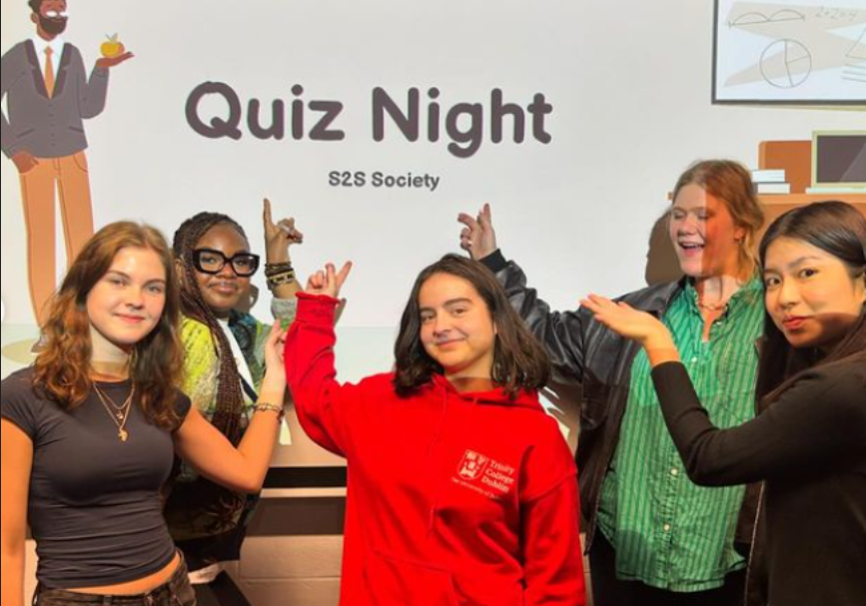
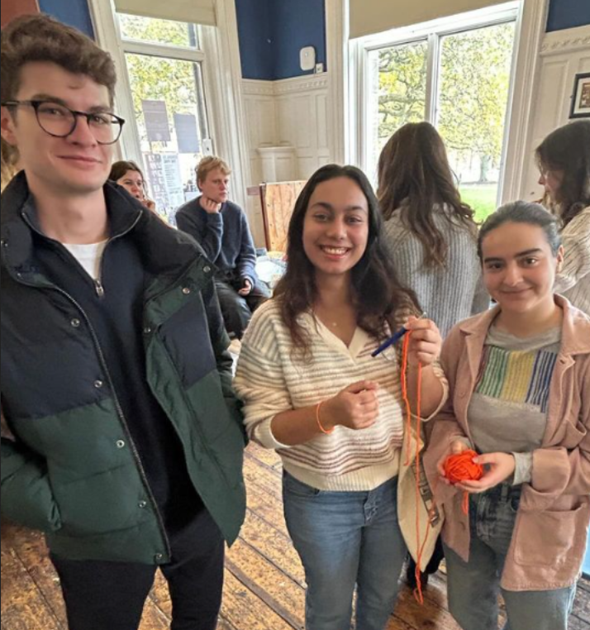
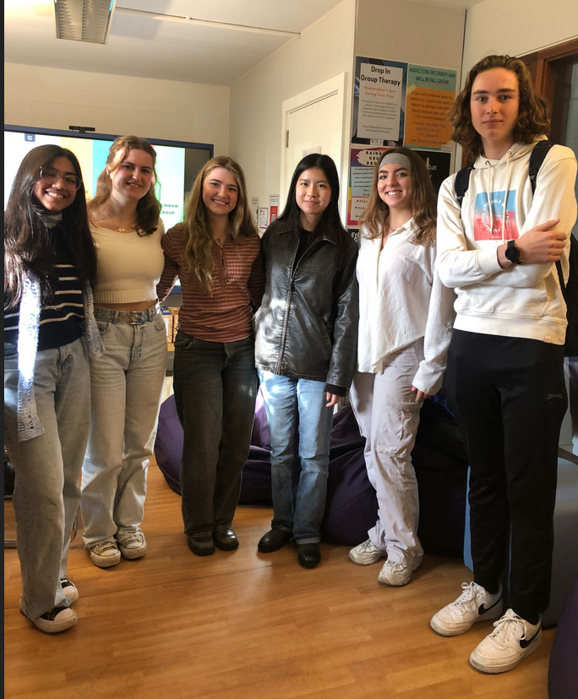

Slide 27








Inclusive Events
Alternate times and days
Alternate alcohol and non-alcohol events
Always include some free events – you can be reimbursed for some minor activities
Don’t promote empty events
Start smaller – aim bigger
Combine with other S2S groups
Piggy back on society, school and larger S2S events
Include the study skills!

Slide 28
Event Logistics
Events Funding
Room Bookings
S2S has a small budget to fund Mentor meet-ups with mentees.
Applications must be submitted at least 1 week in advance (but the earlier the better!)
Applications must include:
Screenshot of email to mentees including event date, time, location
Copy of room booking confirmation
Must choose food options from S2S supplier list and adhere to quantity limits.
S2S places food order on your behalf and liaises with you throughout process.
All S2S funding requests require a confirmed room booking.
Generally speaking you should always have a venue for your event (can never predict Irish weather!)
There are several bookable spaces on campus, including the S2S student space in House 47.
Important to note that if you wish to have food at a campus location other than House 47 you must submit a request to the Junior Dean at least 10 working days in advance.
In Groups
All this info is available on the S2S website and will be recapped in the Blackboard module!

Slide 29

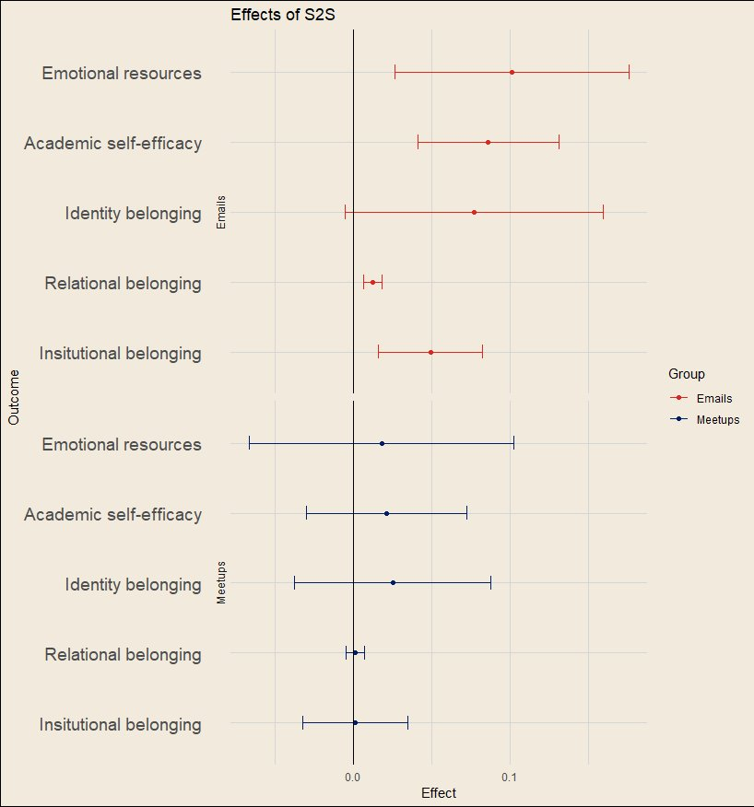
Outcomes for Mentees
S2S emails showed a significant effect on all outcomes except identity-related belonging (smaller effect).​
Meetups themselves indicated a positive direction.
n=1,043

Slide 30
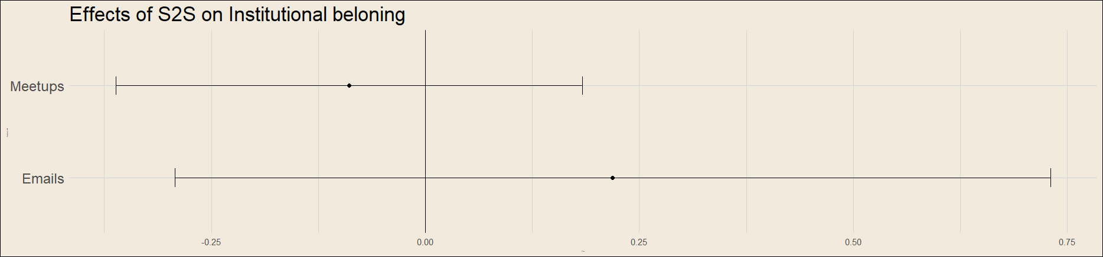
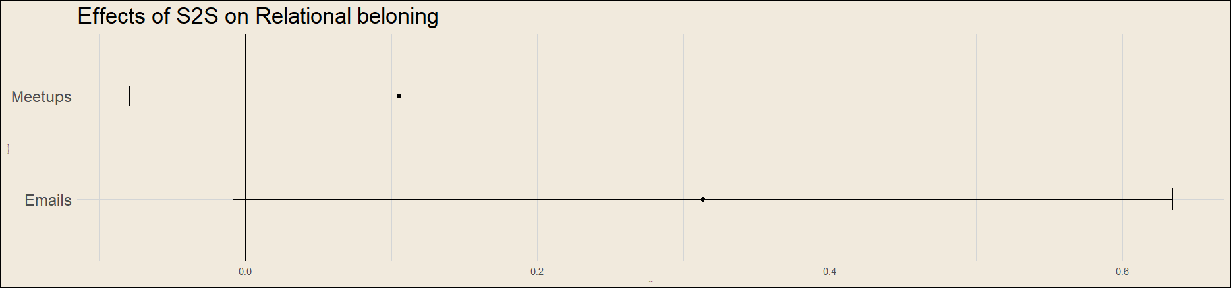
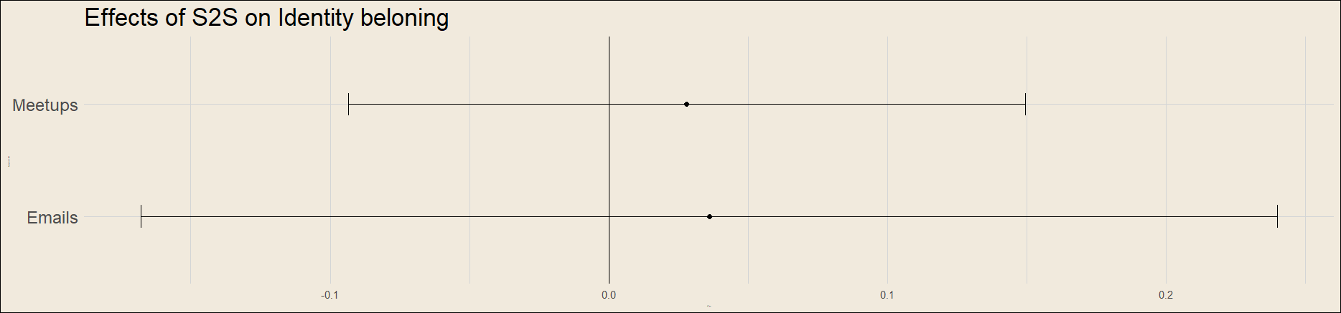


Outcomes for Mentors
Meetups showed a negative impact on institutional belonging. We suspect this is because of meetups that were arranged and nobody came!
Your mentees need to know that their presence at a meetup enhances belonging for you and for their peers – it’s not just there “if they need it”. They are part of the community, and they are needed!
NB - small sample, and no data for peers who didn’t volunteer. As we collect data over more years we will get a clearer picture.
30
Notes:
Also noting that lack of turnout at meetups is probably a strong contributing factor to negative outcomes. Working to build that back up post-covid, with staff supporting student innovations (purchase of specific board games, making room bookings easier, small budget for food etc.)

Slide 31
Story Time!
Mentor Trainer Event Examples

Slide 32
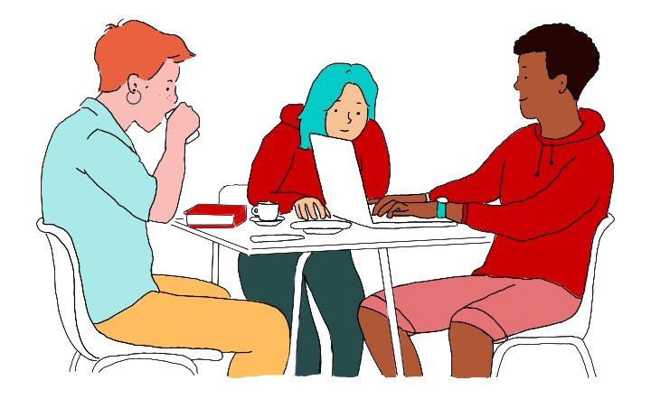
Group Dynamics
There are all kinds of reasons why you might end up working with someone you don’t know instead of, or as well as, a friend
What would you find challenging in a Mentor buddy’s behaviour? How can you set expectations for each other early on?
Things to think about:
Get in contact long before orientation
Plan your first session
Plan how you will collaborate over the weekly emails
What will you do if someone “drops the ball”?
If it’s not working, tell S2S as soon as you can

Slide 33
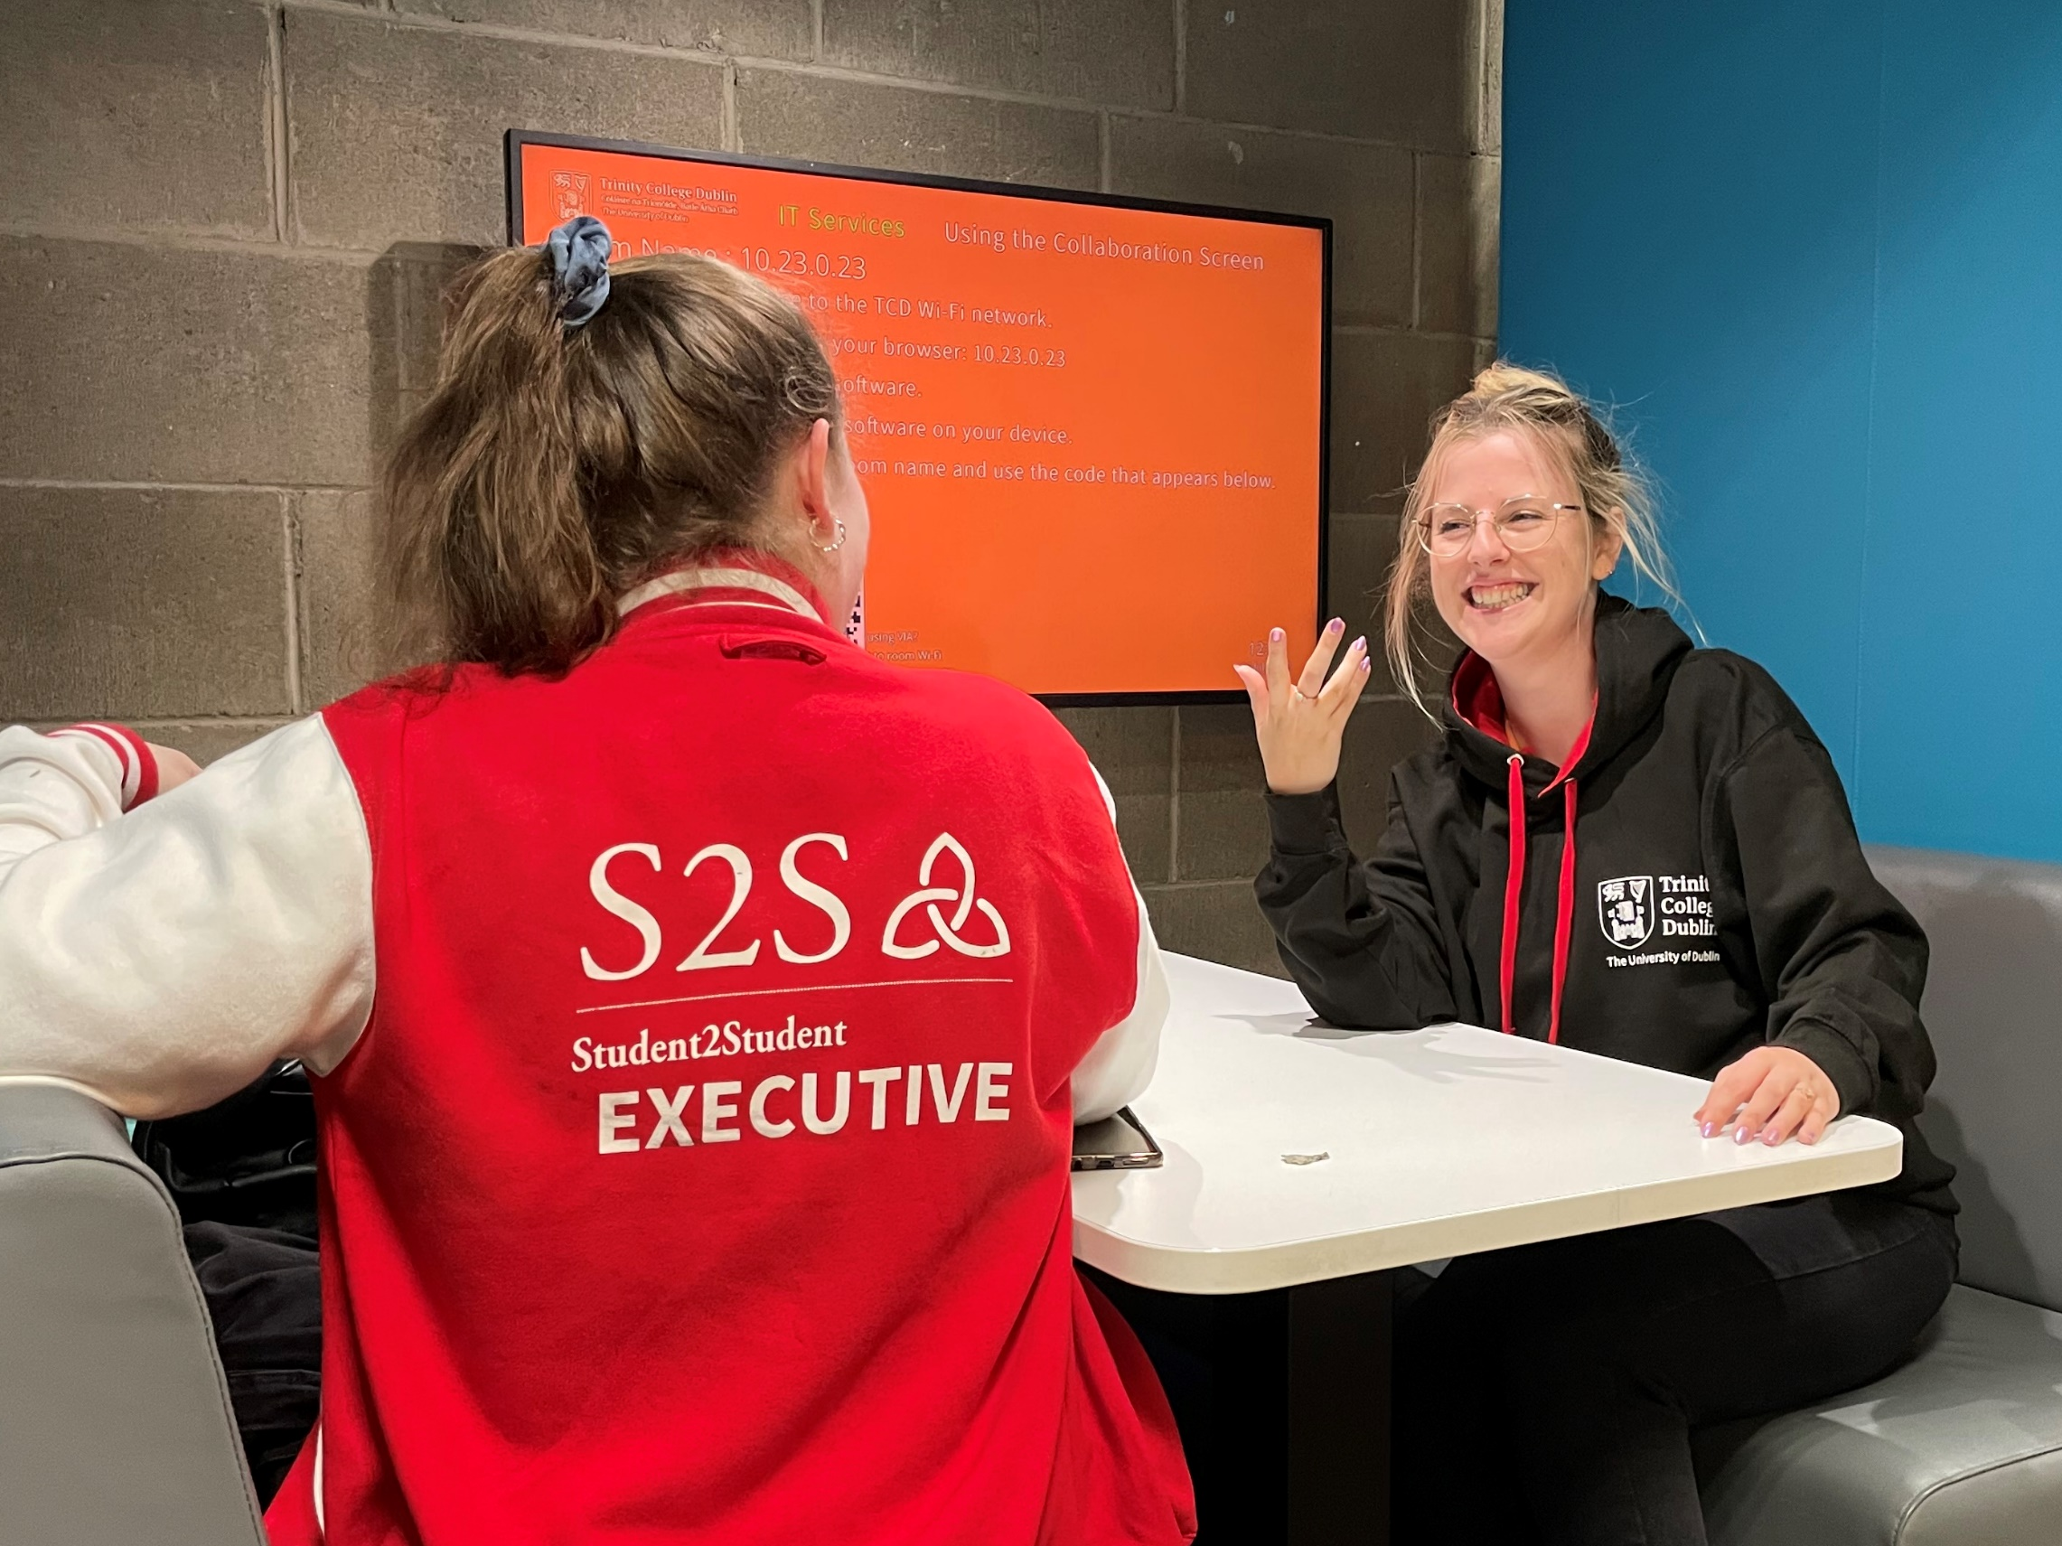
Conflict Resolution
Time to role play

Slide 34


Person A:
You have organised a meet-up with your buddy and they didn’t show up. They didn’t try to reach out. You were left on your own and you’re really annoyed.
Conflict Resolution
Let’s Practice in pairs
Person B:
Be as creative as you like with your reason for not being there but, whatever the reason, it has to be person A’s fault.

Slide 35


Slide 36
Accountability
Accountability is the antithesis of blame
Think about what you really need from this conversation – what is your end goal?
Use an “I” statement to take ownership – without adding a “but you”…
Harriet Lerner – The Dance of Anger

Slide 37
Signs to look out for
Change in appearance
Social withdrawal
Concern from classmates
Direct disclosure of suicide ideation
Distressing social media posts
Low mood
Tearfulness
Suicidality
or
Risk of
Harm
What do I do next?
It’s better to ask and be wrong than to not ask and be right
If in doubt, make the referral
Accompany them, or note where they are and where they go
Always come and talk to S2S afterwards

Slide 38
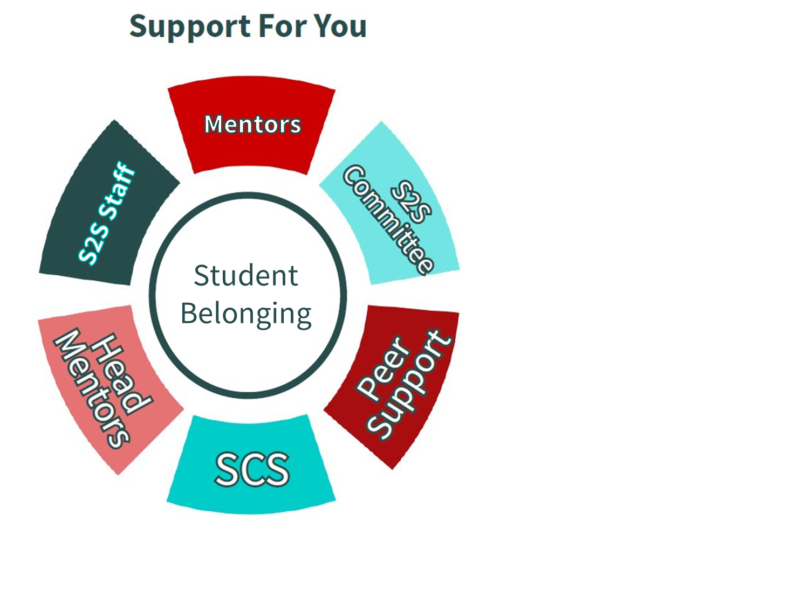
Supports For
You

Slide 39
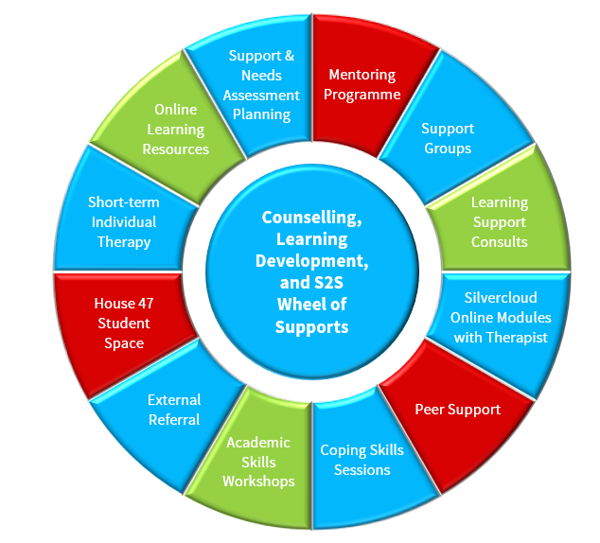



Wider SCS Supports
Mental Health
Social Belonging
Learning Development
Trinity College Dublin, The University of Dublin
Notes:
Discussion around the various services on offer to help with mental health, social belonging, and learning development
Over 12 different supports, many ways to access help for anyone who wants it

Slide 40


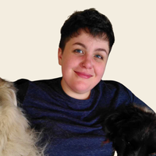
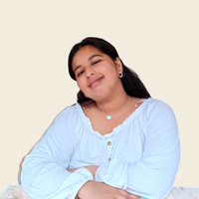
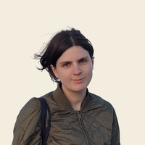
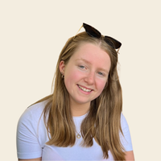

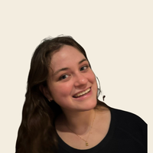
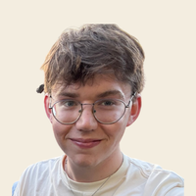



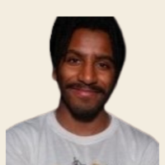
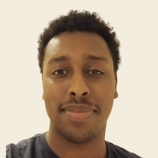
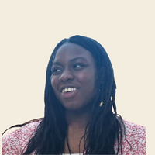
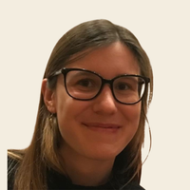

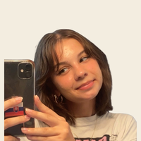
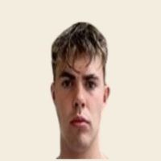
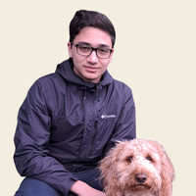
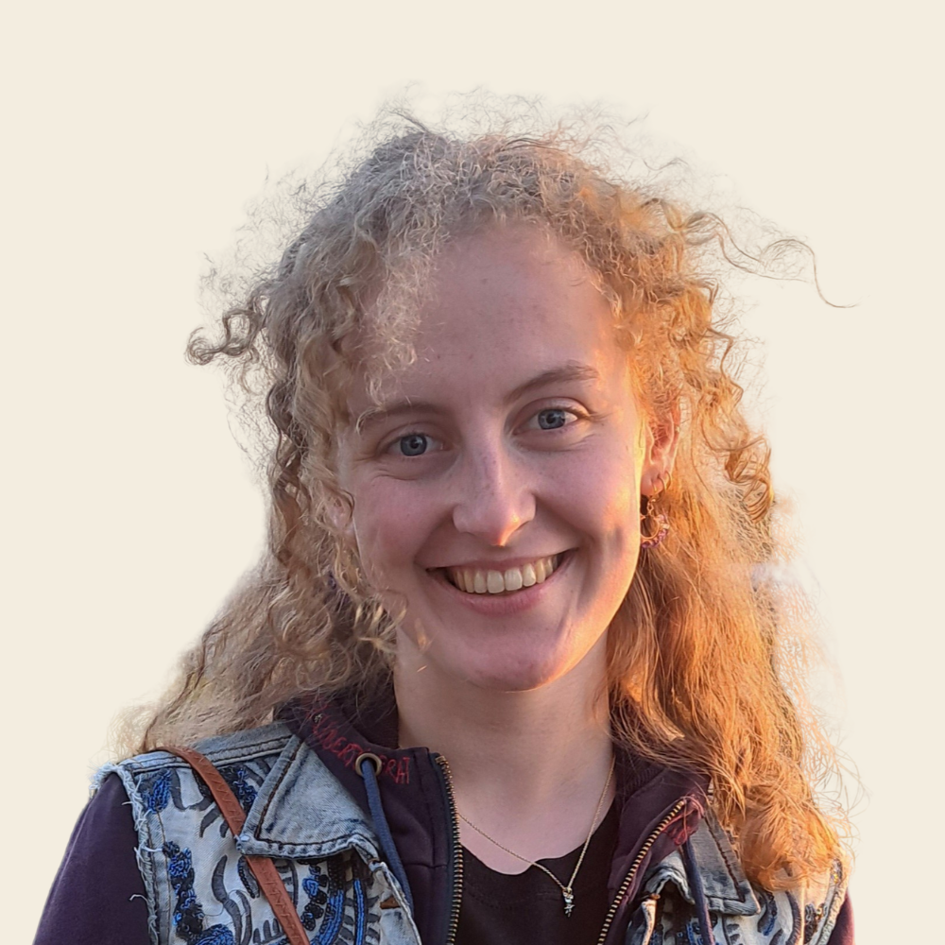


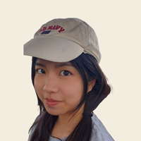

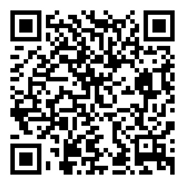

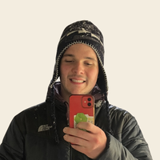
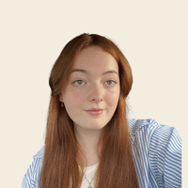
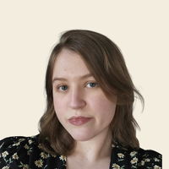
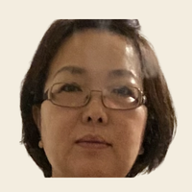

Peer Supporters
Need a Chat?
S2S Peer Supporters are available for 1:1 listening support for issues big or small.
Abigail
Ahana
Ailish
Aisling
Caio
Cara
Conor
Request a Meet-up:
David
Ella
Ethan
Hamza
Henok
Iyobo
Joanna
Scan the QR
Email student2student@tcd.ie
Johana
Louis
Mark
Orla
Ray
Reed
Rianna
Orla
Ros
Rossa
Sarah
Taisiia
Yanqun
Yukta
www.tcd.ie/student2student/get-support

Slide 41









Head Mentors
Your go-to guys!
Think of them as your Mentors.
Any issue, concern, extra support, guidance, they are here to support you.
They will keep in touch with you, your job as a Mentor is to stay connected to them.
They meet with S2S Staff every month to share updates.
41

Slide 42





S2S Staff
Ralph Armstrong-Astley
S2S Coordinator
She/her
Shauna O’Connor
S2S Programme Officer
She/her
Chloe Staunton
S2S Executive Officer
She/her
AL Martin
S2S Intern
He/him
Book in with them online for 1:1 or pop by House 47 between 10am and 5pm
42

Slide 43
Break
See you in 20 minutes!

Slide 44
Emotional support
Help someone feel heard
Active listening
Signposting
Referral
Boundaries
Critical protocols
Section 3
Agenda
Quiz
What's next
Logging activity

Slide 45
Example Time!
Mentor Trainer Emotional Support Examples

Slide 46

Feeling Heard
Body language
Eye contact
Distractions
Time
Poor advice
Sympathy vs Empathy

Slide 47

“you’re
an alien”
Reflection
“You’re from another
planet”
Paraphrase
“So, you’re under financial pressure, but worried about whether you need a work permit to get a job”
Summary
Notes:
(how to listen key skills) [asking]
Needs to be redesigned /editted

Slide 48

Types of Questions
Open question?
Closed question?
Hypothetical question?
Leading question?
Judgemental question?
Inappropriate question?

Slide 49
Person A:
Talk for 2 minutes about something you are looking forward to do at the weekend.
Active Listening
Let’s Practice in pairs
Person B:
You are to not speak but listen. Use body language to convey your understanding.

Slide 50
Person B:
Talk for 2 minutes about the aspect of mentoring you are most nervous about.
Active Listening
Let’s Practice in pairs (again)
Person A:
Use reflection, paraphrases, summaries, open questions and hypothetical questions.

Slide 51
Referral
Helping someone access necessary support, e.g. Tutor, Peer Supporter, Dignity, Respect & Consent, Counselling, GP.
Don’t get of your depth.
Personal comes first!
Be honest.
Go with them.
It’s a sign of strength – never weakness.
You’re still their mentor.
Ralph: astleyr@tcd.ie
Emergencies:
085 7833 548

Slide 52
Signposting
Looking at other sources of support with someone (ideally at least 2 or 3) and helping them to decide if/what they would like to try
Signposting vs
Referral
Referral
Knowing that someone is in need of more help and leading them there directly

Slide 53
Signposting vs
Referral
In groups take a look at the scenarios on the laminate pieces of paper
Decide in your group: is this a signpost or a referral?
Let’s Put it in Practice

Slide 54

It’s OK not to know!
That’s a really important message for your mentees, and for you!
You are never expected to handle everything on your own.
You are never expected to have all the answers.
Lead by example – tell them when you don’t know. Tell them you’ll find out.
Don’t let anyone become a human pinball!
Come and talk to your Head Mentor or to S2S staff.

Slide 55
Break
See you in 5 minutes!

Slide 56

Stand if you agree
Sit if you disagree
Boundaries

Slide 57
Group 1
Critical Protocols
You are emailed by someone claiming to be a mentee’s parent. They say they are worried about their child and want to know if they’ve engaged with their Mentor – apparently, they say they have, but the parent doesn’t believe them.
Let’s discuss in 2 groups
Why might these scenarios hit on specific legislation?
What should you do?
Group 2
During a 1:1 a mentee mentions that a teacher in their school behaved inappropriately with some of the pupils there, and that they have trust issues as a response.

Slide 58
What would you do if…
Group 1
You have arranged 2 consecutive meetups, including one with free pizza and none of your mentees have showed up.
Let’s discuss in groups
(different groups this time!)
What do you think/feel?
What would you do?
Who would you get support from?
Group 2
During Orientation there were Mentors who didn’t turn up, and you are now mentoring a much larger group (35 students and 3 Mentors) which combines two groups

Slide 59

Why to persist
Mentoring is not an “orientation only” role. It should continue for a full academic year.
You can:
Merge with other groups to support the workload and increase participation.
Hold study-related events (assignment prep, exam prep etc.) with support from S2S and SLD.
Talk to your Head Mentors if it still doesn’t seem to be working
But please don’t give up – every year we get feedback that someone didn’t reach out to their Mentor when they needed support, because they’d stopped getting emails!

Slide 60


Quiz
Should you put your group’s email addresses in the “TO”, “CC” or “BCC” bar?
Orientation includes a campus tour, library tour, Q&A and what else?
If you have any difficulty with your Mentor buddy or buddies, who should you talk to?
Should you set up a WhatsApp group?
Is it better to offer a mentee empathy, or sympathy?
Should Mentors give advice?
Who should always take priority; your mentees, your Head Mentors, the S2S staff, or you?

Slide 61



References
Odyssey
The importance of logging
Make it routine – do it as you go!
Awards
Other S2S roles – including trainers!
Notes:
Add photo for references
Make provost more prominent

Slide 62




What’s next?
Blackboard module during summer and mentor matching updates
Meeting your Mentees at Orientation
(week of 14th September)
Keep an eye on emails, double check S2S is marked as ‘safe’ and not landing in Junk
Read
the
Handbook –
everything is in there!

Slide 63


Any Questions?
Notes:
questions

Slide 64


Thank You!
Let us know what you think
@tcds2s
Notes:
Add new survey monkey link / qr

