Slide 1
Introduction to the Literature Review Process
student.learning@tcd.ie
http://student-learning.tcd.ie

Slide 2

Workshop Overview
Examine the elements of conducting a literature review
  Formulating the question
  Identifying the literature
  Critically evaluating the literature
  Practical session on literature search
This Photo by Unknown Author is licensed under CC BY-NC-ND

Slide 3

What is a literature review?
A descriptive, analytic summary of the existing material relating to a particular topic or area of study.
A process that involves a examination of prior scholarly works.
Bangert-Drowns, R. (2005). Literature review. In S. Mathison (Ed.), Encyclopedia of evaluation. (pp. 232-233). Thousand Oaks, CA: SAGE Publications, Inc. doi: http://0-dx.doi.org.leopac.ulv.edu/10.4135/9781412950558.n319
This Photo by Unknown Author is licensed under CC BY-SA-NC
Notes:
A literature review has three key components: 1. A search of the literature available on a given subject area. 2. An evaluation of the literature, including its scope. 3. A well-structured and argued written account of the literature that provides an overview and critique.
Different types depending on the field of research. They can be a full chapter in a thesis, a series of reviews woven throughout the thesis or a systematic review which is more common in health sciences and follows a very specific methodology (Writing a lit review - Student Learning Development University of Otago)
Different types depending on the field of research. They can be a full chapter in a thesis, a series of reviews woven throughout the thesis or a systematic review which is more common in health sciences and follows a very specific methodology (Writi
“A systematic review, increasingly common in Health Sciences, is the subject of the whole thesis. The purpose is to “appraise, summarise, and communicate the results and implications of otherwise unmanageable quantities of research” (Green,2005,p. 270). Green, S. (2005). Systematic reviews and meta-analysis. Singapore Medical Journal, 46:6, 270-274

Slide 4
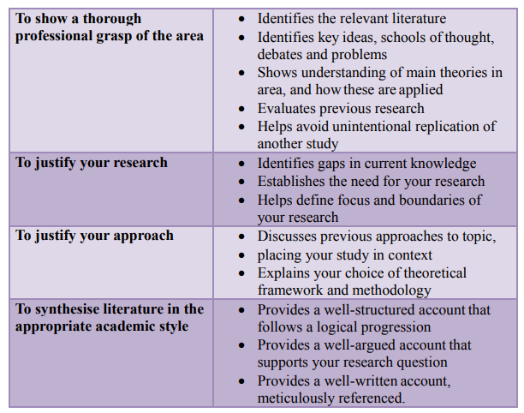
https://www.otago.ac.nz/hedc/otago615355.pdf
Notes:
Regardless of the type of review, the aims are similar

Slide 5
For a Literature Review You need
1. A clearly formulated question
2. System for identifying relevant literature
3. Critical appraisal of relevant research
Notes:
We will look at these in more depth

Slide 6
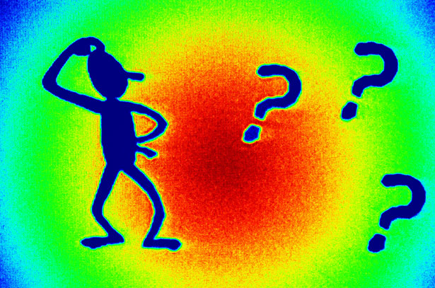
1. Formulating a Problem
A Research Question should be:
Specific
Focused
Clearly formulated
Well defined
Make a research question as narrow and focused as possible
Ask questions of your question!
Notes:
The more specific your question is, the easier it will be to find a more manageable and relevant body of literature. If it’s ambiguous or too broad, you will get too much literature and find it hard to identify the relevant material
You might start with a broad question or topic but as you start to review the literature, you can start to refine your question based on your reading. E.g. you might start by asking ‘what is the role of nurses in the care of people with dementia’. On reading literature on the topic, you realise that caring for people with dementia takes place in a variety of settings, each quite different in terms of the nurses’ role. As a result you decide to focus on care of people with dementia in acute hospital settings as this seems to be an under-researched area whereas Residential units have had a lot of research. You might also decide to focus on a particular grade of nurse such as the role of student nurses or staff nurses as different grades of nurses have different roles.
Ambiguous is where there is more than one interpretation for the question e.g.

Slide 7
Exercise: compare the following theses titles
How has people’s health been impacted by Covid? | What affect has Long Covid had on the mental health of 50-60 year old females working in acute hospital settings.
Notes:
How would these questions affect your literature search?

Slide 8
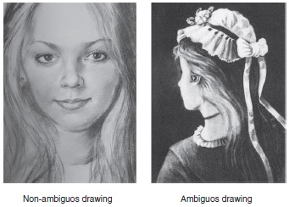
This Photo by Unknown Author is licensed under CC BY-SA
Leave no room for ambiguity or misinterpretation.
E.g. How has Irish society changed in the last 20 years?
http://writingcenter.gmu.edu/?p=307
Notes:
i.e. health can be interpreted in different ways – wellbeing, physical, mental, emotional, long term, short term

Slide 9
Exercise in groups – 20 mins max
Breakout rooms will be open for each faculty
Pick one for your field of research
Each person has 3 minutes to explain their research question and
2 mins for other members should try to ask questions about the question
When your group has finished, re-join the main room

Slide 10

Your turn!
Take a few moments to write down your research question.
This Photo by Unknown Author is licensed under CC BY-SA-NC

Slide 11

Ask questions of your question!
Is your question:
Specific
Focused
Clearly formulated
Well defined
How can you further refine it?
This Photo by Unknown Author is licensed under CC BY-NC

Slide 12
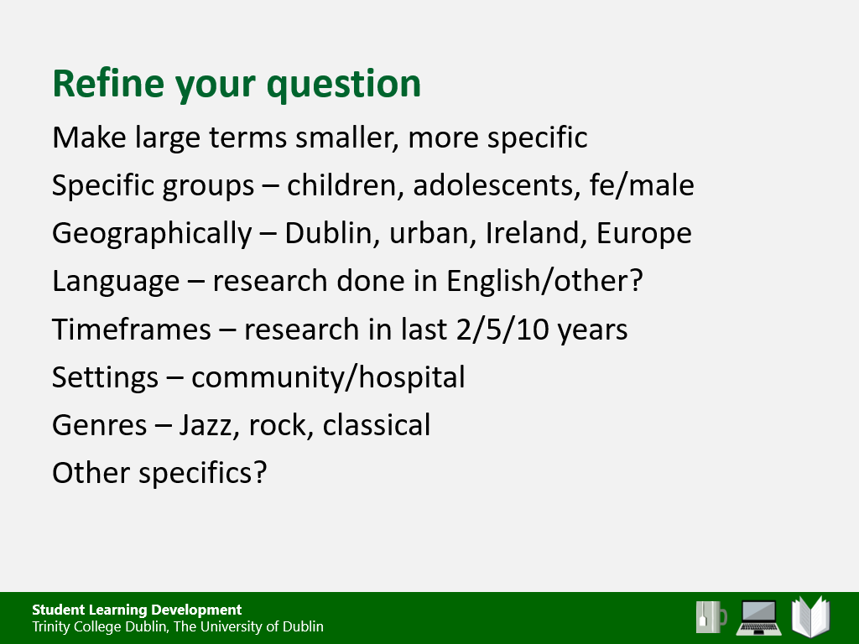
Breakout rooms
Take turns to interrogate each other’s topics. Ask questions to help your partner to refine their topic so that it is:
- Specific
- Focused
- Clearly formulated
Well defined
Notes:
Terms like ‘health’ is a huge term. How has people’s health been impacted by Covid. But it could be mental health, or more specific anxiety for instance, or physical health then obesity. And what people – age, ability, urban, working in certain areas, parents,
Timeframes also refer to the era you’re investigating. So research done in last

Slide 13

Finding relevant Literature
This Photo by Unknown Author is licensed under CC BY-NC
Notes:
How can you search until you know what you are looking for?

Slide 14

Challenges in finding literature
Where to start? (e.g. wide then narrow, or narrow then wide?)
When to stop searching
How far to venture into associated domains
This Photo by Unknown Author is licensed under CC BY
Notes:
Generally start broader and use exclusion and inclusion terms to filter e.g. if you’re searching adult populations if you search for adult in the ‘title’ you might miss papers that discuss adults but don’t have it as part of the title.
Where – reliable journals or unpublished works, - conference proceedings, theses, other?
Stop when you’re not finding anything new. You might need to try different types of search terms to locate the body of literature you want, you will need to re-run the search during and towards the end of your thesis in case of any new publications.
Associated domains might be necessary if your topic is very small e.g. if you’re doing something on the impact of covid on 12 year olds you might have to look at impact of similar conditions on that age group to see what issues 12 year olds face or look at the research on under 18s

Slide 15
How to find relevant Literature
1. Defined search arena
2. Defined search terms
3. Other broad search limits, e.g. language, timeframe
Notes:
Compile list of terms for each component, considering:
Synonyms (from different times and places)
Other words and phrases that are related to what you’re interested in
Words that are broader
Words that are more focused
Index terms or keywords

Slide 16
Finding the Literature
Think about:
Key words
Synonyms
Different spellings
Phrases
Boolean Terms (AND, OR, NOT)
See your Subject Librarian for in-depth search strategies

Slide 17
Where will you search?
databases
reference lists from articles
grey literature – phd theses
conference proceedings
research registers
other
Notes:
Conference proceedings are compilations of papers, research, and information presented at conferences. Proceedings are sometimes peer-reviewed and are often the first publication of research that later appears in a scholarly publication
A research registry is a collection of information about individuals. There are different types of research registries: registries of people with a specific diagnosis or condition and registries that connect people interested in being research participants with health studies.
Examples of grey literature include: conference abstracts, presentations, proceedings; regulatory data; unpublished trial data; government publications; reports (such as white papers, working papers, internal documentation); dissertations/theses; patents; and policies & procedures.
Citation Indices: https://www.isko.org/cyclo/citation

Slide 18
Finding the Literature
Other broad search limits, e.g. language, date
  E.g. Studies published in English in peer-reviewed journals in the last 10 years
What is your rationale for these limits

Slide 19

Selecting the Literature
How will you filter the results?
Inclusion and Exclusion Criteria - related to your research question e.g.
Methodologies used
Timeframes
Sample types
Population
Other?
Not relevant
?
Relevant
This Photo by Unknown Author is licensed under CC BY-SA

Slide 20
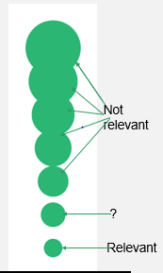
Selecting the Literature based on criteria
Exclude by irrelevant titles
Exclude by irrelevant abstracts
Exclude by irrelevant full text
Left with articles that meet your criteria

Slide 21
Identify the Literature
TIP!
Document the search strategy
Record what research was found
Manage the filtering process – Covidence
Manage the search output, e.g. using
Endnote, Mendeley, Zotero,
Notes:
Compile list of terms for each component, considering:
Synonyms (from different times and places)
Other words and phrases that are related to what you’re interested in
Words that are broader
Words that are more focused
Index terms or keywords

Slide 22
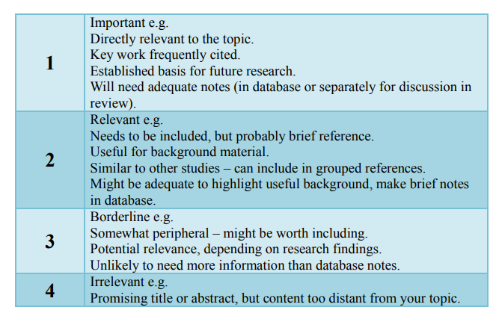
Evaluating relevance of results
https://www.otago.ac.nz/hedc/otago615355.pdf

Slide 23
Literature Search Strategies
Your subject librarian is a great resource
Training sessions on Literature Searching, Endnote, Covidence
There are different strategies you can use to effectively find the literature you need
Highly recommend that you attend
Notes:
https://www.lib.ncsu.edu/tutorials/lit-review
Link for lit search strategies https://eu.bbcollab.com/collab/ui/session/guest/1b754a3fcf6a4bce8ba1bce407cae789

Slide 24
Overview of Literature Review Process
Introduction to 2.00, 3.10 to 3.45
What’s involved from 5.24
https://www.lib.ncsu.edu/tutorials/lit-review (NC State University)
Notes:
https://www.lib.ncsu.edu/tutorials/lit-review

Slide 25
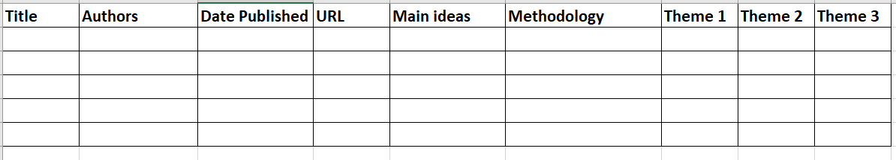
Organise your information
Take notes on relevant information
A spreadsheet can be useful to organise information from readings and compare different readings
Use headings that make sense to you!
Notes:
Use this to develop headings and sub headings and discuss the literature around your research

Slide 26
Organise your information
A citation spreadsheet is another tool that might help
Spreadsheet listing articles read
  put in quotes/paraphrases that you think are useful
  number them
Second spreadsheet with topics
  Under each topic, list the citation number from 1st sheet

Slide 27
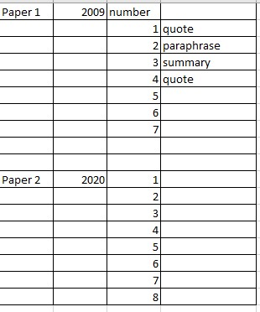
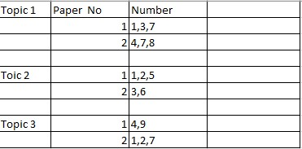
Citation spreadsheet

Slide 28
Critical evaluation of the literature
What are the key terms and concepts?
How relevant is this article to my specific topic?
What are the major relationships, trends and patterns?
What methodologies are used?
How has the author structured the arguments?
How authoritative and credible is this source?
What are the differences/similarities between the sources?
Are there gaps in the literature that require further study?
  From: https://www.citewrite.qut.edu.au/write/writing-well/litreview.html

Slide 29
Structure your Review
Structure that makes sense for your research
Generally includes: Introduction, Body, Conclusion
Use Headings and Sub Headings

Slide 30
Structure your Review
Introduction –
  What is the review about
  Why is it important
  How did you identify the literature
  How is the review organised
https://writingcenter.ashford.edu/sites/default/files/inline-files/Sample%20Literature%20Review_0.pdf

Slide 31
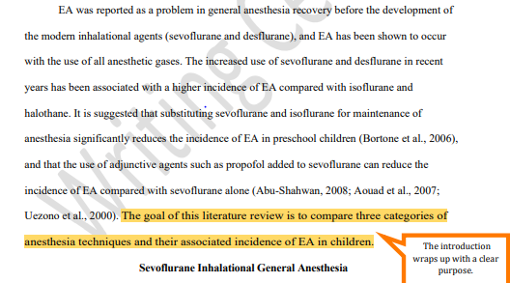
Introduction
https://writingcenter.ashford.edu/sites/default/files/inline-files/Sample%20Literature%20Review_0.pdf

Slide 32
Main body
Sections could include topics like:
  background
  methodologies
  previous studies on the topic
  various viewpoints
  main questions being asked
  main conclusions that are being drawn
  From:https://www.citewrite.qut.edu.au/write/writing-well/litreview.html

Slide 33

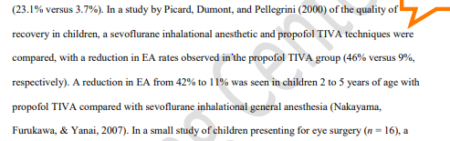
Main body

Slide 34
Conclusion
Summarise
what the main agreements and disagreements are
what the gaps or weaknesses are
your opinions on the topic
relate to your own research question
https://writingcenter.ashford.edu/sites/default/files/inline-files/Sample%20Literature%20Review_0.pdf

Slide 35
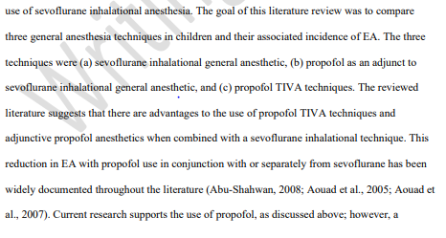

Conclusion
https://writingcenter.ashford.edu/sites/default/files/inline-files/Sample%20Literature%20Review_0.pdf

Slide 36
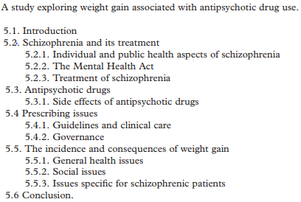
Example structure
From http://publications.aston.ac.uk/id/eprint/3431/1/Jesson_and_lacey2006.pdf

Slide 37
Critical evaluation of literature
Descriptive Summarises what other people have found without saying what these findings mean for your investigation. Usually a chronological list of who discovered what, and when. | Analytical Synthesises the work and succinctly passes judgement on the relative merits of research conducted in your field. Reveals limitations or recognises the possibility of taking research further, allowing you to formulate and justify your aims for your investigation.
For example: "Green (1975) discovered …." "In 1978, Black conducted experiments and discovered that …." "Later Brown (1980) illustrated this in ……" | For example:There seems to be general agreement on x, (see White 1987, Brown 1980, Black 1978, Green 1975). However, Green (1975) sees x as a consequence of y, while Black(1978) puts x and y as …. While Green's work has some limitations in that it …., its main value lies in …."
(Examples taken from https://guides.library.uq.edu.au/research-techniques/literature-reviews)

Slide 38
Critical Evaluation
What do you think the literature says about the topic
What are your opinions on the different points

Slide 39
Redrafting is key
This is a process
First draft is the starting point
Keep redrafting and refining
Save different versions – V1, V2 etc
Don’t get disheartened
It takes time, patience, perseverance and belief
End product will look nothing like first draft!

Slide 40
3. Critical appraisal of studies
https://www.plymouth.ac.uk/uploads/production/document/path/1/1710/Critical_Thinking.pdf

Slide 41
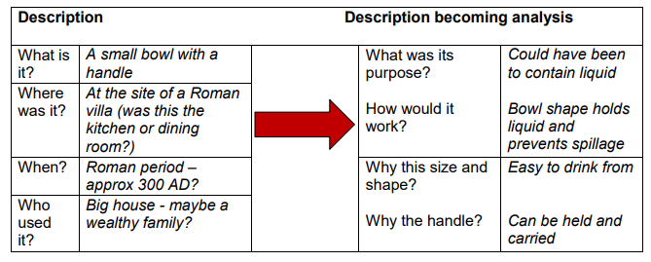
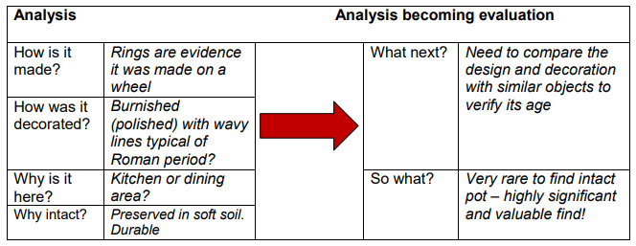
https://www.plymouth.ac.uk/uploads/production/document/path/1/1710/Critical_Thinking.pdf

Slide 42
Comprehensive Literature Review
In which subject areas has the topic been studied?
What are the main perspectives on this topic in previous research?
What have been the main research questions?
Do parallel literatures exist for this topic?
What are the main conclusions on previous research in this area?
What are the key concepts in this area?
Coherent synthesis of past and present research in the domain of study
Who are these “others”?
How is this topic approached by others?
Which existing work could be extended?
Where are the gaps in literature?
Where is existing knowledge “thin”?
Which aspects of this work are of most relevance to my study?
Which discussions?
What are the key areas of debate in this area?
Which work is subject to challenge?
Which sub-themes?
Which writers?
Source: Dr Hazel Hall, Napier University

Slide 43
Write up literature review – Structure
Introduction/Background
Literature Review
Findings/Discussion
Conclusion/Implications/Recommendations
43
Notes:
This is one example of outline of a literature review (which might be your lit review chapter)
Here, method refers to how you conducted your literature review, not how you did your research.
Findings/Discussion refers to analysis of retrieved literature
Implications/Recommendations might be what this means for your thesis. For example, a review of literature on learning skills interventions revealed: 1) two different theoretical approaches that underpin interventions and 2) very little qualitative research on these interventions; therefore, thesis research will focus on these aspects.
Read other theses
43

Slide 44
References
Green, S. (2005). Systematic reviews and meta-analysis. Singapore Medical Journal, 46:6, 270-274
https://www.otago.ac.nz/hedc/otago615355.pdf
44
Notes:
This is one example of outline of a literature review (which might be your lit review chapter)
Here, method refers to how you conducted your literature review, not how you did your research.
Findings/Discussion refers to analysis of retrieved literature
Implications/Recommendations might be what this means for your thesis. For example, a review of literature on learning skills interventions revealed: 1) two different theoretical approaches that underpin interventions and 2) very little qualitative research on these interventions; therefore, thesis research will focus on these aspects.
Read other theses
44

Slide 45
Useful Literature Review Resources
Otago University: https://www.otago.ac.nz/hedc/otago615355.pdf
Toledo University: http://libguides.utoledo.edu/litreview/home
Monash University: https://www.monash.edu/rlo/graduate-research-writing/write-the-thesis/writing-a-literature-review
Other Resources
Phrasebank http://www.phrasebank.manchester.ac.uk/
https://www.plymouth.ac.uk/uploads/production/document/path/1/1710/Critical_Thinking.pdf

Slide 46
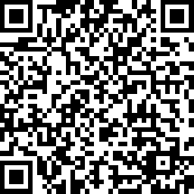
Feedback form
Please complete the form. Thank you
PGSS - Workshop Feedback Survey

Slide 47
Feedback form
Please complete the form. Thank you

Slide 48
Workshop feedback
Please complete. Thank you
PGSS - Workshop Feedback Survey

