Slide 1
Presenting and communicating your research
Student Learning Development
Presented by Dr Maeve O' Regan
E: student.learning@tcd.ie
W: www.tcd.ie/sld/
Notes:
Playing videos – URLS – sharing screen

Slide 2
Aims of the workshop
To understand how to:
plan
prepare
practice
present
effectively

Slide 3
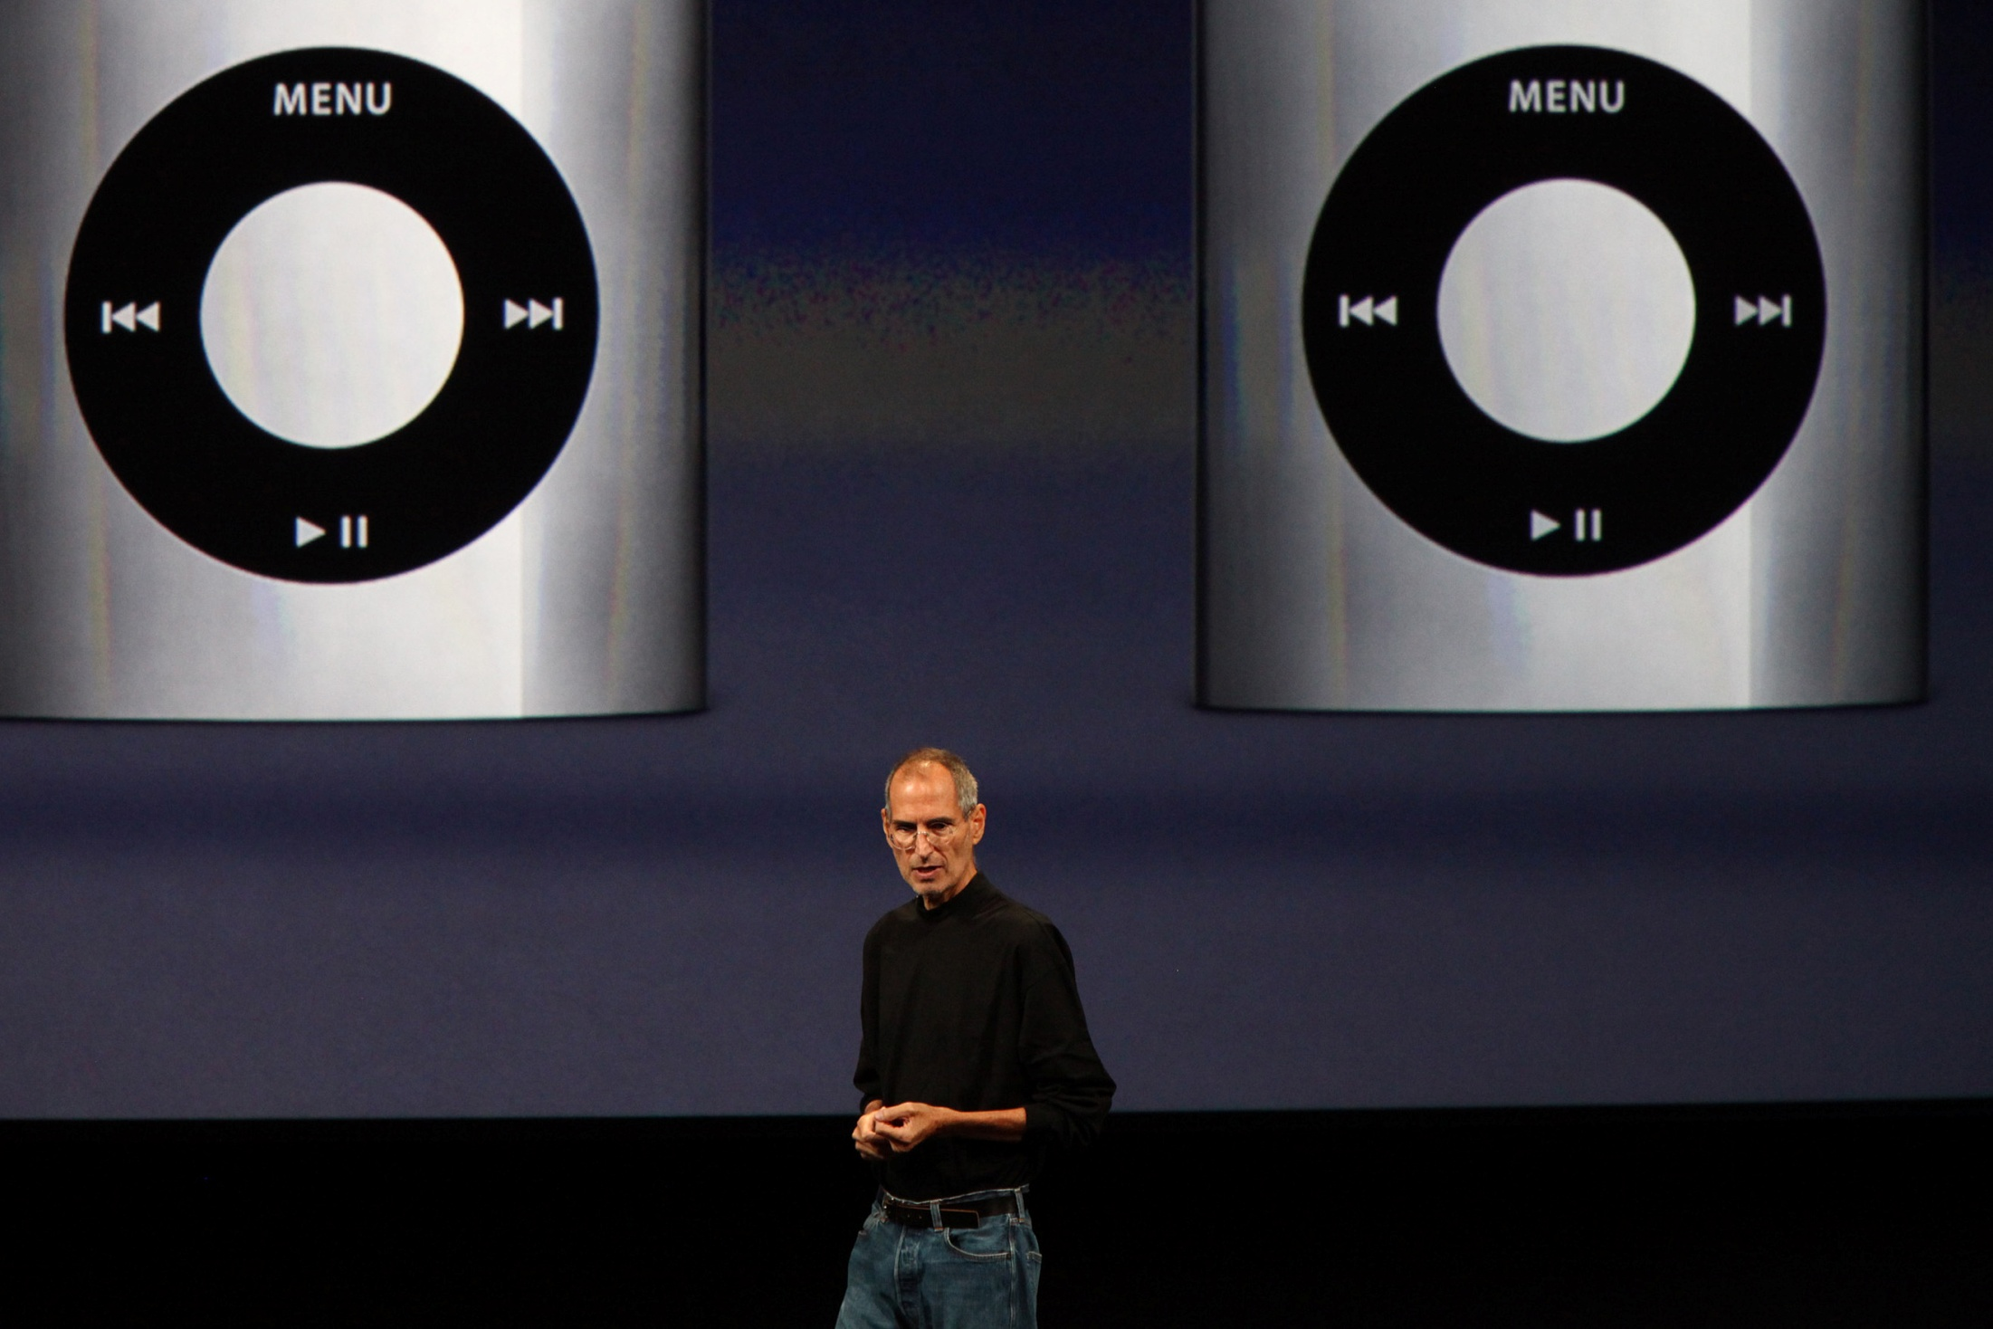
“Presentation is the ‘Killer Skill’ we take into the real world. It’s almost an unfair advantage.”
Ethan Rasiel & Paul N. Friga, ‘The McKinsey Mind’
Notes:
McKinsey – very successful strategic consulting firm worldwide
Soft skill - can open doors for you.
Hard skills = language, technology.
How you use them = soft skills part
Persuading others is a great advantage – Interviews, selling your ideas/business, get grant funding.
Engage your audience without them becoming distracted

Slide 4
What makes a good/bad presentation? Think of ones you’ve been to/watched.
Notes:
Breakout - I person to feed back to the rest of the group
Smiling,
Varying tone
Showing enthusiasm
Engaging with audience
Confidence
Passion
Knowing what to say

Slide 5
Steps in Giving Presentation
Plan
2. Prepare
3. Practice
4. Present
Notes:
How to get to giving effective presentations. Remember the 4 steps. Importance of a process (4 steps)

Slide 6
The first time you present your research should not be at the mid-stage or viva interview!
Image sourced: Creative Commons

Slide 7
Opportunities to present your research
Conference (School or department, or other)
Seminar (to peers and/or staff in your School)
3MT Competition – Your thesis in 3 minutes – see examples on YouTube
https://www.ul.ie/research/doctoral-college/events/iua-national-3-minute-thesis-final-2024
See Irish Universities Association: https://www.iua.ie

Slide 8
1. Planning

Slide 9
Ask yourself
Who is your audience?
Why are they there?
What is your goal?
How long will it be?
Where/how will it take place?
Notes:
Before you even open up PowerPoint
What is the real purpose of your talk?
What is going to make your presentation of these ideas different from reading an article or handout you could produce?
What makes a presentation more than simply a transfer of information?
How long – sticking to time frame shows you can condense/present your ides in a concise timeframe. You could also be penalised

Slide 10
3 things
If your audience could remember only three
things about your presentation, what would
you want it to be?
(1)_____________
(2)_____________
(3)_____________
Notes:
Could be a conference with lots of presentations – how will yours stand out?

Slide 11
Key message
Intro
Main points
Conclusions
Summary and wrap up

Slide 12
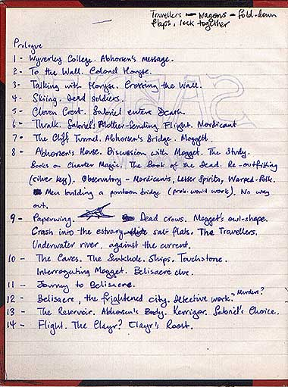
Start with your Outline
No Powerpoint initially
Pencil & Paper/computer
Order your thoughts
Key points
What are you not discussing?
Notes:
What are the key points – you can build content once you have these
Logical Flow
Not discussing – whole of research or just a segment?

Slide 13
Structure
Have a sound, clear structure
Notes:
Outline first – then structure

Slide 14
Structure
Introduction
Get Attention
Main theme
Content
Summary/
Conclusions
Key message
Notes:
Facts in logical order
Re-state your main points
people remember most the last thing that they are told. So the ending of the presentation is key.
End on a light/funny note – image or clip – opening up for questions
Or could simply recap on the three main concepts that you have put forward in the middle section.

Slide 15
Strong Start - Create interest
“We need to open gaps before we close them. Our tendency is to tell people the facts. First, though, they must realize that they need these facts.”
Dan & Chip Heath, Make it Stick
Notes:
Why is it important? Link audience to their interests and lives.

Slide 16
Elevator Pitch
Notes:
Business Card test – can you write what you presentation is about – the main takeaway points, on the back of a business card?
"sell" your message in 30-45 seconds.
Similar to 3MT - These processes helpful in your thesis – can help highlight to you what the key points of your thesis are, elements that might emerge as superfluous when forced to really analyse what your research is ‘about;.
This too is certainly something you do before you ever begin to open up PowerPoint (Keynote).

Slide 17
Elevator Pitch
30 – 45 seconds – your research
Language – concise, engaging
Body language/ voice
Feedback – constructive/ask a question
1 person to be timekeeper/feedback to the rest of the group
Notes:
Safe environment. Gain peer feedback. Not concerned about content – skills.
Groups of 5. Online breakout groups.
5 minutes to discuss difficulties.
5 minutes to write.
Take in turns to deliver.
Feedback – limit to 1 minute.
Needs 25 mins for this exercise.

Slide 18
Mid Stage Confirmation and Viva
Who (if relevant) is your research about? E.g. a group of people, individuals etc
What is your research about?
Where? Is there a context for your research, a place, a setting? E.g. a country, a classroom, an online community
When? Is there a timeframe relevant to your research?
Why? WHY IS THIS IMPORTANT – this is your hook
Who else has looked at this and HOW?

Slide 19
Example
My PhD (2022)
Who? Part-time PhD researchers (completed)
What? PhD: stages from start to completion
Where? Universities in Ireland
When? Preferably recent PhD completers (p/t)
Why? 75% increase p/t PhD enrolments since 2009 (Ireland) HEA stats. ‘Invisible’ in Policy and practice (Neumann & Rodwell, 2009)
How? Narrative analysis – stories from p/t PhD completers – HEIs Ireland – to inform policy/practice

Slide 20
2. Preparation

Slide 21
A few guidelines

Slide 22
Information
Drip feed
Most important information Jumps Out
Don’t use sentences

Slide 23
Colour
Use colour well
Notes:
Pick 3 colours and stick to them.
Color evokes feelings. Color is emotional. The right color can help persuade and motivate. Studies show that color usage can increase interest and improve learning comprehension and retention. presenting in a dark room (such as a large hall), then a dark background (dark blue, grey, etc.) with white or light text will work fine.
plan to keep most of the lights on (which is highly advisable) then a white background with black or dark text works much better.

Slide 24
High quality images
Use images to support your points
Use a consistent theme
This Photo by Unknown Author is licensed under CC BY-SA-NC
https://www.istockphoto.com/illustrations/history
Notes:
But only that push you toward your goal
Free Stock Photos
http://www.sxc.hu/
Commercial Stock Photos
www.istockphoto.com

Slide 25
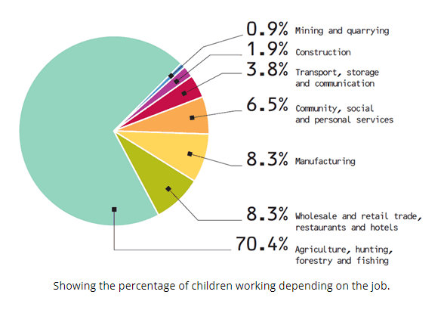
Graphs/figures
Appropriate type
Easy to follow –clearly labelled
Use colour effectively
https://childlaborindustrialrevolutionn.weebly.com/jobs-for-children-during-industrial-revolution.html

Slide 26
How to make a point?
Notes:
Following three slides – what is best way to present my main point
Main point – 51 per cent of college students drop out because of a lack of effective supports

Slide 27
College attrition causes
“Overall, our findings provide a combined retention rate of 92.40 % for students who attended TCD. This is very close to the previous year’s rate of 92.45%. It should be noted that these results should be interpreted on a tentative basis as it is clear that a number of other outside factors impact on a student’s ability to sustain and progress in their chosen area of study at third level.”
16,000+ students come to Trinity every year
There are 3 Faculties
Morgan 2001 A study of non-completion in undergraduate University courses
The average non-completion rate across Irish Universities is 16.8%
Improve all students chances of achieving their maximum potential
Connect with students – building relationships, departmental receptions
51% of college students leave college because of lack of effective supports

Slide 29
Notes:
This slide but talk through a lot of the info from the first slide

Slide 30
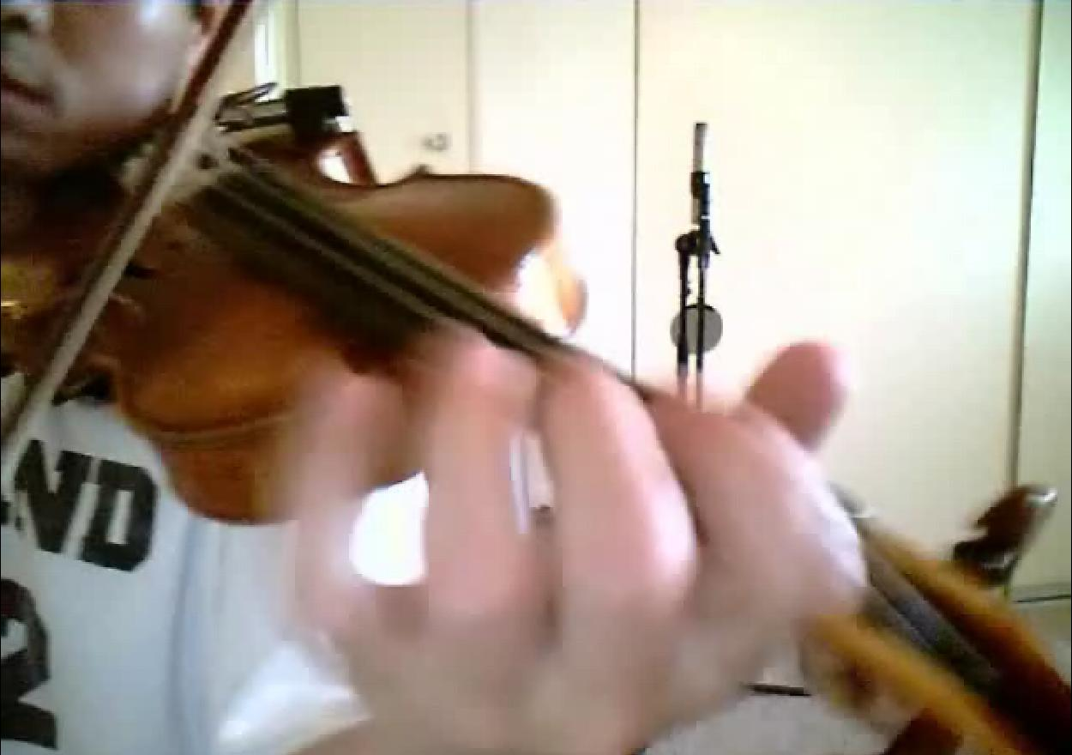
3. Practice
Notes:
According to most studies, people's number one fear is public speaking. Number two is death. Death is number two.

Slide 31
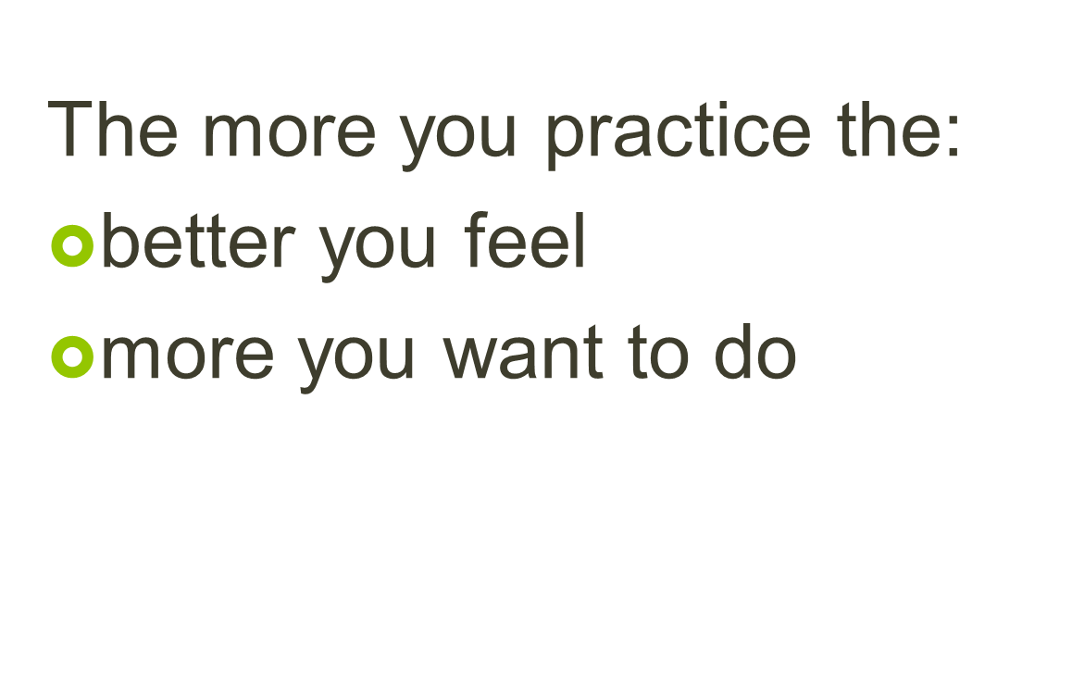

Slide 32
Practice
Standing up
In front of a mirror
Out loud
Time yourself
Video yourself
Review
Redo, redo, redo…
Notes:
Gets better the more you do it
Participate as much as you can in lectures, tutorials, groups etc –
Record your self and review to see how you can improve

Slide 33
Becoming Confident
Be over-prepared
Rehearse and practice
Know your subject
Use relaxation techniques
Be positive +++
Avoid stressors
Notes:
Practice in actual room – full simulation
Prepare for audience questions
Mindfulness

Slide 34
It’s not about you
Focus on your goal
what you are going to say
Audience
Make them comfortable
Interesting
Notes:
Not about you
Control your body: (breathings, palms, water)
Focus on:
Message
Making audience comfortable

Slide 35
4. Presenting
Notes:
Your are the most powerful visual aid:
Introduce:
What you’re going to tell them
Why you’re telling them
Why it’s important
Body language
Eye Contact
Disruptions – an effective way is simply to stop talking and look at the person talking (difficult to do at first but then becomes easy)

Slide 36
The most powerful visual aid is YOU!
Words
Voice – very important
Body language – power stance
Notes:
You are the most powerful visual aid for what you are trying to express
Style – 7 % words / body language / intonation
Natural & Seem comfortable
Pacing
Pausing

Slide 37
Research Presentations
https://www.youtube.com/watch?v=_uNCp82wrxM
Notes:
Oladapo Ogunbodede, 3MT 2020 People's Choice Award Winner
Deep breath
Speaking slowly – slow down!
gestures

Slide 38
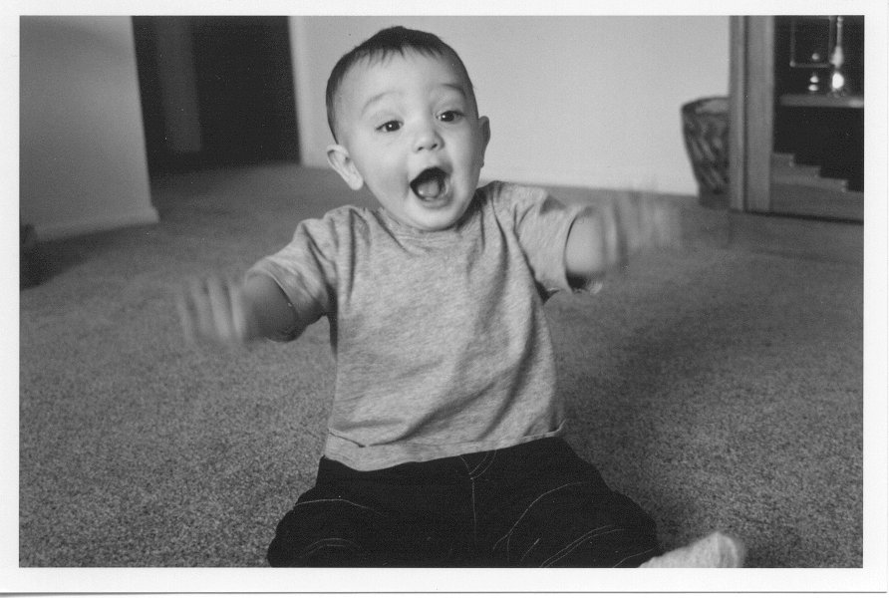
Show your passion
Notes:
Let your enthusiasm come out
Biggest element that separates mediocre presenters from world class ones is the ability to connect with audience in honest and exciting way.
Movement – hand gestures, intonation

Slide 39
Notes:
Get closer to your audience by moving away from or in front of the podium. The podium is a barrier between you and the audience, but the goal of our presentation is to connect with the audience. Removing physical barriers between you and the audience will help you build rapport and make a connection.
Don’t talk & move
Don’t talk over a video

Slide 40
Eye contact
Notes:
Make eye contact
Don’t look at group
Pick out people in the audience as anchors
Experienced teachers will often look at their students' eyes to gain their attention, judge their level of interest and to see how well they understand the material being taught. Eye contact is such a powerful tool that teachers can make an individual connection with every student through its use.

Slide 41
Smile!
Notes:
It might be the last thing you feel like doing – give you confidence, help draw audience in

Slide 42
Dealing with Questions
Think of how you handle each of the following:
Good questions.
Difficult questions
Irrelevant questions
Is there anything you don’t want to be asked?
Notes:
Prepare for any sticky/controversial points
Areas you are not yet expert in and are worried about being asked about

Slide 43
Dealing with Questions
TRACT technique
Thank the questioner
Repeat the question
Answer the question
Check with the questioner if they are satisfied
Thank them again
Notes:
Make sure you tell the audience that you will be taking questions at the end of your presentation.
It’s ok to ask to repeat and rephrase
Ok to ask whether you answered question
Ok to say its not something you’ve thought about but you will
How to deal with ‘not a question, just an observation’.

Slide 44
Think of presentations you have given. What do you think you did well? What do you think you could improve? What can you do to improve?

Slide 45
Remember the 4Ps of Presenting!
Plan
2. Prepare
3. Practice
4. Present
Notes:
Importance of a process (4 steps)

Slide 46
Further information
https://www.tcd.ie/sld/

Slide 47
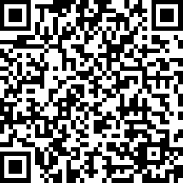
Feedback form
Please complete the form. Thank you
PGSS - Workshop Feedback Survey

Slide 48
Feedback form
Please complete the form. Thank you

Slide 49
Workshop feedback
Please complete. Thank you
PGSS - Workshop Feedback Survey

