Slide 1

Fáilte/Welcome!
BESS Orientation meeting
18 September 2025 Ed Burke Theatre
Asst. Prof. Dr Gorkem Aksaray and Michael Wycherley
  Academic Directors BESS programme

Slide 2
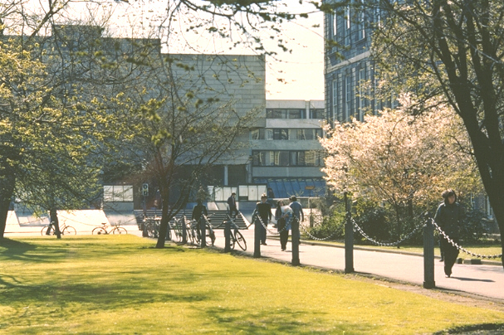
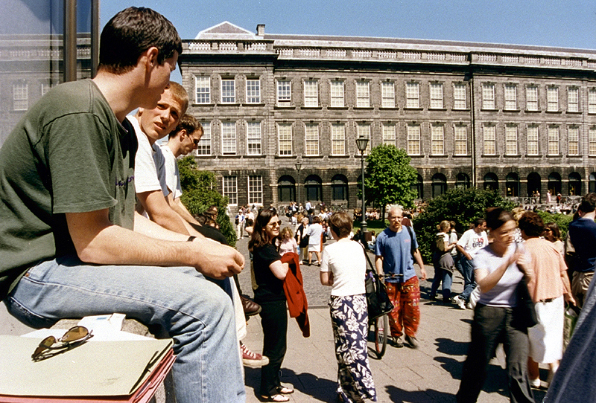


Trinity College… Founded in 1592
A University of Global Consequence
Leading Irish Research University
Global Recognition
Ranked 1st in Ireland and 101st in the World
(QS World University Ranking)
Notes:
Trinity College Dublin was created by royal charter in 1592
The leading Irish research university
Global recognition
Ranked 1st in Ireland and 129th in the World (QS 2014 71st in world and 25th in Europe)
A community of Scholars
Nobel prize winners
Beckett, Shaw, Walton
For the purpose of compiling the rankings, 5,100 academics from around the world were surveyed concerning the research quality of the university and their views accounted for 40% of the score. In addition, 1,480 international employers in a recruiter review were surveyed concerning their views on graduate employability which accounted for 10%. The other half of the marks was made up of teaching quality which was measured by staff: student ratio (20%), a further 20% was allocated to research quality which was gauged by the university’s citations of major papers. The international outlook was also measured by international faculty staff (5%) and international students (5%). Trinity College scored highly in all of these categories.

Slide 3

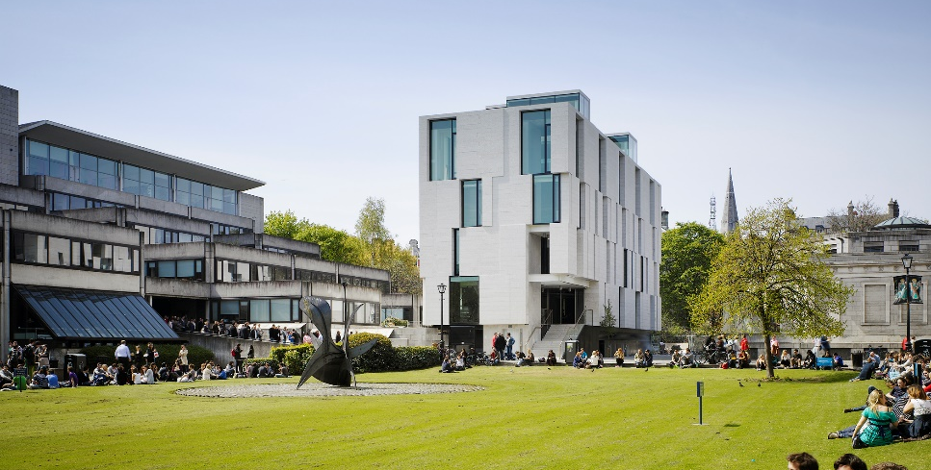
BESS – Business, Economic and Social Studies
One programme crossing two schools
Trinity Business School
School of Social Sciences and Philosophy
Notes:
Strong international research reputation
Excellent links to Irish and global organisations in the private, public and voluntary sector
Active alumni: Trinity Business Alumni
Range of Undergraduate programmes: BESS/BBS, Business & Language, Computer Science & Business, Law & Business
Gain an understanding of the role of management and organisation in society and knowledge of:
marketing, finance, accounting, entrepreneurship, strategy, human resources, innovation, operations, information systems and many more.
Comprises the Departments of Economics, Philosophy, Political Science and Sociology
The School is at the forefront of teaching and research in Ireland across its four Disciplines

Slide 4
What do you study in BESS?
Business
Sociology
Political Science
Economics
The BESS approach
Notes:
BUSINESS
Learn more about the world of business and management and study subjects such as
marketing, finance, accounting, entrepreneurship, strategy, human resources, innovation, operations, information systems and many more.
ECONOMICS
Develops the concepts and tools to understand:
How to limit / prevent unemployment
How to regulate financial markets
How to control the market power of large firms
How best to address climate change
How to help poorer countries grow and develop
POLITICAL SCIENCE
Students will learn about
How democracy works
How people vote
How political parties compete
How European integration works
The values behind political ideologies
SOCIOLOGY
Understand phenomena such as
Social change and how it affects your own life and that of others
Shared practices of behaviour
Social movements like fair trade or feminism
Structures of Inequality in society along lines of social class, gender, ethnicity or race
The nature and meaning of work
How do to social research

Slide 5
What you will study
Overview
1st Year
(Junior
Fresh)
2nd Year
(Senior
Fresh)
3rd Year
(Junior
Sophister)
4th Year
(Senior Sophister)
60 ECTS
60 ECTS
60 ECTS
60 ECTS
Introduction to
all four disciplines
Key foundational skills of your chosen discipline(s)
Specialisation allowing to choose areas of interest within 2nd year discipline(s)
Opportunity to study abroad
Specialisation in your chosen discipline(s)
Capstone project

Slide 6
Manifold exit routes
22 possible degrees
Major/Minor Degrees
Major Sociology/
Minor Political Science
Major Business/
Minor Economics
Major Business/
Minor Political Science
Major Economics/Minor Business
Major Economics/Minor Political Science
Major Sociology/
Minor Business
Major Economics/Minor Sociology
Major Political Science/
Minor Economics
Major Political Science/ Minor Business
Major Political Science/ Minor Sociology
Major Sociology/
Minor Economics
Major Business/
Minor Sociology
Joint Honor Degrees
Business and Economics
Business and Political Science
Sociology and Business
Economics and Political Science
Economics and Sociology
Political Science and Sociology
Single Honor Degrees
Economics
Political Science
Business
Sociology
Notes:
4 + 12 + 6 = 22 possible exit routes

Slide 7
Pathway Structure
JF
Common entry (50 core + 10 DOM)
Single Honors
(40 + 20 DOM/TE)
Major / Minor
(40/20)
Joint Honors
(20/20 + 20 DOM/TE)
Three Strand
(20/20/20)
SF
SF pathway
track choices
Single Honors
(50 + 10 DOM)
Major / Minor
(40/20 – OPTION A)
(30/30 – OPTION B)
Joint Honors
(30/30)
JS
JS final degree
pathway choices
Single Honors
(40 + 20 CS)
Major / Minor
(20/20+20 CS - OPTION A)
(40 + 20 CS - OPTION B)
Joint Honors
(20/20 + 20 CS)
DOM – Designated Open Module
TE – Trinity Elective
CS – Capstone Project
SS
SS degree
Notes:
Major / Minor (40 + 20) ➔ dropped one subject at the end of 3rd year
4 Single honors
12 Major / Min (2 x 4*3 / 2)
6 Joint Honors (4*3 / 2)
= 22 possible degree pathways

Slide 8
1st Year
(Junior
Fresh)
2nd Year
(Senior
Fresh)
3rd Year
(Junior
Sophister)
4th Year
(Senior Sophister)
  Fundamentals of Management and Organisation 10 ECTS
  Introduction to Economics (A & B) 10 ECTS
  Introduction to Political Science (A & B) 10 ECTS
  Introduction to Sociology (1 & 2) 10 ECTS
  Mathematics and Statistics (A & B) 10 ECTS
  10 further credits of your choice 10 ECTS
  (Language, Law or Social Policy)
60 ECTS

Slide 9
1st Year
(Junior
Fresh)
2nd Year
(Senior
Fresh)
3rd Year
(Junior
Sophister)
4th Year
(Senior Sophister)
On track to
You choose your degree subject(s) & pathway
60 ECTS: 20 / 20 / 20 three subjects
60 ECTS: 40 / 20 two subjects
60 ECTS: 20 / 20 / 20 two subjects + DOM/TE
60 ECTS: 40 / 20 one subject + DOM/TE
Designated Open modules (DOM). Modules from within the four BESS disciplines (5 or 10 ECTS).
Trinity Electives (TE). Stand-alone 5 ECTS modules outside core BESS.
Joint H.
Maj/Min
Single H.
Notes:
Language module possible:
S1 20 + S2 20 + 20 OM/TE (third column)
S1 40 + 20 OM/TE (first column)
Designed Open Modules are modules from within the four disciplines that are complementary and related to your own programme of study. Open Modules will provide you with a wealth of opportunities to enrich the study of your core curriculum and to develop the Trinity Graduate Attributes.
Important Quick Facts about Open Modules
Open Modules are taken in combination with Trinity Electives. For more information on Trinity Electives, see www.tcd.ie/trinity-electives.
Open Modules are weighted at either 5 or 10 ECTS (credits); 5 credit modules are taught and assessed within one semester; 10 credit modules may be taught and assessed over one or two semesters. (The modules you take as part of your programme are worth either 5 or 10 credits and you must take 60 credits per year.)
The number of Open Modules you may take varies according to your programme. If you are on a Single Honors or Joint Honors programme (listed below) and opt to take Open Modules and Trinity Electives in your SF year (20 credits in total), you will take either 10 or 15 credits of Open Modules depending on whether you take one or two Trinity Electives (weighted at 5 credits each).
Open Modules will be selected as part of the online enrolment process after the 1st Year end of year assessement results have been published at the end of May.
Allocation will be on a first come, first served basis and places are subject to availability.
Additional information on Open Modules may be found at www.tcd.ie/courses/undergraduate/your-trinity-pathways and www.tcd.ie/courses/undergraduate/your-trinity-education.
Trinity Electives
https://www.tcd.ie/trinity-electives/apply/
You can only choose ONE elective per semester.
For any students eligible to take Trinity Electives, a maximum of two may be taken, one per semester.

Slide 10
1st Year
(Junior
Fresh)
2nd Year
(Senior
Fresh)
3rd Year
(Junior
Sophister)
4th Year
(Senior Sophister)
Be mindful of
mandatory modules for specific degree pathways (see BESS handbook)
prerequisites for 3rd/4th year subjects (see BESS handbook) and their implications for your pathway opportunities
Examination for Foundation Scholarship (early January of SF year) – most prestigious undergraduate award in the country.
Study abroad prep: Application process for going abroad in the 3rd year.
See BESS Handbook for details on pathways, modules and prerequisites!

Slide 11
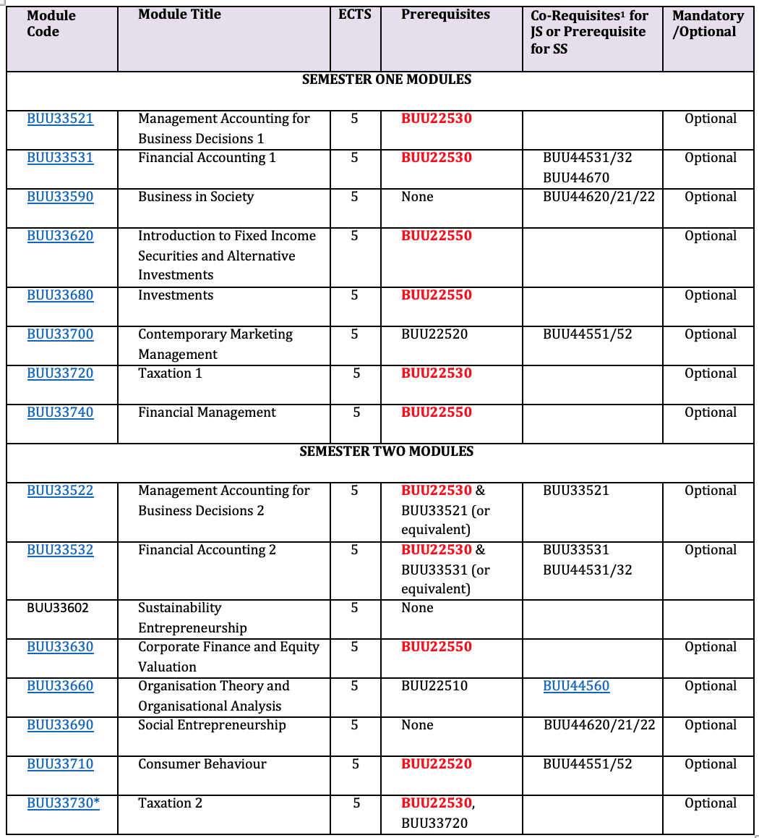
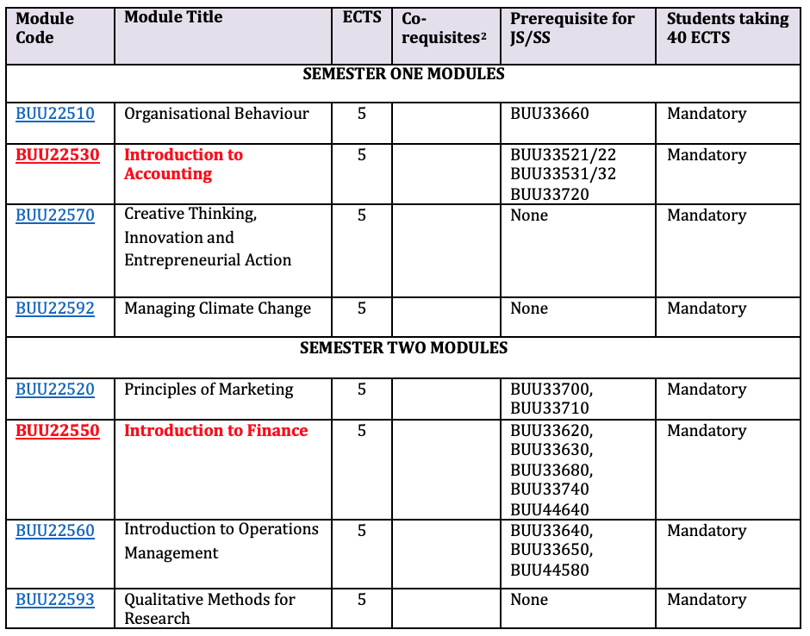
Example
Junior Sophister (3rd year) Modules
Important prereqs in Business
Senior Fresh (2nd year) Modules
Notes:
Implication: Without having heard Accounting or Finance in 2nd year,

Slide 12
1st Year
(Junior
Fresh)
2nd Year
(Senior
Fresh)
3rd Year
(Junior
Sophister)
4th Year
(Senior Sophister)
Confirm degree pathway and choose which areas to study within your chosen discipline(s)
Opportunity to study abroad – in Europe and the World – in 3rd year.
Capstone project (20 ECTS) undertaken in all 4th years.
See BESS handbook for full details.
Notes:
Access Trinity Electives (10 ECTS) in 3rd year under single honor degree
Capstone project (20 ECTS) undertaken in all 4th years. Choice of which discipline to do it in for a joint degree.
Major / minor
Capstone in major
S1 40 + Capstone 20 -> 60 and 1 subject only, e.g.
Major Sociology minor business: 60 ECTS from sociology including the capstone + 40 optionals
See BESS handbook for full details.

Slide 13
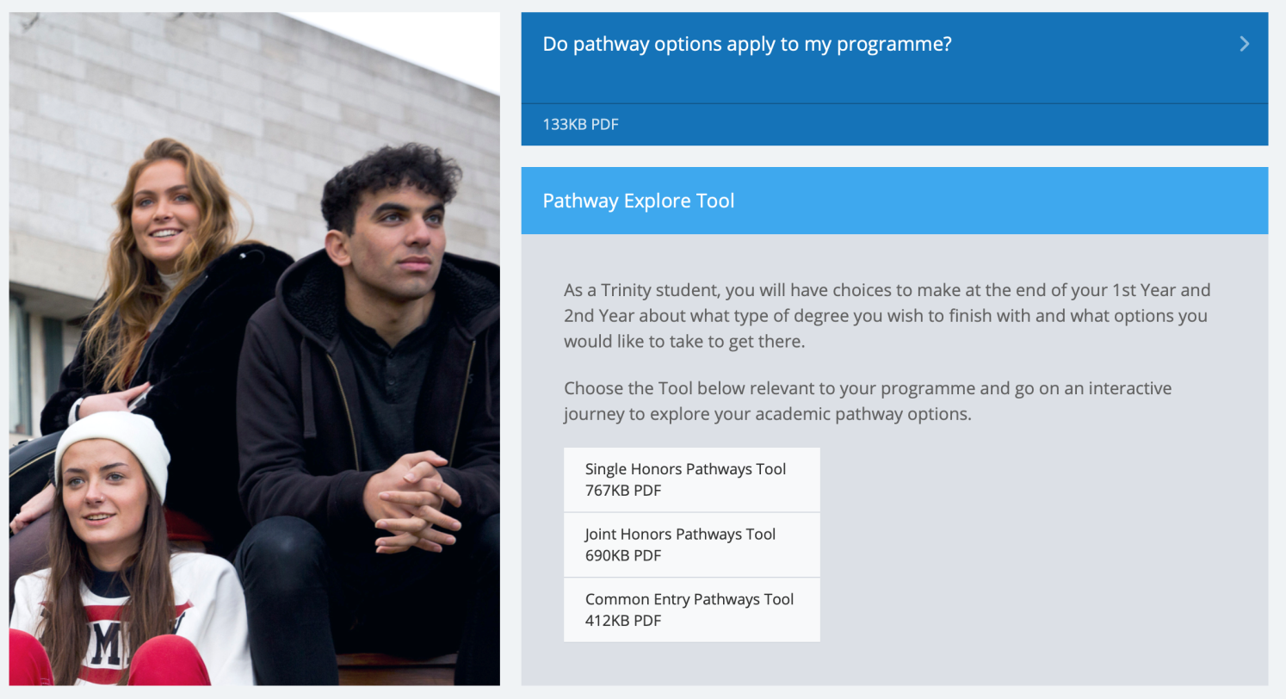
Pathway Explore Tool
https://www.tcd.ie/courses/undergraduate/your-trinity-pathways/

Slide 14
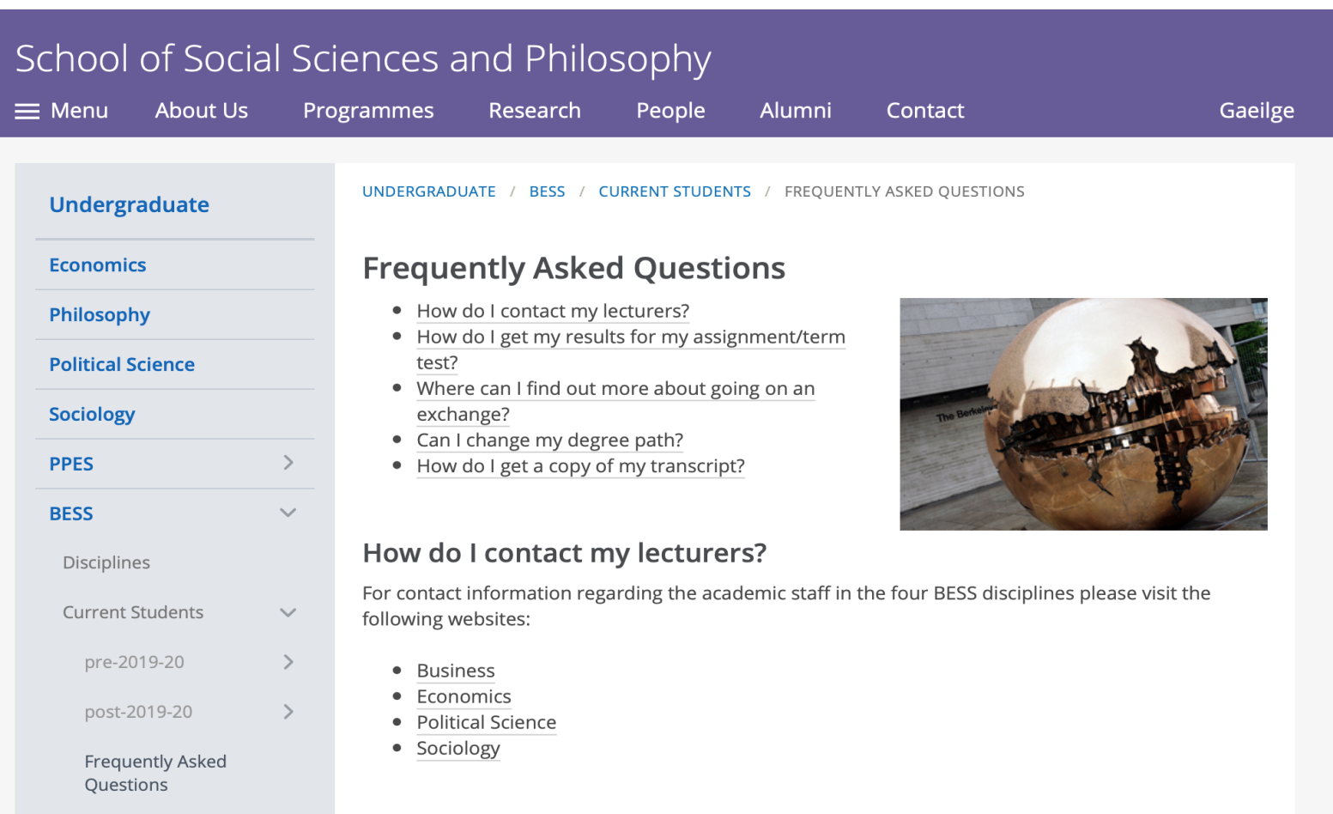
Frequently Asked Questions
https://www.tcd.ie/ssp/undergraduate/bess/current/faq/

Slide 15
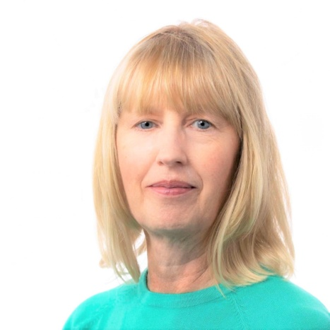

BESS Programme Administration
Administrator: Martina Ní Chochláin
Email: bess@tcd.ie (giving your student number)
  Don’t be a stranger! Available every day via Teams & Email.
  Available in person/telephone Mons & Wed
Office: Room 3023, Level 3, Arts Building
Martina Ní Chochláin
Annual/Re-assessment Progression & Publication of Results Mark Changes Timetabling Course Regulations | Management of Course Handbook/Web Site Student Cases General Course Queries – If I can’t help you personally, I’ll know someone who can!

Slide 16

We are here to help!
BESS website www.tcd.ie/bess
BESS Handbook
BESS Administration and Directors
Your Module Lecturers
Module Teaching Assistants
Your College Tutor
Student Learning Development
Mathematics Help Room https://maths.tcd.ie/outreach/helproom/
Notes:
Student Learning Development supports Trinity students reach their academic potential. We offer a range of services including individual appointments, workshops and skills events.
Mathematics Help Room -> school of math
https://maths.tcd.ie/outreach/helproom/

Slide 17
Important BESS Rules (1)
Attend your lectures and tutorials!
Lectures and tutorials are compulsory!
Students with significant level of absenteeism can be deemed non-satisfactory (“NS”) and prevented from sitting final examinations!
Some tests may take place during Michaelmas and Hilary Terms
(e.g. in modules with continuous assessment).
Lecture, test and exam scheduling is done by central College and students are generally informed at the same time as academic staff
Notes:
Students with significant level of absenteeism can be deemed non-satisfactory (“NS”) and prevented from sitting final examinations

Slide 18
Attend your lectures and classes
“Expected” grade=> | I | II.1 | II.2 | III/Fail | Total
Virtually all (> 90%) | 43% | 49% | 29% | 14% | 30%
Most (> 66% but < 90%) | 43% | 35% | 46% | 42% | 40%
Around half (> 33% but < 66%) | 14% | 14% | 21% | 32% | 24%
Not many (> 10% but < 33%) | 0% | 3% | 1% | 6% | 3%
Hardly any (< 10%) | 0% | 0% | 1% | 0% | 1%
Total | 100% | 100% | 100% | 100% | 100%

Slide 19
Important BESS Rules (2)
Keep updated and communicate properly
Check your college emails daily!
Only use your official college email address (…@tcd.ie)
You cannot expect responses to private email accounts!
Be polite and respectful when writing emails to college staff
Write concise emails that state clearly your concern
Always provide your course and student ID in emails!

Slide 20
Important BESS Rules (3)
What to do if …
… you are ill for tests and/or examinations?
Absences are excused only with a medical certificate or equivalent (communicate with/via your College Tutor), need to do this immediately.
Absence is not the same as getting zero. If you fail to turn up to an exam you need to explain it formally to the college through your tutor.
The assumption is that if you sit an exam then you were healthy. Typically it is not possible to claim illness after an exam.

Slide 21
Important BESS Rules (4)
What to do if …
… you are unable to submit an assignment on schedule?
Contact your tutor and the lecturer concerned, preferably before the deadline.
… you are unable to attend a mandatory class?
Contact your tutor and the lecturer concerned, preferably before the class is taking place.

Slide 22
Next week
Two hours of lectures in each of the modules.
In the first lecture the requirements and rules of the module will be explained, so make sure you attend.
Usually, no seminars or tutorials in week 1 (but check module descriptions)
  Seminar/tutorial groups assigned via SITS.
  Only in exceptional cases, you can request a change of tutorial group by contacting the relevant departmental office (not the Course Office).

Slide 23
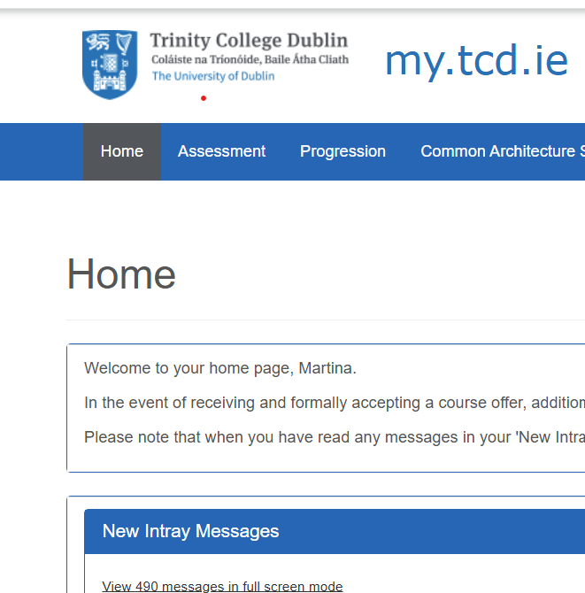
Your college timetable
Your lectures and tutorials/seminars will be available on my.tcd.ie
Along with your module choices, it also contains information on where the lectures and seminars will take place
It may include optional courses that are available on learning about plagiarism and academic integrity; navigating the library; engaging with student development
Notes:
Please ensure today that you are registered for 60 ECTs for year 1 of your degree.
Ensure you are registered for relevant tutorials or seminars for each module that are enrolled in.

Slide 24
Soon / near future
Get in contact with your College Tutor.
Get in contact with Student 2 Student (S2S).
Maintain steady progress with your modules.
Check your college email regularly (communication from the Course Office will be via your TCD email address only).
Get to know your classmates.
Be inclusive and have different friends.

Slide 25
Making your voices heard
BESS: student representative on the programme committee.
Students’ Union: class reps who meet with individual Department Heads on a regular basis.
Module evaluations by students: at the end of Hilary and Michaelmas terms. (http://www.tcd.ie/ssp/undergraduate/student-evaluations/YouSaid_WeDid.php)
Each year is invited to partake in a Course Evaluation Survey.
Problems with a module? – in general, if possible bring it up with the module lecturer in the first instance.
Individual/personal problems? – discuss with your College Tutor and there’s also the counselling service and peer-support offered by Student 2 Student (S2S).

Slide 26

The Trinity Experience
https://www.tcd.ie/students/clubs-societies/
Wider student life is important, and BESS provides plenty of scope for engagement in a wide range of activities.
50 sports clubs, 120 societies.
Some societies seem particularly suited to
BESS Students
DUBES – Dublin University Business & Economic Society | Political Science Society | Social Studies Society
AIESEC | Foresight | Enterprise Trinity
Upstart | Mature Students Society
Notes:
HOW MANY SOCIETIES
Foresight: business school: forum to meet businessmen
Enterprise: supports start ups
Upstart: entrepeneurs

Slide 27
And Finally….
Enjoy your studies on the BESS Programme at Trinity College Dublin!
Asst. Prof. Dr Michael Wycherley & Gorkem Aksaray
Academic Director BESS programme

