Slide 1

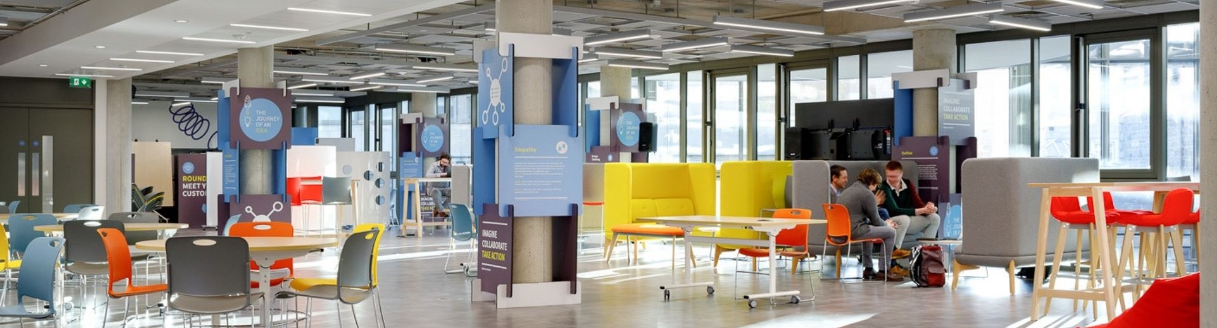







Main Space Screen
Guidelines & Template

Slide 2
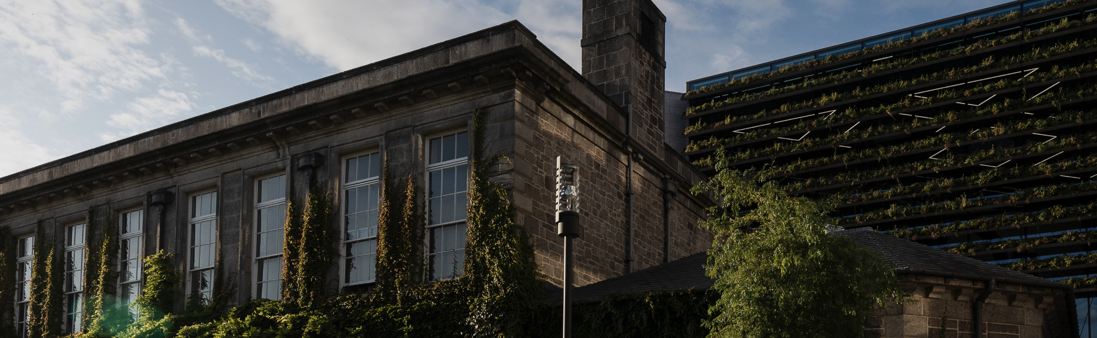
Agenda
1. Slide Size
2. Customising Your Slide
3. Examples
4. Template

Slide 3
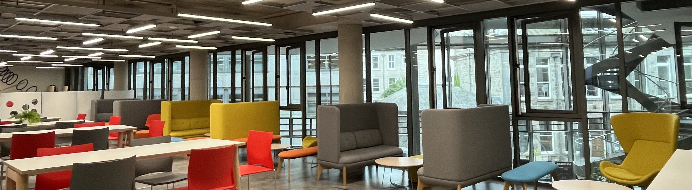
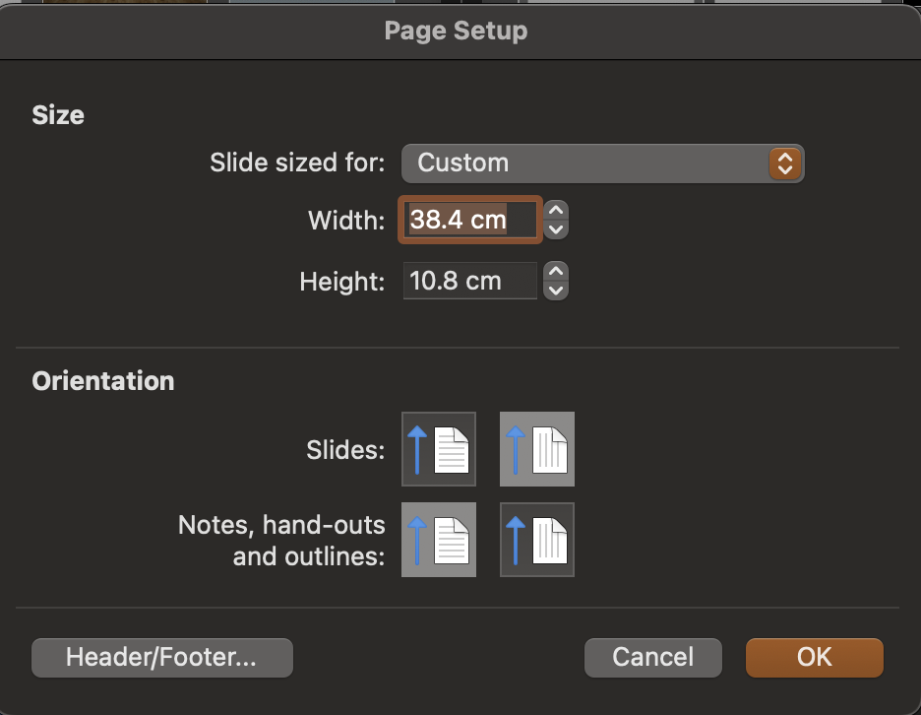
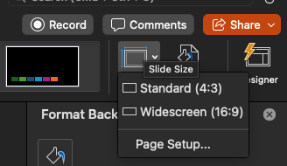
Slide Size
This template uses a custom slide format:
38.4 (width) × 10.8 cm (height)
To check or edit: Design → Slide Size → Page Setup.. → Custom Slide Size
4
1
2
3

Slide 4
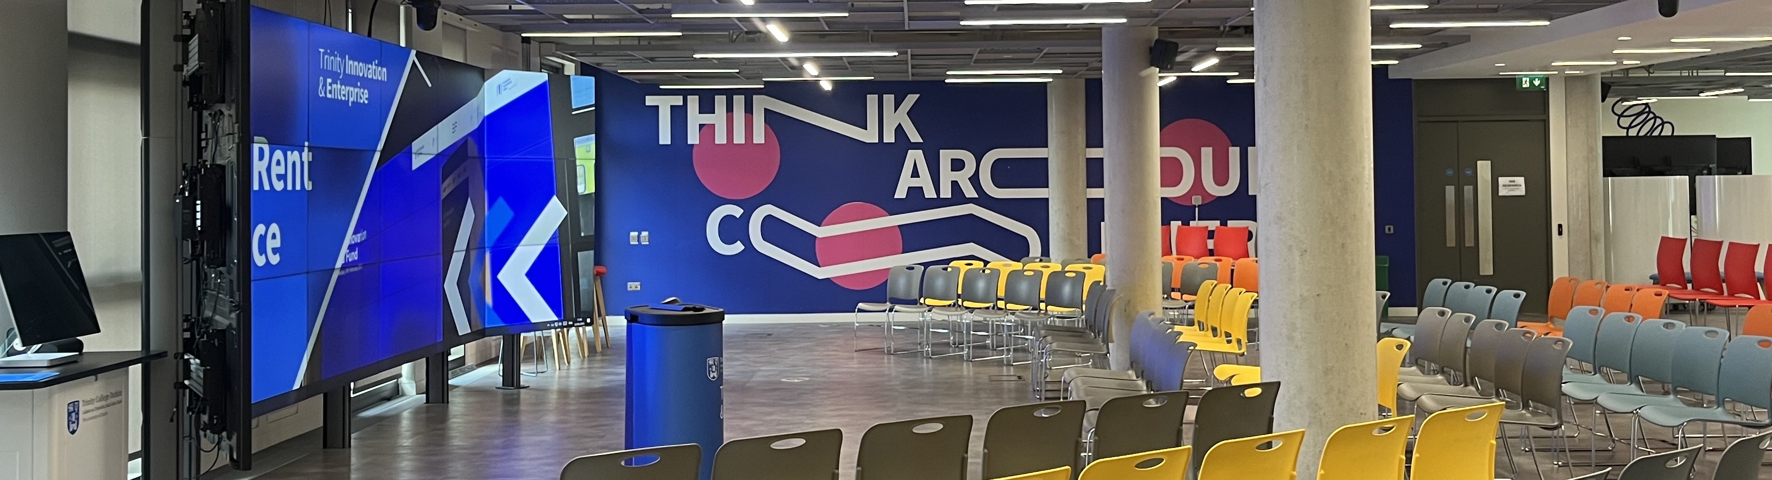
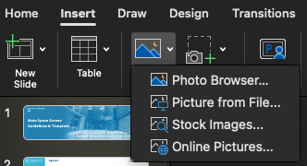
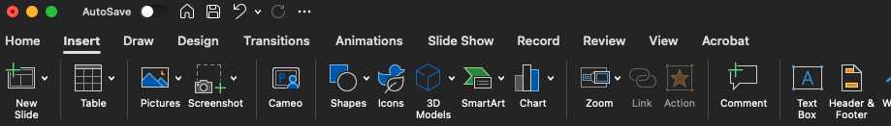
To add an Image:
→ Insert → Pictures → Choose from your device or online.
→ Resize and position it within the panel.
1
Customising Your Slide
The provided template is intentionally left blank, it’s your space to fill in with content.
You’ll need to add text, images, icons or visuals depending on your message.
2
3
To add text:
Go to Insert → Text Box to place text wherever needed.
1
2

Slide 5
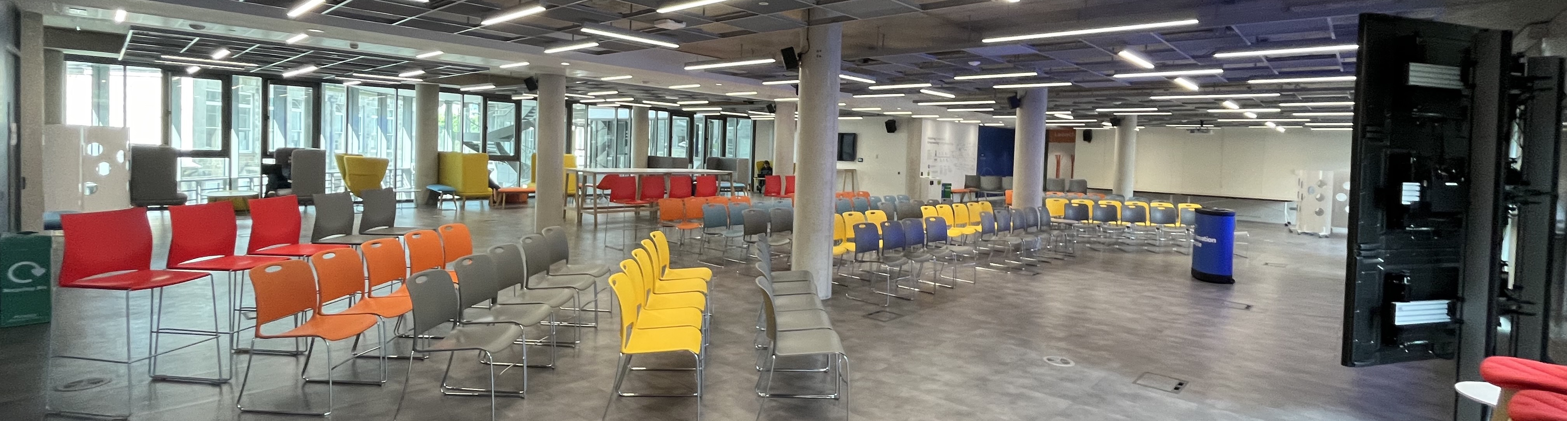
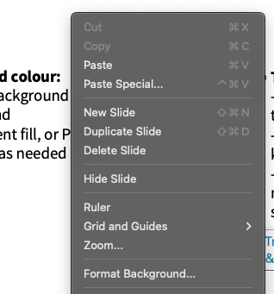
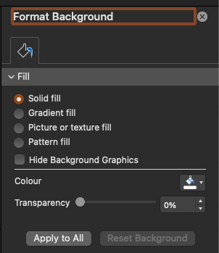
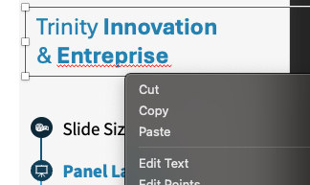
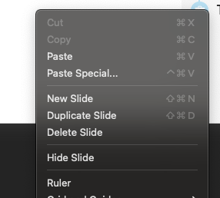

To change the background colour:
→ Right-click on the slide background
→ Select Format Background
→ Choose a Solid fill, Gradient fill, or Picture
→ Apply to one or all slides as needed
To delete an element:
→ Click on the text box, image, or shape you want to remove
→ Press Cut or Delete or Backspace on your keyboard
→ Make sure only the selected element is removed, not the slide itself, unless if you want to delete the slide
Customising Your Slide
3
1
2
1
2

Slide 6
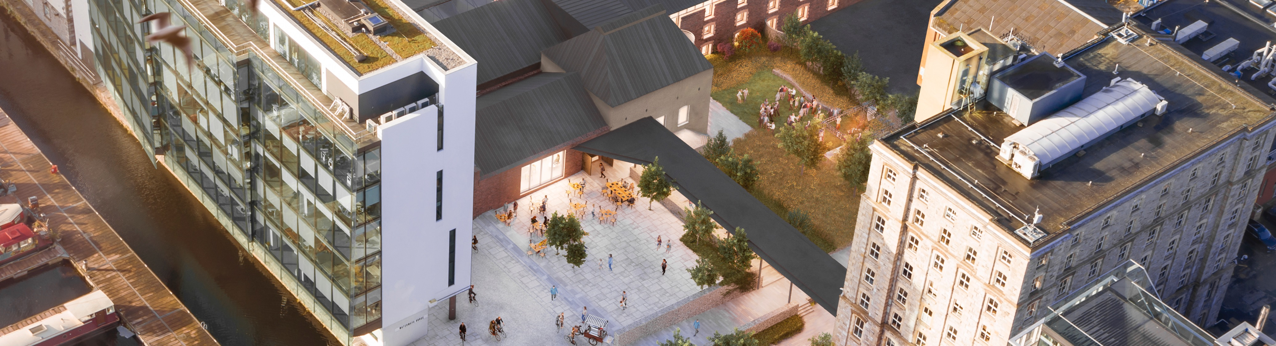
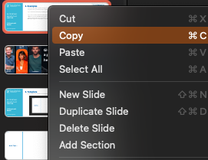
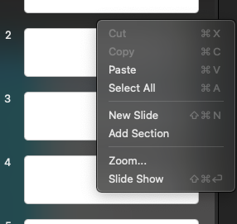
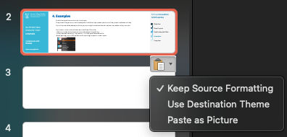
However if you want to move the slide to another PowerPoint file you need to:
→ Make sure the slide dimensions are the same in both files
→ Copy the desired slide,
→ Paste it into the new PowerPoint file
Don’t forget to select “Keep Source Formatting” when pasting, to preserve the layout.
The following slides are here to inspire you. They show how you can use the template for different purposes (welcome slide, panel conference slide).
If you like one of the example slides, you can duplicate it and replace the content with your own
Examples
1
2
3

Slide 7






School Of Design
School Of Design
Graduation 2025
It’s always a good idea to place your logo in one of the corners.
Don’t be afraid to go big — large text and images are often the most effective!
If speakers are seated or standing in front of the screen, make sure key content is placed towards the top to remain visible.
Always consider how your audience will view the slide during your presentation.
Join us in celebrating the creativity, passion, and innovation of this year’s graduates.
From first sketches to final projects, they’ve shaped the future of design — one idea at a time.

Slide 8
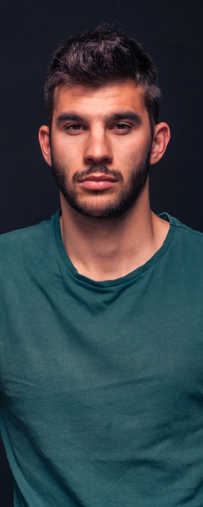



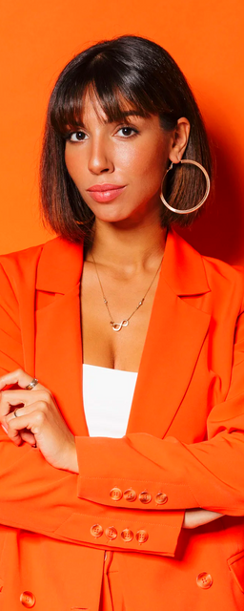



Hannah
Morales
Looking for an abstract background image?
Check out pexels.com — it’s free and copyright-safe.
Give your event a great title here!
Sponsored by.
Morgan
Maxwell
Studio
Shodwe
Warner & Spencer
Wardiere Inc.
Lars Peeters

Slide 9

Using a full-slide image? Make sure it’s sized exactly 70 cm × 19 cm for the best fit.
If it looks blurry on your screen, it will be blurry on the big screen too — always use a high-resolution image to keep your slide sharp and professional.

Slide 10
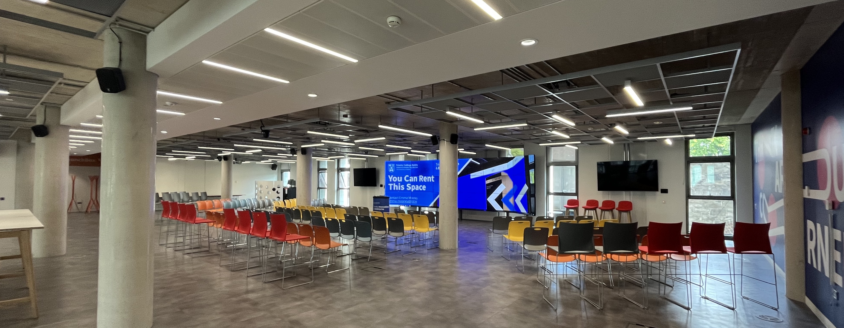

Template
Template

