Slide 1
Building Resilience into the Irish health system
  Steve Thomas
  Director and Associate Professor
  Centre for Health Policy and management

Slide 2
Recession Severity Index
2008-2009
Notes:
Note: early stage analysis but wanted to link to Health Expenditure data (only available for 2009)
Also looked at 2008-2010 Severity Index were we included years of recession

Slide 3
The Resilience Project
Resilience of the Irish Health System: Surviving and utilising the economic contraction
Duration: Oct 2011 – March 2014
Initial Collaboration:
  Centre for Health Policy and Management, TCD
  Economic & Social Research Institute
  WHO, Health Systems Strengthening, Barcelona
Broader Collaboration
  Countries in Crisis Group and European Observatory

Slide 4
Project Aims
Overall Aim:
to identify best practice guidelines and strategies for how the Irish health system can
withstand the current crisis (in terms of protecting resources for health and managing resource scarcity well)
benefit from the opportunities that the recession brings to pursue reform and alleviate system bottlenecks.
build the resilience of the Irish health system in anticipation of future crises

Slide 5
Health System Resilience
Financial resilience: the protection of funds for health care, and particularly that of the vulnerable, in the face of economic contraction.
Adaptive resilience: the ability of government and providers to manage the system with fewer resources, through efficiencies, while not sacrificing key priorities, benefits, access or entitlements.
Transformatory resilience: the ability or capacity of government to design and implement desirable and realistic reform when the current organisation, structures and strategies are no longer feasible.

Slide 6
Key Findings
1. Financial Resilience
Failure to protect the sick and the old
Increased financial burden on households
2. Adaptive Resilience
  Efficiency to rationing
  From more with less to less with less
3. Transformatory Resilience
  Captured voice
  Management capacity for change constrained

Slide 7
Change in budget, staff & hospital activity
2005 – 2014

Slide 8
Numbers waiting for inpatient & day case hospital treatment 2008 to 2014

Slide 9
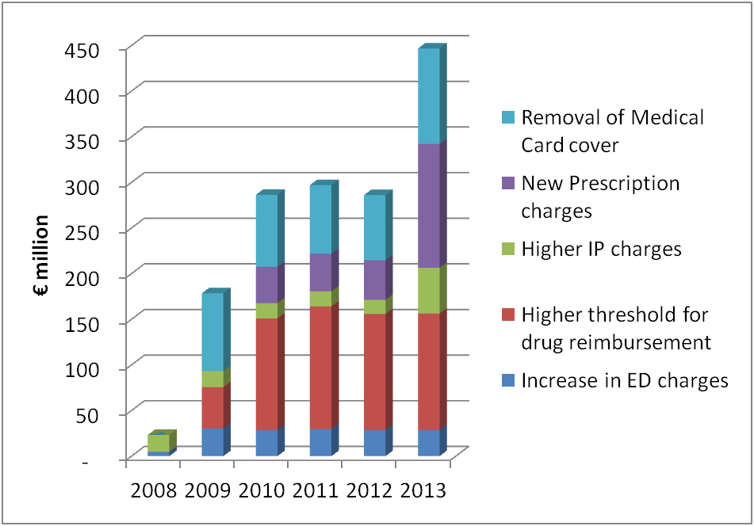
Cost shifting on to households 2008-13

Slide 10
Managers’ Priorities vs Time

Slide 11
What ties up managers’ time?

Slide 12
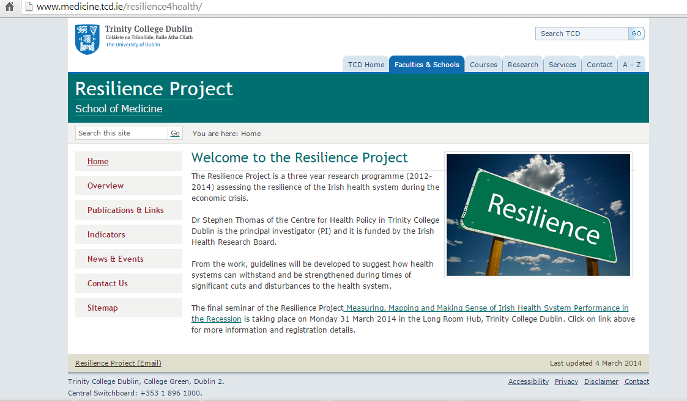
Resilience project website

Slide 13
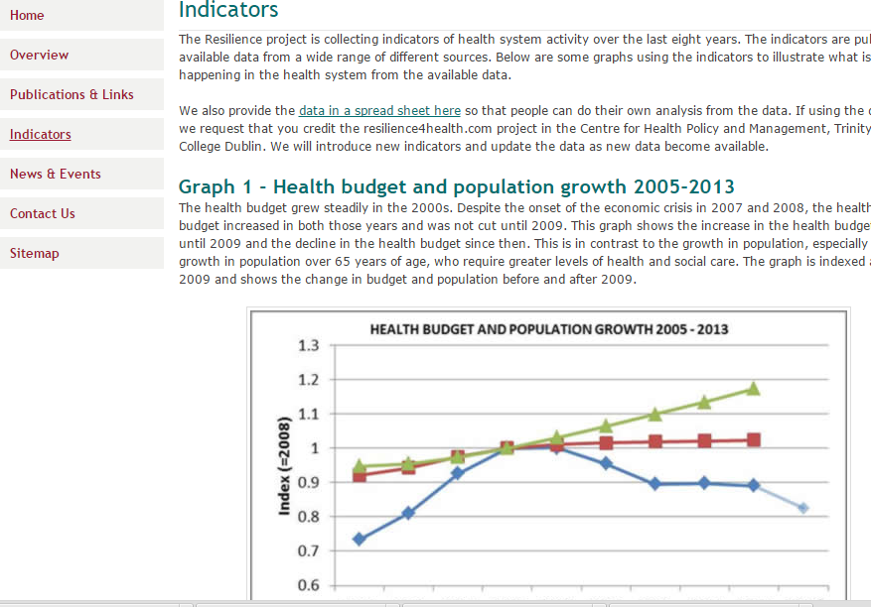
With access to indicators for all

Slide 14
Key Outputs
7 international peer-reviewed publications + 2 case studies
13 International presentations at conferences and to international bodies (WHO, World Bank, OECD, European Observatory)
3 national workshops/conferences
1 National Policy roundtable
1 International Policy consultation
Numerous national presentations (>25)
  HSE Master class, 05/14, Convention Centre Dublin
  President Higgins’ ethical initiative on health, Galway, 2/15

Slide 15
Informing international research

Slide 16
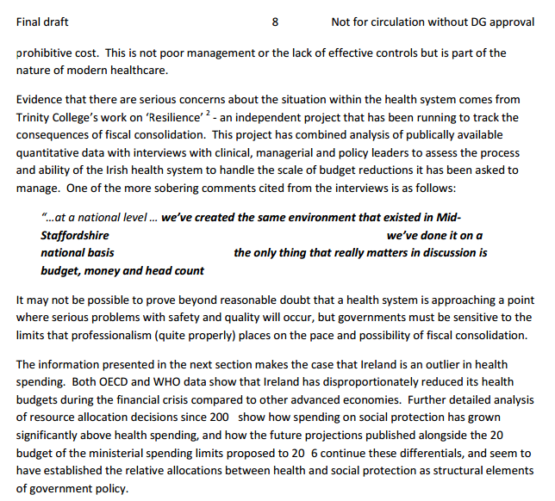
Informed 2015 Budget negotiations

Slide 17
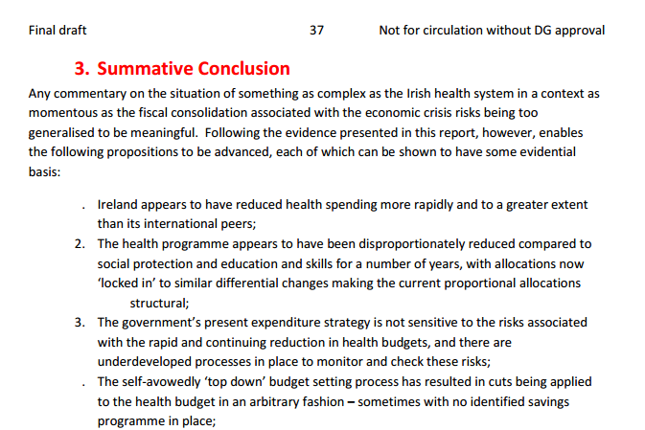
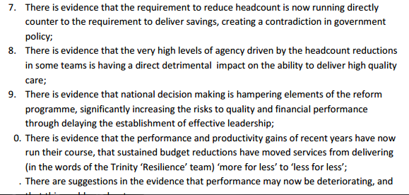

Slide 18
Informed HSE 2015 Service planning

Slide 19
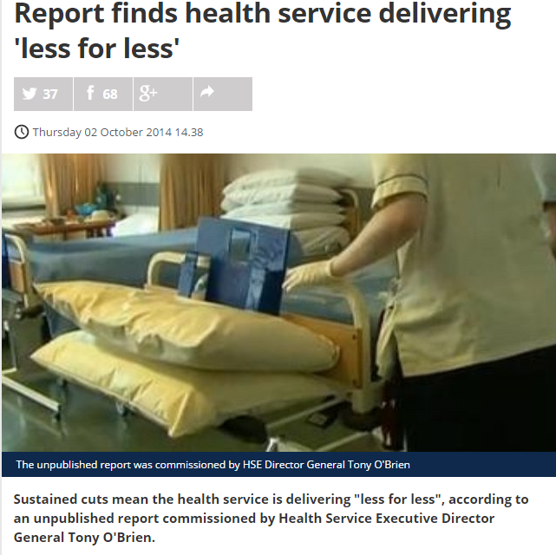
Good media coverage

Slide 20
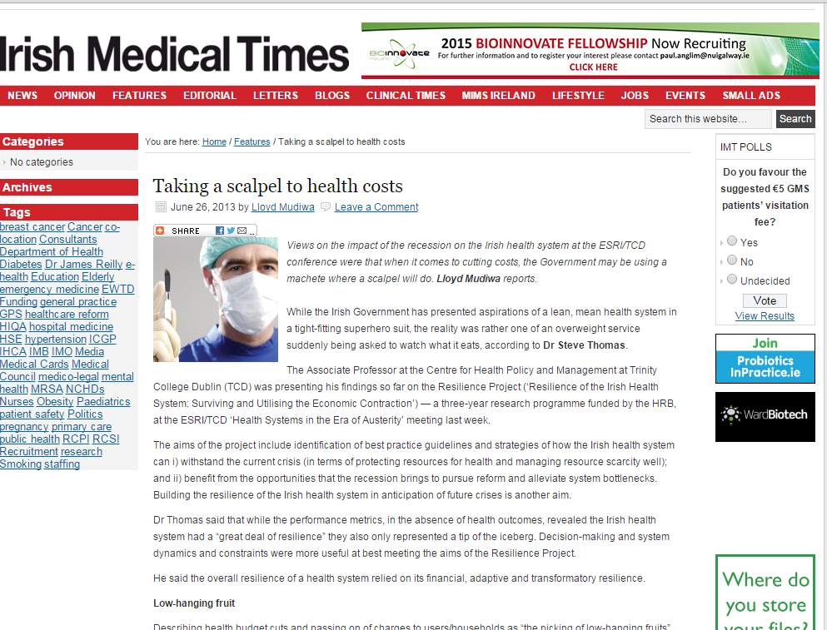

Slide 21
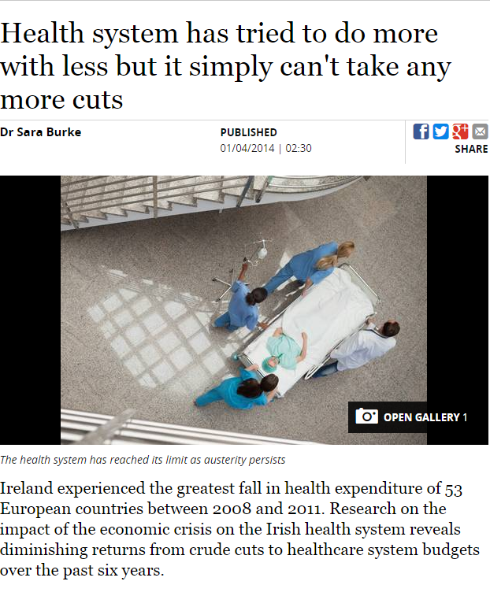

Slide 22
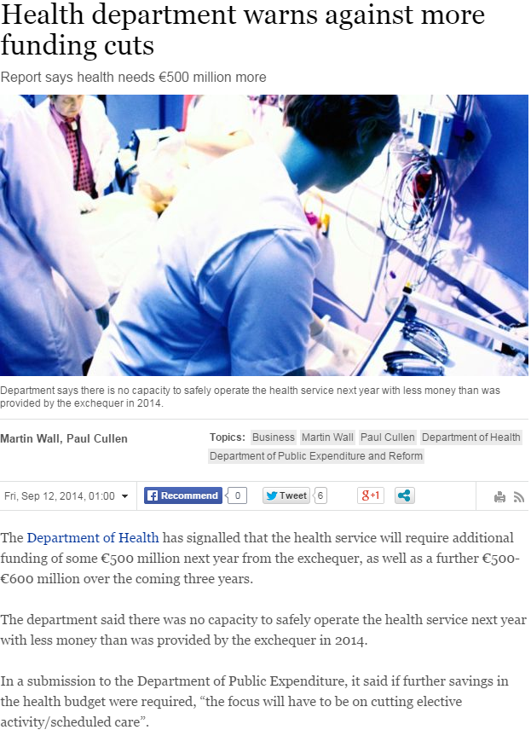
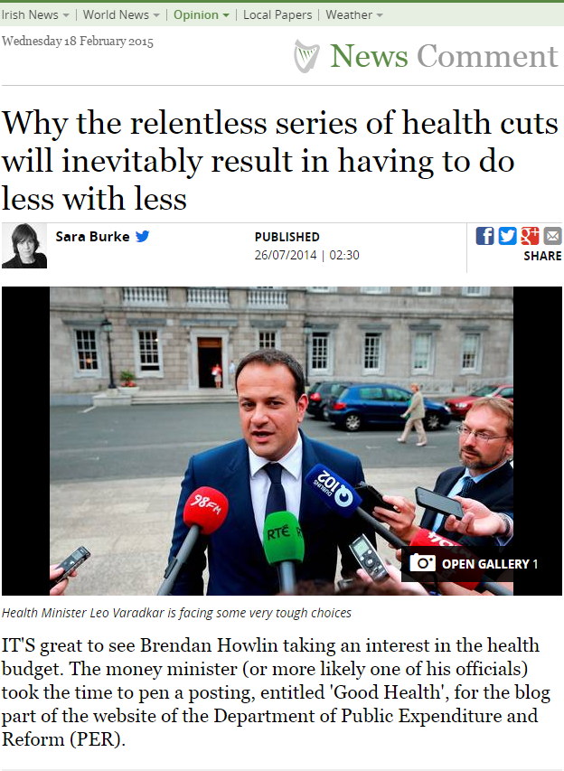

Slide 23
Text from senior health service leader after Budget 2015
The resilience findings were a big help in making the case for more
money
From more with less to les with less

Slide 24
Response from senior political figure to Resilience journal article sent
From more with less to les with less
One for my armoury…
Thank you!

Slide 25

Why the impact?
Zeitgeist and Barndoor
International networks/friends
Convenient and Inconvenient Truths
Media links
Patience and help early on
Team

Slide 26
Next up…Pathways to UHC
HRB HRA: October 2014 – 3 years
Aim: To provide an excellent evidence base that will inform strategic direction and implementation of universal health care in Ireland.
Components:
Assessing the gap between where we are and UHC
Evaluating the options or pathways to get to UHC
Assessing the organisational challenges of moving to UHC
…Watch this space

Slide 27
Thank You

