Slide 1

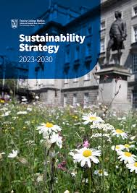
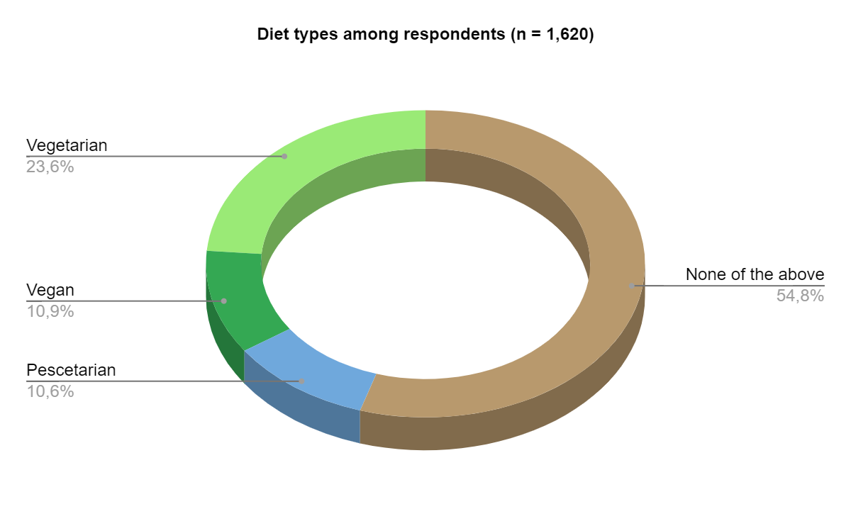
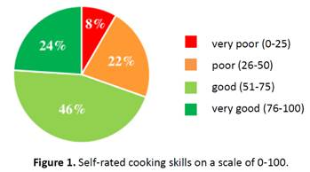
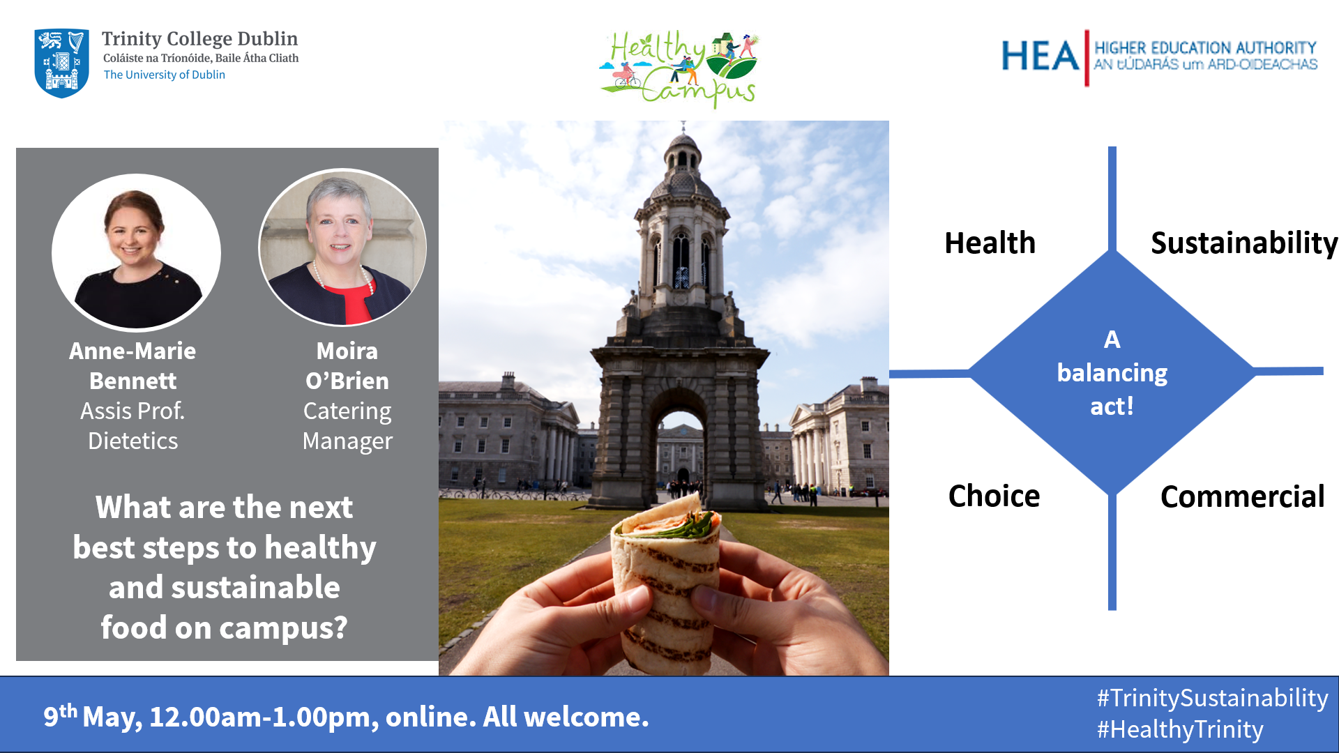

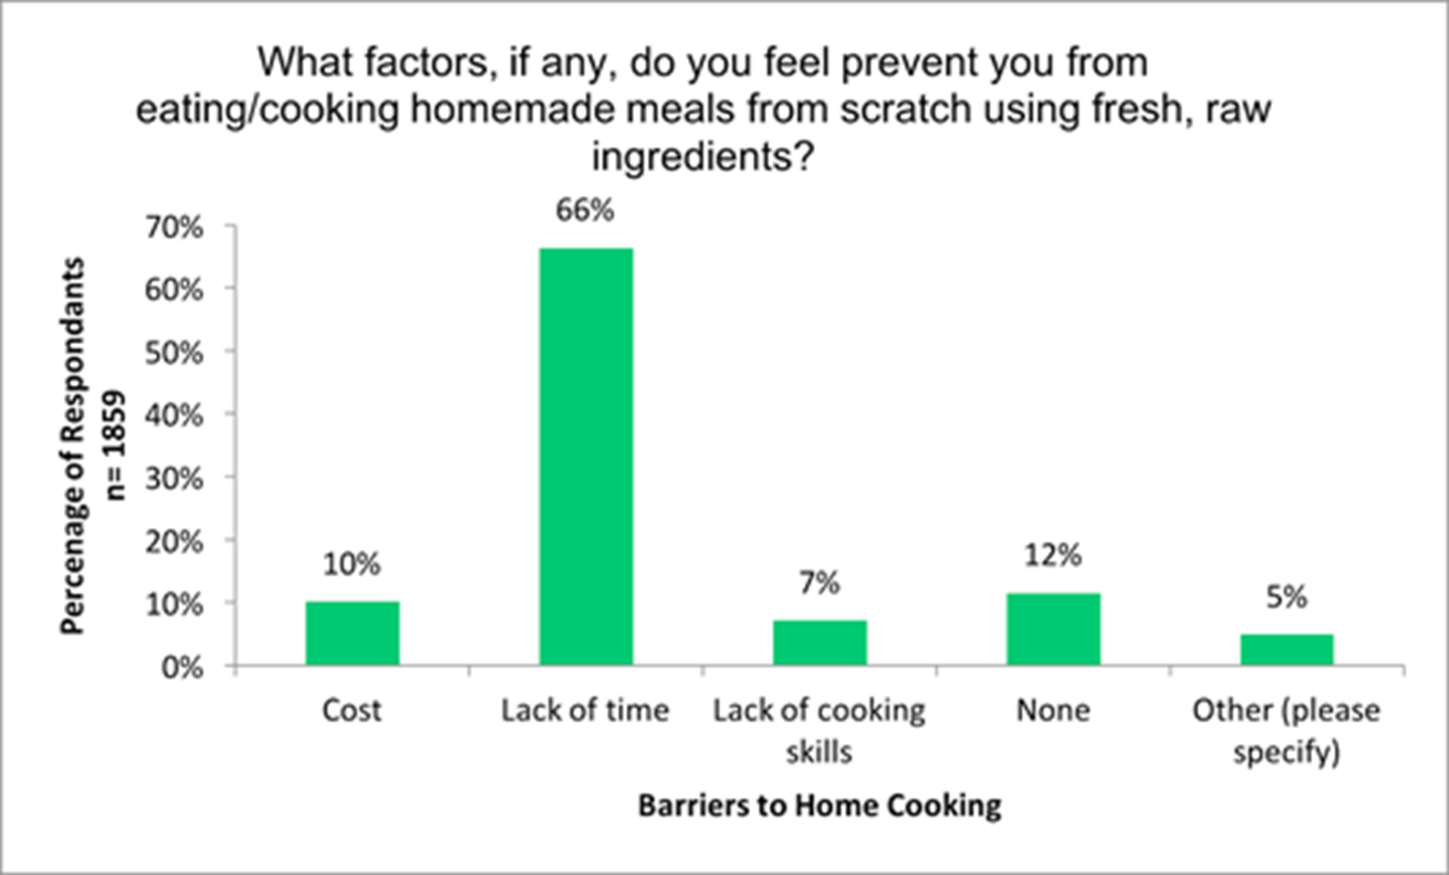
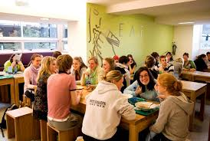
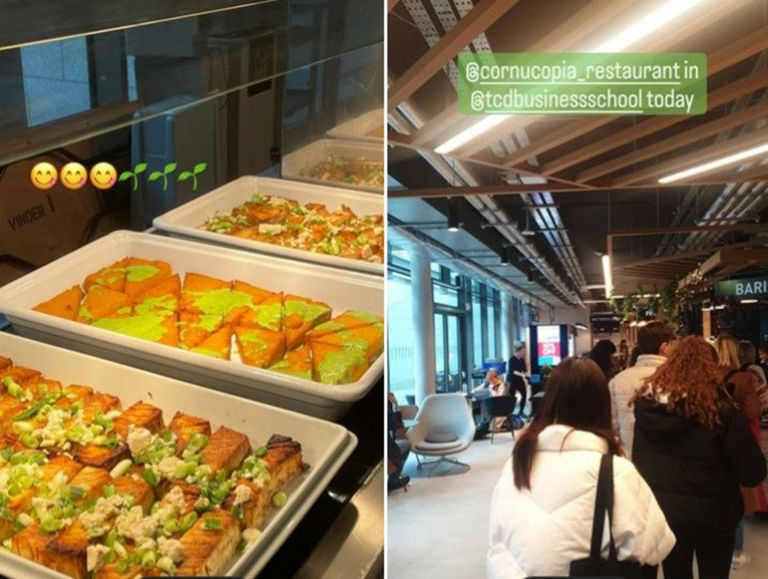
Food in Trinity
A living, whole-university map of actions complete and under consideration
#TrinitySustainability
#HealthyTrinity Apr 2025
Plant milk subsidies
Free water
Plant-first restaurant-Forum
Communications
Website, Campaigns, student recipes, insta, twitter, podcast
Living Lab datasets
Fellows’ Dinner
2GoCups
Mural
Change to date
Staff training
Courses
Plant chef
Green, H&S Weeks
Schols veg options
2022 Plant based diet demand
FHS trials
Plant-based campaign
Trinity Staff, Students, TCDSU 75%, UK and Ire campaign
TRiSS events
Meat-free Mondays
Plastic
50% ↑ plant based
Waste
Procurement
Events
Catering Business School Collab
Curriculum
Dietetics, Business, Geography, Charm EU, Medicine?
2019 Skills & facilities on campus
Ethos?
Local? Co-op? Staff? Cost
Forum pictured, Earthling Ed, etc
WHO Best Buys – 6 strategies
Greening campus
Planters TBS, Masterplan, Pocket Forest, Urban Garden, Farming is Medicine, Biohavens, Outdoor classroom
Venues
Cornucopia trial
Societies
Details here
2017 Barriers to Healthy Eating
Procurement
Details here
Big picture: Precedent Unis (UCC, Queens, Exeter, Edinburgh, Berlin), NHS, New York Hospitals, Twickenham, CDOH, DCU, Edible Edinburgh; Climate & Health alliance, Food lit, national guidelines, EAT Lancet
Trinity Catering
James’s, Tallaght, Halls, BYO, SU cafe
20-30% ↑ sales
Deliveries
Study ongoing
Food Safety
Details here
Health Services
Disordered eating

