Slide 1
Master in Education (M.Ed.)
Welcome & Induction 2026/27
School of Education
  Trinity College Dublin
    11 September 2026
Notes:
Music in the background with this slide for 15 mins before start

Slide 2

Today’s purpose
Making connections
Getting familiar with your programme
Key information
Notes:
MS

Slide 3
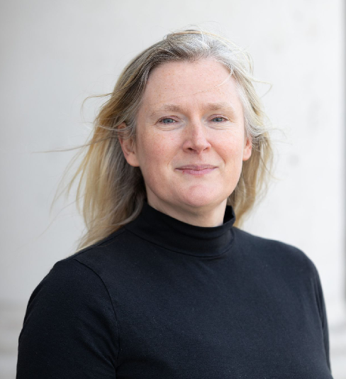
Welcome from Head of School, Professor Ann Devitt
Notes:
Welcome, school identity, values and significance of joining the M. Ed Community 2 mins

Slide 4

Neighbour introductions
Speak to one or two people sitting next to you
Find out:
  Name
  Pathway or area of interest
  One thing that they hope to get from the M. Ed.
Notes:
[8 mins] Ann or Michelle to do this – ask students to speak to one or two people beside them.
Name, pathway or area of interest and one thing that they hope to get from the M. Ed

Slide 5

Let’s find out who is in the room
Notes:
Michelle –

Slide 6
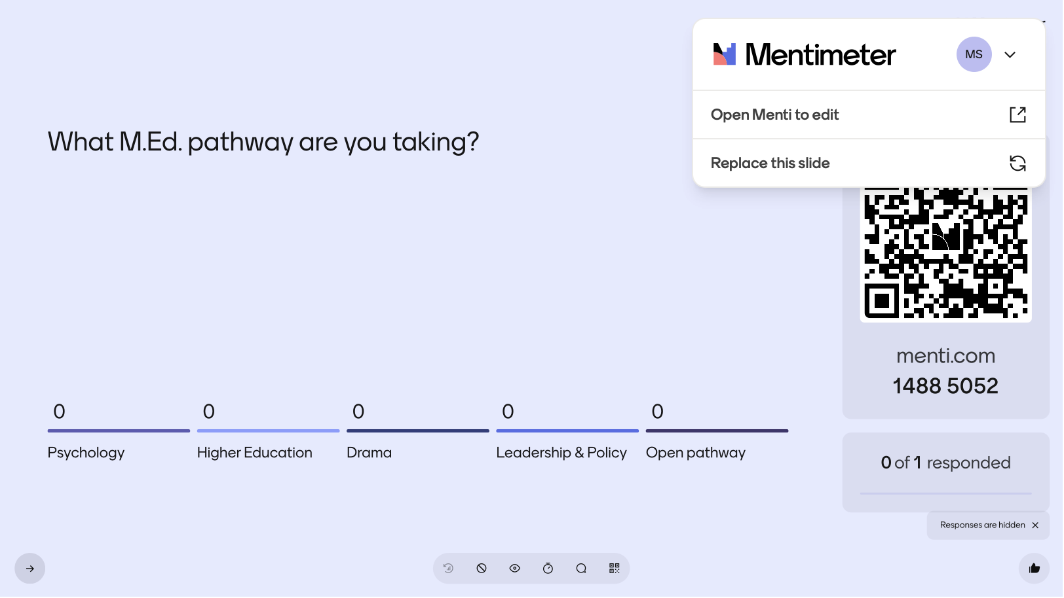
What M. Ed pathway are you taking?
Notes:
Michelle 2 mins

Slide 7
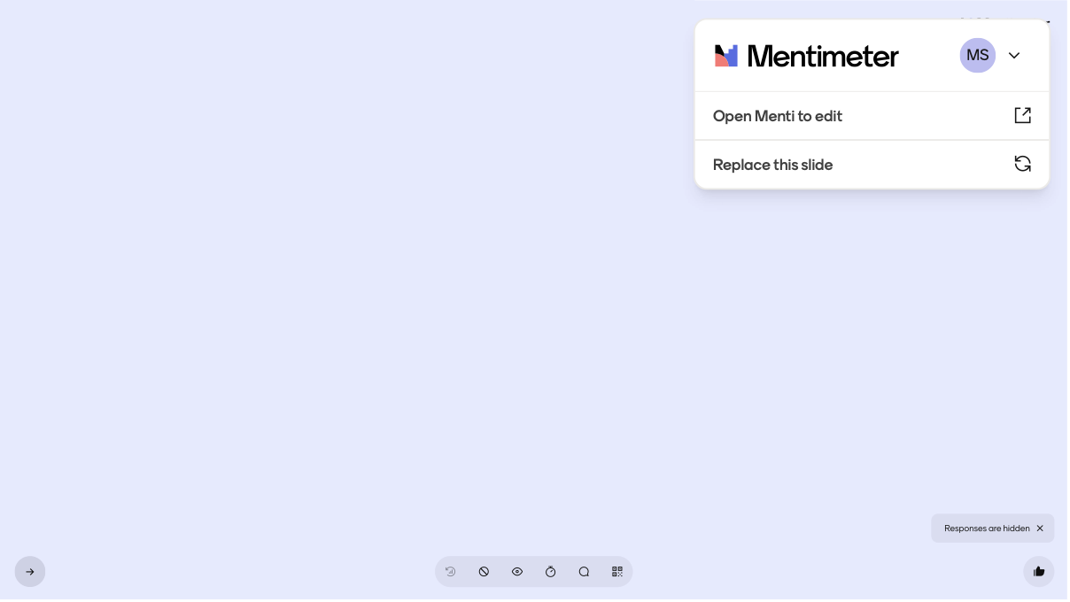
What do you hope to achieve on the M. Ed programme?
Notes:
Michelle 2 mins

Slide 8

How the M. Ed. Works in practice
Programme shape, routes, expectations, where the guide/handbook fit
Clear explanation of routes, pathways, full-time/part-time study, guide, handbook and first-month expectations.
Notes:
Michelle to lead in to introducing Programme Team 1 minute

Slide 9
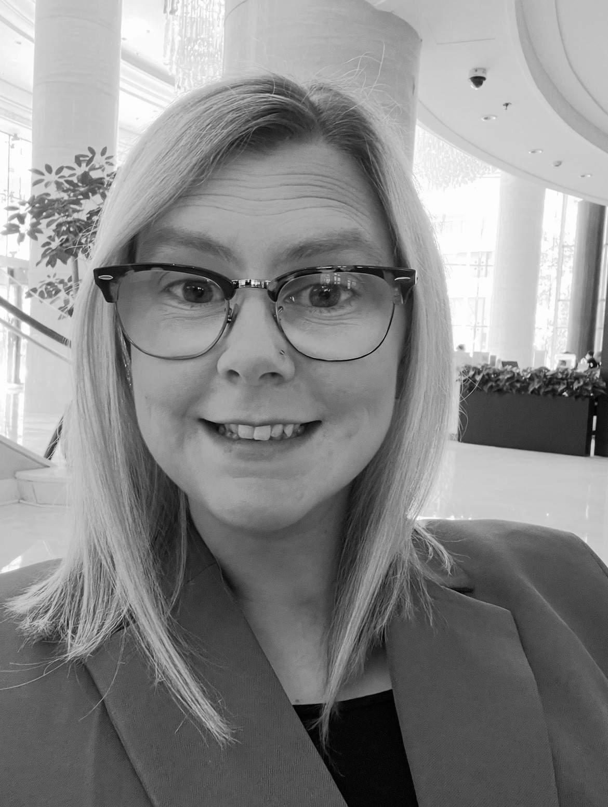
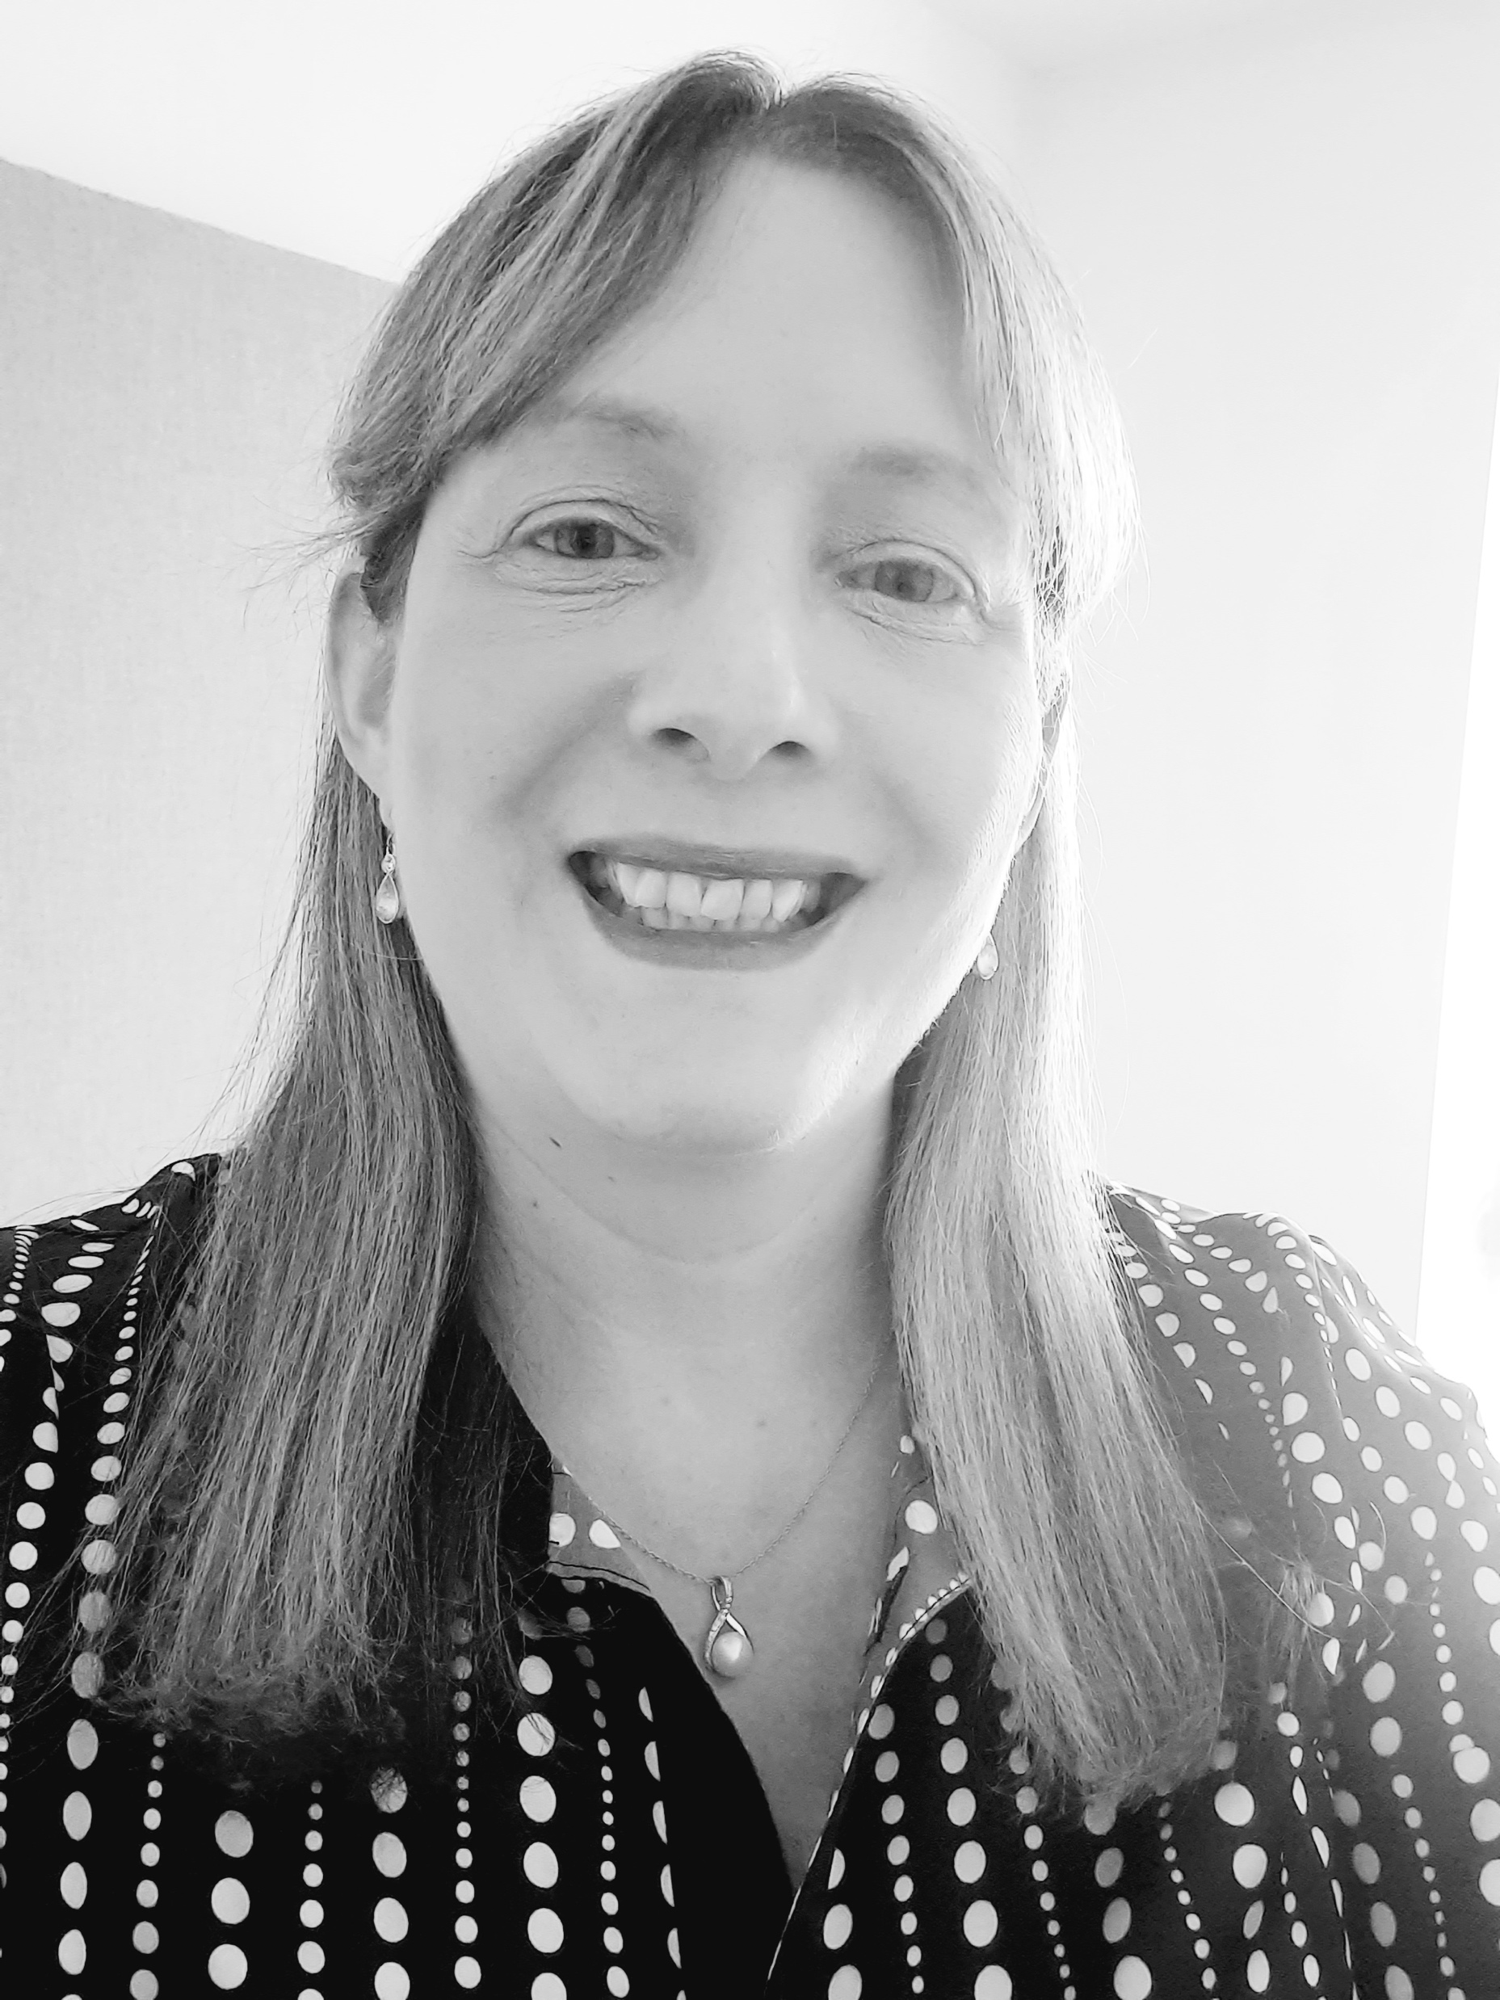
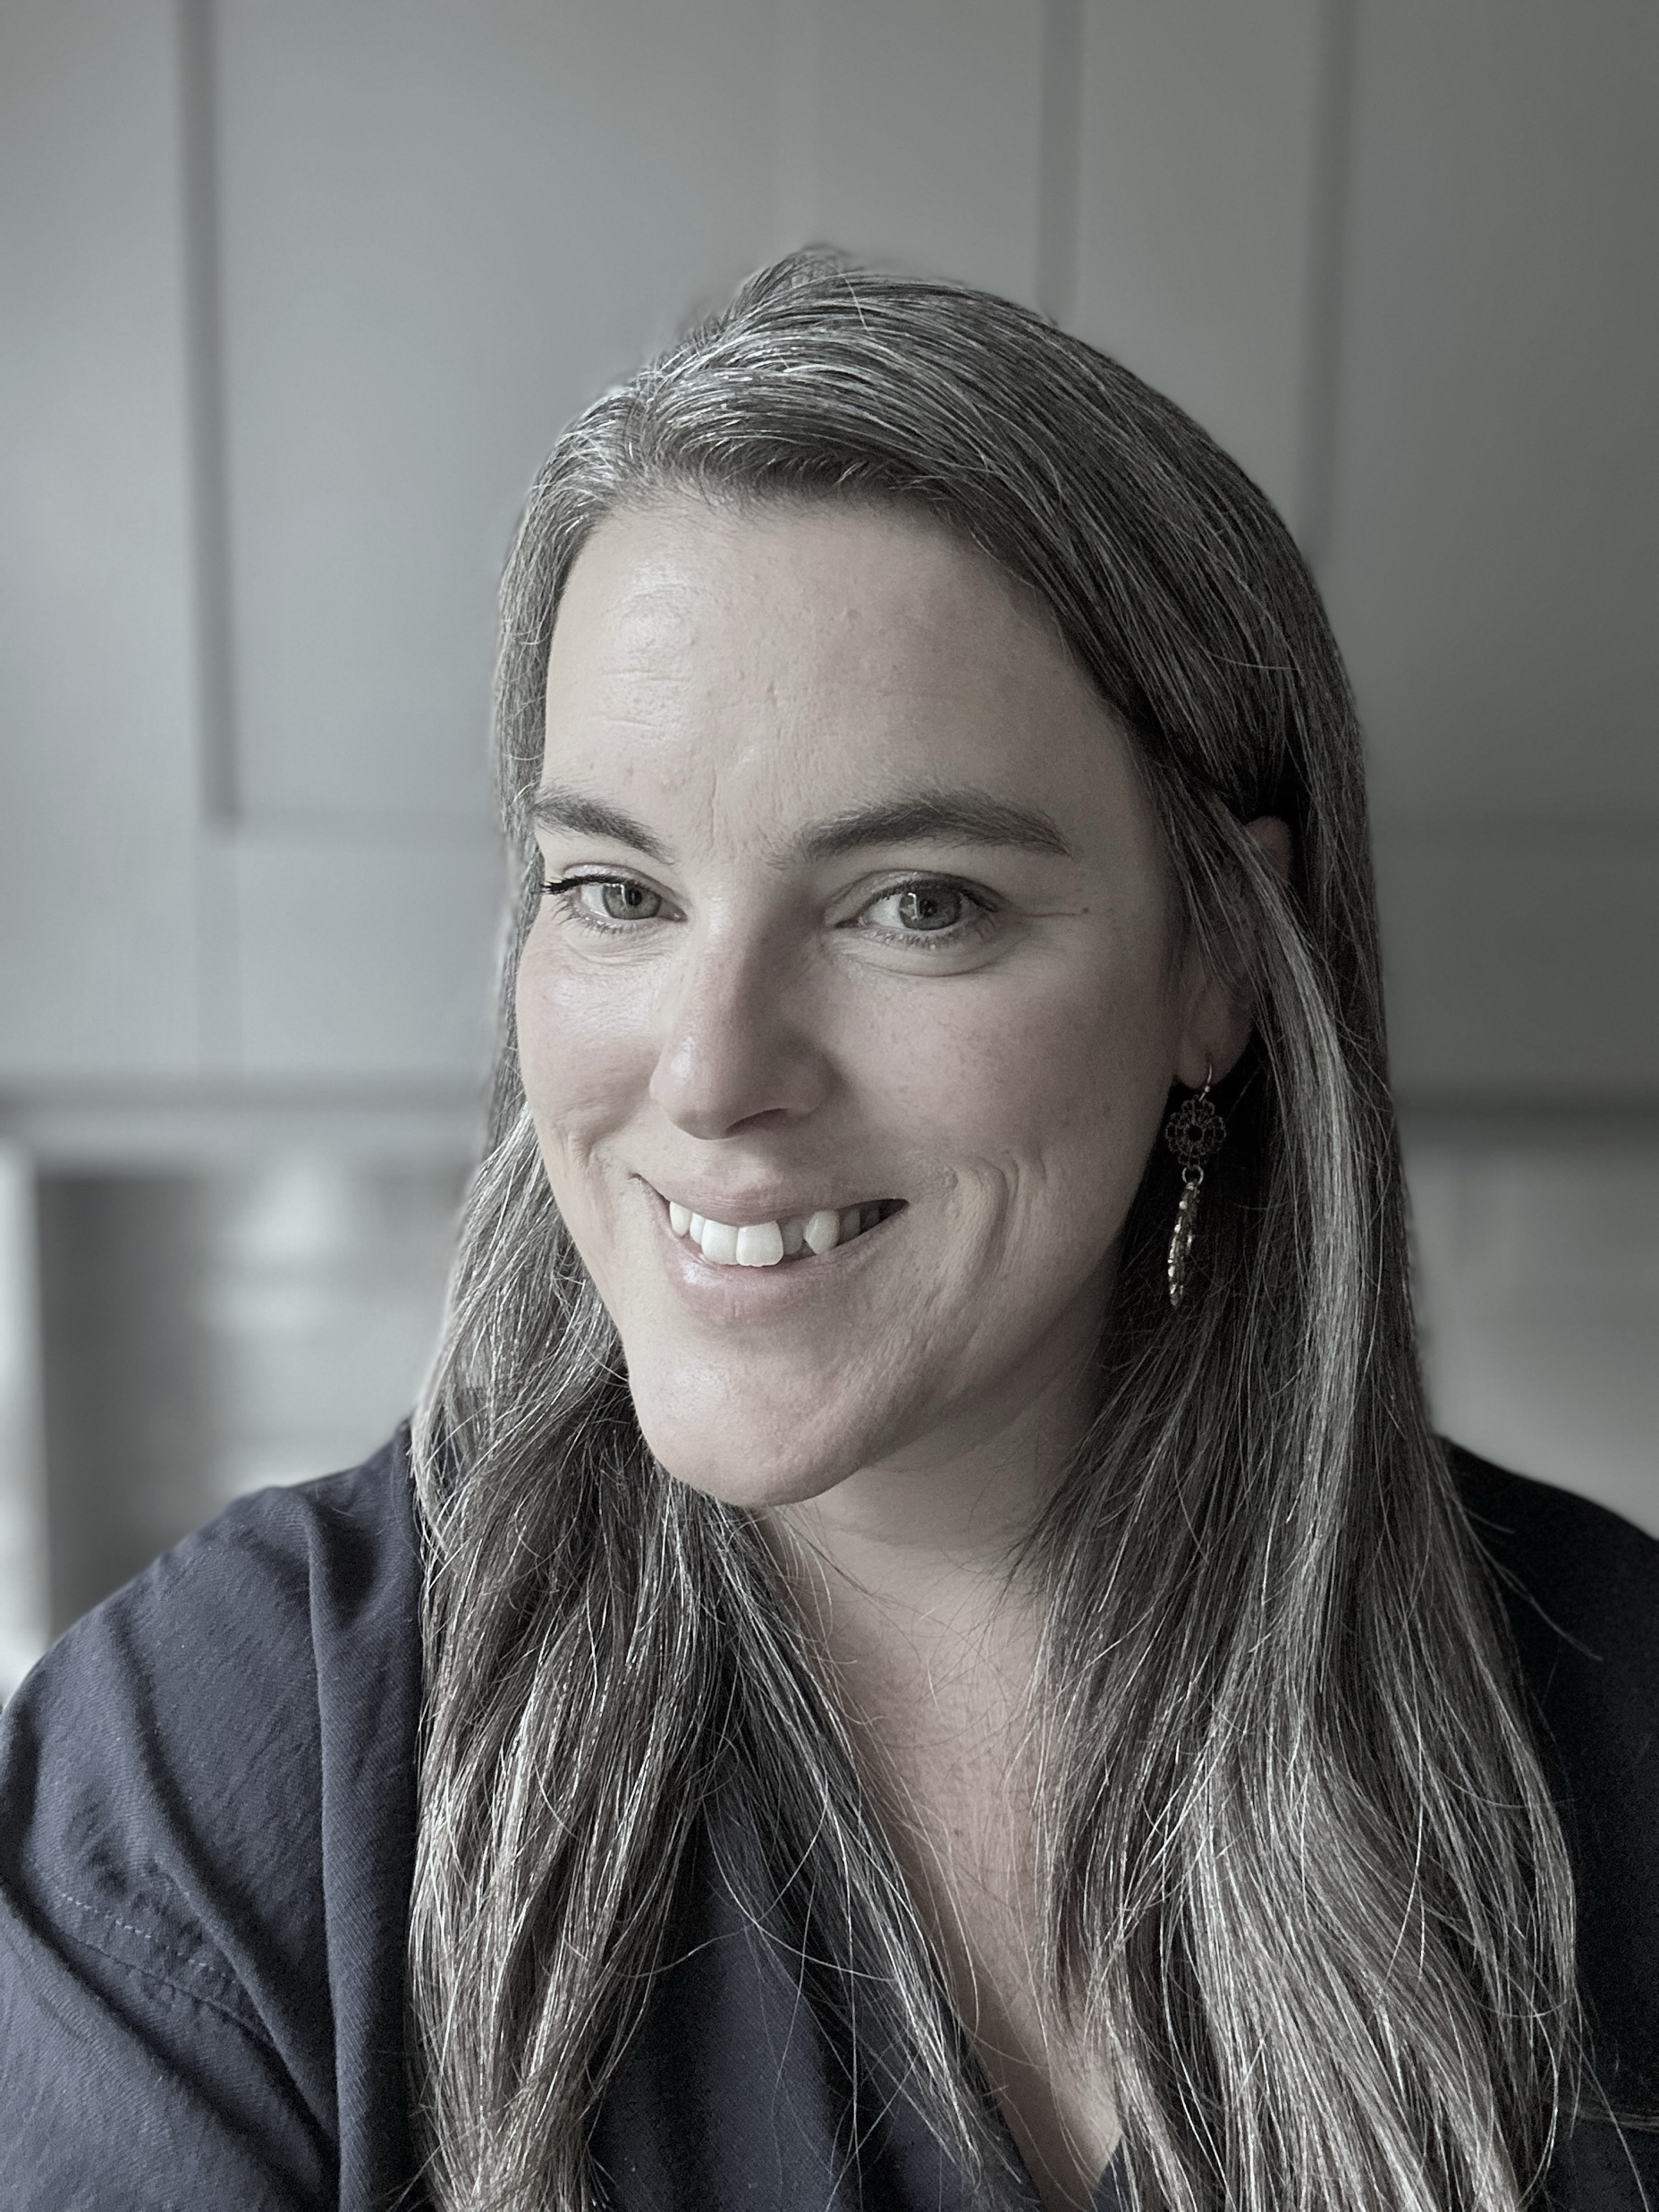
M.Ed. Programme Team
Jess Freeman
SOE Programmes Manager
Sheena Helbert
Executive Officer
Lucy Banks
Executive Officer
Notes:
Jess to introduce

Slide 10

Your route through the programme
This Photo by Unknown Author is licensed under CC BY-SA-NC
Notes:
Jess – 30 seconds

Slide 11
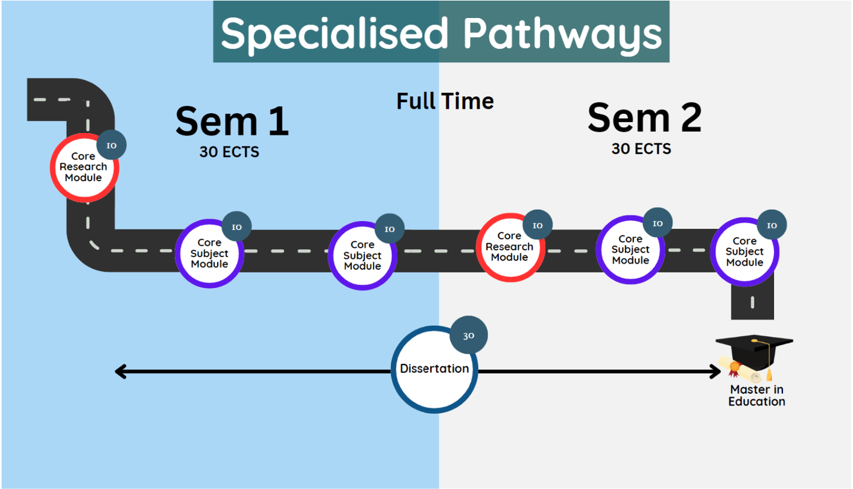
Specialised Pathway
M.Ed. 2026/27
Notes:
Jess 2 mins – you will also need to make ref to part-timers but not go into to much explanation

Slide 12
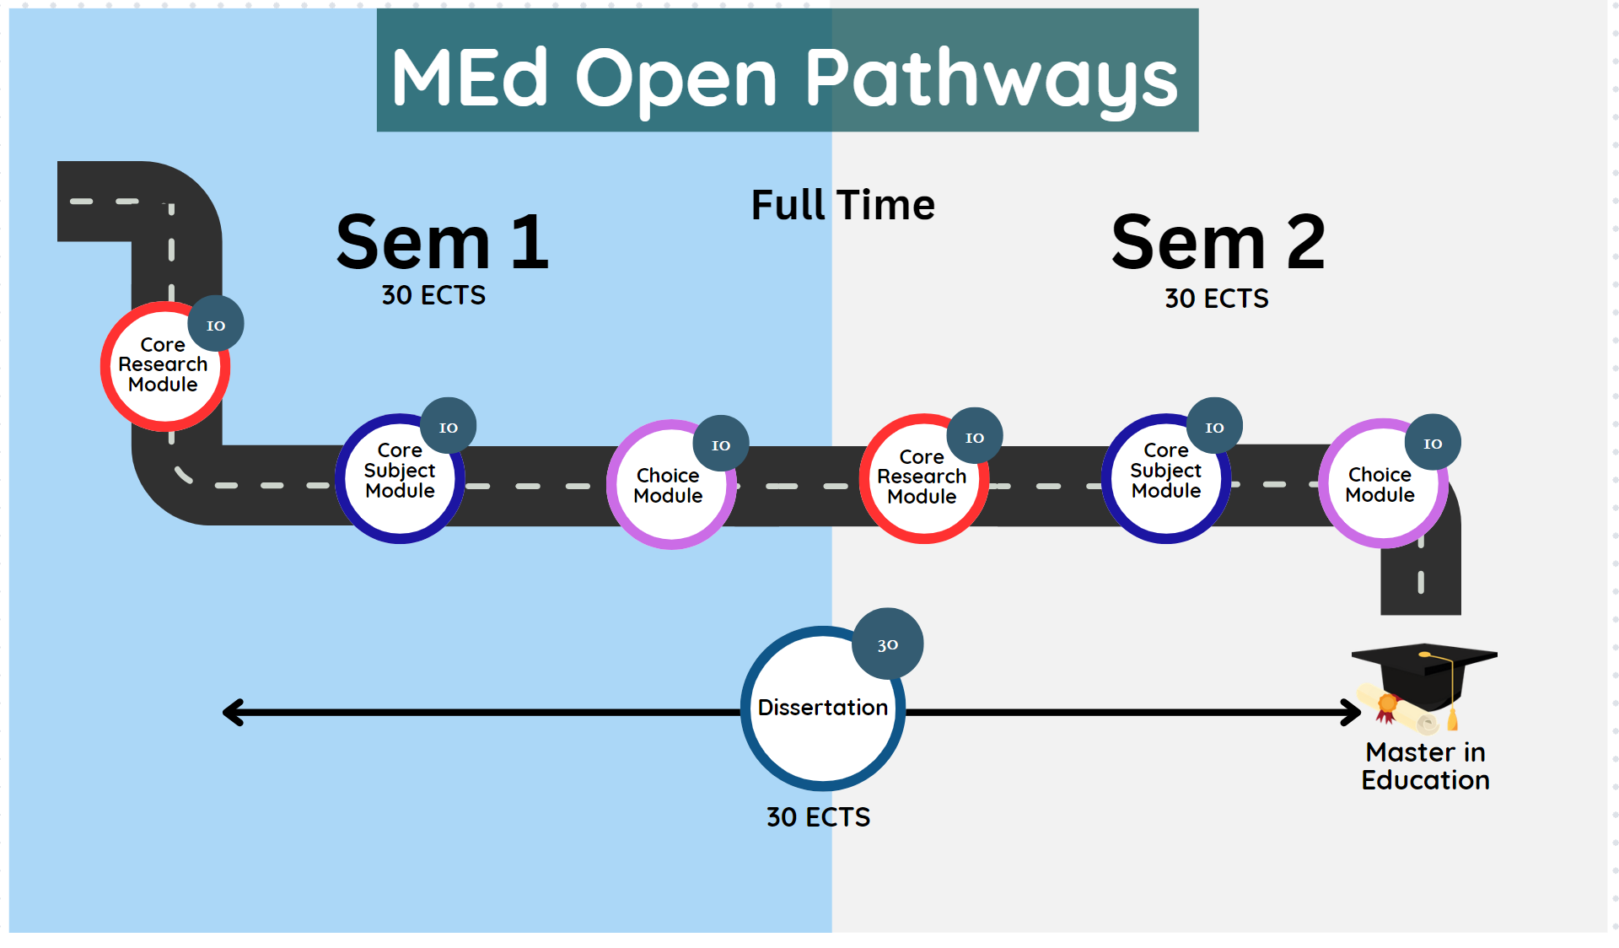
Open Pathways
M.Ed. 2025/26
Notes:
Jess 2 mins

Slide 13

M.Ed. Office
M.Ed. 2026/27
Support you through your time here at Trinity College
No query is ever too small. We are here to help; Point you in the right direction if we are unable to help
Contact us at MASTERED@tcd.ie
Use your TCD emails for all official correspondence, signing off with your registered name
Always quote your student number!!!!
Best of luck and enjoy your studies : )
MEd office
Room 3088
Opening hours: 9am-1pm / 2pm-5pm
(by appointment only)​
Notes:
Sheena– 2 mins

Slide 14
Key Dates 2026/2027
Master in Education (M.Ed.)
  Semester 1 (Michaelmas Term)
  Monday 14th September 2026 to Sunday 6th December 2026.
  Reading Week (Week 10): Monday 26th October 2026 to Sunday 1st November 2026.
Semester 2 (Hilary Term)
  Monday 18th January 2027 to Sunday 18th April 2027
  Reading Week (Week 28): Monday 1st March 2027 to Sunday 7th March 2027.
Notes:
Sheena – 2 mins

Slide 15
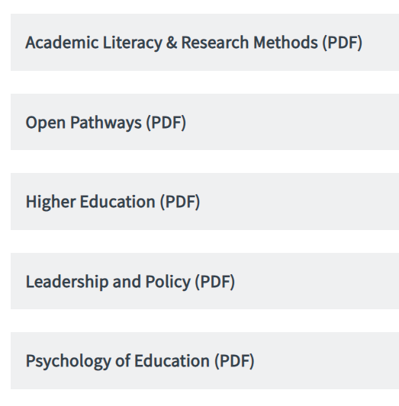
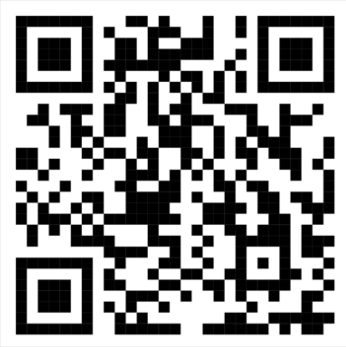
M.Ed. Timetables 2026/27
Notes:
Jess - 2 mins

Slide 16

The questions you brought with you
Speak to the person or persons beside you (pair or trio)
Discuss the question you brought with you
Choose one shared question
Place it on the board under a heading
Notes:
Michelle [10 mins] for whole activity
Board to be reviewed and then key questions mentioned in the next slide – they can also be taken up when we move for conversations and refreshments

Slide 17
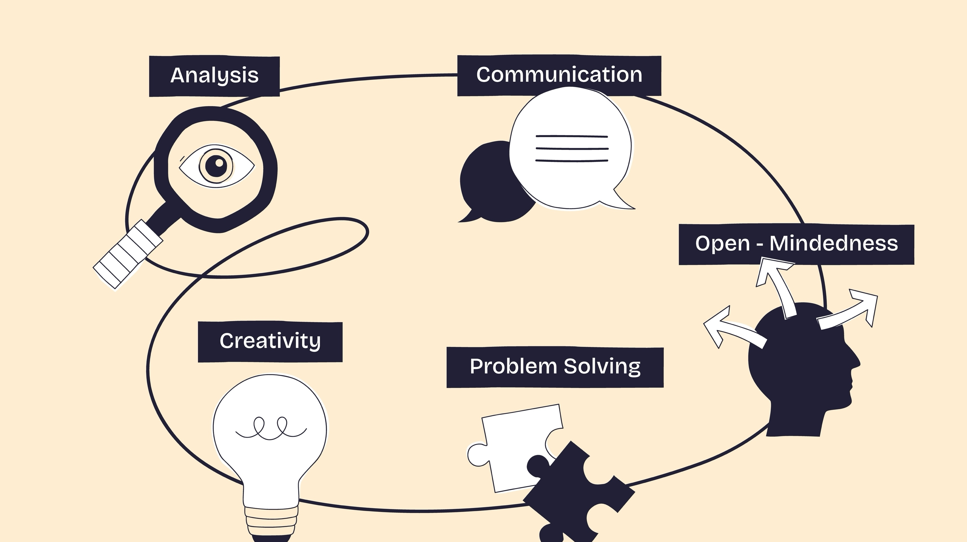
Studying at Master’s level
Notes:
Michelle [3 mins}

Slide 18
Four questions for Master’s level thinking
When you are reading, listening, discussing, or preparing an assignment, ask:
1. What is being argued?
What is the author, lecturer, policy, or theory saying?
2. What evidence is being used?
What research, theory, policy, or practice supports this view?
What is taken for granted, and what other perspectives might exist?
How do I understand this issue, and how can I support my view?
4. What is my emerging position?
3. What assumptions are being made
Notes:
Michelle [2 mins] and then introduce Louise

Slide 19
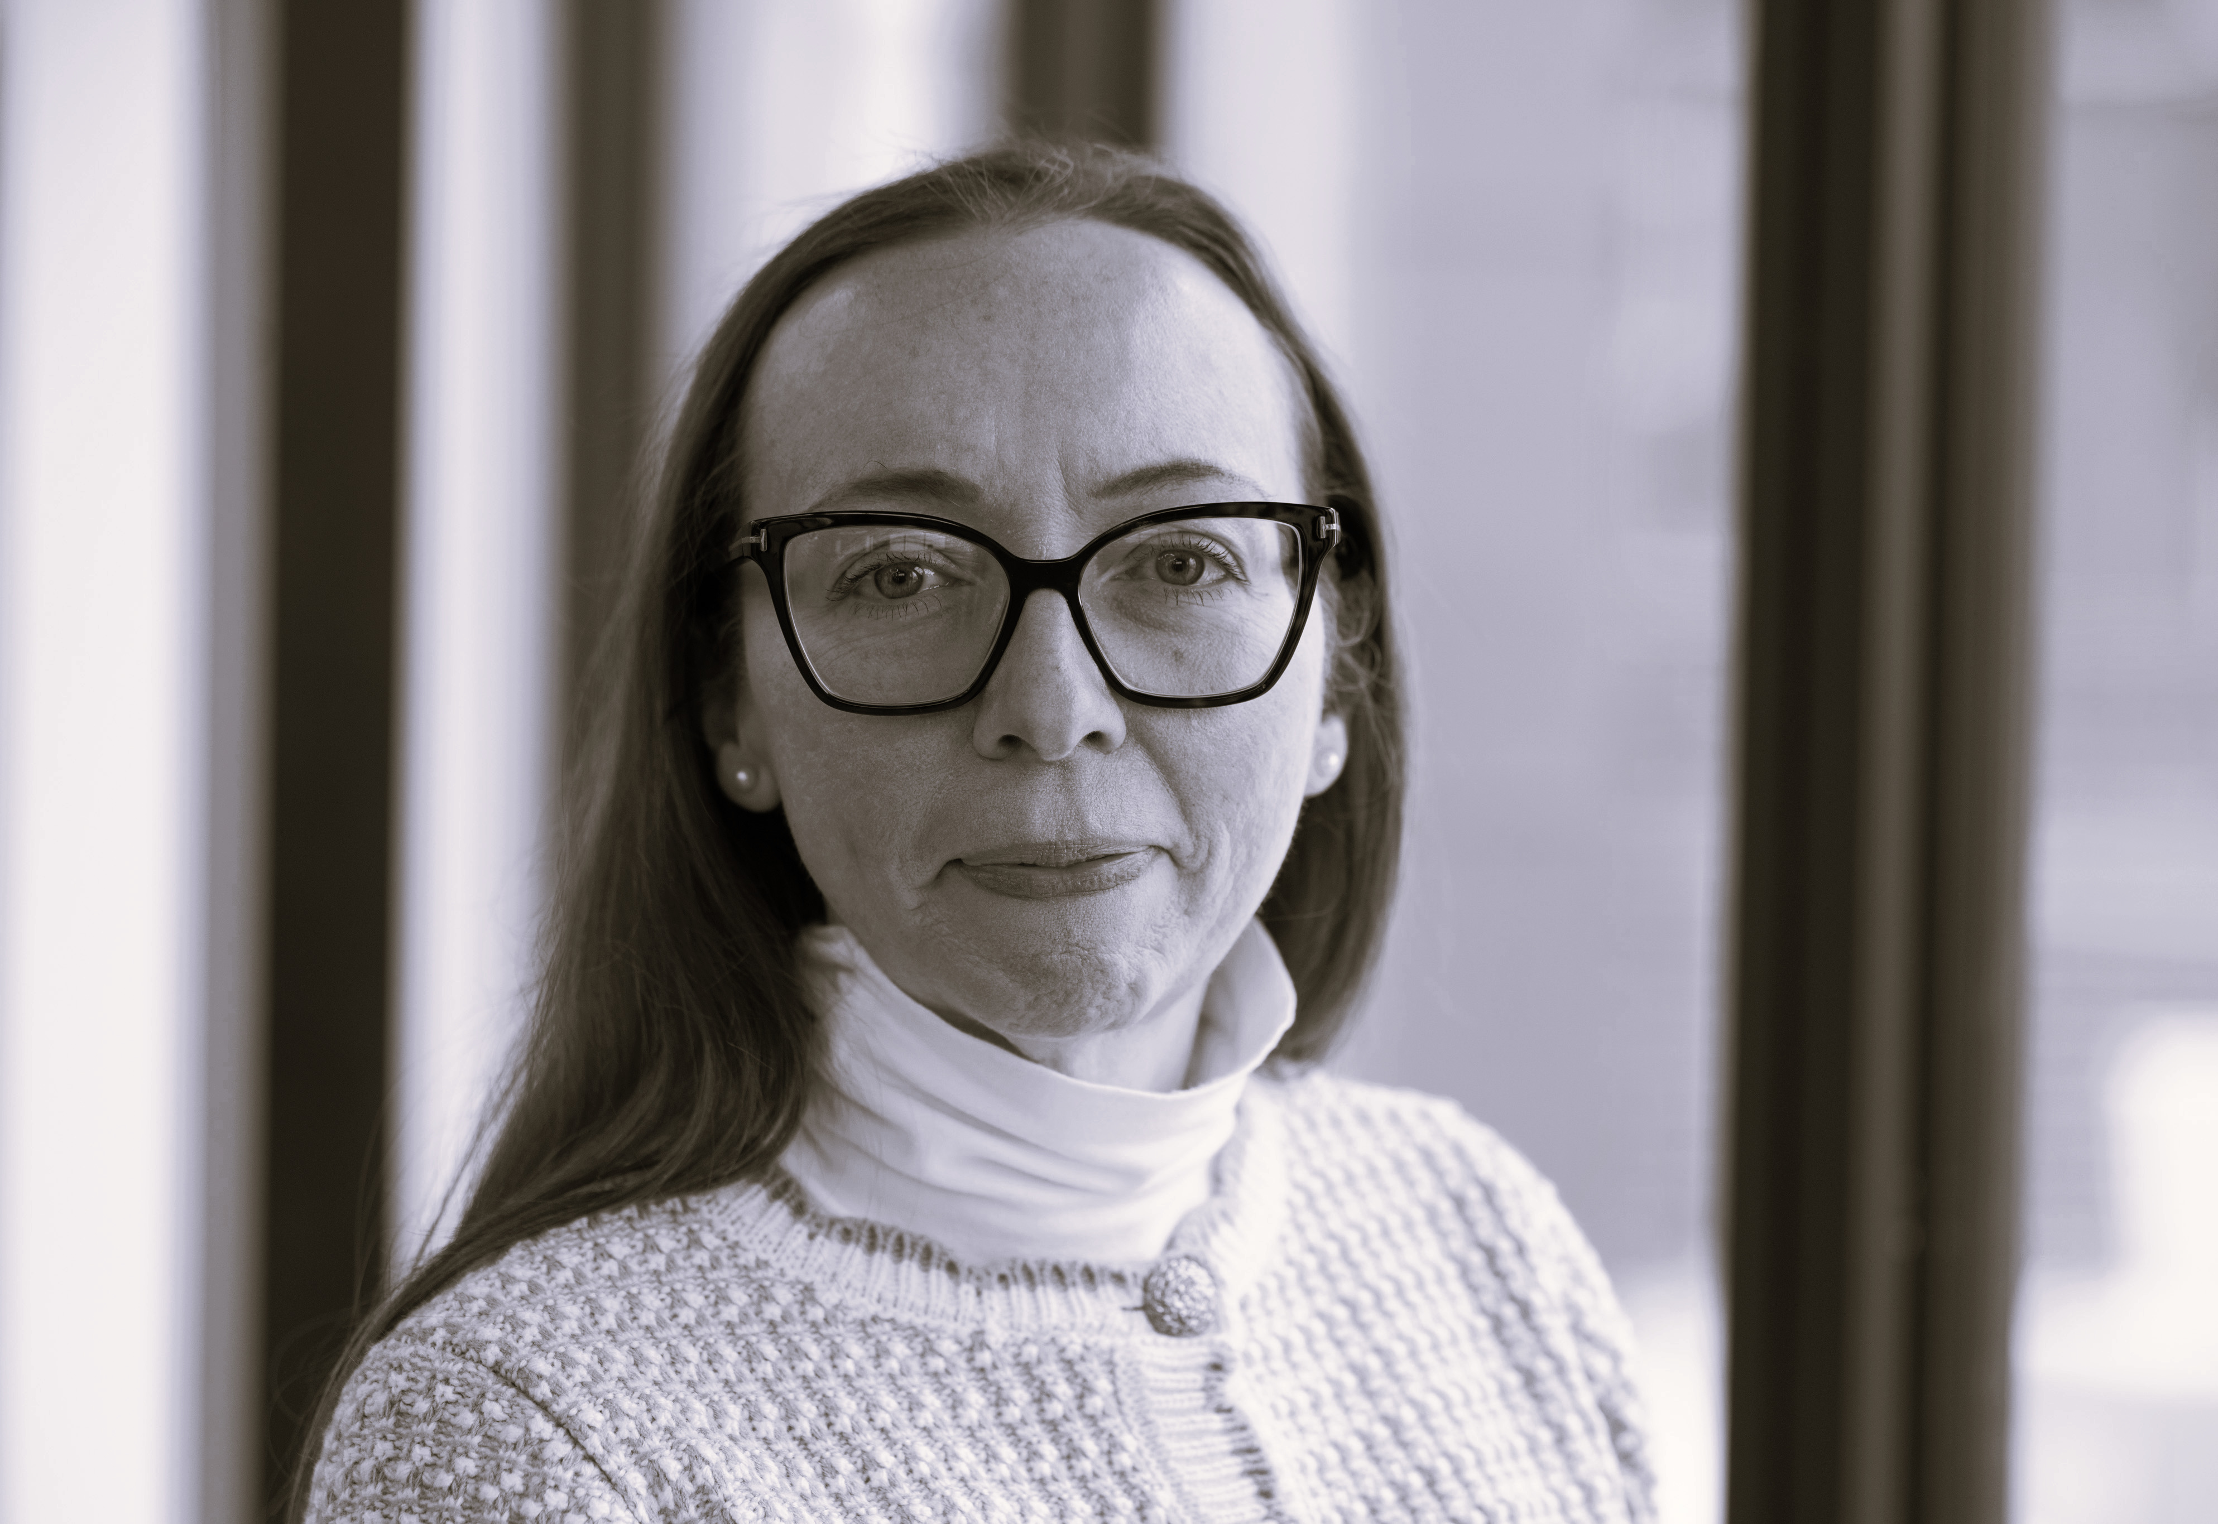
Welcome from Dr Louise Heeran Flynn
Dissertation Co-ordinator
Supporting students in the dissertation year
Dedicated dissertation support sessions
Supervisor allocations
Handbook
Fulltime students dissertation proposal
Notes:
Louise 2 mins

Slide 20
Getting settled and connected:
Global Director/
Student Union /Disability Service/ Trinity Access Programme & Volunteering
Notes:
Me to introduce Gavin, Ava, Fionn and Bernadette – 1 minute

Slide 21
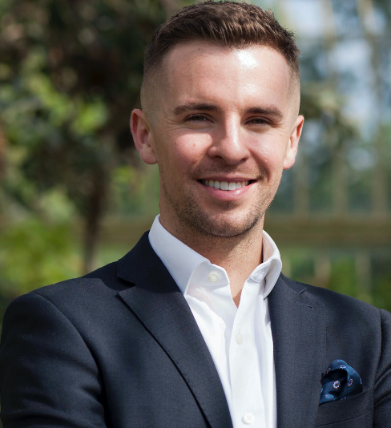
International Student Coordinator
M.Ed. 2026/27
Dr Gavin Murphy
gavin.murphy@tcd.ie
Welcome
College Support:
  TCDGlobalRoom@tcd.ie
  https://www.tcd.ie/study/international/student-experience/global-room/ (register for events; New2Dublin programme Mondays)
School-level Support:
  Your class rep(s)
  International Student Coordinator (more information to follow)
Notes:
Gavin 2 mins

Slide 22
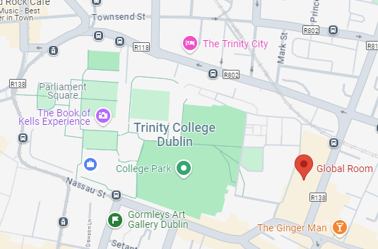
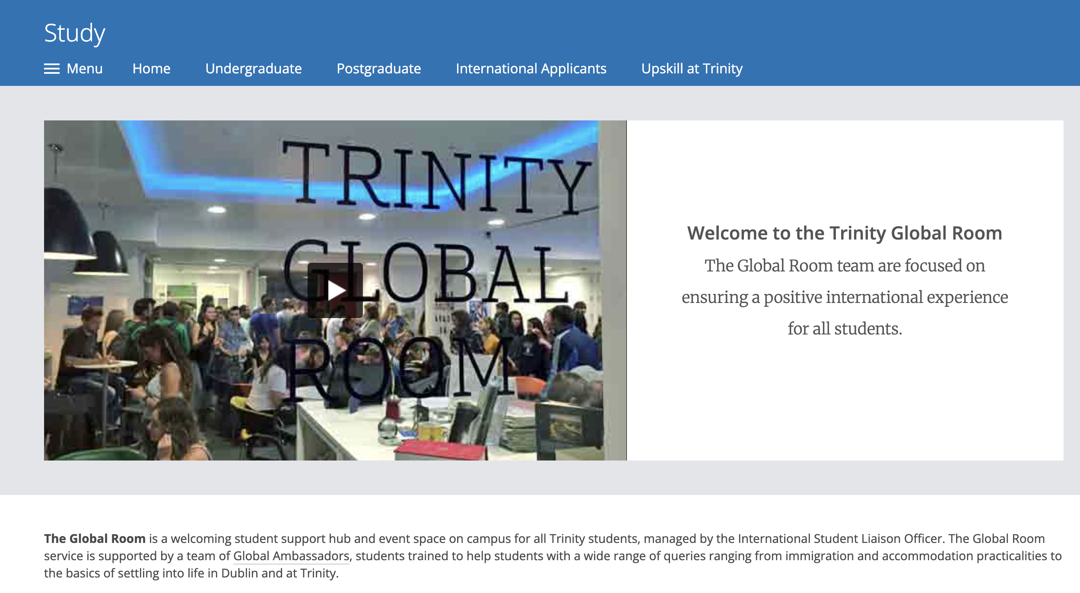
The Global Room
M.Ed. 2026/27
You are here
Notes:
Gavin 1 min

Slide 23
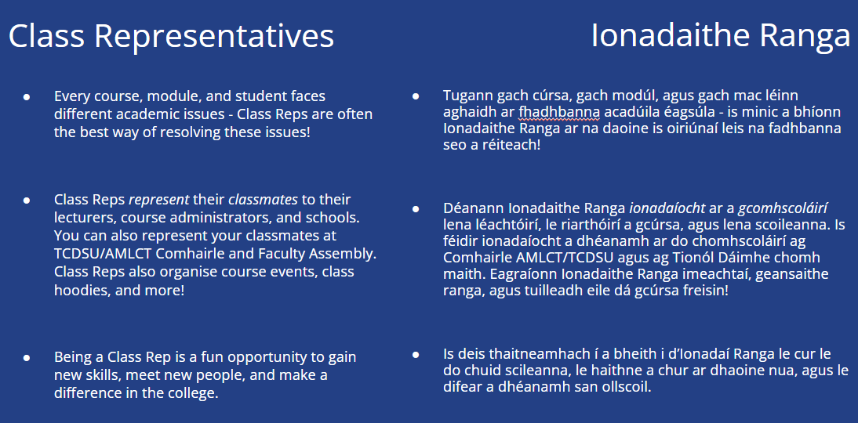
Student Union
M.Ed. 2026/27
Notes:
Ava 1 min

Slide 24
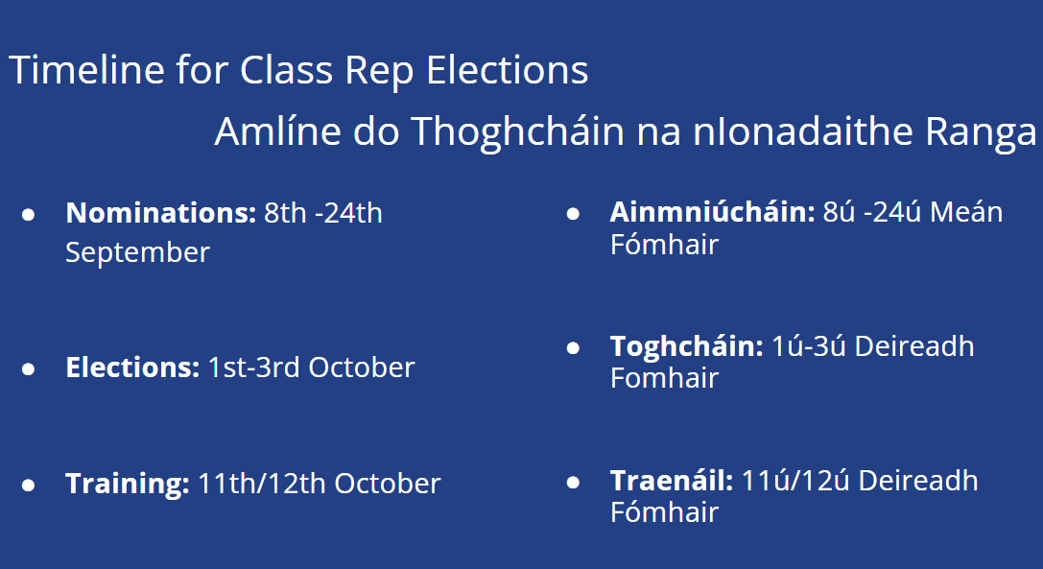
Student Union
M.Ed. 2026/27
7ú-23ú
7th-23rd
September 30th - October 2nd
30ú Meán Fómhair - 2ú Deireadh Fómhair
October 10th and 11th
10ú/11ú
Notes:
Ava 1 min

Slide 25

Disability Service
How We Can Help
M. Ed. 2026/7
Exams and Assessments
Workload and Deadline Management
Managing your Environment
Placement and Careers
1:1 and Group Supports
"Reasonable accommodations" are agreements/supports meant to alleviate substantial disadvantages that disabled students may otherwise experience.
Notes:
Fionn 2 mins

Slide 26
Disability Service
Who can register
with the disAbility Service?
M. Ed. 2026/7
  Students with confirmed or suspected disabilities can register with the Disability Service to access supports.
  You may have received supports for your disability in the past, or this might be your first experience with reasonable accommodation.
Mental Health Condition
Significant Ongoing Illness
Dyspraxia
SpLD
Neurological Condition
Physical
Reasonable Accommodation Deadline for Semester 1 Exams:
October 30th 2026
Deaf/Hard of Hearing
Blind/Visually Impaired
Autism
ADD/ADHD
Notes:
Fionn 1 min

Slide 27
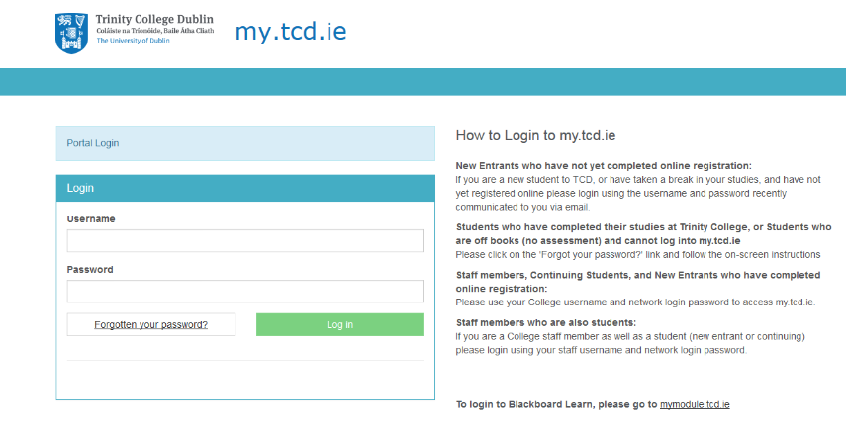
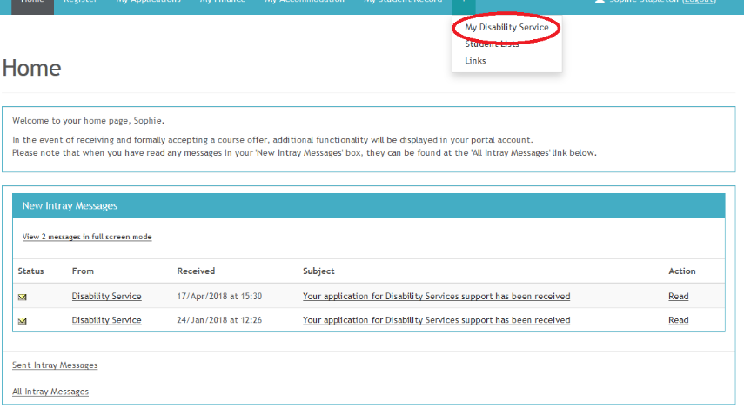
How to Register for
Reasonable Accommodations
Disability Service
M. Ed. 2026/7
Once registered, your "Reasonable accommodations" are listed on a document:
"LENS Report", which informs your course of which accommodations they are to provide.
2. Click the “My Disability Service” tab under the “+” sign
1. Log into my.tcd.ie
For queries email us at askds@tcd.ie or visit Printing House Square during our drop-in hours 12-2pm, Mon-Fri
Notes:
Fionn 1 min

Slide 28

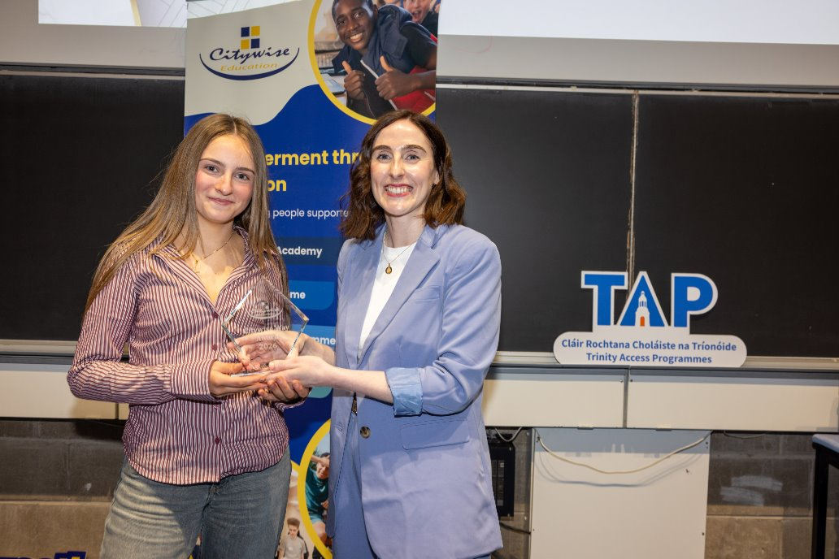

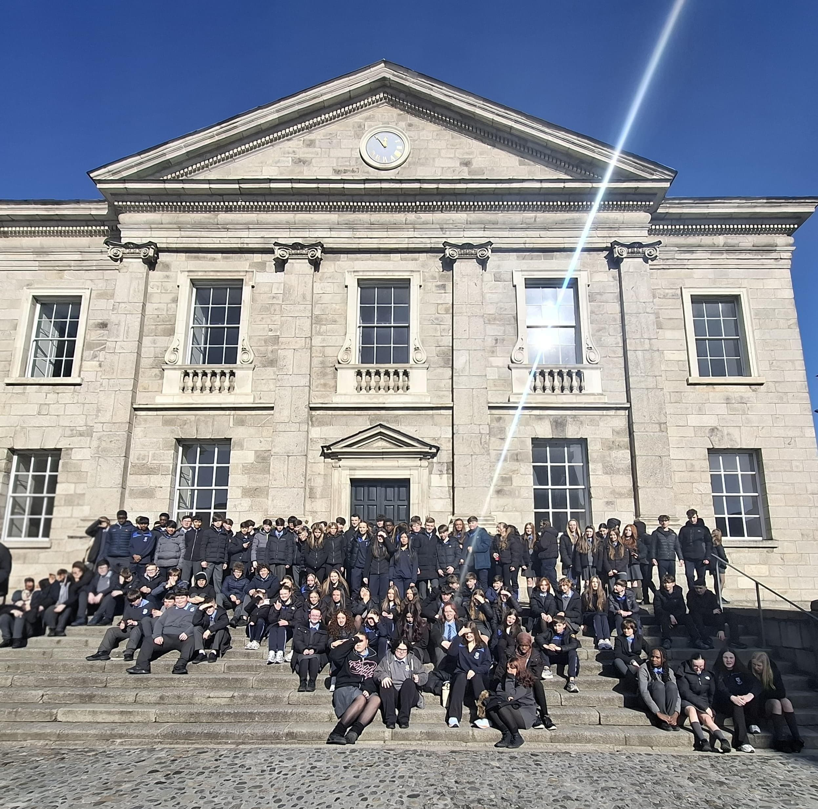

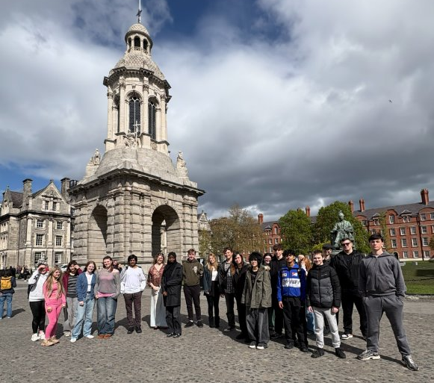
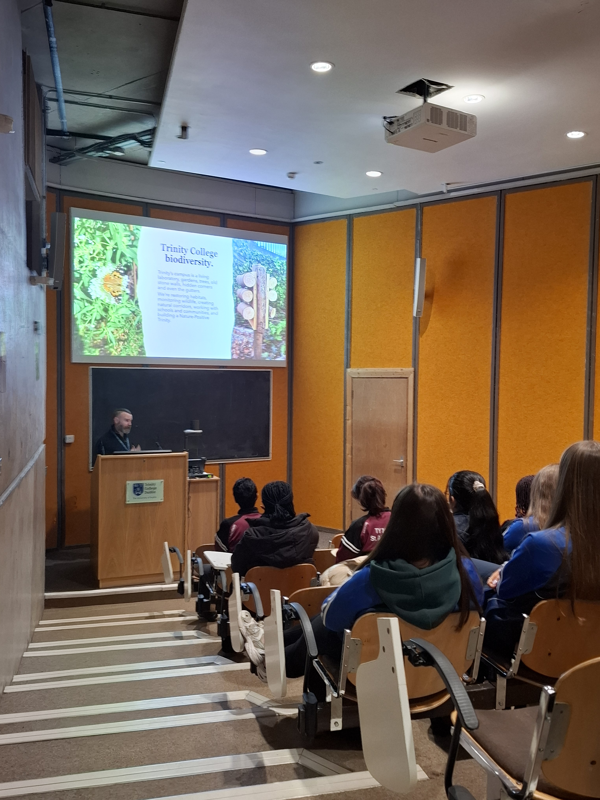
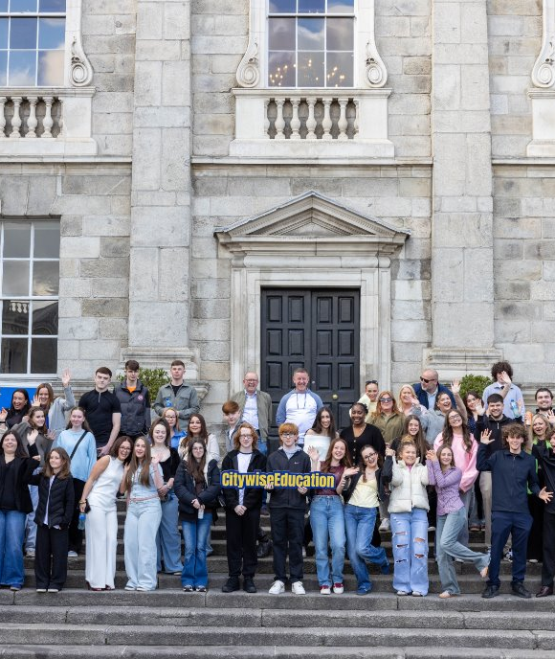

Work and volunteering opportunities
M.Ed. 2026/27
Our aim is to widen access to and participation in Higher Education
Over 150 programmes each academic year
Our programmes focus on academic supports, college experiences & discipline-based student opportunities
Email: bernadette.scott@tcd.ie
Notes:
Bernadette 2 mins

Slide 29
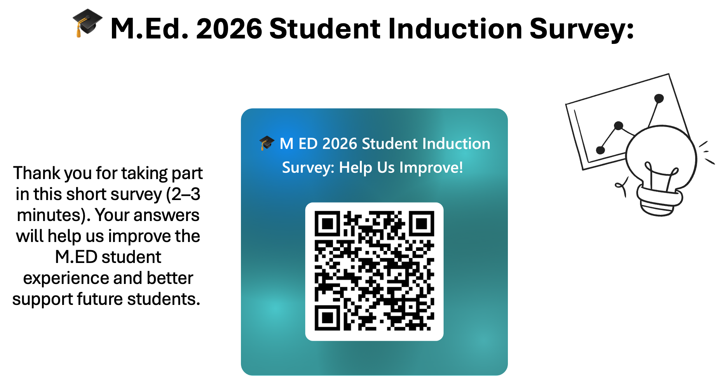

Slide 30
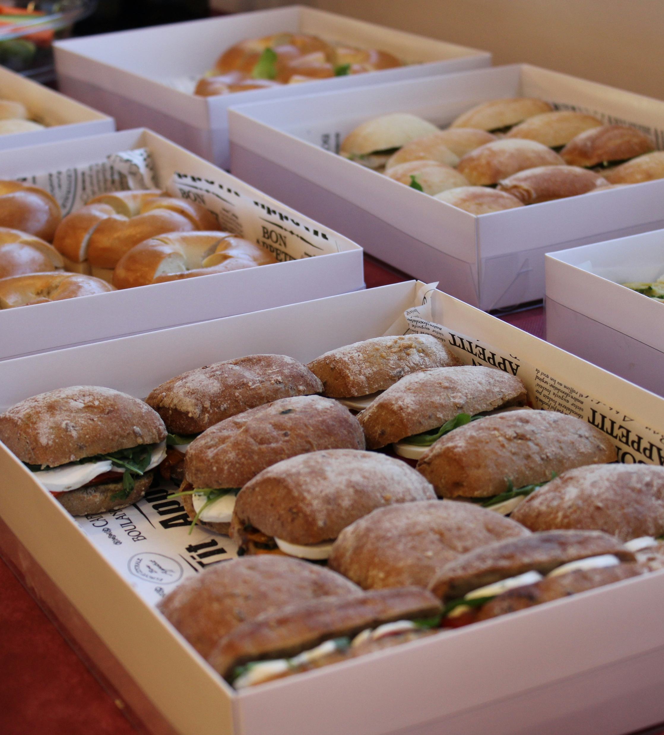
Refreshments, conversations and where to find answers
Please join us in
Room 3074
to continue the conversation with some refreshments
Photo by Razi Abramovich on Unsplash
Notes:
Michelle 1 min

