Slide 1








TCD Sense
Think Sensory...
TCD Sense
The Trinity Sensory Processing Project
A Summer Internship Journey

Slide 2

TCD Sense
Introduction
TCD Sense is an initiative striving to enhance inclusivity at Trinity College Dublin by optimising new and existing spaces, elevating sensory awareness, and providing specialised support to students and staff facing challenges in adapting to the college's sensory environments.

Slide 3






TCD Sense
Sensory Needs
When we speak of "TCD Sense" we are addressing a concept that goes beyond merely creating spaces that are sensory-friendly. At its core, TCD Sense is a commitment to understanding and catering to a diverse range of sensory needs within the Trinity College Dublin community.

Slide 4

Completed
Ongoing
TCD Sense
Project Objectives
Strand One:
Student Approaches with
the disAbility Service
Strand Two:
College Environment
Website content redeveloped
Linktree
developed
Sensory Spaces
Three strategic aims:
  To enable students with sensory processing differences to more fully participate in student life.
  To develop inclusive venues on the college campus from a sensory perspective.
  To conduct research into the experiences of college students with sensory processing issues .
Ongoing
Ongoing
Strand Three:
Awareness
and Training
Strand Four:
Research
Sensory Map
of Trinity
Research Connection with Disc. of Occupational Therapy in TCD

Slide 5


TCD Sense
Project Outline
The TCD Sense project is in line with the Trinity and Disability Service Strategic Plans 2020-25 and Trinity Disability Service Strategic Plan 20-25.
TCD Sense Mission:
To create environments in Trinity that allow all students and staff with different sensory preferences to flourish, and to empower individuals to understand themselves as sensory beings.

Slide 6

TCD Sense had five interns working in the Summer Internship 2023 programme.
TCD Sense
Summer Internship 2023
“Trinity’s Summer and Graduate Internship Programme a Necessary Shift In Supporting the Needs of Disabled Interns.”
Internship Aims
  Development of a Sensory Map
  Survey of Sensory Spaces
  Improvement of Sensory Spaces from Survey Feedback
  Development of a Matrix outlining TCD Sense Spaces and other spaces on campus
  Signage and posters for all TCD Sense spaces
  Develoment of a Sensory Trail for the Trinity College Botanic Garden
Summer Internship
2023

Slide 7
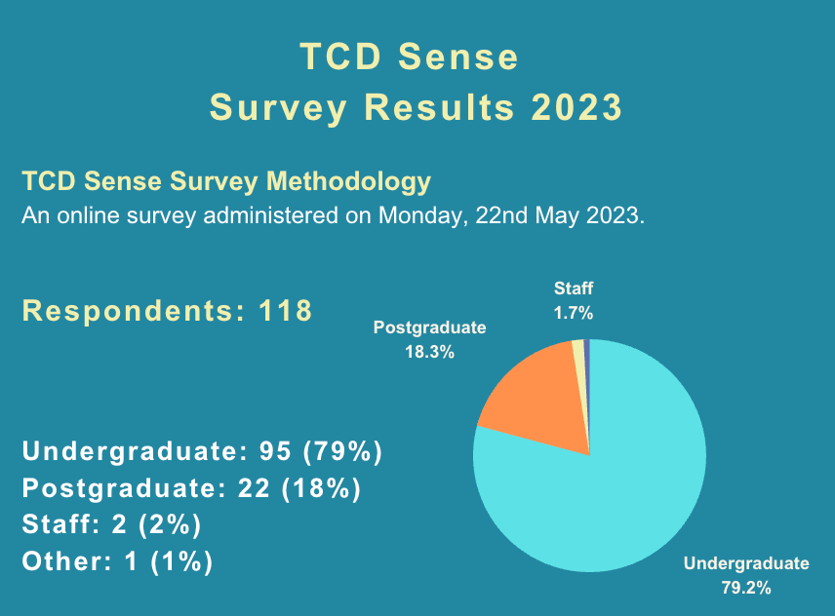
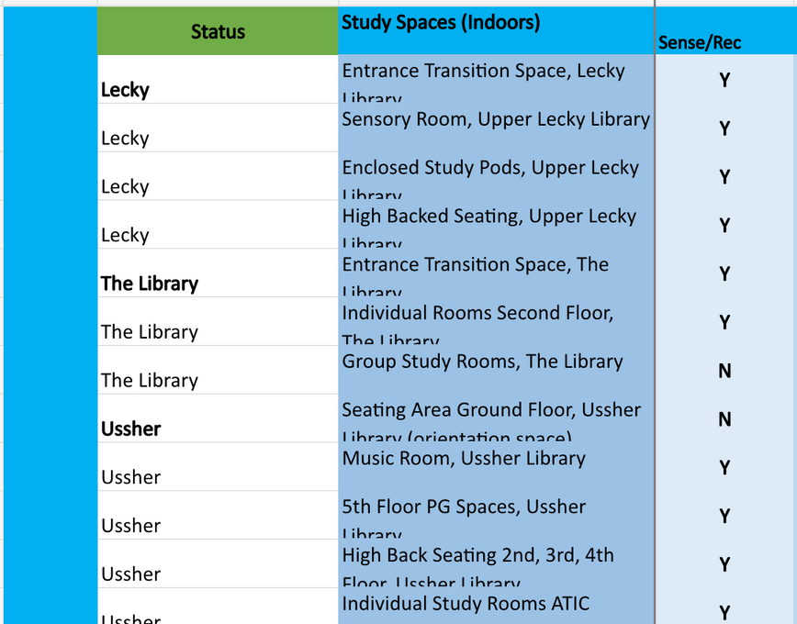
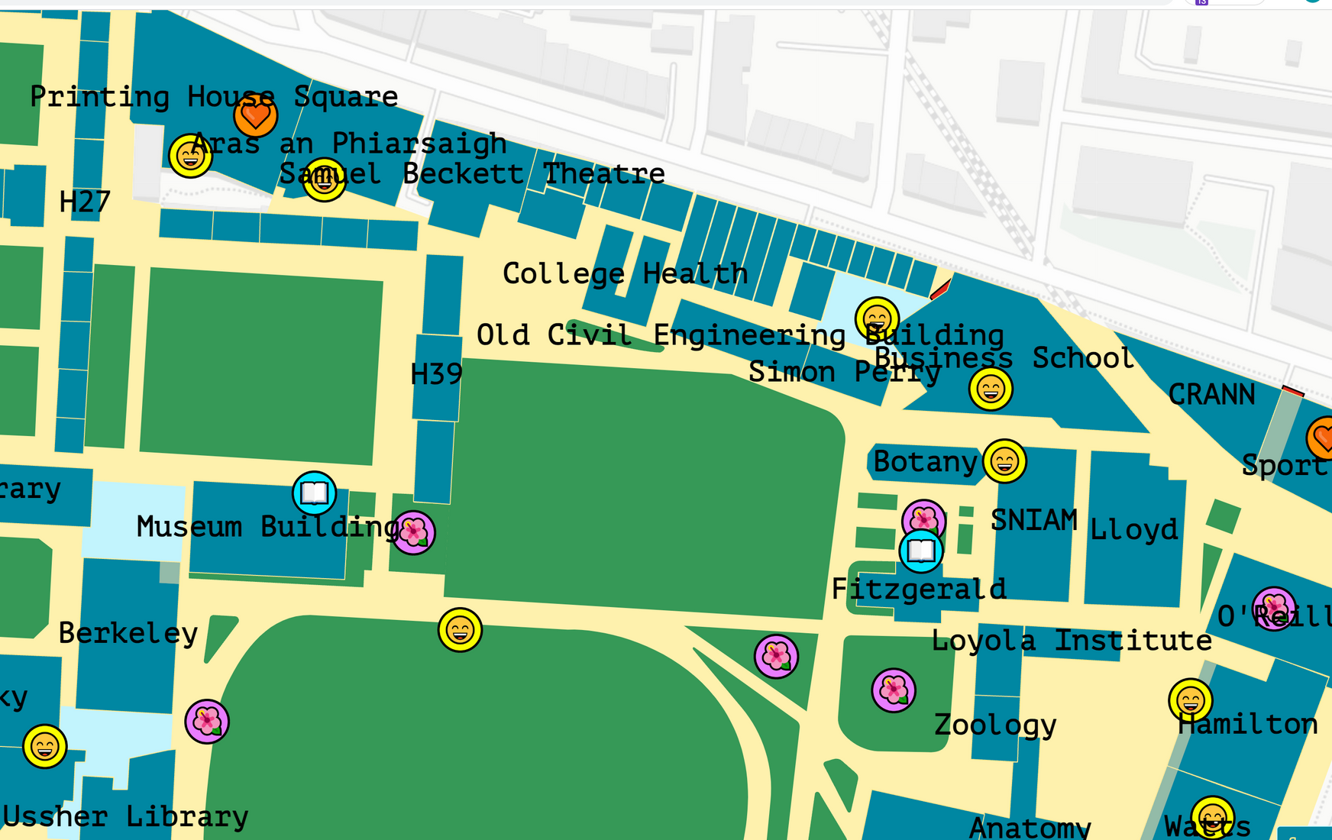
TCD Sense
Summer Internship 2023
TCD Sense Survey 2023
TCD Sense Space Matrix
TCD Sensory Map

Slide 8
TCD Sense
Summer Internship 2023
Student Feedback:
  Awareness and appreciation for sensory-friendly seating and respite rooms
  Challenges in booking and locating sensory spaces
  Suggestions for improvement and addressing sensory sensitivity
TCD Sense Survey Results 2023

Slide 9
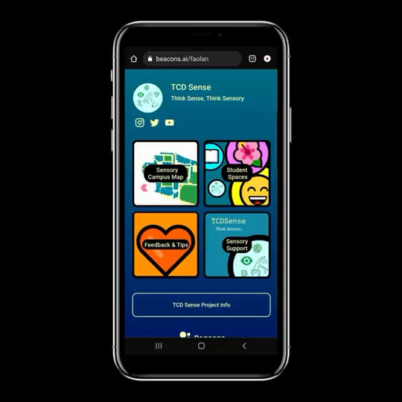
TCD Sense
TCD Sense Sensory Map
  Provides information about the sensory environments
  Provides physical access information for buildings across campus
  Dynamic and interactive tool for campus navigation
  Sensory inclusivity and detailed visual representation
Short Video of TCD Sense Map

Slide 10




TCD Sense
Respite Room
Study Space
Think Sensory...
TCD Sense, a programme focused
on creating indoor and outdoor SENSORY SPACES and develop partnerships with academic and professional areas.
Social Space
Quiet Space

Slide 11
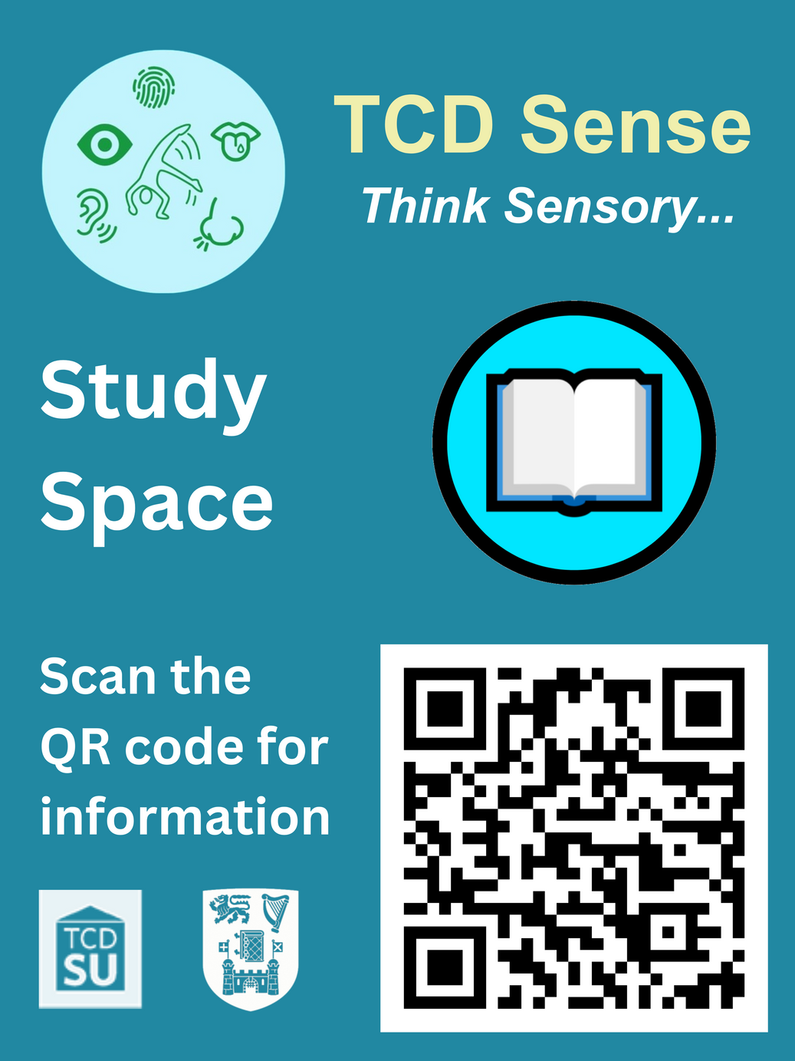
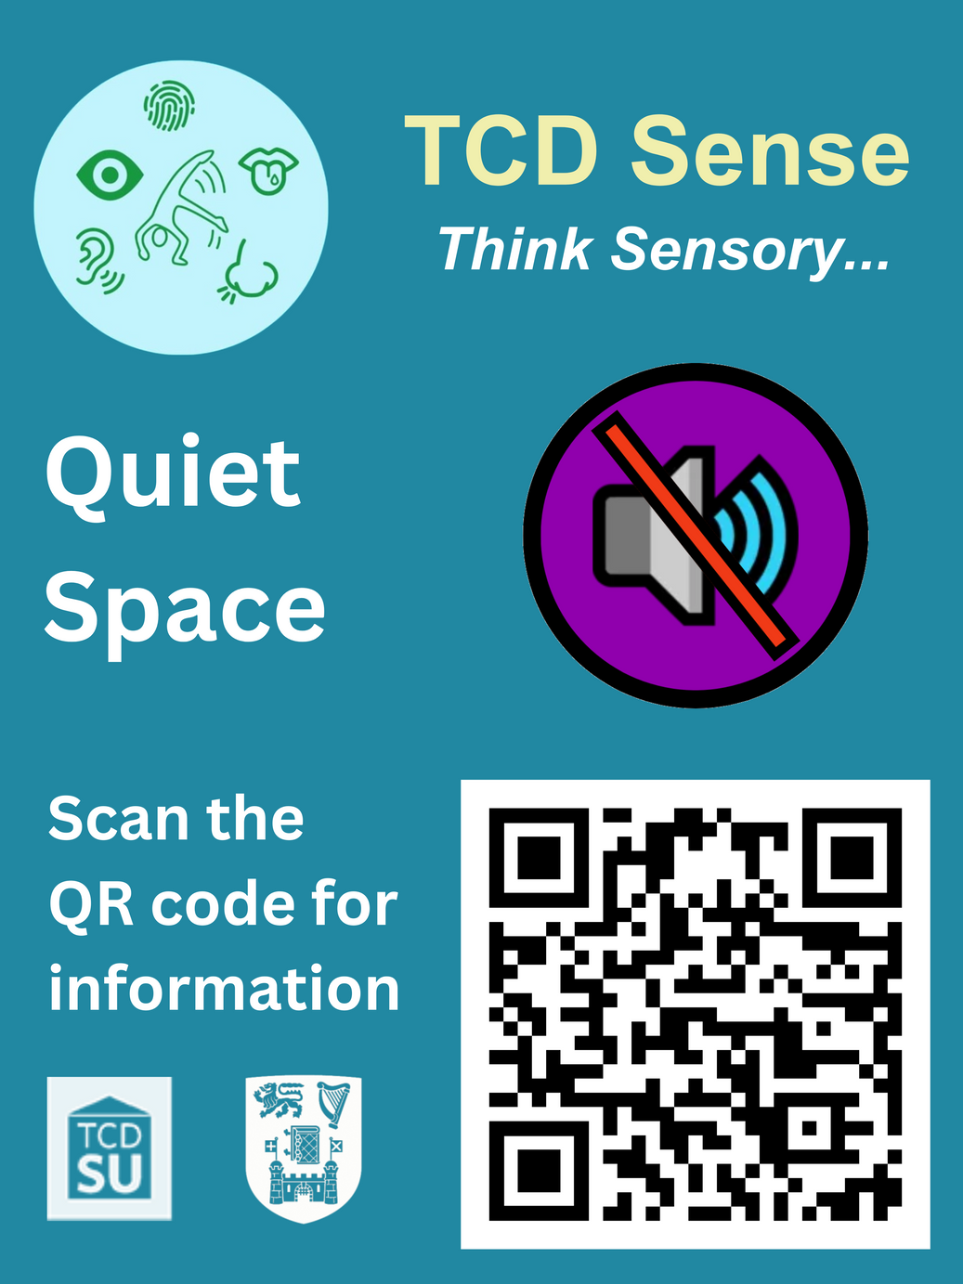
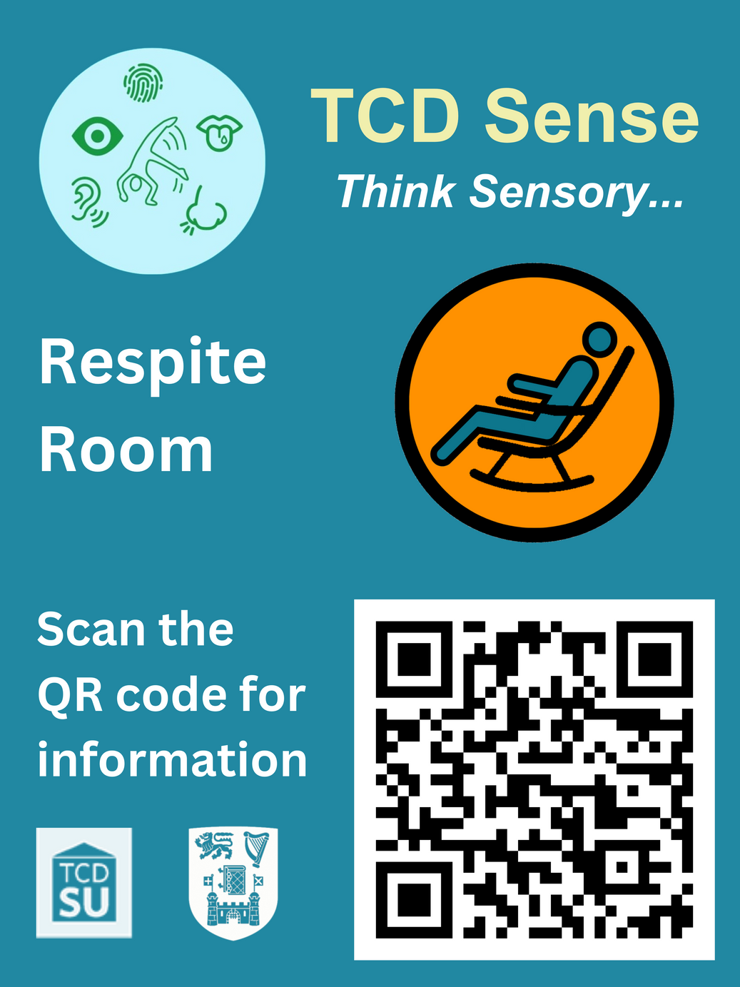
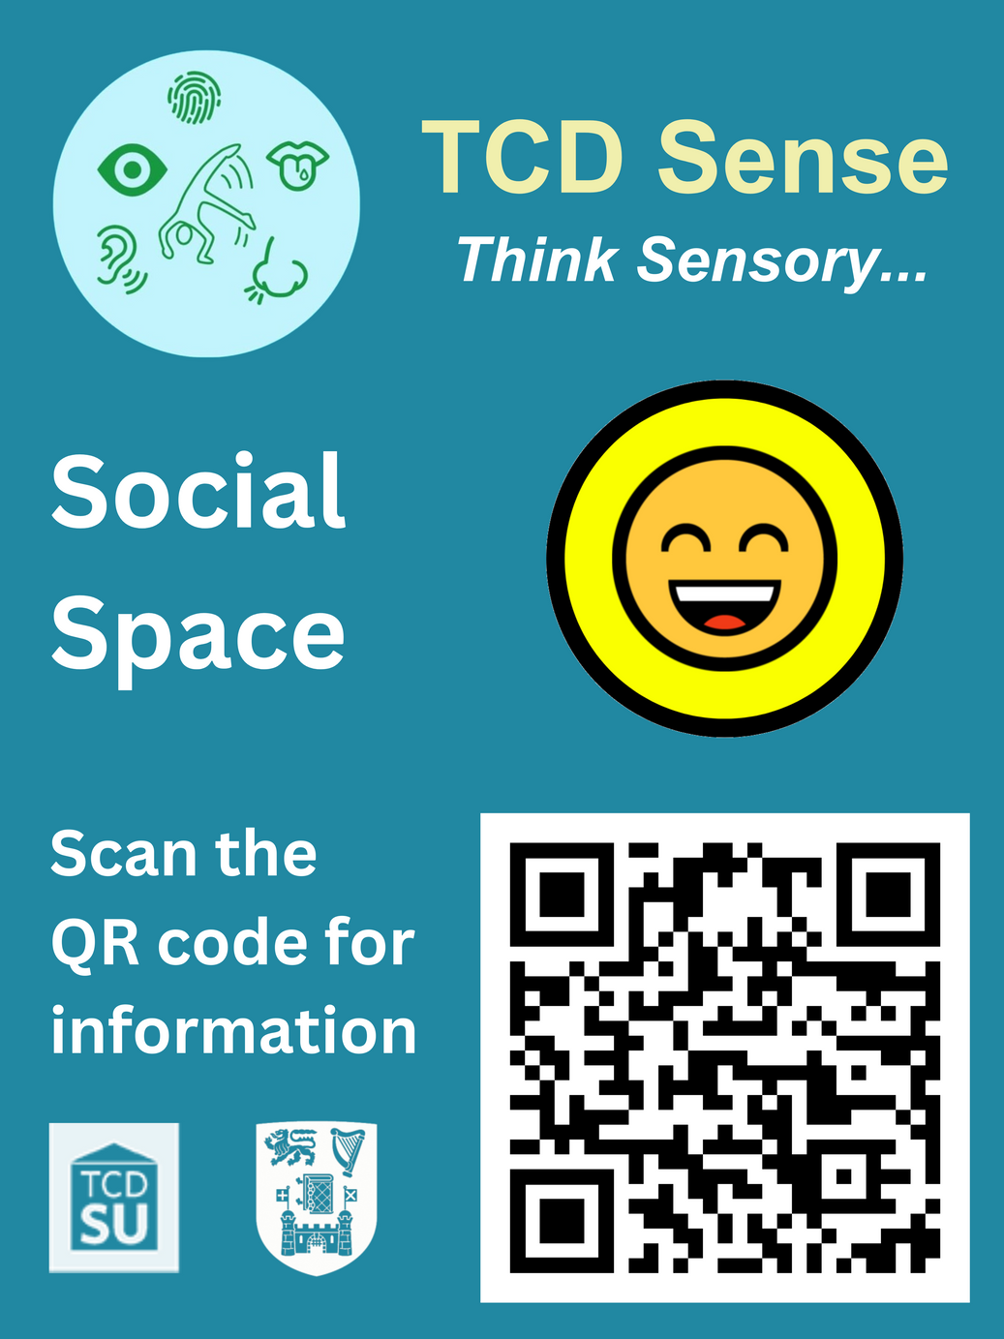
TCD Sense
Summer Internship 2023
Posters Designed for TCD Sense Spaces

Slide 12
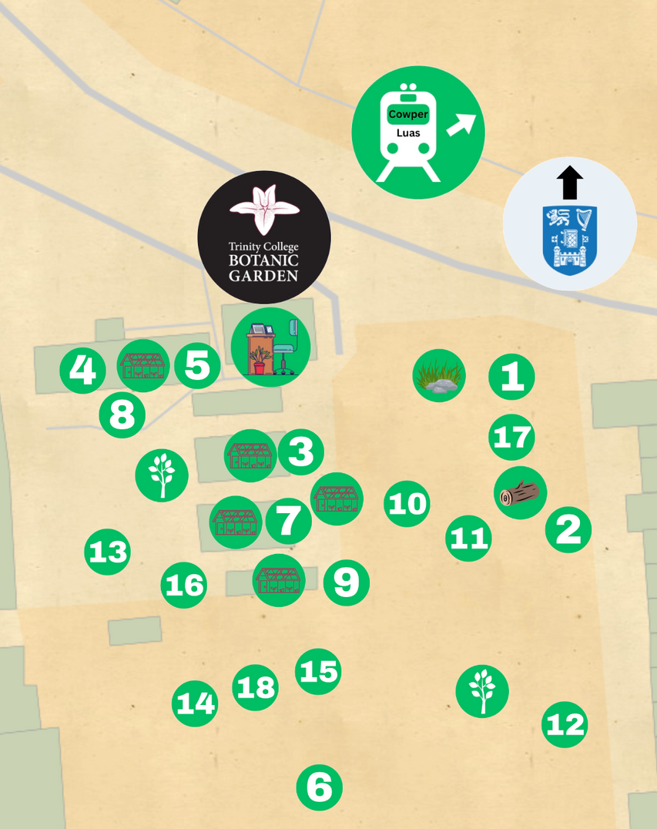

TCD Sense
Summer Internship 2023
Trinity College Botanic Garden Sensory Trail
A collaboration between the disAbility Service,
TCD Sense, and Trinity College Botanic Garden.
The Sensory Trail and Sensory Stops were created by Heather McLean, TCD Botany Student 2023.
  Sensory Trail Map
  Sensory Stop Descriptions
  Audio Descriptions of Sensory Trail Stops
  Log Seats made from fallen trees in the Botanic Garden

Slide 13

TCD Sense
Think Sensory...
Lessons Learned
  Importance of collaborative partnerships and co-production
  Impact of sensory awareness training
  Importance of feedback and continuous improvement

Slide 14
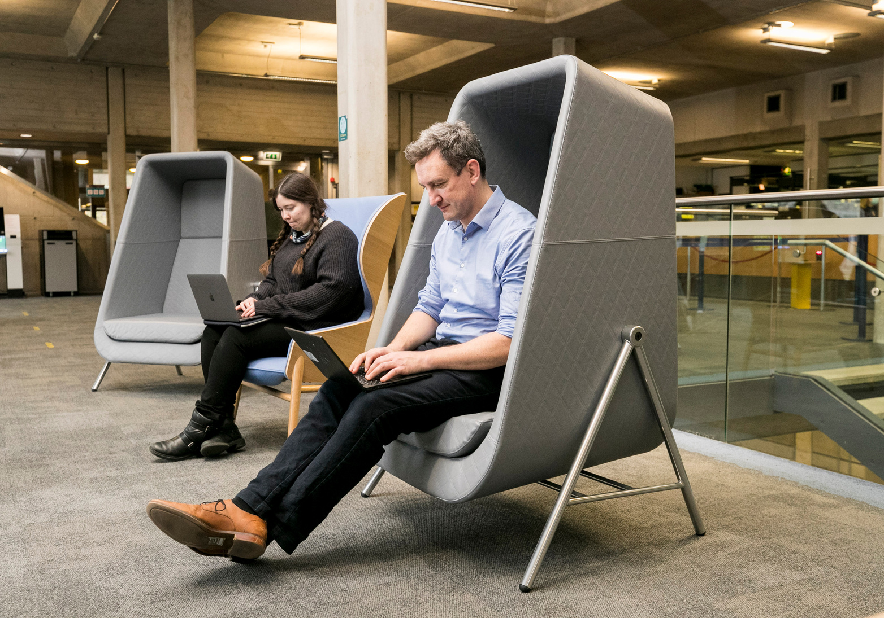
Kieran Lewis (Senior Occupational Therapist,
TCD Sense Project Lead)
TCD Sense
Think Sensory...
Future Directions
  Addressing demand for sensory spaces
  Expanding sensory considerations in design
  Creating inclusive study environments and curriculum
  Promoting collaborative research

Slide 15
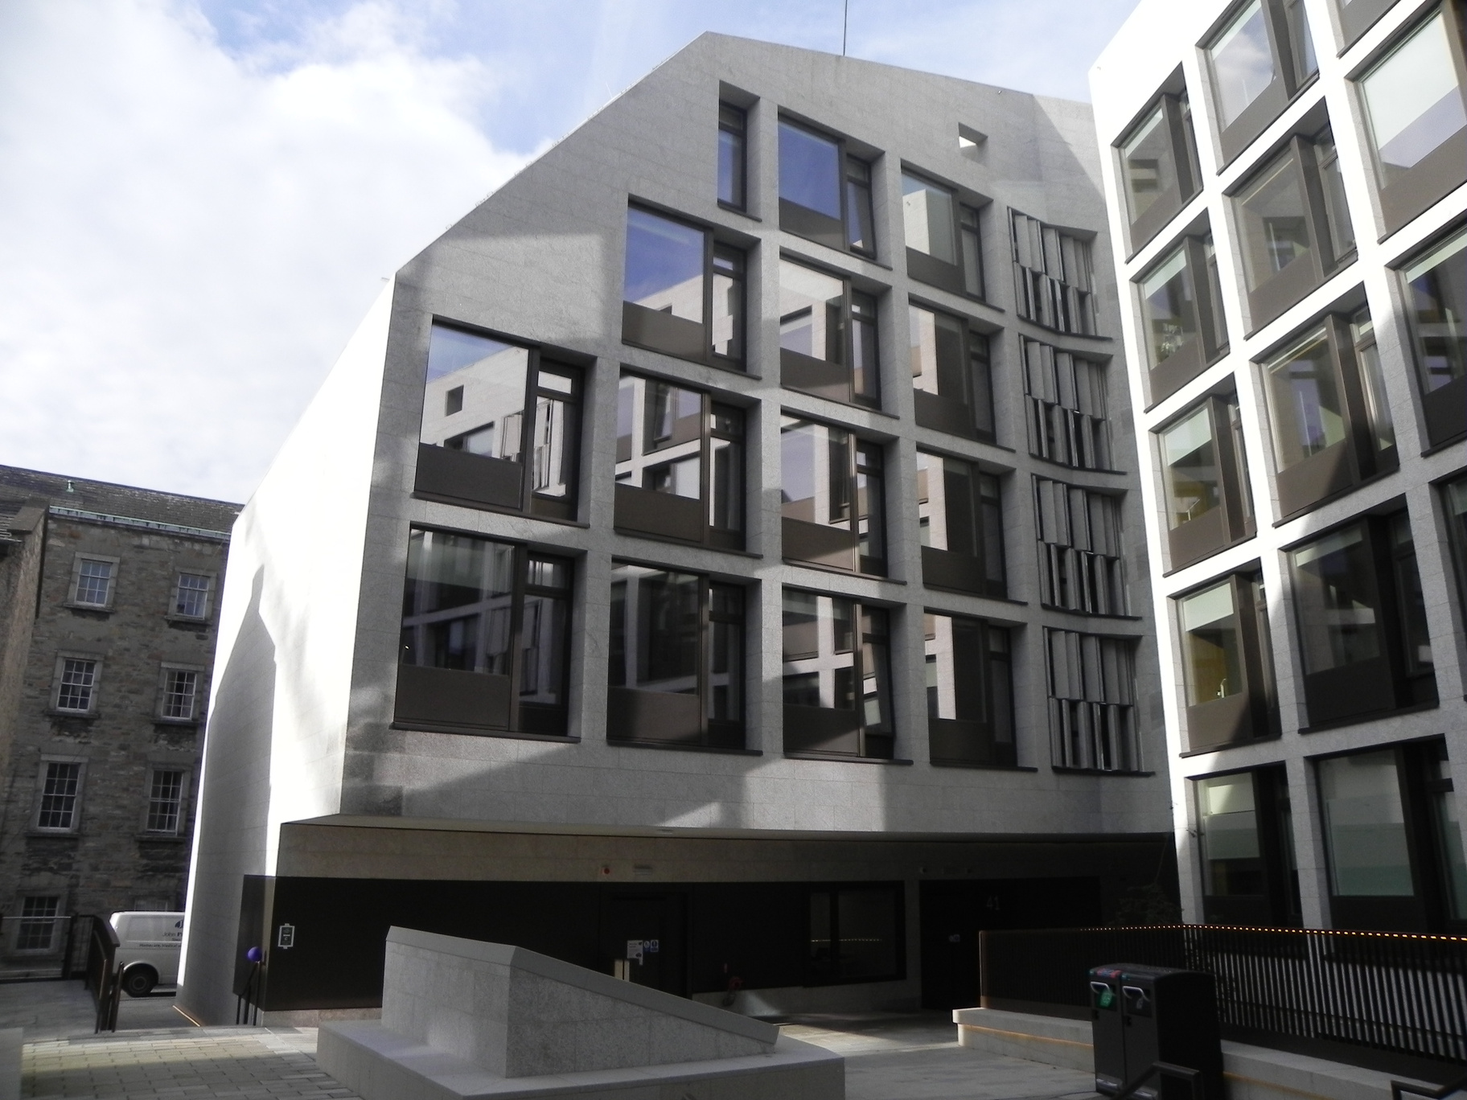
TCD Sense
Think Sensory...
Conclusion
  Success due to collaborative partnership model and diverse funding
  Commitment to creating a sensory-inclusive environment
  Serving as a model for other institutions

Slide 16





Acknowledgements:
Kieran Lewis
Declan Treanor
Trinity disAbility Service
Laura Crean
Fáolan Doecke Launders
Heather McLean
TCD Student Union
Trinity Students & Staff
TCD Library & Staff
TCD Sense
Think Sensory...
S
C
A
N
Email: askds@tcd.ie
the QR Code
Linktree: linktr.ee/tcdsense
beacons.ai/tcdsense
tcd.ie/disability

