Slide 1


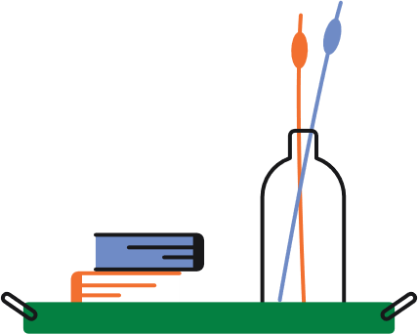



THE DISABLED STUDENT ACCOMMODATION BURSARY
Information Session
Click Here

Slide 2



Eligibility
Criteria
Accomodation
Registration
Financial
You need to have been offered a room in Trinity owned accommodation in order to be eligible for the Bursary
You need to be registered with the disAbility Service to be eligible for the Bursary
You must meet the financial criteria in order to be eligible for the Bursary

Slide 3



Cost of Disability
Based on a research paper submitted to the Department of Social Protection, the cost of disability on average per year is €11,734.
This includes costs relating to equipment, aids, appliances, mobility, transport, communications, medication, care and assistance services and additional living expenses.

Slide 4

Income Thresholds
Number of Dependent Children | Income Threshold
Less than 4 dependent children in the household | €40,343
Between 4 and 7 dependent children in the household | €43,093
8 or more dependent children in the household | €45,723

Slide 5
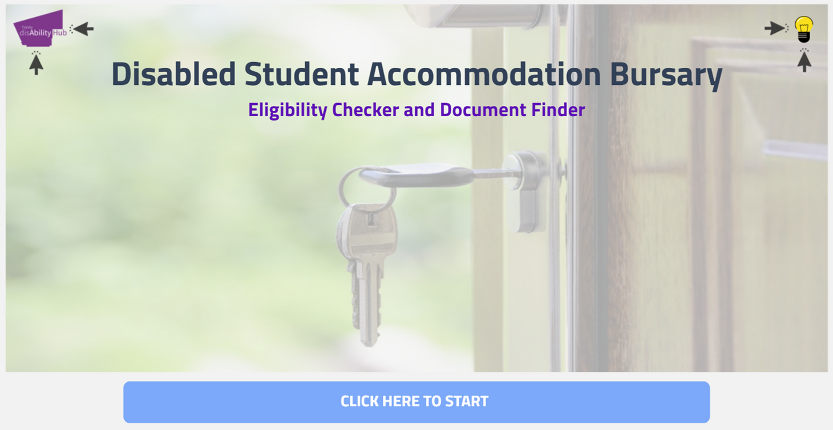



Supporting Documentation

Slide 6





How to Apply
Complete the Eligibility Checker and Document Finder
Gathering Supporting Documentation
Complete the online application

Slide 7
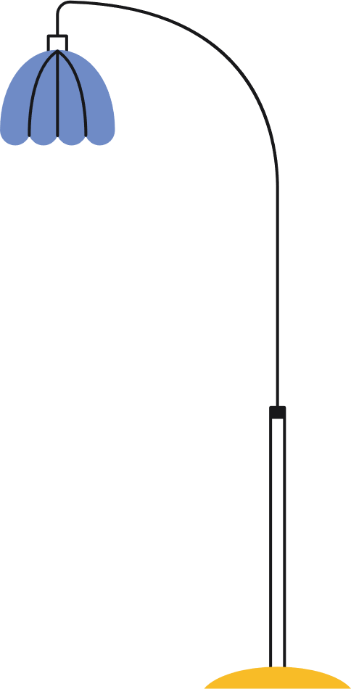


THANK YOU!
Any questions, please email askds@tcd.ie

