Slide 1
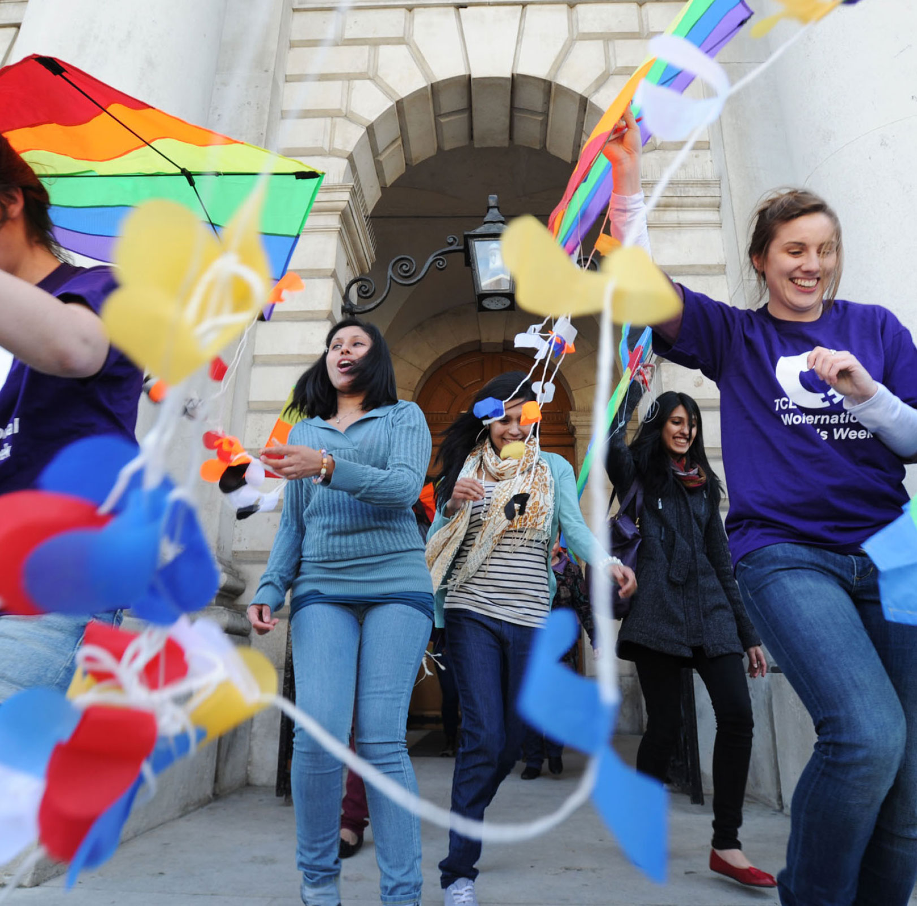

International Women’s Week at Trinity
Date: 6th to 10th March 2017
Time: Various
Venue: Various
Admission: Free but booking required for some events
International Women’s Week is an annual Trinity festival celebrating women’s achievements and promoting gender equality. Events are open to the public.
For more information please visit: www.tcd.ie/equality/projects/international-womens-week/ or email equality@tcd.ie

Slide 2
Headline – Calibri 125pt
Subheading – Calibri 65pt
Date: Calibri 53pt
Time: Calibri 53pt
Venue: Calibri 53pt
Admission: Incl. ticket prices if applicable (Calibri 53pt)
Additional information here including an outline of the event, web links and/or contact details for further information. Include whether event is open to the public (Calibri 53pt)
[Word count: max. 30]

