Slide 1


Assistive Technology and Gen AI
Supporting disabled users in TCD

Slide 2
Introduction
Assistive Technology aims to empower people by enhancing their abilities or compensating for challenges caused by disabilities.
For example, it includes tools like screen readers for the visually impaired, speech-to-text software for those with mobility challenges, or hearing aids for those with hearing impairments.
Generative AI can play a role in advancing assistive technology. By generating text, images, speech, or even code, Generative AI can contribute to tools like:
Real-time captioning for live events.
Creating personalized learning materials or accessible content.
Generating visual descriptions for individuals with visual impairments.
Voice synthesis or conversational AI for those who cannot speak.

Slide 3
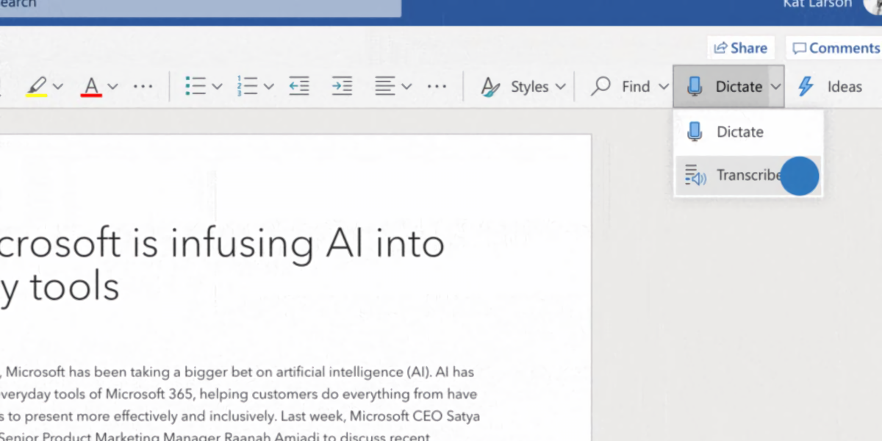
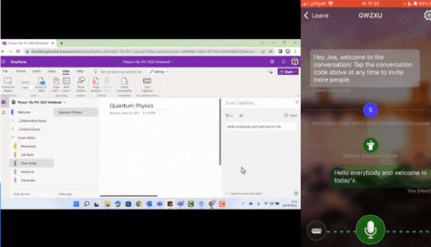
Key Applications of Generative
AI in Assistive Technology.
Communication : AI-powered speech-to-text and text-to-speech systems:
Immersive reader and transcribe with Microsoft Word
Microsoft Transcribe : Microsoft translation app with Microsoft OneNote

Slide 4
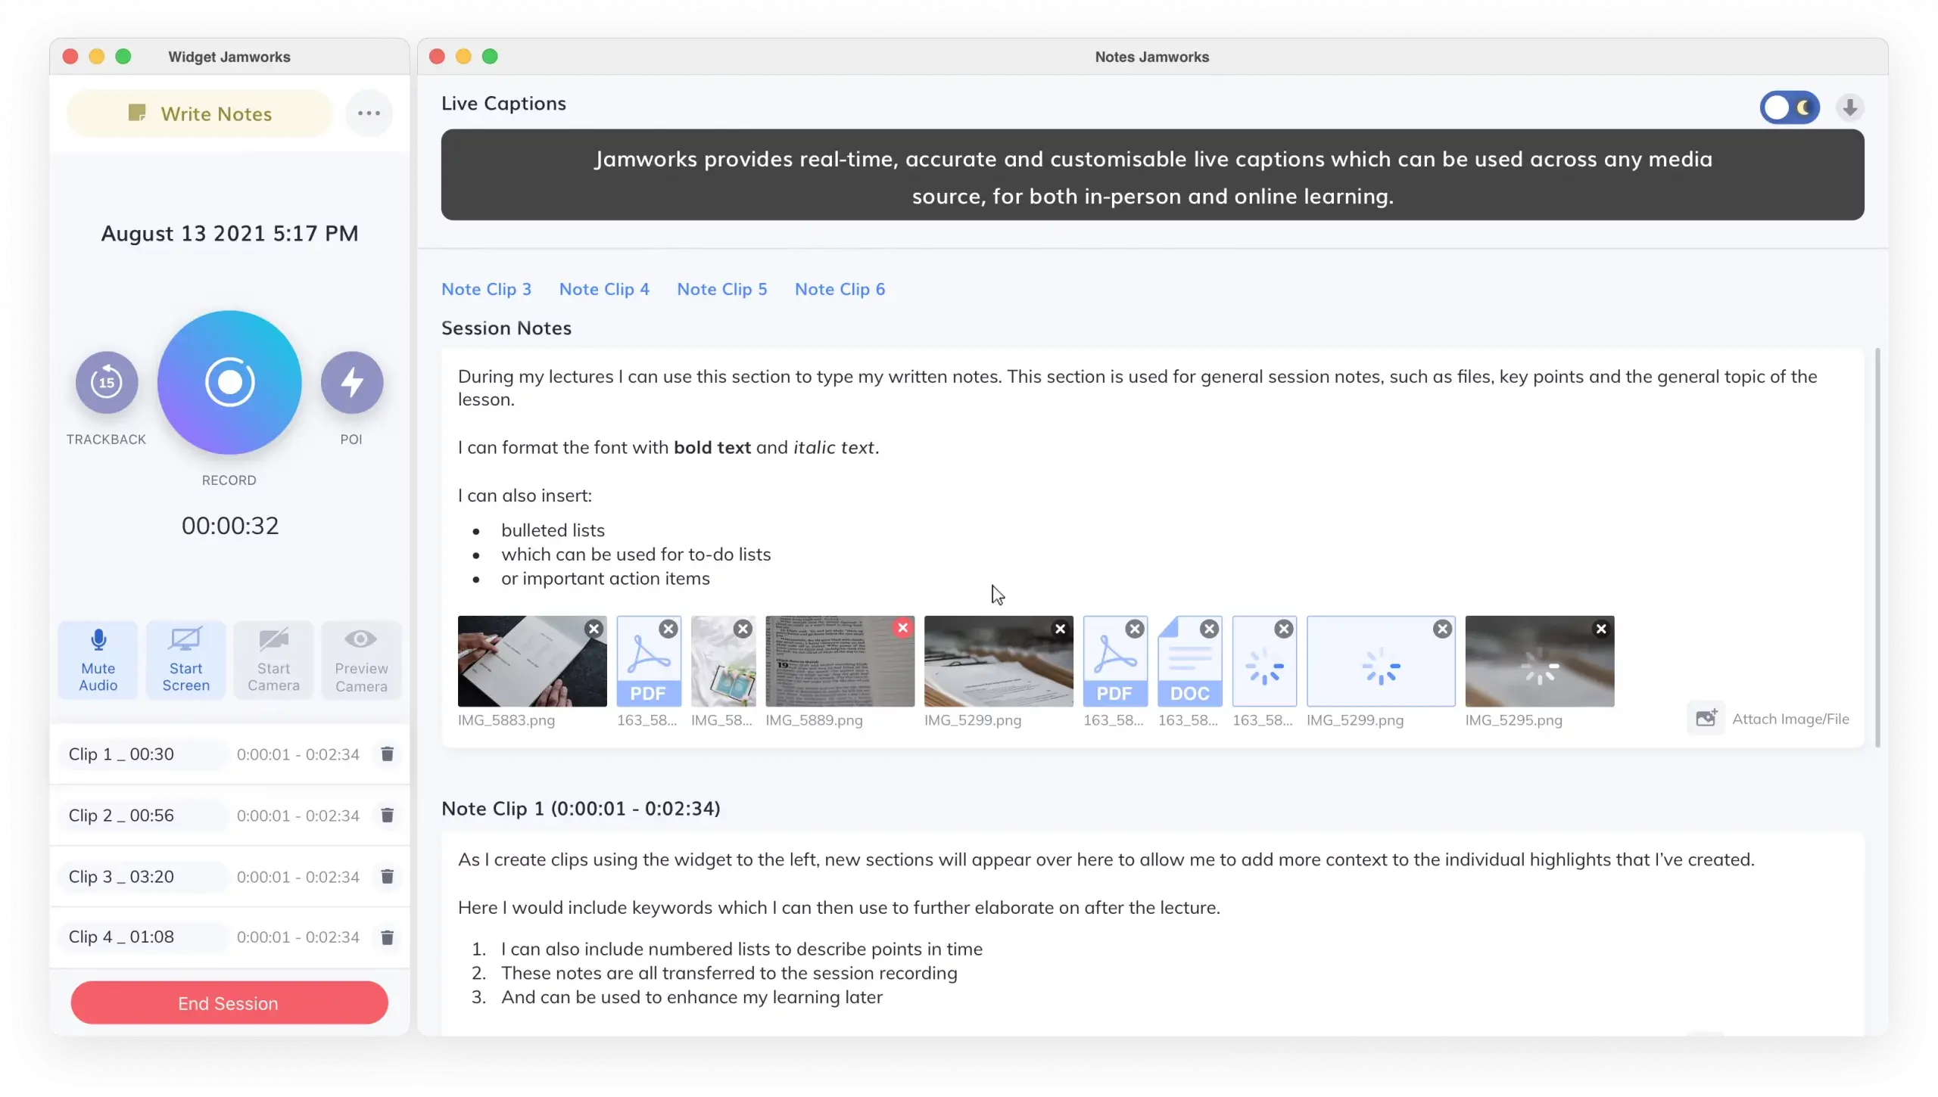
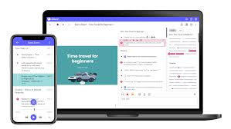
Key Applications of Generative
AI in Assistive Technology.
Learning Aids: Personalized learning platforms for cognitive disabilities.
Notetaking Apps:
Glean- 90+ users in TCD
Jamworks – 6 users in TCD
Google Notebook LM is another free to use
tool

Slide 5
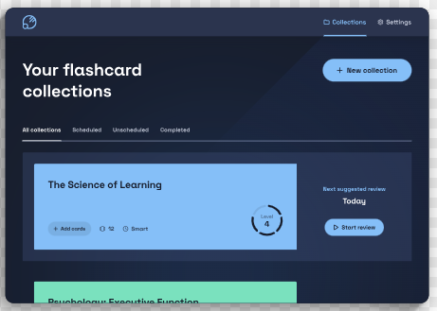
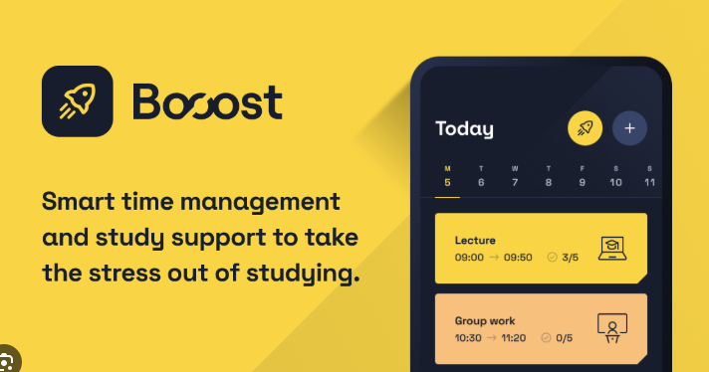
Key Applications of Generative
AI in Assistive Technology.
Learning Aids: Personalized learning platforms for cognitive disabilities.
Revision and time mngt
Luna Flashcards -
Boost – Organisation

Slide 6
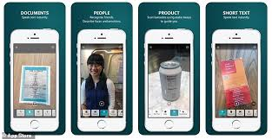
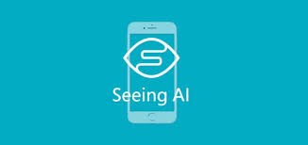
Key Applications of Generative
AI in Assistive Technology.
Mobility Solutions:.
Tools like the Microsoft Seeing AI App describe nearby objects, people, and text, providing real-time situational awareness:

Slide 7
Benefits for Users with Disabilities
Increased Independence: Smart assistants (e.g., virtual AI helpers) allow users to control devices, manage schedules, and perform everyday tasks using voice commands or accessible interfaces – Boost tool
Enhanced Accessibility: Real-time language translation and sign language recognition expand communication possibilities for deaf or hard-of-hearing individuals sign language avatars, etc. - ISL : Avatar Page
Personalization: AI-driven applications can adapt over time, learning from user behaviour to provide better support and reduce frustration – e.g. Grammarly
Accessibility Across Digital Platforms - Automatic captioning, transcription services, and AI-generated alt text make online content more inclusive for individuals with visual or auditory disabilities – transcription tools within Office 365

Slide 8
Future Opportunities
Adaptive Prosthetics: AI-driven prosthetic devices with enhanced precision and adaptability for real-time user needs.
Companion Robots: Providing emotional support, assistance with daily tasks, or even social interaction for individuals with limited mobility or isolation- e.g Gemini from Google been an example
Cognitive Enhancements: Tools for memory support, task organisation, and learning aids for people with cognitive disabilities – like the Luna
Immersive Experiences with AR/VR: Developing immersive environments that can simulate real-world scenarios to aid in therapy, skill development, and accessibility training.
Advancing Policies and Ethical Design: Opportunities to influence global standards for inclusive technology design. Collaborative efforts to create affordable and universally accessible assistive tools.

Slide 9
Challenges and Considerations
Ethical Concerns: Privacy, data security, and bias in AI systems - Lack of representation of marginalised groups in development processes.
Accessibility Gaps: Ensuring inclusivity in AI design - Ensuring these technologies are easy to use for people with diverse disabilities. Addressing compatibility with other assistive tools (e.g., screen readers, Braille devices).
Privacy and Security Concerns - Generative AI systems often require significant data collection, which raises concerns about how personal and sensitive data is handled. Risks of unauthorised access or misuse of user data.
Training and Awareness - Users and caregivers may require training to fully benefit from these tools.
Lack of awareness about available technologies or how to integrate them effectively.

Slide 10
Conclusion
By integrating AI into workplaces and educational institutions, individuals with disabilities can overcome barriers to employment and education, promoting inclusivity and equity.
Assistive AI tools help users participate fully in social, professional, and recreational activities.
Call to action: Advocate for inclusive innovation and accessibility.

Slide 11

.
How to contact The Disability Service
.
Email – askds@tcd.ie.
Visit us at the disAbility Hub in Printing House Square.

