Slide 1
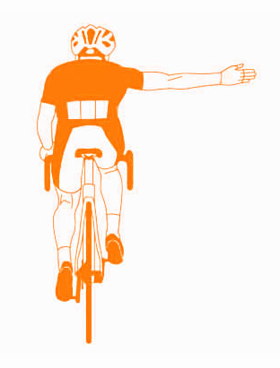
3B8 Universal Design Innovation
Dr. Gareth Bennett
Group 5
Conor Kirwan
Eimear O’Connor
Leo Devlin
Matty Burke
Department of Mechanical and manufacturing engineering

Slide 2
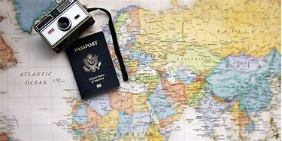
The Task
Surveys – To give real data and opinions from potential consumers.
“The focus of the project is “Smarter Travel”, specifically the design of products and services to encourage or to address obstacles to more environmentally friendly, healthy and societally responsible travel modes.”
Research – Gather information on the topic and see if there is a correlation with the survey results.
In order to do this, research was conducted via
Observations – If there are any personal experiences that may identify a problem not previously picked up

Slide 3
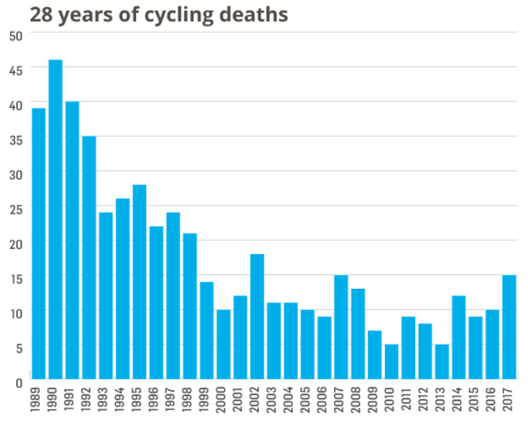
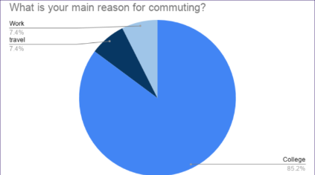
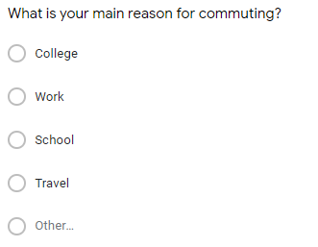
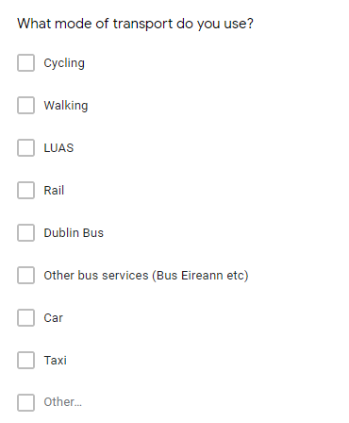
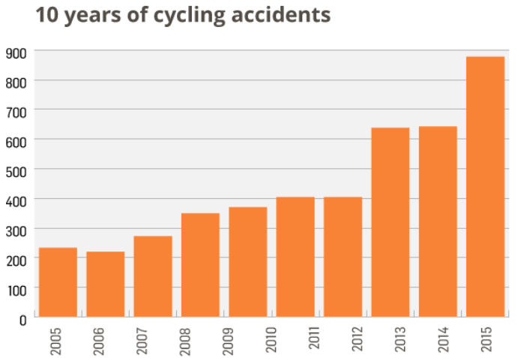
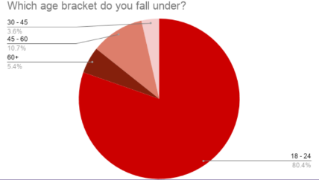
Needfinding & Research
Some sample questions from the survey.
Some sample answers from the survey.
Some research into cycling accidents in Ireland (Irish Times, 2018)
Important to gain information e.g. % of people commuting using a certain mode of transport.
Shows us information that may not be gathered from observations or research.
It shows an increase in cyclist accidents and deaths in recent years
Helps us to identify problems & identify potential stake holders for the project.
All this analysis helped us to identify a problem with cycling in Ireland

Slide 4
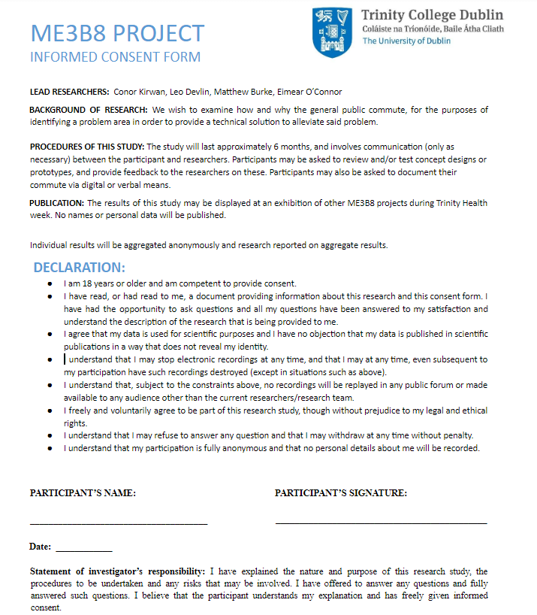
Stakeholders
All people who cycle regularly of all ages.
Important that they understand that none of their personal data will be used.
2 stake holder, male & female, early 20’s that commute daily to college by bike.
2 stake holder, mid 40’s, both male, commute daily to work by bike.
Stake holder, female, early 30’s, cycles weather dependent to work.

Slide 5
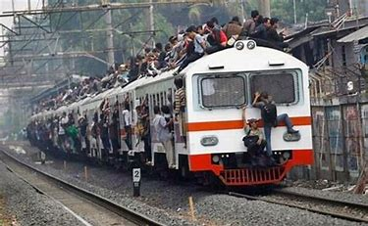
Defined Problem
3 main problem areas, safety, over crowding & climate.
Over crowding is hard to fix, as peak hours will always be busy.
Climate is also something that is very hard to control.
Exploring safety, and more specifically safety of cyclist leaves us with may avenues to go down, as we shall see on the next slide.

Slide 6
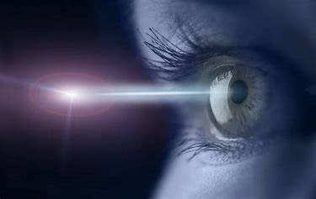
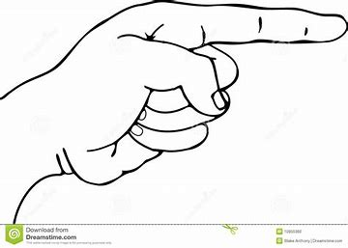
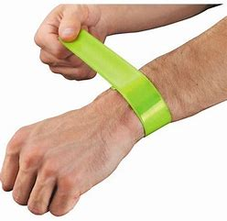
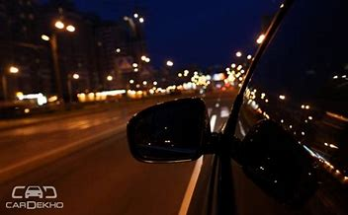
Mission Statement
Cyclists Vision
Indication
"Our goal is to improve the safety of cyclists on the road by providing them with a safer commute, while not causing unnecessary distractions"
"Our goal is to improve the safety of cyclists on the road by providing them with a safer commute, while not causing unnecessary distractions"
Visibility to Cars
Biometrics

Slide 7
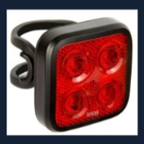
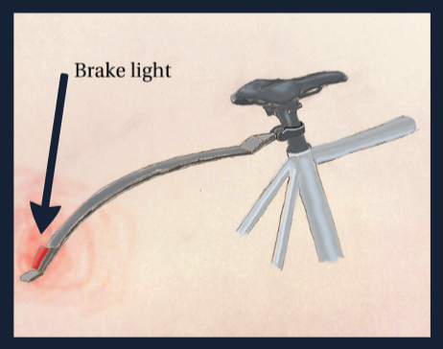
Proposed Solution 1
Brake light - Mudguard
Easily attached
Connected to front brakes
Splash protection
Arduino can be integrated

Slide 8
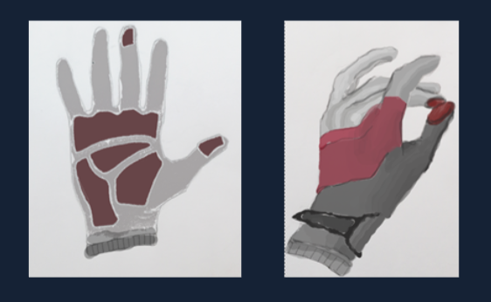
Proposed Solution 2
Indicating biometric gloves
Left hand finger touching = left indication, etc
Response to middle finger and thumb coming into contact
Reduced distraction by using button
Protection against elements

Slide 9
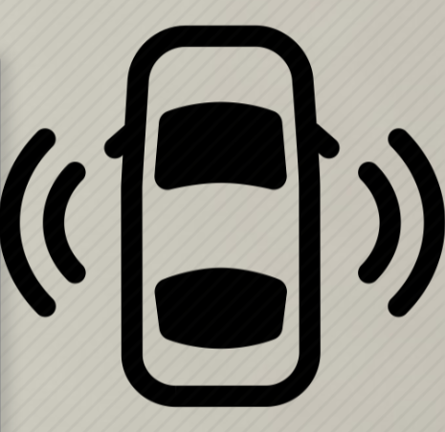
Proposed Solution 3
Proximity car sensor
Sensor on cars sides that initiate when car indicates
Arduino connected to car sensor and indicator
Audio or visual cue triggered if cyclist is within range

Slide 10
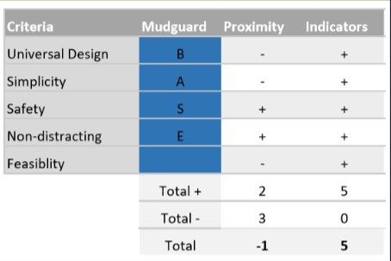
Choosing Prototype
Pugh matrix made.
Indicators scored the highest.
Pugh Matrix not the only factor used to determine final concept.
In the end though, it was decided that it would be best to do the indicator gloves.

Slide 11
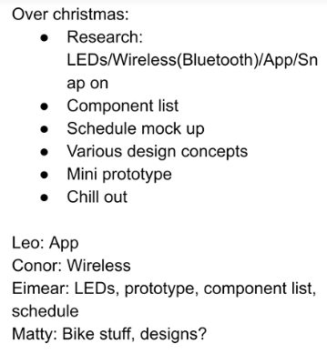
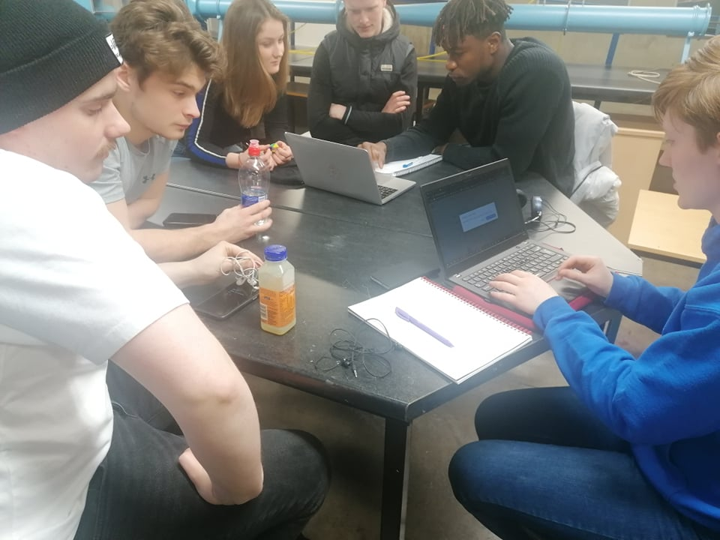
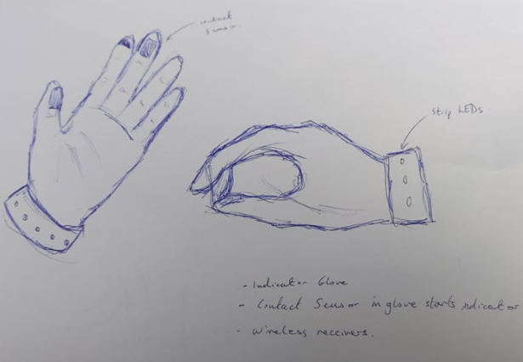
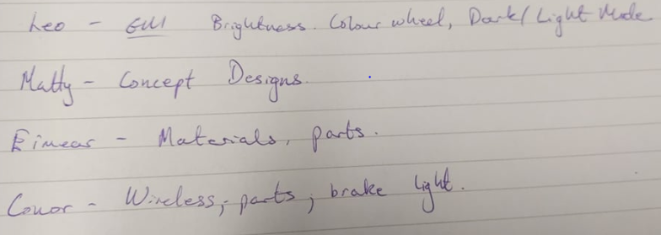
The Design
A plan was set up for over the Christmas period.
A rough sketch of the design was drawn up, specifying key features & materials
Everyone would do research on a certain topic in order to select the required electronic parts and to 3D print an adequate part

Slide 12
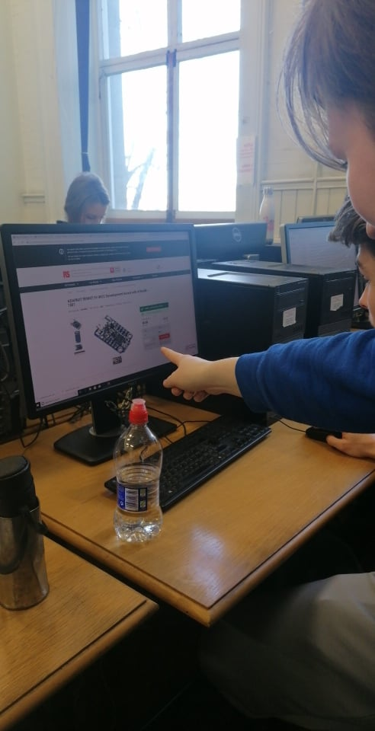
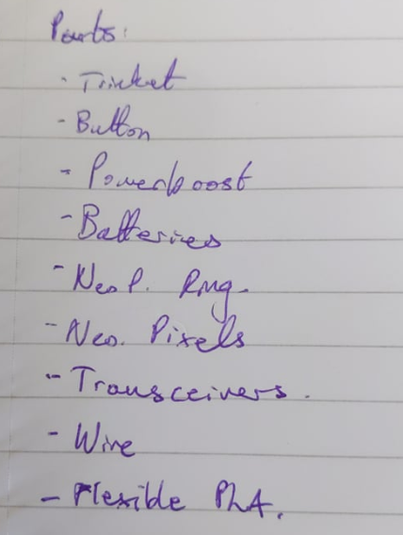
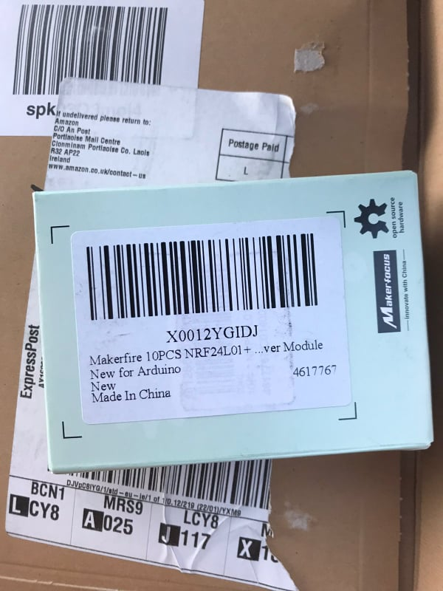
Parts
The electronic parts were chosen, taking into account, size, weight, functionality, etc.
A full parts list was devised.
Parts were ordered mainly from the website Adafruit.
Eventually the parts arrived, in the mean time the design of the glove and band were finalised.

Slide 13
Drawings
These were the drawings designed for the for the glove and band
The design is universal and functions easy with the tactile button switch
The glove material is stylish and comfortable which providing protection from the elements
The band adds extra visibility when trying to indicate the direction

Slide 14
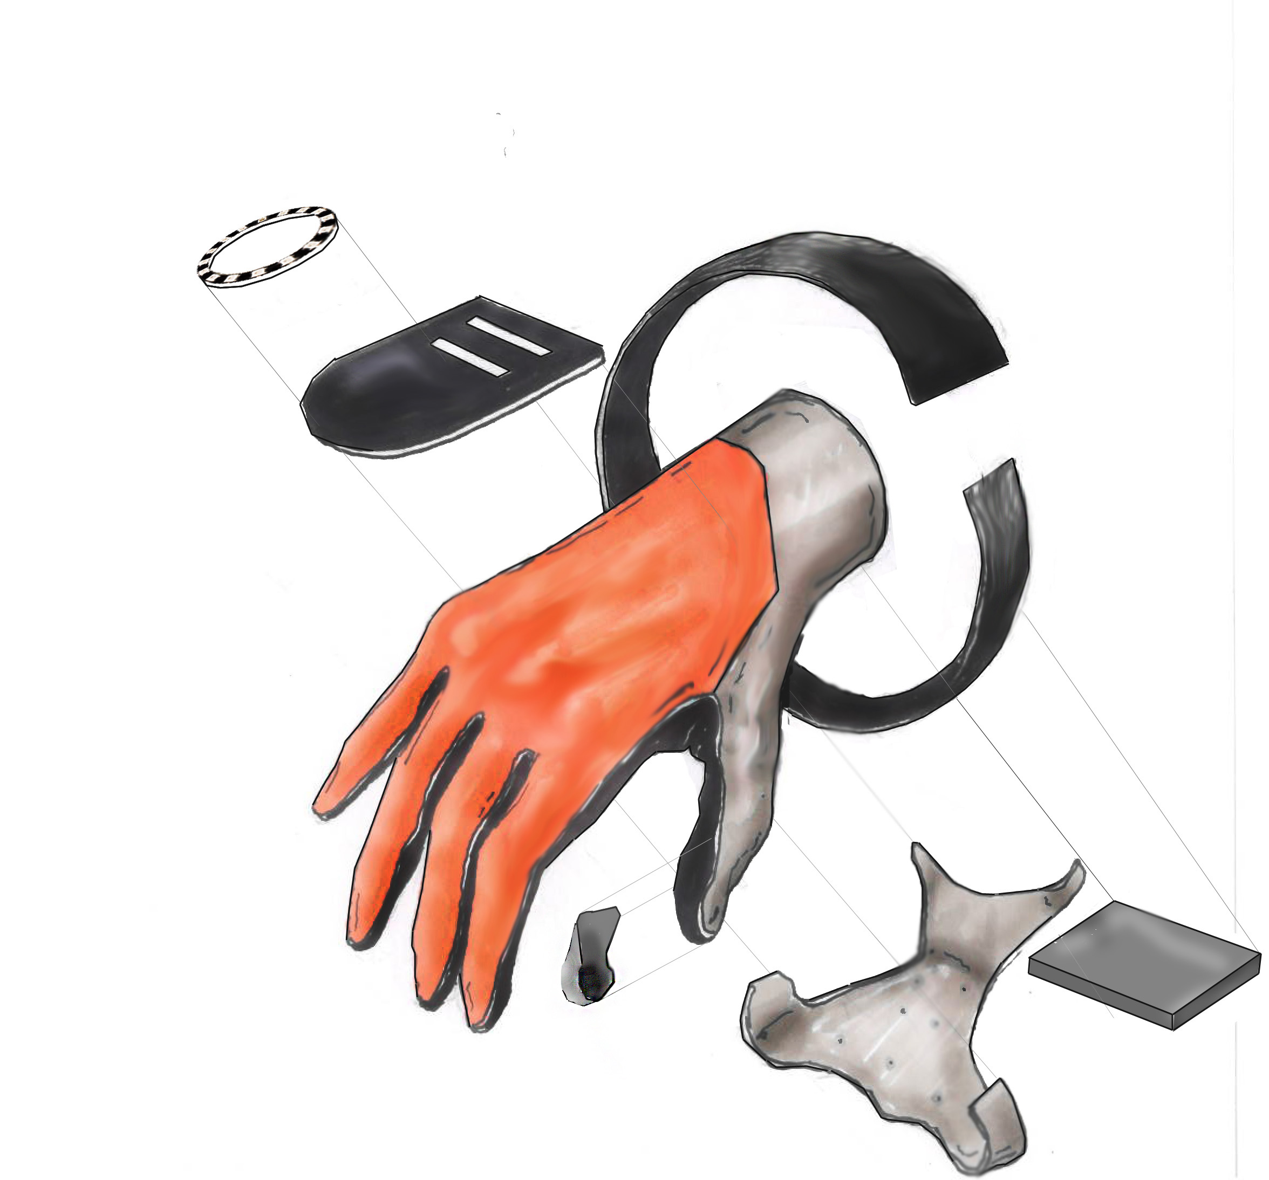
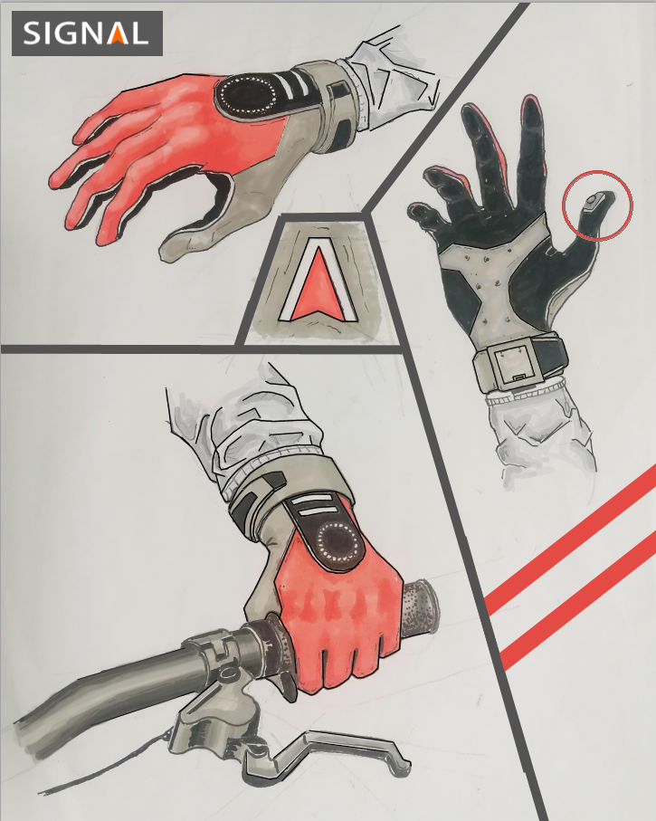
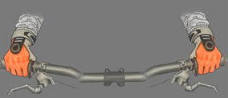
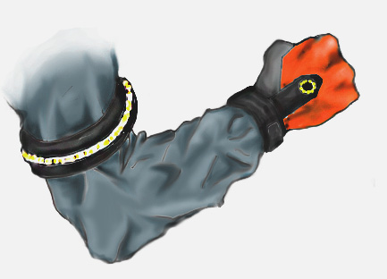
Drawings

Slide 15
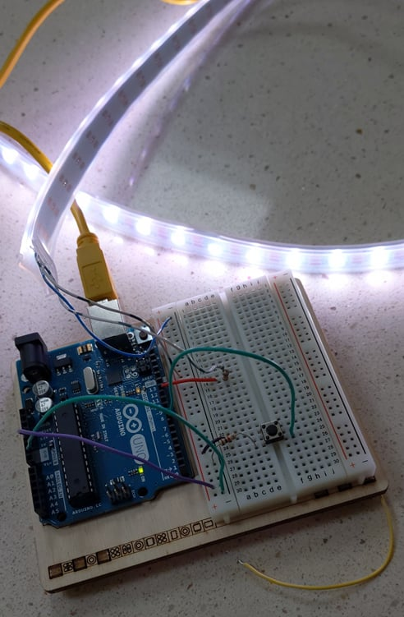
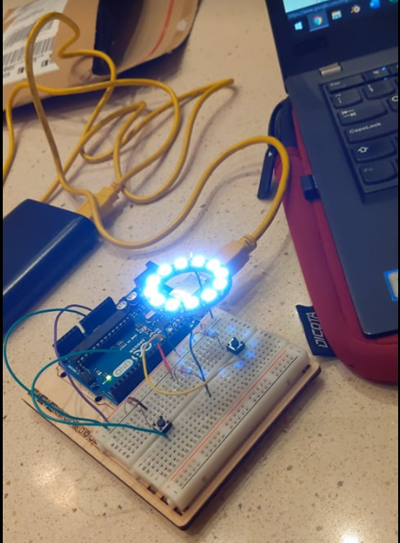
Testing the Electronics
The LED ring and strips remain bright when not indicating
The LED ring will flash orange when the button is pressed
A transceiver picks up this button being pressed, and it also flashes orange

Slide 16
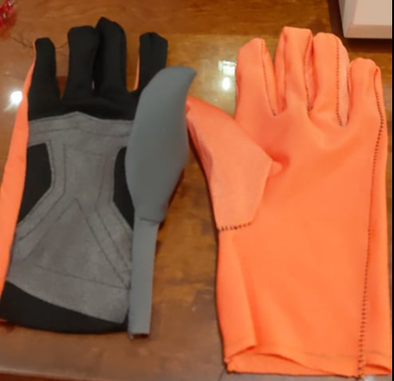
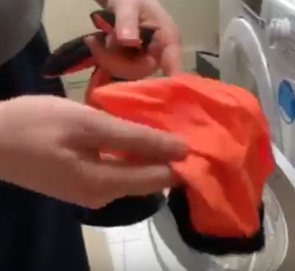
The Prototype - Glove
The glove has an inner and outer lining for extra protection
A velcro strip holds the 2 linings together
The inner lining is machine washable
The outer lining holds the electronics and LED’s

Slide 17
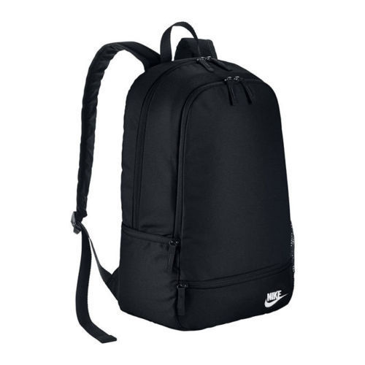
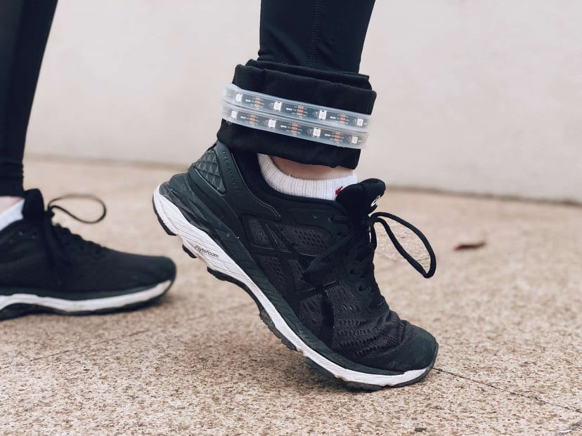
The Prototype - Band
The band is made from the strap of a recycled school bag
It also houses the electronics, hidden in the 3D printed box
The band is adjustable and can be worn on the arm or leg

Slide 18
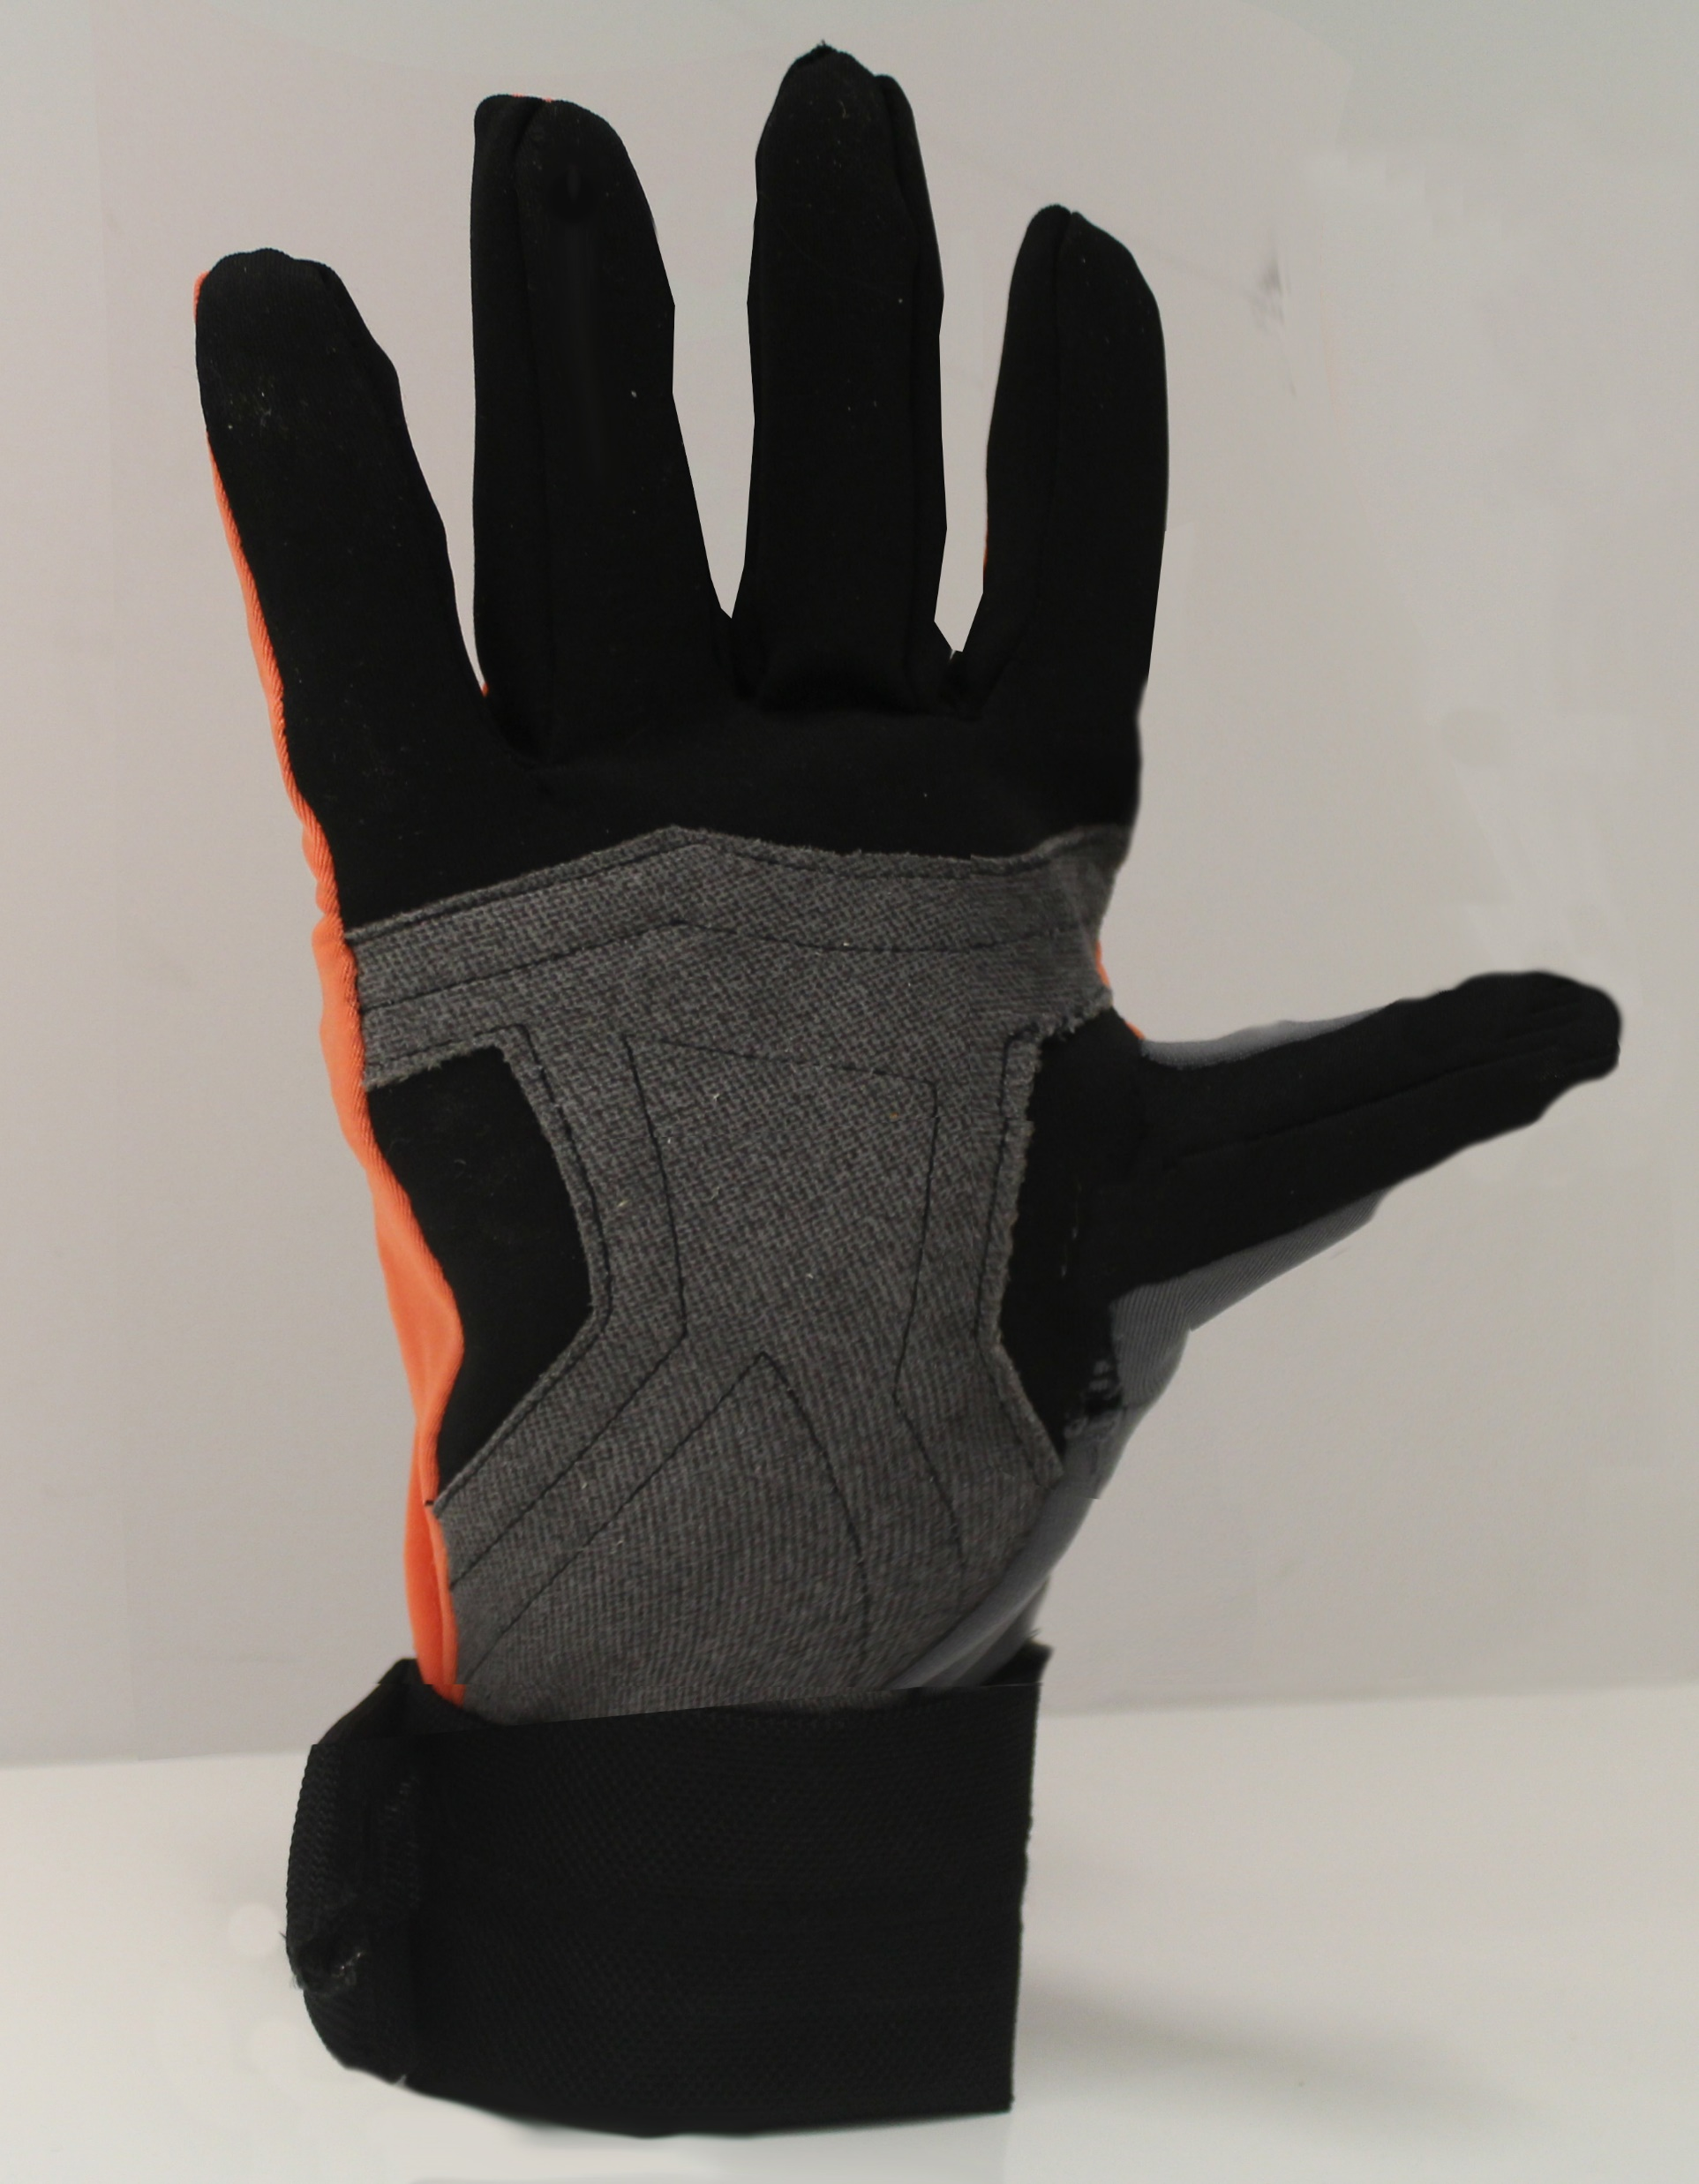
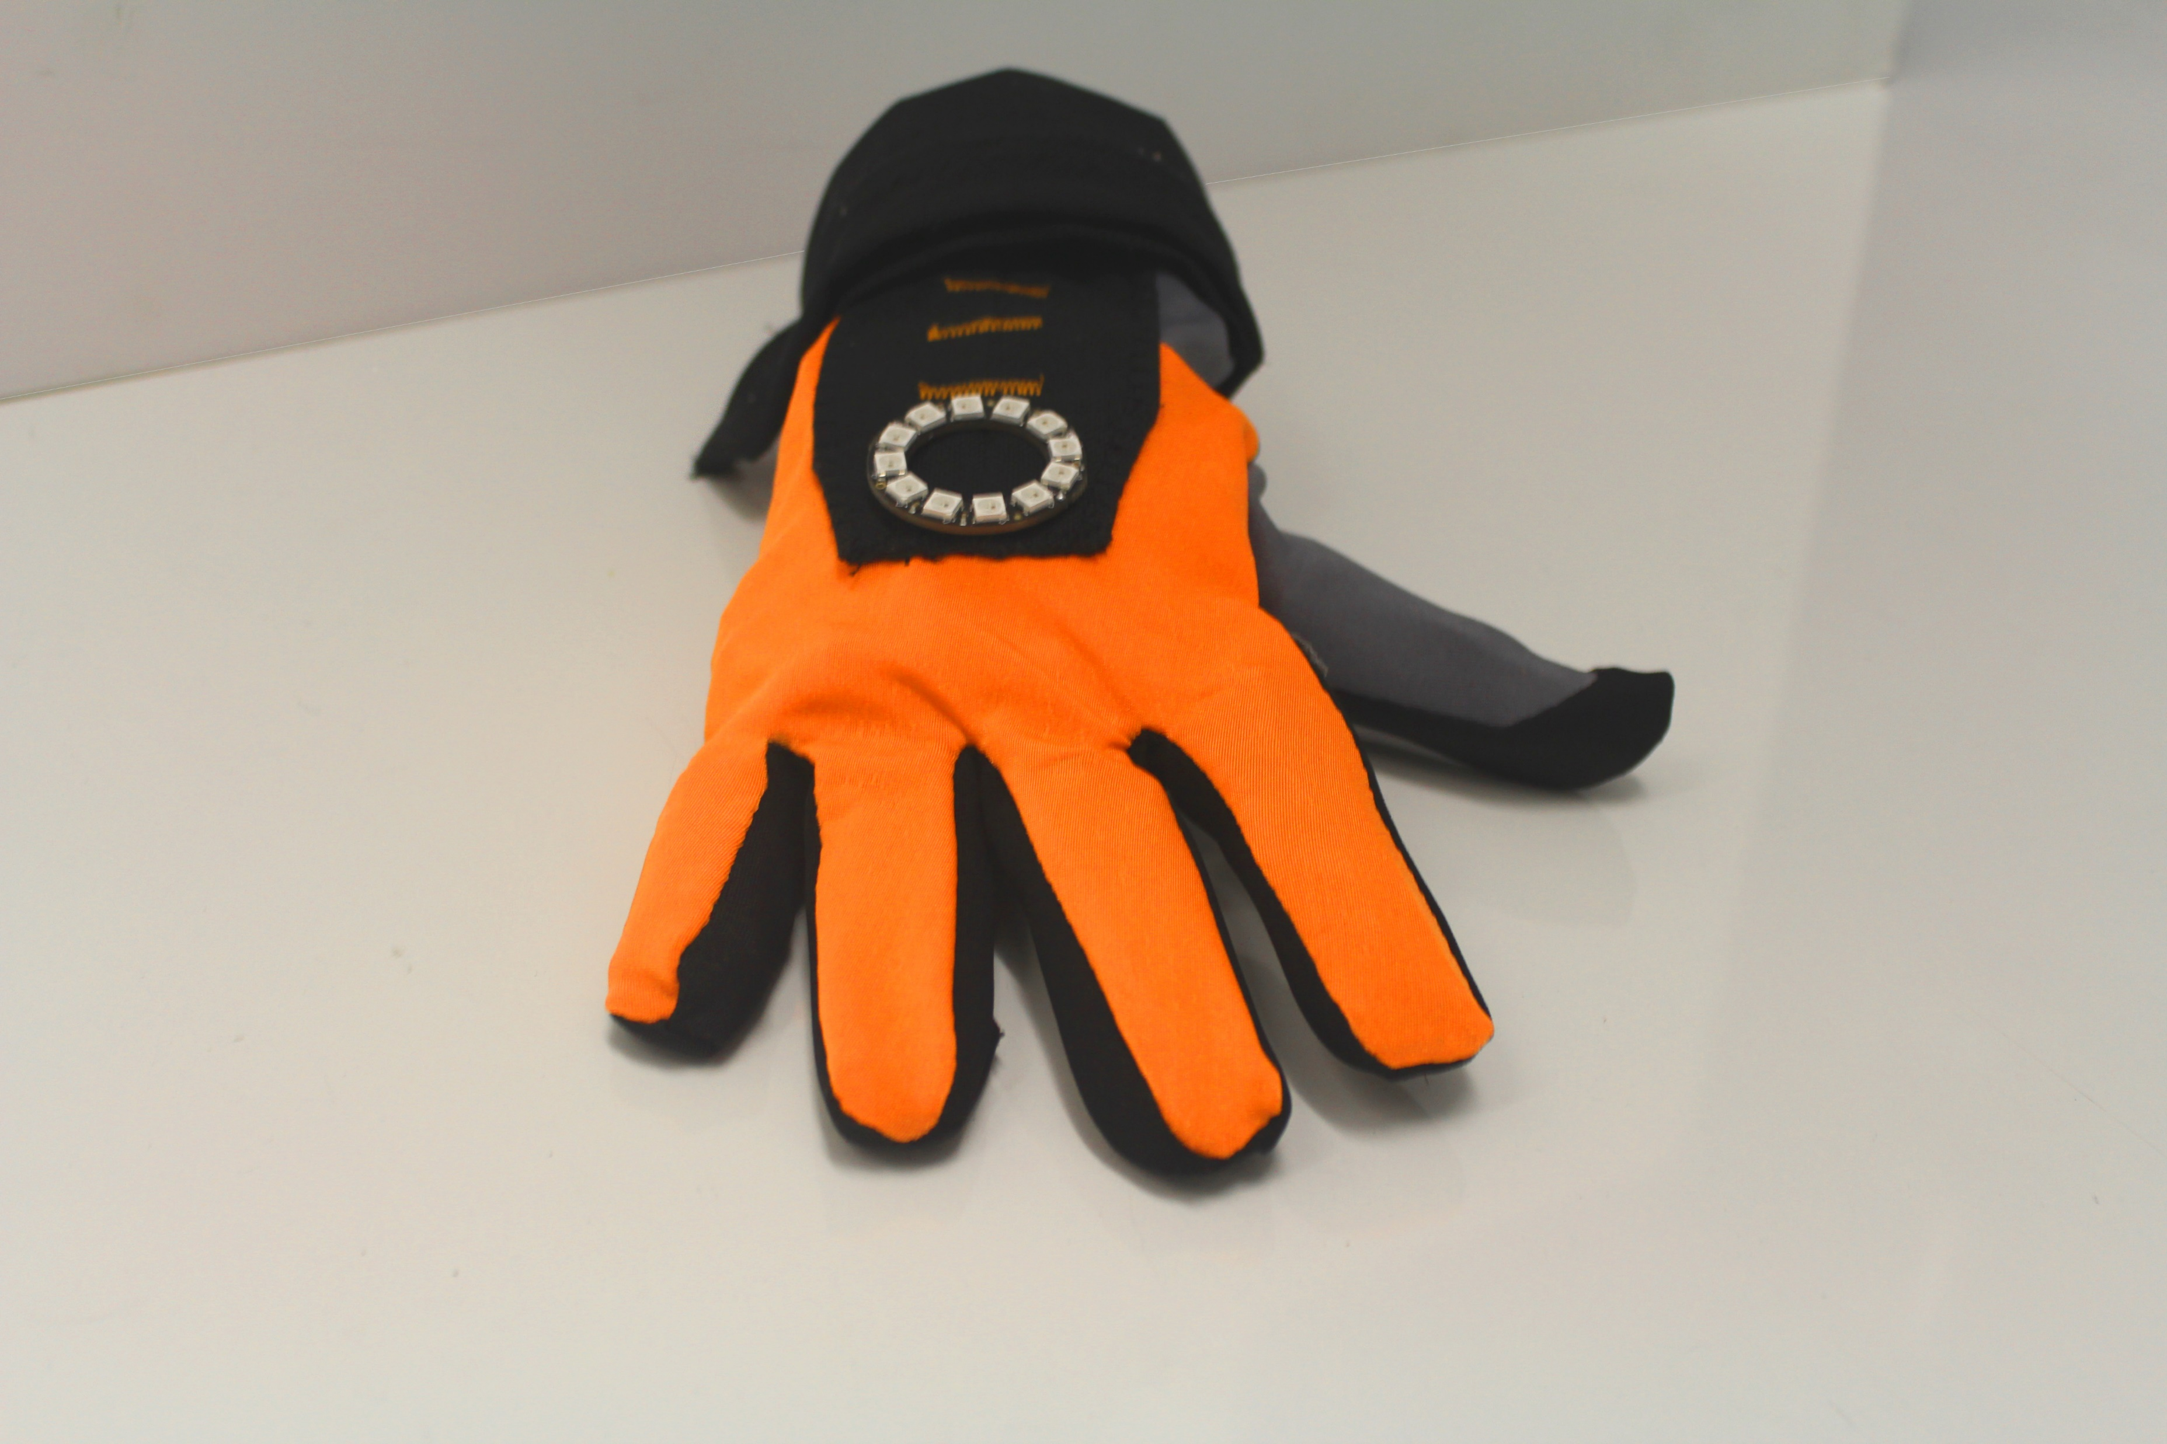
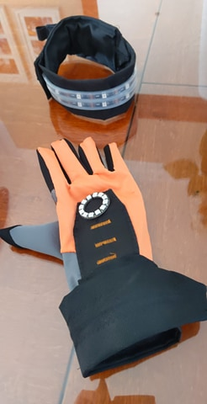
The Final Product

Slide 19
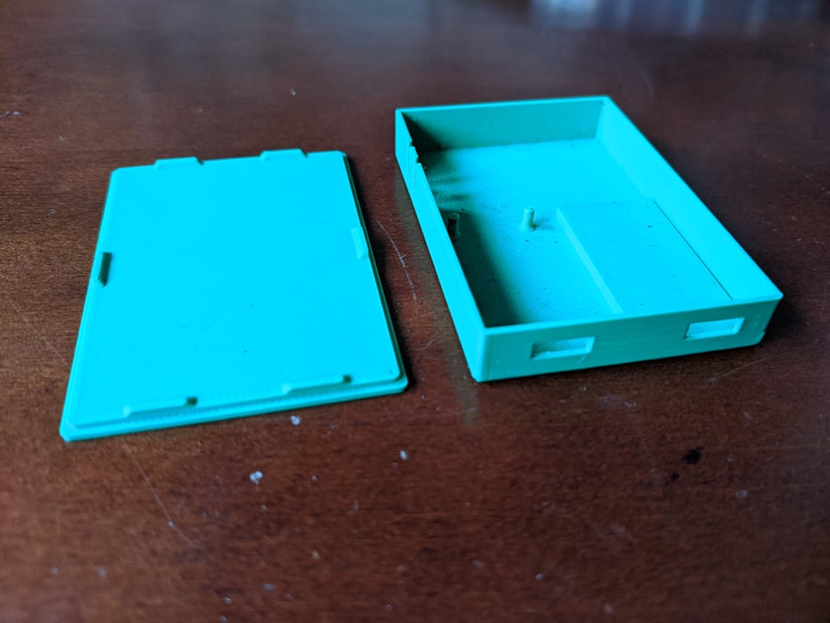
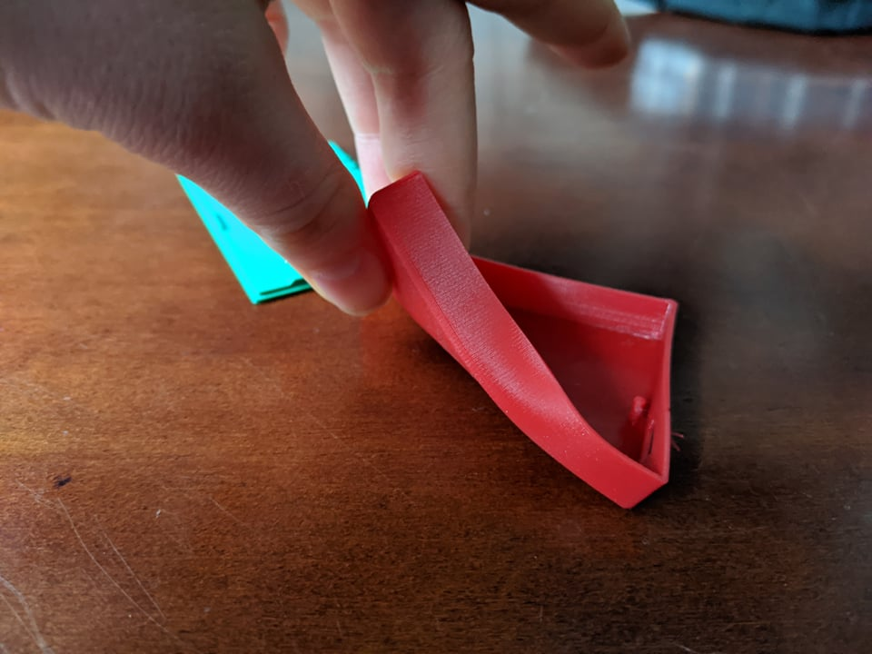
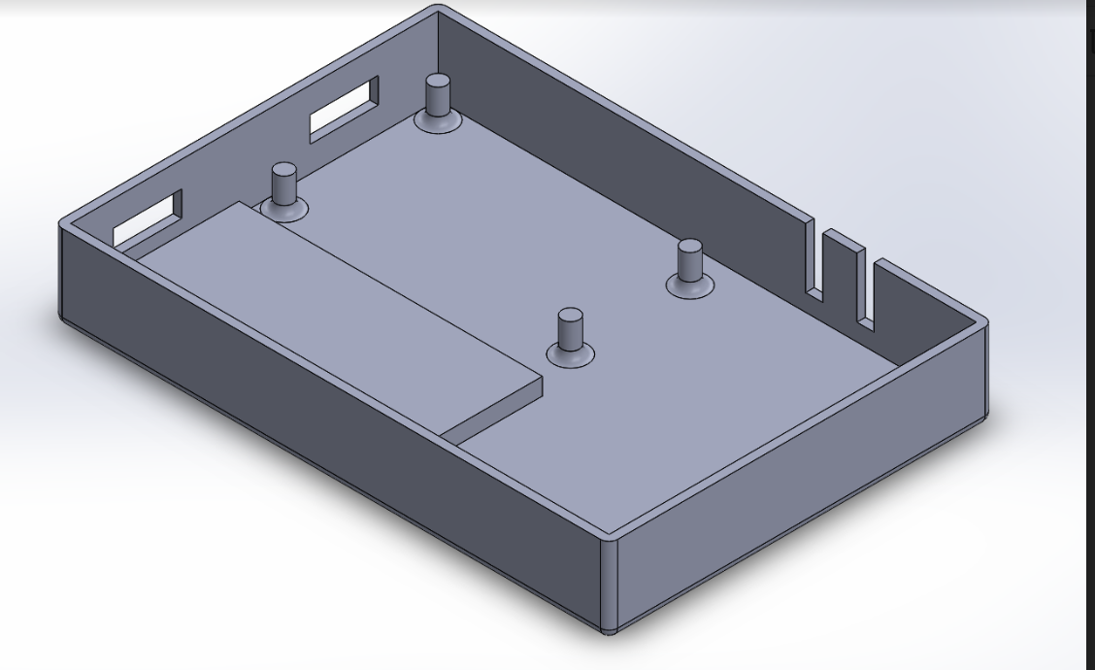
3D Printed Housing
2 boxes are printed off for housing the electronics, one for the glove and one for the band
The first housing is made with PLA, a non flexible material, for the glove
The second housing is made with TPU, a flexible material, for the band

Slide 20
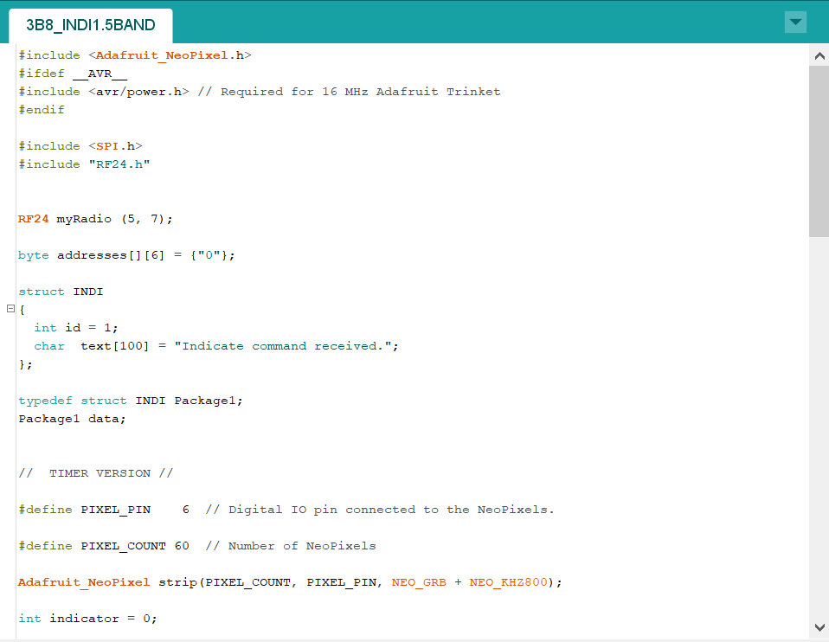
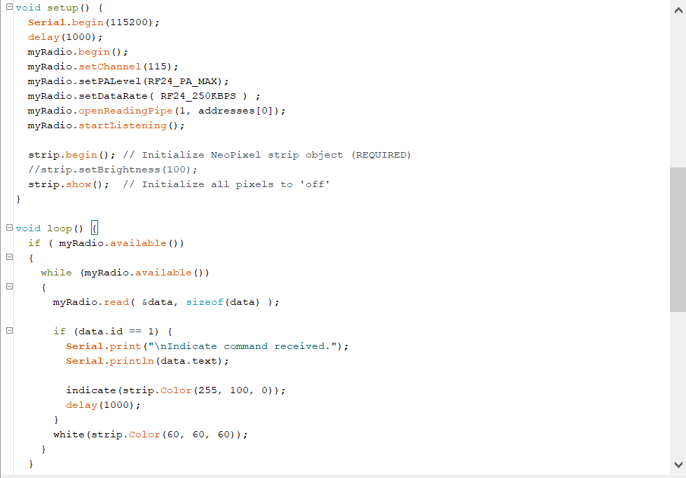
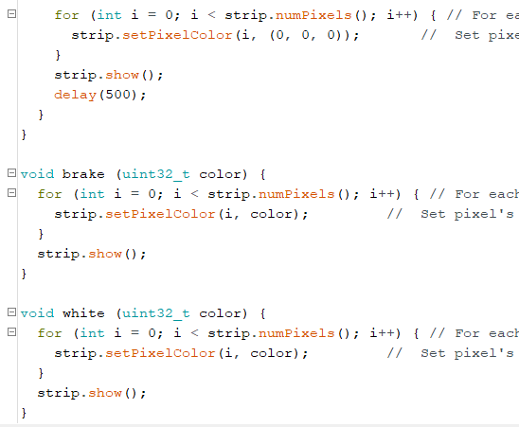
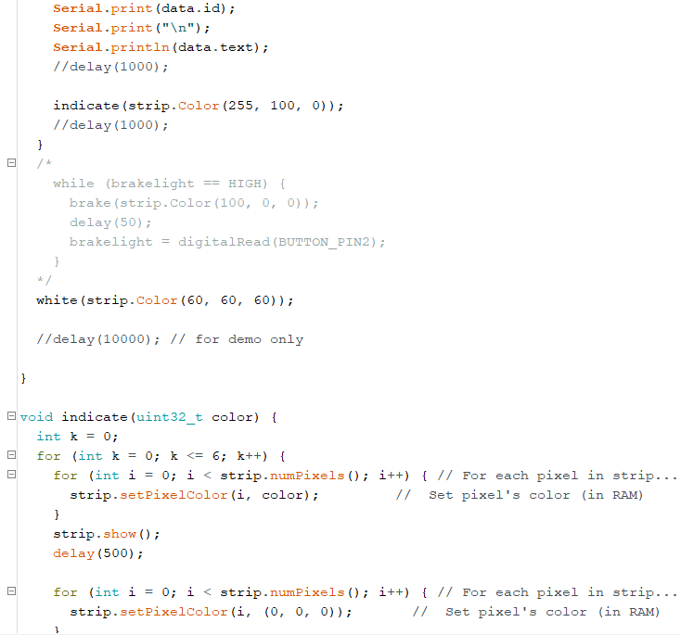
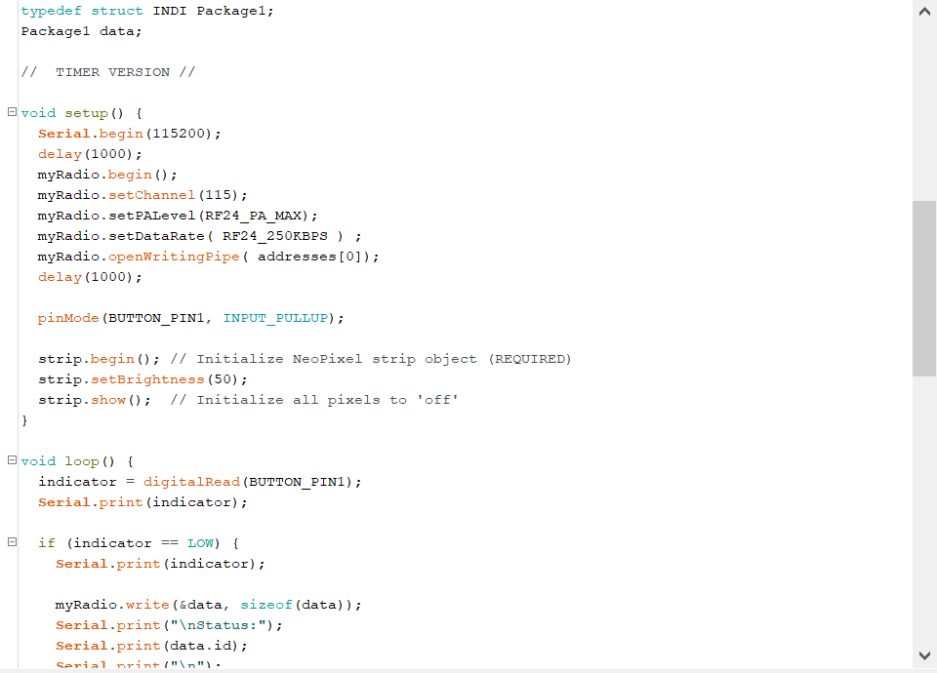
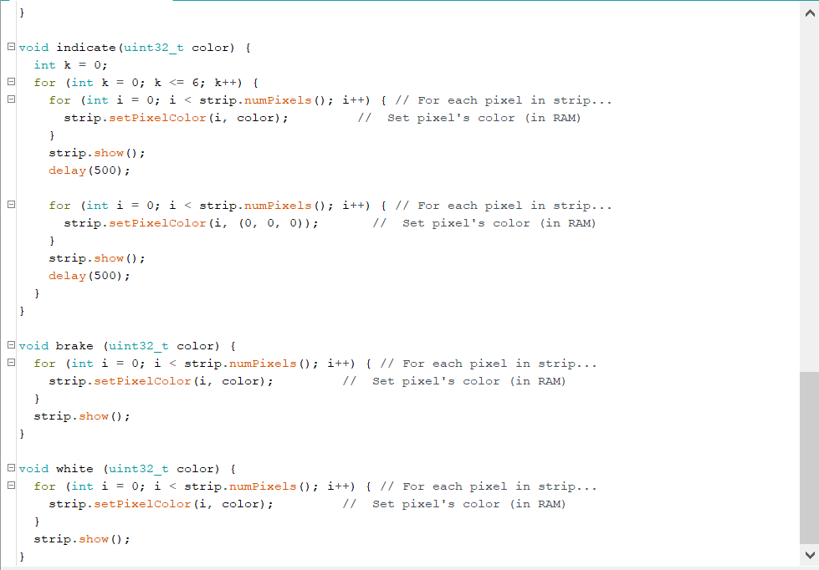
Software Code
Arduino code for the glove
Arduino code for the band

Slide 21
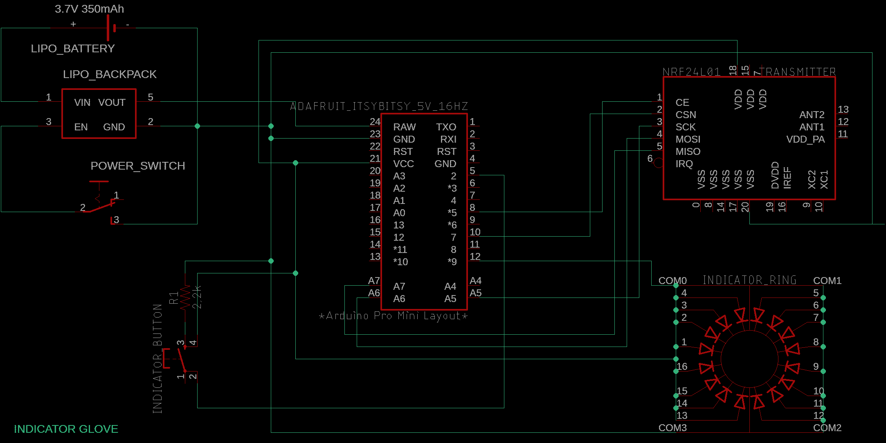
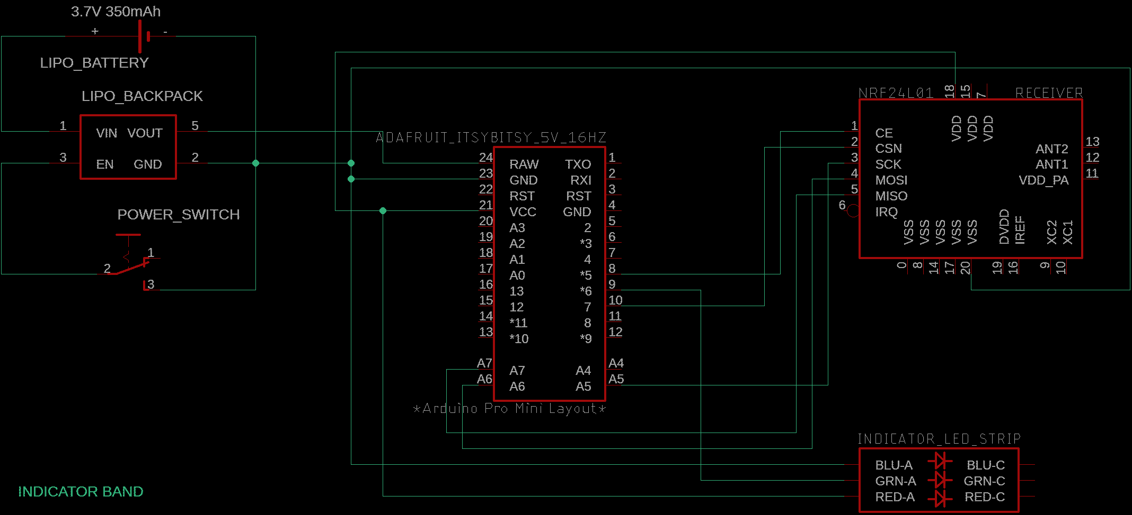
Schematics
Glove schematic
Band schematic

Slide 22
Thank you for listening!

