Slide 1
Research Supervision at
Trinity College Dublin
Research Supervision Development Programme
Graduate Studies Office
10th October 2023

Slide 2
Outline
Welcome and introductions
Rules, processes and resources (and who to contact)
'Bumps on the road’: PG Cases, extensions, off-books etc.
The Trinity Structured PhD
Confirmation / Transfer processes
Navigating supervision - Q&A

Slide 3
Introduction
Graduate Studies Office
Prof. Martine Smith, Dean of Graduate Studies
Frances Leogue, Administrator in Graduate Studies Office
Dr Cormac Doran, Assistant Academic Secretary
Appointments with Dean
Sian Bradley
Queries about graduate education: Genadgso@tcd.ie

Slide 4
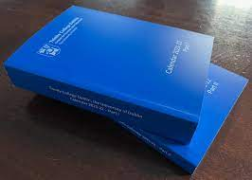
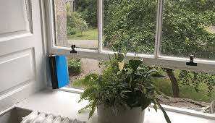
Calendar Part III
www.tcd.ie/calendar/graduate-studies-higher-degrees/
Calendar Part III = Graduate Studies
Regulations on:
Admissions
Registration
Supervision & thesis committees
Annual progress reviews
Confirmation on register
Thesis examination process
Conduct of viva voce etc.
Graduation
Notes:
MARTINE

Slide 5
Guidelines & Handbooks
Supervision of Research Students Best Practice Guide
Postgraduate Research Student Handbook
PhD Viva Voce Guide
Notes:
EWA start here

Slide 6
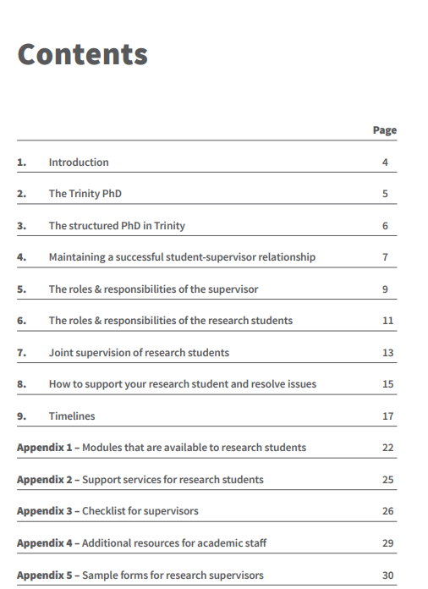

Slide 7
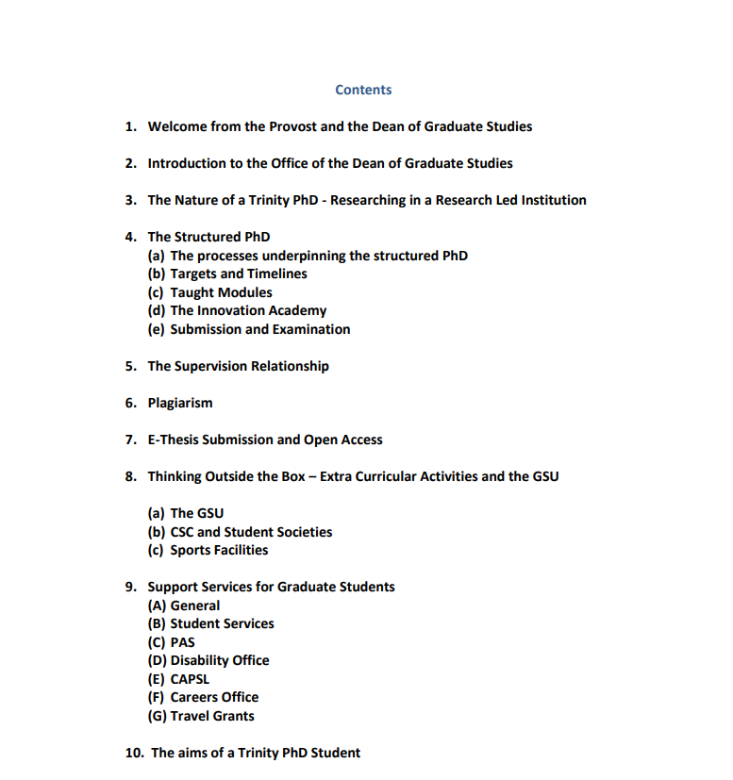
www.tcd.ie/graduatestudies/assets/pdf/research-handbook-23.pdf

Slide 8
Online Resources
www.tcd.ie/graduatestudies/staff/supervisor-development/
www.tcd.ie/graduatestudies/faq/
Notes:
EWA start here

Slide 9
www.tcd.ie/graduatestudies/staff/supervisor-development/

Slide 10
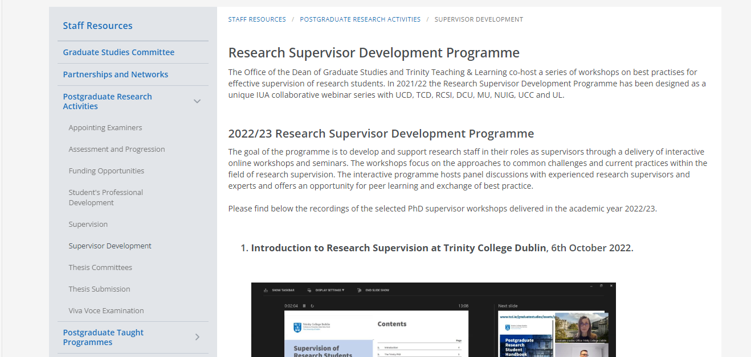
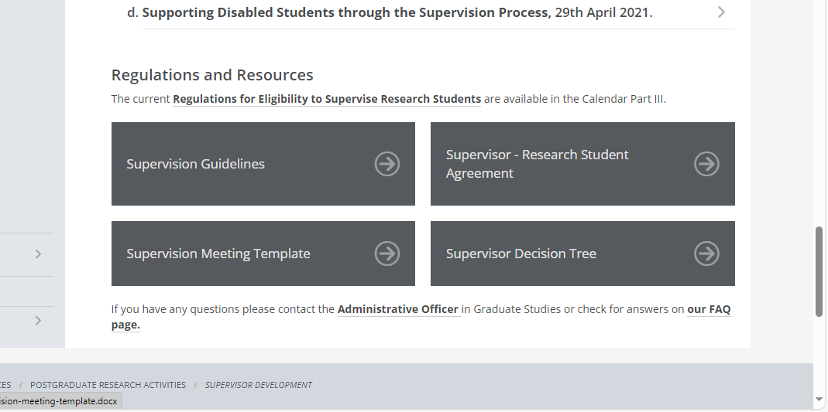
www.tcd.ie/graduatestudies/staff/supervisor-development/
Workshop recordings

Slide 11
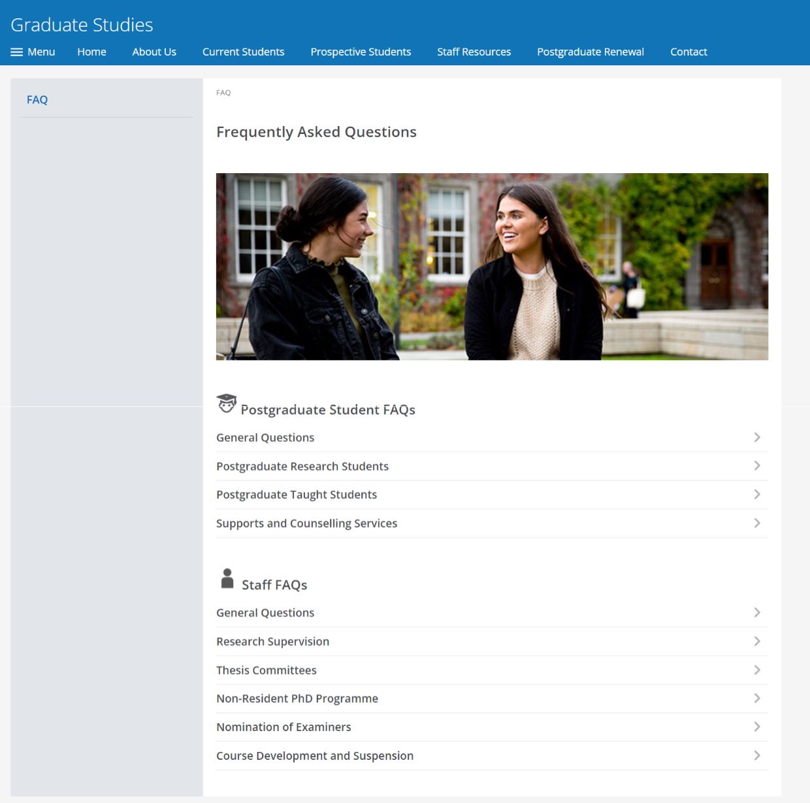
www.tcd.ie/graduatestudies/faq/

Slide 12
Who does What?
Graduate Studies Office
Graduate education policy
Graduate Studies Committee
Strategic projects: PG Renewal
Student cases and appeals – decision making
Travel grants / Benefactions & Awards
The Academic Registry
PG applications and admissions
Research examinations processing
Student cases & record management
Student finance
Thesis submission
Graduation

Slide 13
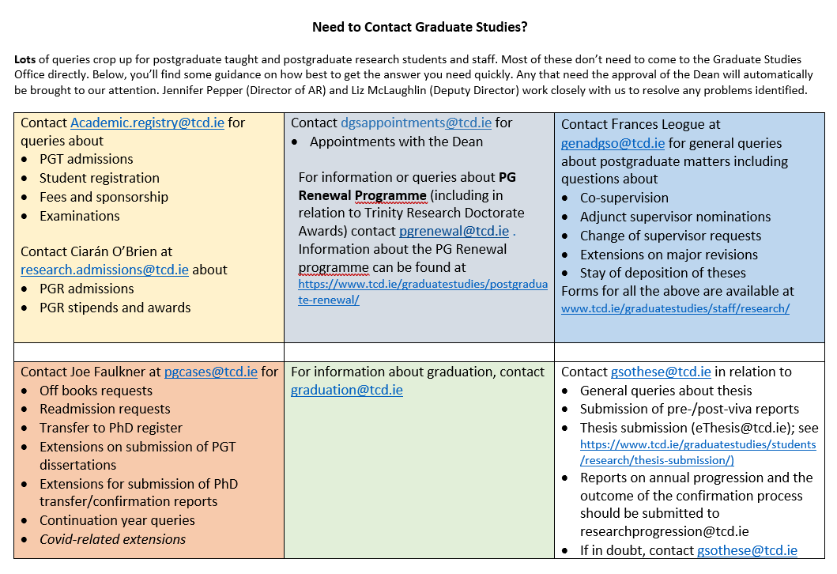

Slide 14
Bumps on the Road
PG Cases
Off-books
Extensions
Withdrawals
Pgcases@tcd.ie
Graduate Studies Office
Supervision challenges
Supervisor concerns
Genadgso@tcd.ie
Notes:
EWA finish here

Slide 15
Intermission of Studies: Externally funded students
Request to go Off Books is an internal mechanism
Request to interrupt research that is externally funded is a contractual matter
BOTH processes must be completed if a student is externally funded and in receipt of a stipend.
Off Books periods are normally processed only for 6-month intervals (Sept-March; March-Sept)
Request should come from supervisor to pgcases@tcd.ie and include any relevant documentation
Important to limit circulation list if there are confidential or sensitive medical or personal details
Supervisor should advise DTLP of the request
PG Cases will liaise with me for approval

Slide 16
Thesis Committees
For all students registered from Sept. 2019 onwards
Two members, one of whom must be an academic from within the School who is not involved in the research. The second member may be outside the School.
Set up within six months, and student is introduced
Annual review and sign off on annual report
Confirmation process and sign off on recommendation
More regular updates/meetings towards end of cycle, if necessary
Available as a resource to the student and/or the supervisor
Do not have pastoral responsibility, but may guide a student who needs additional pastoral supports
Notes:
MARTINE

Slide 17
Structured PhD
Core taught component (10-30 ECTS, 20 ECTS minimum if non-resident PhD pilot scheme)
Research integrity and impact in an open scholarship era (CA7000 – 5ECTS of the mandatory 10)
Discipline-level requirements (including placement modules)
Transversal skill modules: within Schools, 'Dean's basket'
Should be completed in time for Confirmation process

Slide 18
The Annual Review Report
Annual requirement and is needed in order for a student to be invited to register for the next year
Since 2019: report must be signed by full thesis committee
Important to flag any factors likely to impact progress and to make a clear recommendation
Continue; do some additional work and review again; recommend transfer to different register; recommend not to continue
A valuable gate-keeping and feedback process vs a tick box exercise
Ensure there is an opportunity to meet with the student, independent of the supervisor

Slide 19
Transfers / Confirmation on PhD Register
Students on the Research Register – to be organised in first 18 months
DTLP appoints the panel (minimum of 2)
Supervisor should attend the interview (not a panel member)
Student prepares a draft and submits to Supervisor
Supervisor provides comments
Student is invited to transfer interview
Interview
Written feedback

Slide 20
Transfers / Confirmation on PhD Register
Possible Outcomes:
Confirm / Transfer forthwith
Confirm / Transfer after some minor changes have been made to the transfer report
Confirm / Transfer not recommended at this time: a new report to be written and transfer interview to be held again as soon as possible thereafter
Continue on the Masters register to complete a Master’s thesis, or
Not to continue as a research postgraduate student

Slide 21
Thesis Submission and Examination: Gsothese@tcd.ie

Slide 22
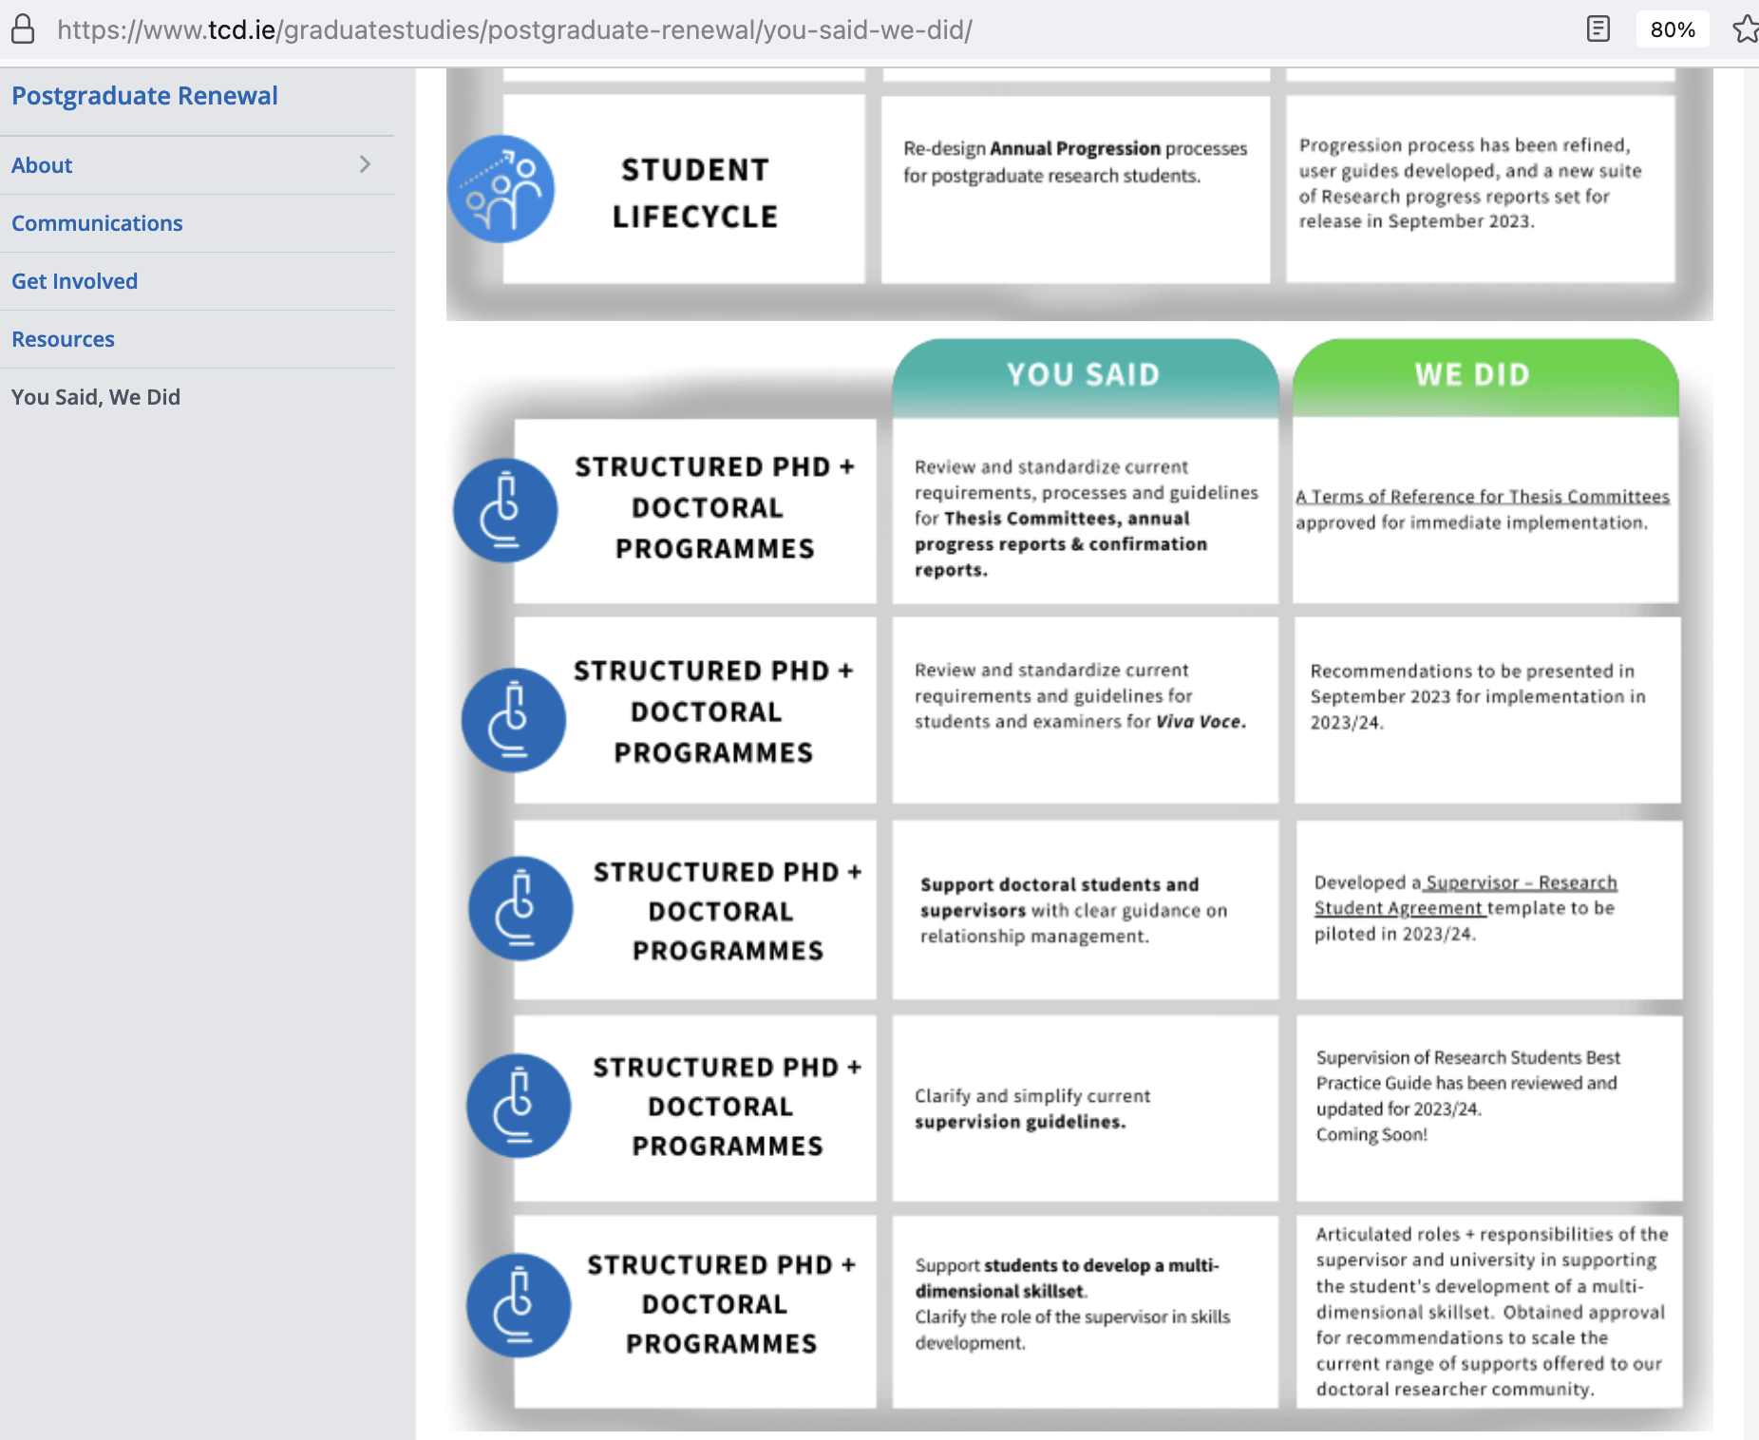

Slide 23
Thank you
Genadgso@tcd.ie
@GraduateTrinity
Trinity College Dublin, The University of Dublin

