Slide 1
Corporate Services Division
Summer Townhall
27 June 2019

Slide 2
Agenda
Welcome
Trinity in 60 seconds
CSD highlights
Spotlight on Summer Operations
Commercial Revenue Unit
Academic Registry
Wrap up

Slide 3
Trinity in 60 seconds Chief Operating Officer Geraldine Ruane
Philanthropic campaign
Business School
E3 Learning Foundry
Quality reviews
Strategic plan

Slide 4
Around CSD
Estates & Facilities
IT Services
HR
Commercial Revenue Unit
PMO
Sport
Diversity & Inclusion
Student Counselling
Academic Registry
Day Nursery
Health Service
Disability Services

Slide 5
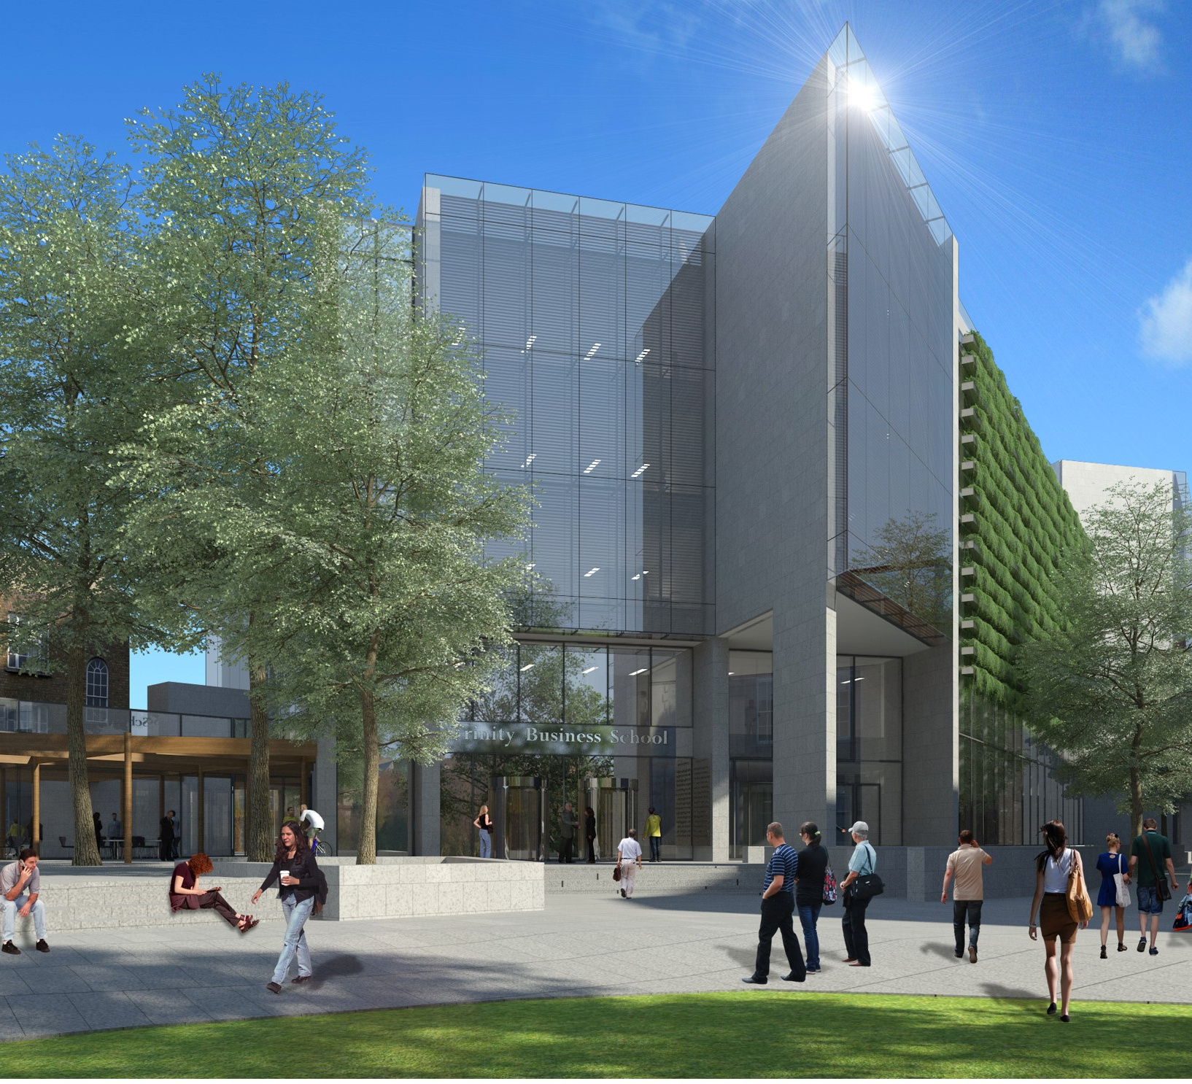
IT Services Estates & Facilities
Business School

Slide 6
IT Services Academic Registry
Trinity Electives
Notes:
Trinity Electives – IT Services delivered on student allocation algorithm, analysis and reporting for this project.

Slide 7
Estates & Facilities
Everyone
Green Flag
Notes:
Retained our Green Flag status following an inspection by An Taisce.

Slide 8
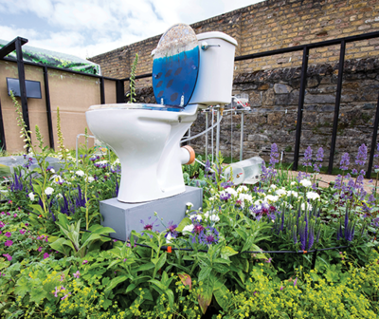
Estates & Facilities
E3
Maintenance
Show Gardens

Slide 9
Facilities
Space Management
Notes:
Our new Space Management team have been busy getting to know all the various ‘nooks and crannies’ around the Estate and this will inform the need to use our space more effectively

Slide 10
Health Services
Sport
Disability
Counselling
Academics
Collaboration
Notes:
Recognised Sub Committee of Student Life
Collaborative Partnership Professional and Academics Services
UN Sustainable Goals
Strategy

Slide 11
Since April …
40,000 exams / court of examiners / results / cases
2,000 graduates
3,500 health appointments
2,500 counselling appointments
550 disability students supported
Learning development Exams, Procrastination, Thesis Writing
Trinity Sport Awards, Regatta, Chariots of Fire
Trinity Sport Code of Ethics
Major Critical Incident Masterclass
Nursery graduation, speech & language programme
€9m debt recovered
Analytics Admissions, Finance, Mobility, Retention, Widening Participation
Helped by all of CSD

Slide 12
HR
Trinity’s growing
Recruitment pressures

Slide 13
Equality & Diversity
Retained Institutional Bronze
Notes:
Commitments to equality and diversity are values on which Trinity’s excellence relies.
Gender advancement – successfully retained institutional Athena SWAN Bronze Award
Greater inclusion – revised Gender Identity and Gender Expression Policy review approved by Board
Not just Gender
But also
Age / Disability / Family / Ethnicity & Nationality / Gender / Religion / Sexual Orientation / Socio Economic Background / Traveller Community

Slide 14
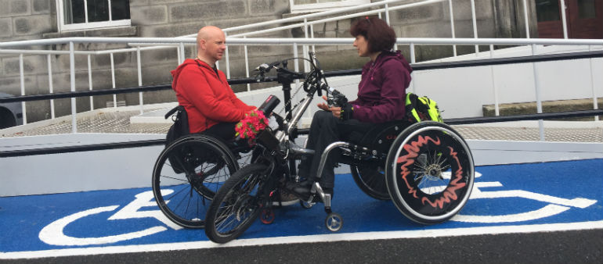
Health Services
Disability Services
Estates & Facilities
Disabled Bike Parking
Notes:
Recognised Sub Committee of Student Life
Partnership Professional and Academics Services

Slide 15
Project Management Office (PMO)
Project Portfolio Management (PPM)

Slide 16
CRU
Estates & Facilities
Notes:
A new term for Commercial Revenue….Royalties

Slide 17
Dining Hall
Monday July 15th
3 pm
Shortlist announced (30)
Notes:
Who has gone above and beyond? I think you all have.

Slide 18
Bernadine Rooney Commercial Revenue Unit
Summer Operations

Slide 19
Summer Operation
HR
Marketing
IT Services
BOK/Library Shop
Catering
Accommodation Team
Central Events
Estates & Facilities
Finance

Slide 20
Guest Satisfaction KPIs 2019
Booking.com review score of 8.2
Welcoming staff: ‘The accommodation staff and cleaners were extremely charming, efficient and helpful. The office is fully staffed from 7.30 am until late in the evening.’
Cleanliness: ‘The room was very comfortable and spotlessly clean.’
Location: ‘This is a great opportunity to stay in Trinity College, an historic landmark in the heart of Dublin.’

Slide 21
Leona Coady Academic Registry
Summer Operations

Slide 22
Academic Registry
2019 Summer Timeline
2019
Jun
Jul
Aug
Sep
2018/19
Reassessment
Graduation
Cases / Appeals
Theses
2019/20
Admissions
Bill & Collect Fees
Registration
Module Enrolment
2020/21
Open Admissions Cycle

Slide 23
ACADEMIC REGISTRY PROJECTS … in progress
Student Management Information
Applications & Admissions
Student Finance
Debt Management
Development of new processes to improvement management of
Digital Trinity 1 & 2
Online Module Enrolment of Trinity Electives
Online Module Enrolment for all other UG modules
Standard Operating Procedures
Assessment & Progression
Applications & Admissions
Student Finance
Business Support & Planning
Records & Case Management
Sponsor Debt
Student Debt
Academic Transcripts
PGR Thesis Examination

Slide 24
One Team
Estates & Facilities
IT Services
HR
Commercial Revenue Unit
PMO
Sport
Diversity & Inclusion
Student Counselling
Academic Registry
Day Nursery
Health Service
Disability Services

