Slide 1
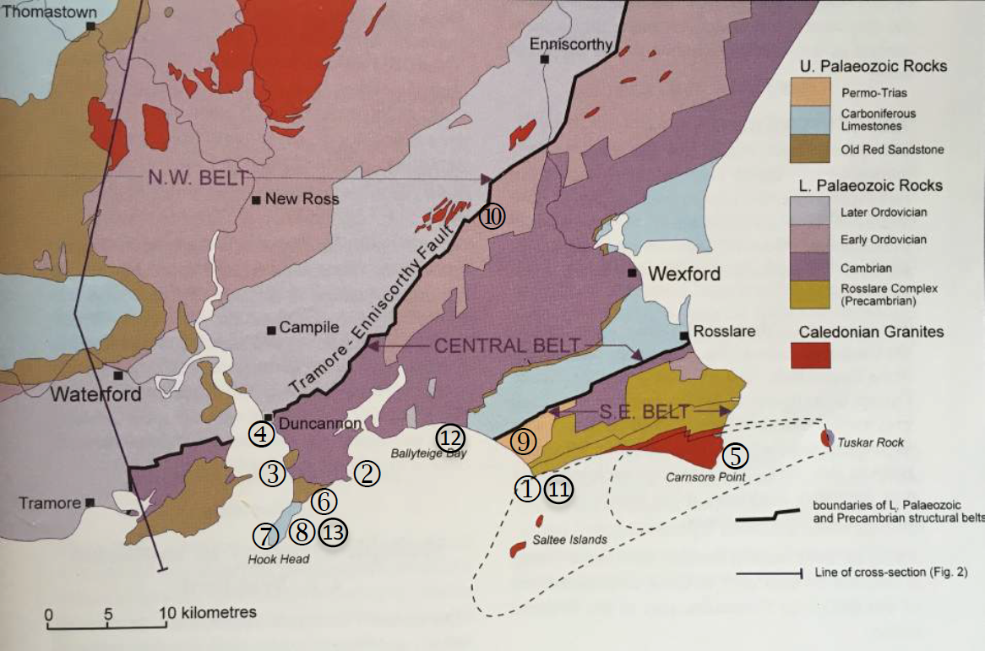
Map of Locations Visited During Wexford Field Trip

