Slide 1
Trinity Careers Service
careers@tcd.ie

Slide 2
Careers Service can support students with:
“Next Step” Career guidance appointments
Careers workshops
Personal Development Programme
Practice interview preparation
Help with applications – CVs and cover letters, personal statements and LinkedIn
Connect students with employers through employer Fairs

Slide 3
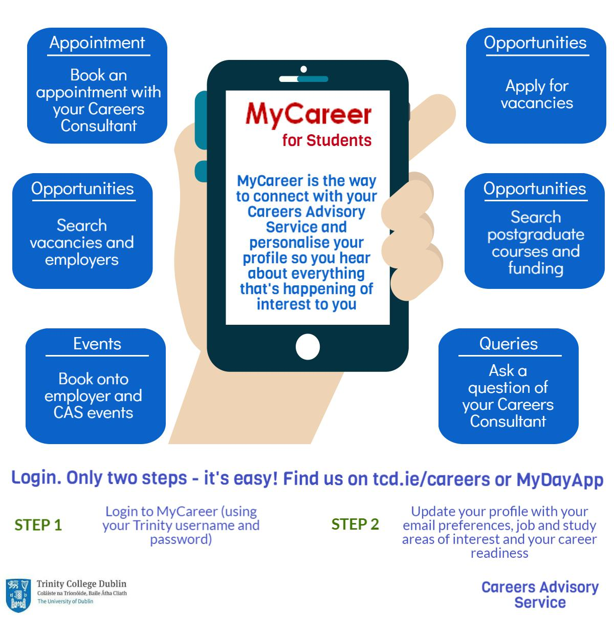
Connect with us

Slide 4
Thank you
Careers Service
2nd floor, 7-9 South Leinster Street
Dublin 2
(+353 1) 896 1721
careers@tcd.ie

