Slide 1
Erasmus and International Exchange Information Meeting
Dr Michelle D’Arcy
Director of Study Abroad, SSP

Slide 2
Agenda
Structure of the Evening
18.00 – 18.20: General Session
18.20 – 19.00: Departmental Sessions

Slide 3
Departments and Coordinators
Business – Jimmy White
Email: business.exchange@tcd.ie
Office Hours: : Undergraduate Office, 3rd Floor, School of Business, Aras an Phairsaigh – Tuesday & Thursday 9.30 – 12.30
Economics – Davide Romelli
Email: Econ.Exchange@tcd.ie
Office Hours: Room 3010, Arts Building – Tuesdays 10.00 – 12.00
Political Science – Emanuel Coman
Email: comane@tcd.ie
Office Hours: Room 5.08, 3 College Green – Thursday 10.00 – 12.00

Slide 4
Departments and Coordinators
Philosophy – Lilian Alweiss
Email: alweissl@tcd.ie
Office Hours: Room 5007, Arts Building – Tuesday 15.00 - 16.00
Sociology – David Ralph
Email: ralphda@tcd.ie
Office hours: Room 2.03, 2-3 College Green - Monday 16.00 - 18.00, Tuesday 16.00 – 18.00

Slide 5
Before Applying
Think about:
Where to go
How long to go for – half year or full year?
Is Erasmus/exchange for you?

Slide 6
Where to go
Over 150 places in 50 universities in 22 different countries: https://www.tcd.ie/ssp/undergraduate/study-abroad/Outgoing/destinations/index.php

Slide 7
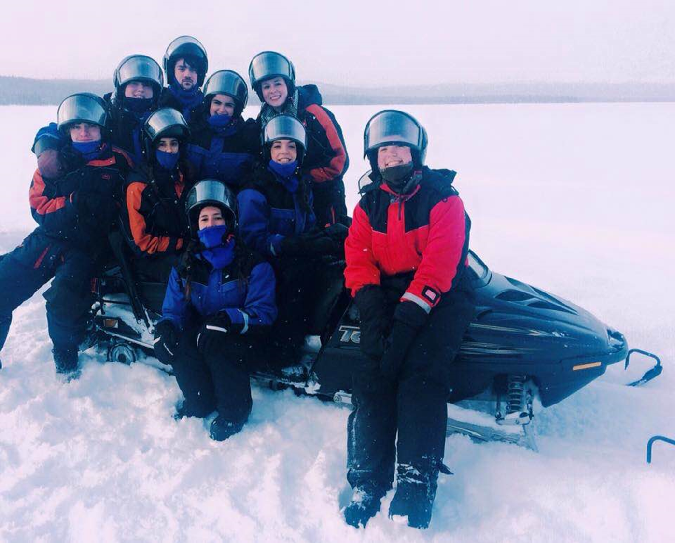
Where to go
Scandanavia: Uppsala Sweden, Hanken Finland

Slide 8
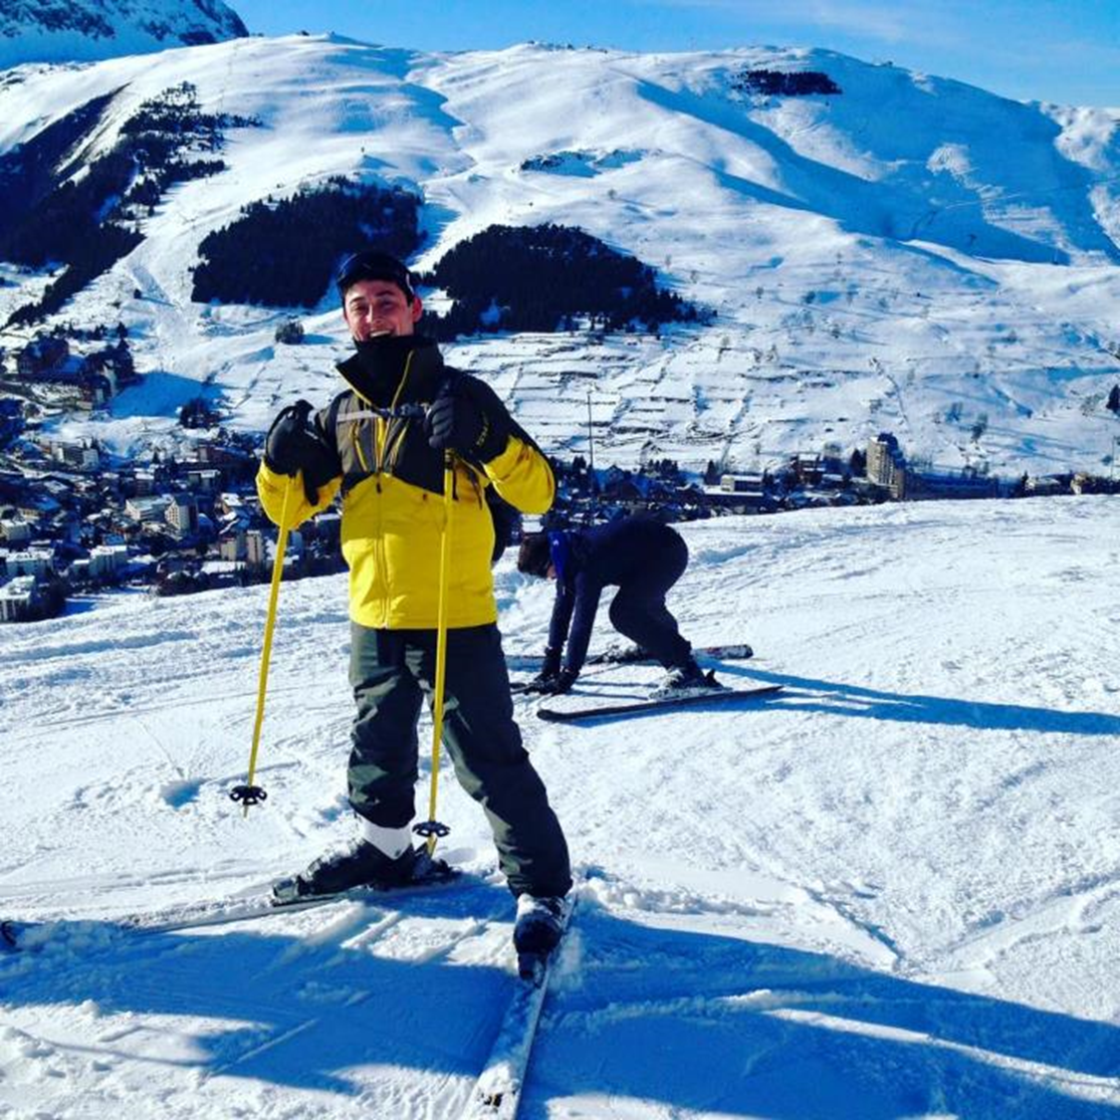
Where to go
France: Paris, Remmes, Strasbourg, Grenoble

Slide 9
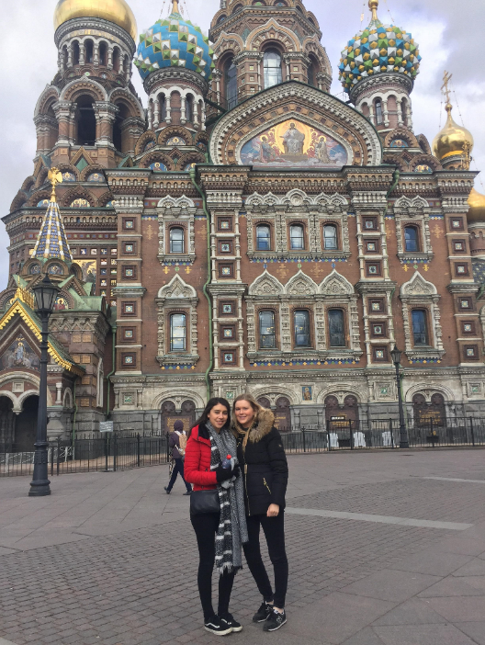
Where to go

Slide 10
Where to go
Spain: Barcelona

Slide 11
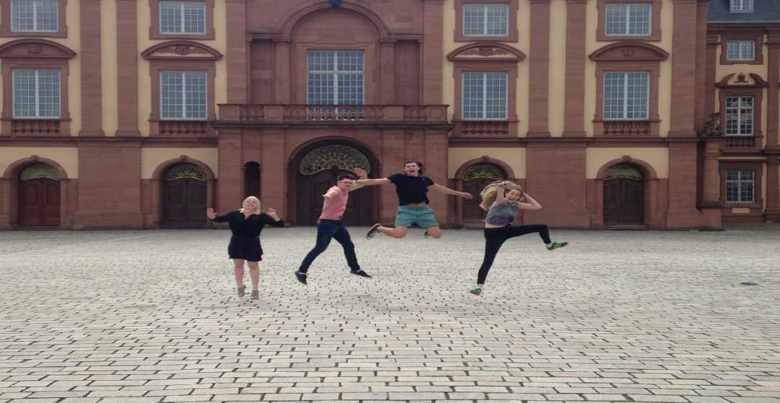
Where to go
Germany: Trier, Mannheim, Heidelberg

Slide 12
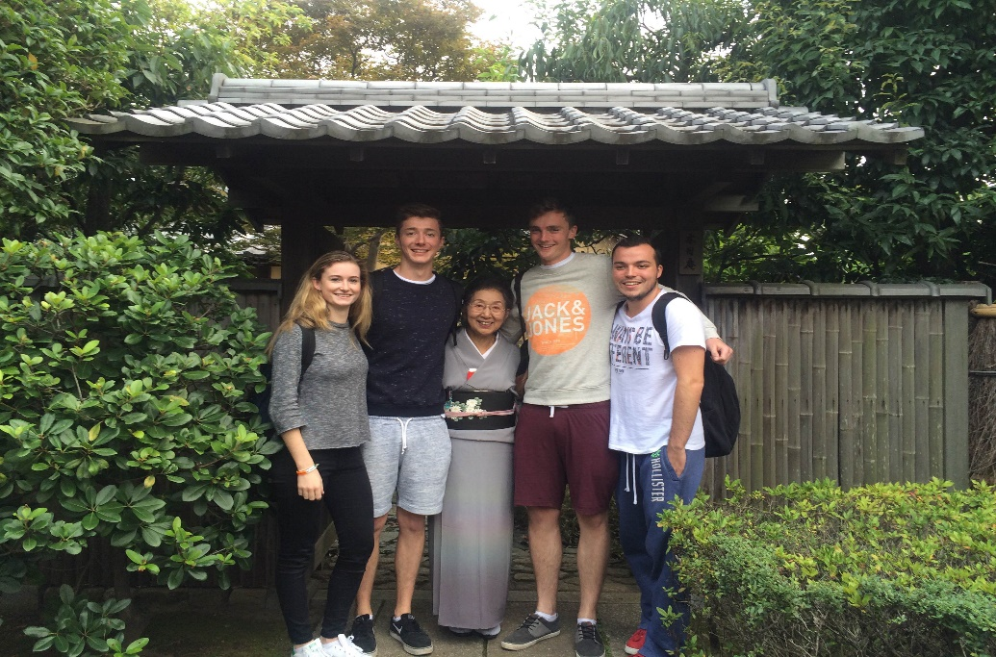
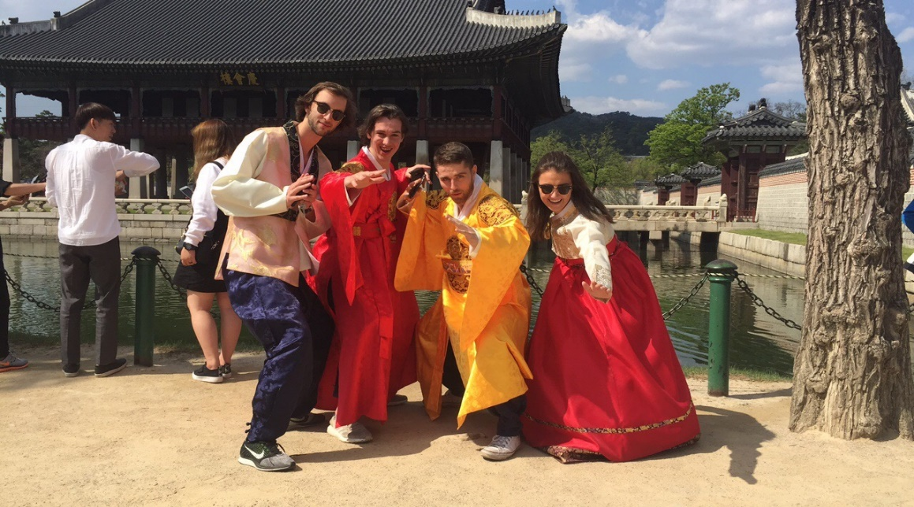
Where to Go
Asia: Japan, China, South Korea, Hong Kong

Slide 13
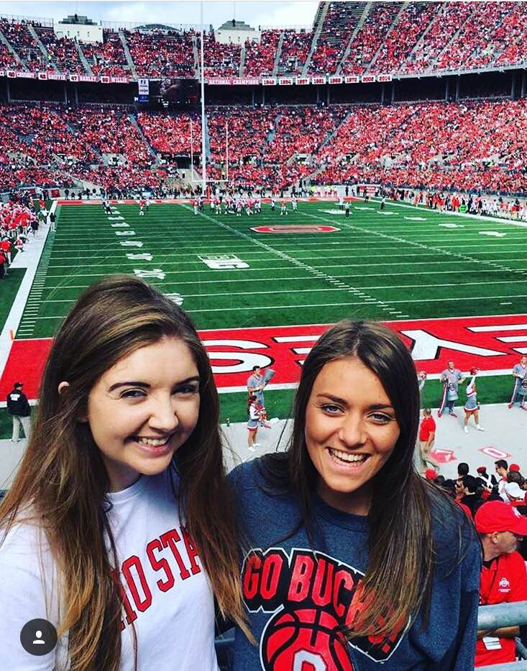
Where to Go
North America: Babson, Queens, Emory,

Slide 14
Which Exchanges can I go on?
You are eligible to apply in either Department/School you are studying with
Check the exchanges available for each department you are studying with on website: http://www.tcd.ie/ssp/undergraduate/study-abroad/Outgoing/destinations/index.php
If you study two subjects, its important that you make sure that you can take both subjects in the university you select before applying – look at eligibility notes and talk to your coordinator

Slide 15
Half a Year or a Full Year?
If you spend half a year abroad, you will be examined on the basis of work completed in Trinity and abroad
If your second subject is not offered in a university you are interested in you may consider going on a half year exchange, provided you are able to frontload your modules- please check with coordinator!
There is a section to indicate your preference on the application form

Slide 16
Applying for Erasmus
Application form available on: http://www.tcd.ie/ssp/undergraduate/study-abroad/Apply/
Applications to be submitted via surveymonkey. Practice form in Word available on website. Only fully completed applications submitted via survey monkey will be accepted.
Applications open on Friday 19th October
Deadline: Friday 23rd November, 2018
Places will be allocated on basis of grades, availability and suitability of exchanges

Slide 17
Applying for Erasmus
When giving your JF grades please enter NUMERICAL PERCENTAGE grade
You will be asked to list five top preferences – please use university names exactly as they appear on the Study Abroad website (link in the form)
Please do your homework on which exchanges are suitable for your subject combination before you list them on the form

Slide 18
After you Apply
First round offers will be made in mid January
Provisional: If you are applying for a College wide exchange as well, we will aim to make Erasmus offers at the same time so that you can choose and you will have 1-2 days to accept/decline Erasmus offer
You will have roughly a week accept or decline the offer
Please note: before you accept consider financial implications etc. as withdrawals are only permitted in exceptional circumstances
Remaining places will be offered on a second round

Slide 19
Who is responsible for what?
We expect you to:
Research exchange programmes thoroughly before you apply/accept an offer
Be able to act independently on a day to day basis
Investigate courses in advance, and expect to be flexible
Inform us promptly if you encounter difficulties
Although we will give you all assistance we can to support you academically, we cannot:
Help with finding accommodation
Control the courses that other universities offer
Review or intervene in the decisions of partner universities

Slide 20
Things to consider before applying
Can be challenging:
‘I hadn't fully considered the implications of moving away from family and friends for 7 months and at times found this harder than I had expected. However overall it was a great experience and I would definitely do it again.’
Part of the experience is taking responsibility, being comfortable in a new and different environment, developing resilience and independence.
Erasmus is a wonderful opportunity:
‘An absolute must. best decision I ever made & I wasn’t even too excited about it when I went. Tell students to Beg borrow or steal to fund it, it's worth it! Doesn’t matter where you go either, its just about the friends you make.’
‘By far the best year of my life overall.’

Slide 21
Disciplinary Meetings
Business – Ed Burke Theatre
Economics – Robert Emmet Theatre (2037)
Political Science – 4050B
Sociology – 5052
Philosophy – 3020

Slide 22
Thank You

