Slide 1
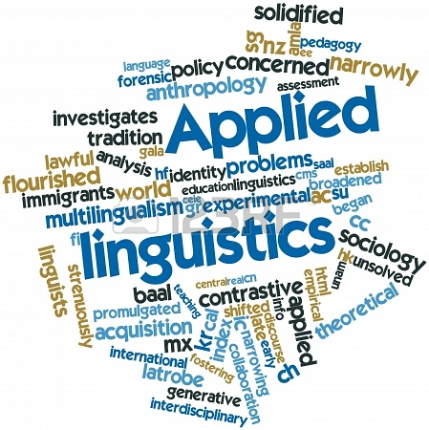
A brief introduction to contemporary
http://www.123rf.com
For incoming students of CLCS M.Phil. courses

Slide 2
Definition?
http://dare.wisc.edu/
“the academic discipline concerned with the relation of knowledge about language to decision making in the real world” (Cook, 2003, p. 5)
“The focus of applied linguistics is on trying to resolve language-based problems that people encounter in the real world, whether they be learners, teachers, supervisors, academics, lawyers, service providers, those who need social services, test takers, policy developers, dictionary makers, translators, or a whole range of business clients” (Grabe 2002, cit. Davies & Elder 2004, p. 4)

Slide 3
Established 1964; World Congresses held every three years

Slide 4
AILA World Congress 2011 (Beijing)
Conference theme: “Harmony in diversity: language, culture, society”
Strands:
Language Acquisition and Processing
Language Teaching and Learning
Language in Professions
Language in Societies
Applied Linguistics and Methodology

Slide 5
Strand A: Language Acquisition and Processing
1. First Language Acquisition 2. Second Language Acquisition 3. Written and Visual Literacy 4. Psycholinguistics

Slide 6
Strand B: Language Teaching and Learning
5. Mother Tongue Education 6. Standard Language Education 7. Foreign Language Teaching and Teacher Development 8. Learner Autonomy in Language Learning 9. Language and Education in Multilingual Settings 10. Educational Technology and Language Learning

Slide 7
Strand C: Language in Professions 11. Business and Professional Communication 12. Translating, Interpreting and Mediation 13. Language and the Law 14. Language and the workplace 15. Language in the Media and Public Discourse

Slide 8
Strand D: Language in Societies 16. Sociolinguistics 17. Language Policy 18. Multilingualism and Multiculturalism 19. Intercultural Communication 20. Applied linguistics within Asian contexts

Slide 9
Strand E: Applied Linguistics and Methodology 21. Discourse Analysis and Pragmatics 22. Rhetoric and Stylistics 23. Contrastive Linguistics and Error Analysis 24. Lexicography and Lexicology 25. Multimodality in Discourse and Text 26. Language Evaluation, Assessment and Testing

Slide 10
AAAL: American Association for Applied Linguistics
Holds its conference annually

Slide 11
Subject strands for AAAL 2014
Analysis of Discourse and Interaction
Assessment and Evaluation
Bilingual, Immersion, Heritage, and Minority Education
Corpus Linguistics
Educational Linguistics
Language and Cognition
Language and Ideology
Language and Technology
Language Planning and Policy
Language, Culture and Socialization
Pragmatics
Reading, Writing, and Literacy
Second and Foreign Language Pedagogy
Second Language Acquisition, Language Acquisition, and Attrition
Sociolinguistics
Text Analysis (Written Discourse)

Slide 12
Stand-alone fields?
Sociolinguistics
Psycholinguistics
Anthropological linguistics
“Clinical linguistics”

Slide 13
“Linguistics Applied” or “Applied Linguistics”?
A distinction made by Widdowson (right).
“L-A uses language data to develop our linguistic knowledge about language, while A-L studies a language problem […] with a view to correcting it” (Davies & Elder 2004, p. 11)

Slide 14
Applied Linguistics and language teaching/learning
“just what the term [AL] actually refers to remains somewhat uncertain. In its early use, it was taken to mean a more linguistically informed approach to language teaching. […] There was some suspicion at the time that the use of the term was motivated by the desire to give heightened status to the rather humble and humdrum activity of teaching – rather as one might use a term like ‘domestic management’ to refer to house-work.”
(Widdowson 2006, p. 93)

Slide 15
Society: planning & policy
Policy / institution: curriculum, syllabus, testing
Classroom: tasks, materials, discourse
Learner as person: needs, attitude, motivation, biography…
Learner as mind: aptitude, age, processing, memory…
Teachers: teacher beliefs, education…

Slide 16
Learner, language, context
Foreign Language
Second Language
Regional minority language
Heritage language education
Migration and mobility – economic, political
Bilingual first language acquisition
Adult, child, adolescent

Slide 17
Grammar-translation
Tradition from the teaching of Latin and Greek
Grammar as end in itself and key to the language (often written)
Specimen sentences linked to grammatical points; translation in both directions

Slide 18
Behaviourism, contrastive linguistics, and error analysis
Learning as habit-formation
To learn a language is to acquire a habit
L1 Interference
L1 “habit” interferes with new L2 “habit”
Associative learning
Imitation exercises
To learn a second language is to acquire a second habit
Nature of interference predictable from comparison of L1 and L2
Transformation drills
Addition drills
…etc.

Slide 19
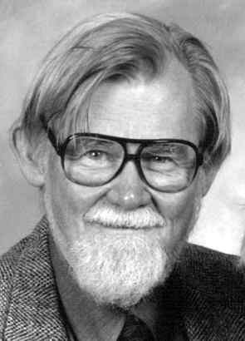
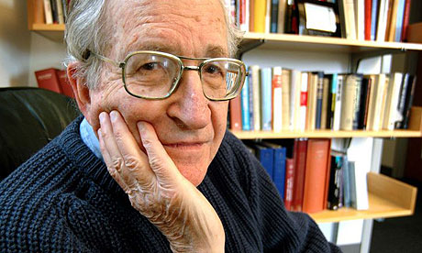
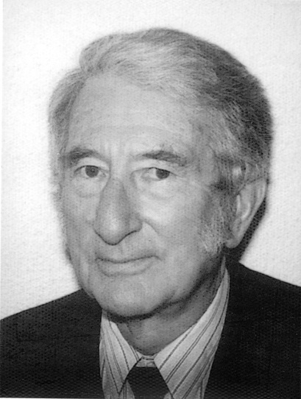
Chomsky’s inadvertent part in the rise of the communicative approach
- Demise of behaviourism, rise of ‘cognitivism’
- L2 as a rule-based system: interlanguage
- Krashen’s comprehensible input hypothesis
- Hymes & communicative competence
- Functional linguistics (e.g., Halliday)
- Speech act theory and the functional-notional syllabus

Slide 20
The Communicative approach
Aims to develop communicative competence, informed by needs analysis
Not just linguistic competence, but discourse & sociolinguistic competence too
Multiple form-function mappings
Notions and functions as the units of syllabus organisation:

Slide 21
Developments in communicative language teaching
Task-based learning and teaching (TBLT) – pioneered by Prabhu’s procedural syllabus – The Bangalore Project
Content and Language Integrated Learning (CLIL)
The Common European Framework of Reference (CEFR) and the European Language Portfolio

Slide 22
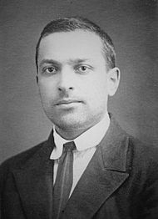
Theoretical instability: rise of ‘contextualism’
In opposition to the perceived reductiveness of mainstream, cognitive-psychological second language acquisition studies, we have seen the emergence of sociocultural approaches:
Ultimately from the work of L. S. Vygotsky
Emphasis on social context of language learning and use
Most recent form: Activity Theory

Slide 23
Global perspectives
English as a global language
Multilingualism as a norm
Challenges to the native speaker norm
English as a Lingua Franca (ELF)
Role of native-speaker teachers
Expectations and testing

Slide 24
