Slide 1
TOPIC A: Irish Economic History to Independence
TCD M.Sc.(EPS) – Ronan LYONS – EC8001 Irish Economic Policy ISSUES & Context

Slide 2
Module Outline
Topic | Title | EoI Ch | Dates
A | Irish Economic History to Independence | 1+ | MT1-2
B | Irish Economic History since Independence | 1+ | MT3-4
C | The Economy & Economic Growth | 2, 7 | MT5-6
D | Public Finances, Debt & Taxation | 3, 4 | MT8-9
E | The Labour Market | 6 | MT10-11
F | Social Justice & Inequality | 8 | HT1-2
G | Regulation & Competition | 5 | HT3-4
H | Competitiveness & Trade | 9, 11 | HT5-6
I | Health & Education | 12, 13 | HT8-9
J | Natural Resources & Real Estate | 10, 14* | HT10-11

Slide 3
Topic A: Structure
Irish Economic History to Independence
Why bother?
The Irish Economy before Waterloo
From Waterloo to the Great Famine
The Great Famine
The Post-Famine Economy

Slide 4
Ireland before the famine
George O’Brien (1921)
Joel Mokyr (1983)
VS.
“The destiny of Ireland in the early 19th Century was very largely moulded by the ideas of two great economists, Adam Smith and Malthus, and of the two, the latter was probably the more influential.”
“At least as far as pre-famine Ireland is concerned, Malthusian models seem to have little explanatory power.”

Slide 5
Why we Bother (Revisited)
Economics, development and famine
  What can perhaps the world’s most famous famine tell us about the economic causes and effects of famine?
Remember important distinction between farming class and labourer class
  Trends for country as a whole may be different to trends for poorest labourer class
About 85% living in rural Ireland
  Slowdown in population growth at odds with idea that Irish procreated “oblivious to their hardship”
1800-01 and 1817-19 famines saw significant deaths
  But failures of 1822 and 1830 did not

Slide 6
Role of the Corn Laws
Per-worker output half of UK – higher land/lab ratio
  Nonetheless, access to same technology, markets?
  Typical acre rented for ~17s. compared to ~25s.
High price of tillage due to Corn Laws saw it spread
  Longford/Roscommon, Antrim, Clare/W. Limerick/Kerry
  Grain yields also increased ~20% between 1770s and 1840s
UK-wide protection central
  From 17% of Britain corn imports in 1790s to 80% by 1830s
Corn Laws “encouraged and reduced the burden of Irish industrial decline after 1815”
  Led to not only “too much” tillage, but also too much potato (given its role in rotation)

Slide 7
Ireland’s transport boom(s)
Underpins market economy (like financial services)
A mini-boom in road infrastructure & mail coaches
  Regular Limerick-Dublin service by 1760s, Belfast from 1789
  Belfast-Dublin: travel time from 21hrs (1802) to 14hrs (1825)
Much less success with canals (vs. Britain)
  Only 1 of 5 could be deemed a success – lack of S or D?
  Then again, British success down to coal deposits
A world leader in ferries & steamships
  1818, Belfast-Greenock; by 1836 Dublin to Liverpool, London and Glasgow
  By 1840s, 100 regular crossing, with intense fare competition
Railway mania mid-1840s – 17/100 schemes by 1850

Slide 8
Transformation of Banking
Remember: pre-1820s, many small banks
  Removal of restrictions on # partners, merchants in 1824
1825-45: all of Ireland main’s banks (except BofI)
  Northern Bank, Provincial Bank [landlord bank par excellence], Hibernian (all 1825)
  National Bank, 1830s [O’Connell brainchild and millstone!]
Upper and middle class clientele
  Core business was converting rural deposits into urban commercial loans, typically 1-year
Despite competition, high dividends
  From 5% (Royal, National) to 10% (BofI, Northern)
Bank of Ireland still special (LOLR)

Slide 9
Cycles but no trend

Slide 10
Fertility Before the Famine
Fertility: Evidence from Quakers suggests that marital fertility in Ireland was high but fell between late 1700s and early 1800s
Nuptiality: pre-Famine, a high proportion never married (10-12%)
  Census 1841 implies increasing marriage age during 1830s – ~15,000 “averted births”

Slide 11
The Wandering Irishman
Substantial shift in migration after Waterloo
  Brutal 1740s famine in South: barely any emigration
  Temporary linen crisis in North: large migration to N. America
  Exceptions: seasonal migration, fishing (Newfoundland)
1815-45 saw 1.5m Irish emigrate
  Roughly one third each to Britain, U.S. and Canada
  Highest per capita rate in Europe
Start of debate about brain drain
  Vs. win-win for those who leave and those left behind
  Cf. land-labour ratio

Slide 12
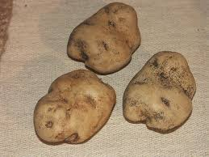
Insights from Calories & Spuds
Solar has estimated total calorific consumption
  2,500kcals per person per day (3200 per adult male)
High relative to England, France ~1800
What about poorest?
  Depends on inequality – higher implies ~1,500kcals
Evidence on Lumper potato far from damning
Quick note on turf: important subsistence fuel
The Lumper potato: a symbol of impending disaster or bad luck?

Slide 13
Anthropometrics
Ireland’s “height advantage” seems to have persisted into 1800s
  Nutritious if boring diet
Evidence from Philadelphia immigration
  1850s, 60s: Irish migrants had heavier babies than other groups
Caveats:
Who joins the army? What backgrounds/incomes? Do trends in general employment matter?

Slide 14
Stuttering to a halt?
High-frequency data from the banks show downturns in 1815, early 1830s and early 1840s, as well as 1846-51
Roy Foster & Ray Crotty: 1815 was the turning point for Ireland, not 1845
  The Famine merely an acceleration of a downward trend
  Deindustrialization following union: agri from 40% of exports in 1780s to 62% in 1820s
But Irish terms-of-trade (price of exports vs. imports) actually improved significantly 1800s-1830s
Little evidence of economic stagnation pre-1845

Slide 15
The missing apocalypse?
Per capita income ~40% of that in Britain – similar to much of Europe then
Wages: fall in wages for unskilled building workers
  But cost of living also fell
Consumption: imports of tea, sugar, tobacco
  No significant fall
Education: an “income-elastic” good
  % in school increased
Average vs. poorest
1840 Metric | Europe (similar incomes) | Ireland
Birth-rate (crude) | 39 | 39
Death-rate (crude) | 29 | 24
% male LF in agri | 73% | 70%
% male LF in industry | 10% | 15%
School enrolment | 17% | 20%
Urbanization | 13% | 14%

Slide 16
Topic A: Structure
Irish Economic History to Independence
Why bother?
The Irish Economy before Waterloo
From Waterloo to the Great Famine
The Great Famine
The Post-Famine Economy

Slide 17
Basics of the Famine
1845: new fungus wiped out half of potato crop
1846: near-total failure of crop – excess deaths
1847: high yields per acre
  Given another chance
1848: almost non-existent crop
  Deaths continued to 1851
Most deaths due to hunger-induced dysentery and typhus

Slide 18
Demographic Toll
Counterfactual: What would population have been without Famine?
  Excess deaths – numbers converge on 1m
  Averted births – often forgotten, a further 0.4m
Half of deaths were of under-10s
  These would have been the household-formers of the 1860s
Regional impact varied
  Mokyr: perhaps 1 in 4 people in Connacht died by 1851
Ukrainian famine of 1930s only other recent European famine of similar scale (10-20%)
  Finnish (1860s), Flemish and Dutch crises less than 100,000

Slide 19
Who was to Blame?
Government? Landlords? Landless?
Famine was more likely unpredictable than inevitable – given pattern of crises since 1800
  Note that 1845 shortfall was just about dealt with
  Potatoes “stored” in pigs, tougher to transport vs. grain
“Moralists” vs. “environmentalists”
  The Economist (est. 1840s): “it is no man’s business to provide for another”
Belief markets could do more than governments, hence removal of grain import tariffs
  Board of Works replaced in 1847 with direct food grants (soup kitchens) – as most too unfit to do any work

Slide 20
Bottom-up Responses
Ireland was a net food exporter pre-Famine
  Enough corn, butter and meat to feed population
Fall-off in calories produced by ~1/2
  Not offset by extra corn or livestock
Robbery, and stealing of cattle and sheep, rose dramatically
  Vs. rape, which fell dramatically during the Famine
The landlord response
  Those who did, those who couldn’t, those who didn’t
  Few studies of landlord rent receipts during this period
As before, farmers vs. landless class

Slide 21
Crotty vs. O’Rourke
A 45% decline in rural employment 1840s-1870s
  A shift in labour demand? Or in labour supply?
Crotty: Famine merely accelerated rural decline in employment – 1815 is to blame
  Due to shift from labour-intensive tillage to livestock
O’Rourke: developed model of 1840s Irish economy
  Shift in prices towards livestock would actually have increased agri employment (by 6%-30%)
  Extra potato – labour-intensive, needed for animal feed
Great Famine (in contrast with the Black Death)
  No antidote to fungus until 1880s, so a shock to capital productivity as well as to labour supply

Slide 22
Topic A: Structure
Irish Economic History to Independence
Why bother?
The Irish Economy before Waterloo
From Waterloo to the Great Famine
The Great Famine
The Post-Famine Economy

Slide 23
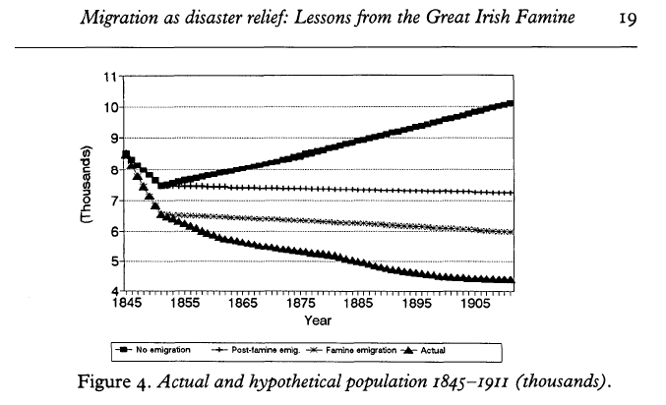
A much smaller ireland…

Slide 24
Post-Famine Demographics
Famine: shift from 150 years of upward momentum in population to 150 years of downward momentum
  Only the spur, though, as rural population fell from 7m in 1841 to 3m in 1911
  Rural Ireland similar to Scottish Highlands, as opposed to Scotland as whole
Urbanisation during the post-Famine period
  From one in seven to one in three
  Belfast the largest city on the island, by early 1900s
What drove declining population?
  Marriage fertility vs. nuptiality (see earlier slides)
  “Stopping” vs. “spacing” – only small slow-down in Ireland

Slide 25
Was Marriage an Inferior Good?
Income elasticity of demand:
  How does demand for something change with income?
  Luxury good: if incomes rise 10% but demand rises by more
  Inferior good: if incomes rise but demand falls
Kenneth Connell: the Famine ended rural labourers’ “happy-go-lucky” marriage strategy
  But age at first marriage barely budged between 1821 and 1861 – 26-27.5 window for women
Timothy Guinnane: (arranged) marriage an inferior good
  Lower nuptiality a sign of affluence, spread west
  1851-1911: from ~12% who never married up to ~26%

Slide 26
As usual, Not that simple
Guinnane’s evidence was based on 1911 Census returns for Meath, Wicklow
  Broader study from 1920s and 1930s Censuses shows that celibacy falls with farm size (i.e. easier to marry if you’re rich)
On balance, some evidence that previously viable marriages were ruled out
  Rising expectations of a decent standard of living
A general theme of post-Famine Ireland
  The rural Irish labour market (and thus income, standard of living) was now connected with global labour markets, in particular through ties with the US

Slide 27
Link was through migration
Roughly 4m Irish emigrated 1850-1914
  US-bound are best known, but roughly 40% went to Britain
  A gradually falling emigration rate – but 1880s blip
Pull factors probably dominated over push
“Friends and family effect” and relative wages
  Most of the gap between highest rate (Ireland) and lowest rate (France) can be explained by economic variables
  Nothing ‘cultural’ – big bang of Famine created networks
Remittances of ~£1m a year (vs. poor relief)
Trading higher wages for poorer health
  Greater child mortality among first and second generation migrants to cities than among rural Irish

Slide 28
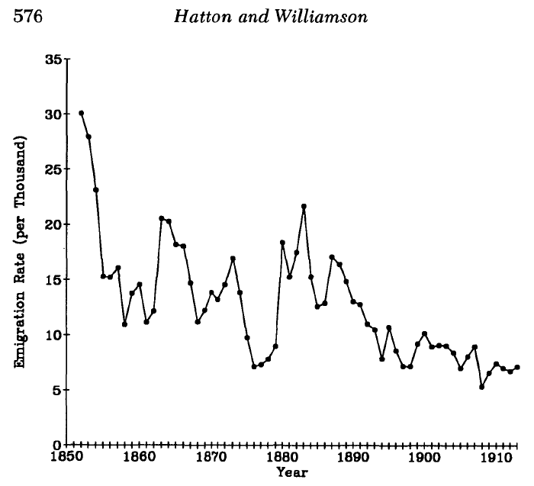
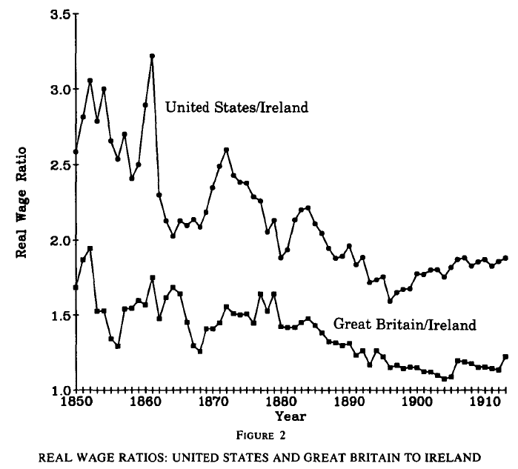
Emigration & Convergence
Emigration Rate
Ratio of real wages

Slide 29
Time of steadily rising incomes
Nominal wages doubled in Ireland 1850-1894
  £0.18 per week in 1770s, £0.24 in 1850 and £0.53 in 1894
  Regional dispersion of wages fell
Real wages: some increase in cost-of-living
  Stirabout replacing potatoes (sign of affluence?)
  Seems real wages increased by 60% post-Famine
1914: semi/skilled in Ireland paid similar to in Britain
  Unskilled paid 25% less, agri labourers perhaps less again
Literacy rose from ~50% to ~90%
Fraction in 3rd/4th class housing fell from 63% to 29%
  Dublin an exception: still 36% in 1-room tenements in 1911

Slide 30
Cycles amidst the Trend
Life expectancy up from ~40 to ~60
  Driven by rural gains – Dubliners typically died at 50
Nonetheless not smooth
  Poor harvests in 1859-64, 1879-81 – peaks in emigration
  Less severe failure in 1890-1, 1894-5, 1897-8
Reflected in banknote circulation, property deeds
Non-Famine of early 1860s: cottier class thinned out
1879-81 led to Land War
Far greater emphasis on poor relief by late 19thC
  Disraeli spent £2.6m 1879-84
  1890s saw Congested Districts Board, Recess Committee

Slide 31
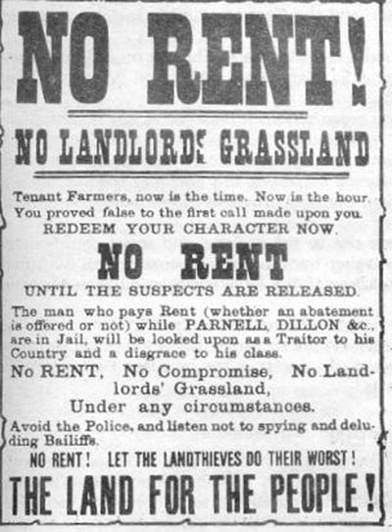
Losing the Land War?
‘New history’ response to nationalist version
  Unnecessary – evictions tied to agri conditions
  No victory – Danish, Dutch gains in Britain
17thC land conquests undone peacefully in 19thC – remarkable
Fall in tillage (65% to 21%)
Increase in productivity
  ~0.7% a year

Slide 32
Switch to modern Commerce
Link: urbanization, commercialisation & regional specialization
Bank deposits: from £8m (1850) to £43m (1900)
  Similar large increase in rail traffic
Example of Mayo shop
  1880: ~3/4s of business in 6 items (sugar, tobacco, tea, flour, meal, whiskey)
  1917: less than 20%

Slide 33
An IRish Puzzle?
An open economy…
  1-2% of population emigrated annually
  Britain-Ireland transfers ~2% of national income
  Exports ~50% of GDP
… enjoying convergence benefits of integration
  Up to 1890s, catch-up in living standards
Win-win: those who left and those who stayed benefited
But why did Irish industry so spectacularly fail to take off?
Given where Irish industry was in late 18thC, Ireland appears to have industrialized in 19thC
Definitely a legacy issue in 20thC

Slide 34
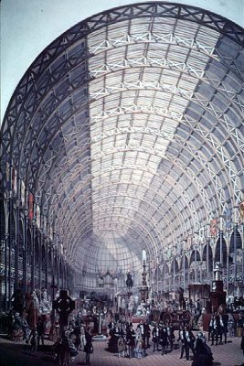
Tackling Irish Industry
A perspective on Irish industry
  Before1820s vs. after 1820s
  Six key sectors – textiles (cotton, linen, wool), non-textiles (shipbuilding, distilling, brewing)
Explaining deindustrialization
  Natural resources and the turf question
  Capital markets, entrepreneurship and property rights
  Productivity
  Agglomeration economies and regional specialization

Slide 35
No lack of industry pre-1830s
More than 40% of all adults in 1821 Census involved in trades
  Cottage industry, cities not needed
Both commercialization and land hunger
  Small farmers worked by night to make ends meet
Where did it all go wrong?!

Slide 36
Textiles: Fleeting Cotton
1780: Arkwright spinning technology-led boom
  Ahead of US, Netherlands, Switzerland…
Industry prospered due to high trade costs
  Prosperous, Malahide, Balbriggan, Cork – plus many in North
  Malcolmsons of Portlaw: ~50% of cotton industry by 1850s
Lots of enterprise, few successes in South, especially once tariffs were removed
  South specialized in coarse cottons, printing
  From 9000 weavers in Dublin in 1800 to 500 in 1830
Longer success in North – finer cloth, bleaching
  In Belfast, 33 mills (15 steam-powered), with 150,000 spindles employing 2,000 spinners and 11,000 weavers

Slide 37
Textiles: Ulster Linen
Did wet-spinning save Belfast industry?
  20 mills switched from cotton to linen
Role of long-run factors – comparative advantage
  Immigrants to North-East in late 17thC were English weavers
  ‘Linen triangle’ of Belfast-Dungannon-Armagh
Long tradition of linen trade
  1700-1780: exports of linen cloth rose 60-fold
  1820s-1850s: grew from 45m yards to 65m
Flax industry employment grew from 9,000 in 1839 to 90,000 by 1917 – almost entirely confined to Ulster
~7% of national income – more important to Ireland than cotton to Britain (~4%)

Slide 38
Textiles: Water-powered wool
Specialization was in south and south-east
  Spinning for women/rural, weaving for men/urban
Innovation and growth in late 18thC, early 19thC
  Mahony’s (Blarney) and Lane’s (Cork) used machinery
Crisis in domestic sector by 1820s
  Competition from Yorkshire – imports up ~50% in 10-15 years
Post-Famine period saw recovery, but in particular of smaller mills
  From 11 mills in 1850 to 82 in 1899 – mostly water-powered
Mahony’s (Blarney) the notable exception

Slide 39
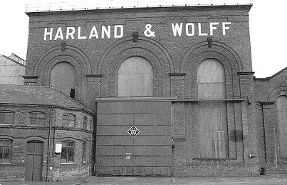
Non-Textiles: Ship-Building
True success story
~8% of world output by 1910s… down to 2 firms
  Harland & Wolff, and Workman Clark spin-off
Unlikely location – required cuts to sea
  Generated new island, H&W HQ
Example of Belfast’s “municipal socialism”

Slide 40
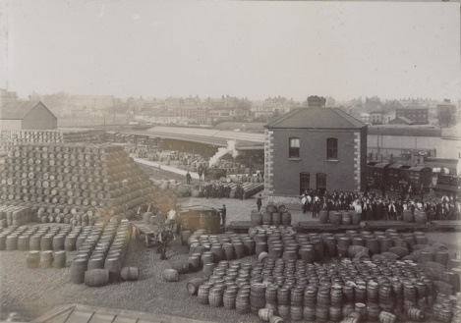
Non-Textiles: Alcohol
Distilling doubled 1840s-1900s: small for the times
  Just 2,400 workers in 1907
Weak domestic D
  4.2l p/cap 1857, 2.4l by 1910
Vs. Scottish: poor marketing and distribution networks
  1880-1910: From 47% to 29% of English internal imports
  Pot-still vs. patent issue something of a distraction
Brewing output trebled – down to Guinness

Slide 41
Blame it on Britain?
Instructive contrast 1780s vs. 1800s
  1783-4 depression led to Dublin-London initiative to lower tariffs – post-Adam Smith World
  British manufacturers opposition ‘noisy and effective’ – e.g. of 80,000 signatories to Lancashire petition
  In 1800 Act, Article 6 a response to Dublin industrialists’ fears
Simple nationalist version doesn’t stack up: technology-induced fall in textile prices
  If Act of Union hadn’t occurred, tariffs would have made very little difference
Also somewhat inconsistent – blame protectionism pre-1800 and free trade after 1800

Slide 42
Tackling Irish Industry
A perspective on Irish industry
  Before1820s vs. after 1820s
  Six key sectors – textiles (cotton, linen, wool), non-textiles (shipbuilding, distilling, brewing)
Explaining deindustrialization
  Natural resources and the turf question
  Capital markets, entrepreneurship and property rights
  Productivity
  Agglomeration economies and regional specialization

Slide 43
Resource Constrained?
Coal was the driver of the Industrial Revolution in Britain – but scarce and expensive in Ireland
  £0.25 a ton in Scotland/Wales but £1 on Dublin quays
In general, labour more important input than fuel
  Cheap Irish labour should have offset expensive coal
Some coal produced – and lots of speculative companies established
  500 mostly exhausted sites by 1922
  No lack of capital or enterprise when resources involved!
Peat/turf given every opportunity but failed
  Factories did not spring up beside turf as they did with coal

Slide 44
A Lack of Entrepreneurs?
In rail, early capital (largest gains) provided by British investors, not Irish… conservative?
Nonetheless, huge labour mobility
  O Grádá gives a long list of foreign-born Irish-based entrepreneurs, including Arnott, Bianconi, Harland, Wolff…
  About 1.35% of population foreign-born by 1861
Ireland unique in having limited liability from 1780s
  Although this was not the same as applied after 1850s
Little evidence of crime – and thus insecure property rights – deterring investment
  1836 Poor Inquiry: just 2% of parishes disturbed vs. 60% “no unrest” – most unrest related to agricultural labour groups

Slide 45
Cheap labour for a Reason?
Did cheap labour drive Industrial Revolution?
  North vs. South of England / Belgium vs. Amsterdam
  Vs. Bob Allen: high ratio of labour/energy prices
Mokyr: variation in wages across counties can be explained by literacy (i.e. productivity)
  Irish construction not cheap, on basis of output
Main evidence is in wages of unskilled labour
  50% cheaper in Ireland vs. Britain…
  Suggests labour less productive – why?
Wakefield: a more social work environment?!

Slide 46
External Economies
Marshall: how can you have competitive markets and increasing returns to scale?
  Standard economics: IRTS means natural monopoly
  Marshall: ancillary services, input lumpiness
Allows path dependence, chain of events
  E.g. of weaver settlement in Ulster -> linen -> industrialization in that sector -> industrialization more broadly
Krugman: high populations drive low transport costs to market, and thus agglomeration
2-way causation between decline, industrialization
  Did Famine spur on decline by reducing Irish % of UK mkt?
E.g. of Dunlop’s: Dublin to Coventry in 1895

Slide 47
Essay & Exam-Style Questions
Was Ireland sitting on a demographic time-bomb before the Great Famine?
Was 1815 more important than 1845 for Irish economic history?
Is Ireland’s failure to industrialize in the 19th Century a puzzle?

Slide 48
Topic B: A Preview
Irish Economic History since Independence
1932: From globalization to autarky
1959: From autarky to globalization
The 1990s: The 30-year overnight success story
The 2000s: Bubble and crash

